Slide 1

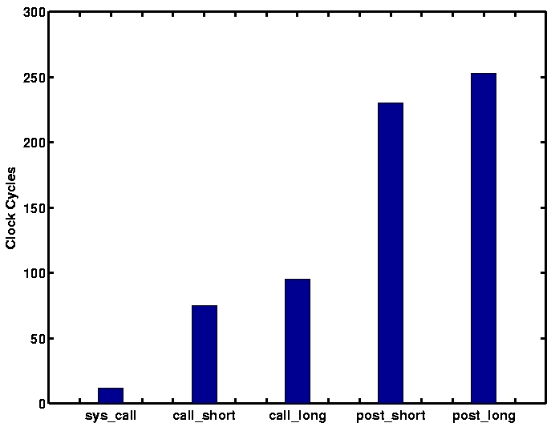
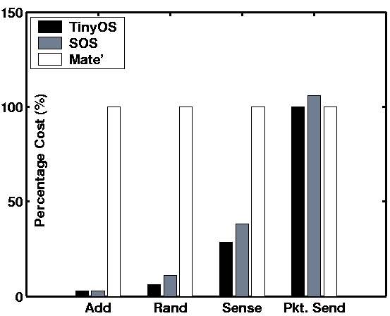
Harbor: Software based Memory Protection for Sensor Nodes
Center for Embedded Networked Sensing
Ram Kumar, Akhilesh Singhania, Eddie Kohler and Mani Srivastava
Introduction: Memory protection required to build robust sensor software
Memory Corruption in Motes
MMU is not the solution
0x0200
MMU hardware requires lot of RAM
Increases area and power consumption
Poor performance - High context switch overhead
Microcontroller minimize price, area and power
Run-time Stack
Single address space CPU
Shared by apps., drivers and OS
Many bugs in deployed systems come from memory corruption
Corrupted nodes trigger network-wide failures
Globals and Heap
(Apps., drivers, OS)
No Protection
Core | MMU | Cache | Area (mm²) 0.13u | mW/MHz
ARM7-TDMI | No | No | 0.25 | 0.1
ARM720T | Yes | 8 Kb | 2.40 (~10x) | 0.2 (~2x)
0x0000
Sensor Node Address Space
Proposed Solution: Sensor Network System Support for Loadable Modules
Need a Minimal System Kernel
Need Loadable Binary Modules
System Core Implements Basic Services
Message passing scheduler for messages between parts of the system.
Low layer hardware abstractions for a given system platform.
Fixed-partition dynamic memory mechanism to provide constant time dynamic memory allocation to the SOS kernel and modules.
Dynamic Loadable
Binary Modules
Dynamic Loadable
Binary Modules
Modules Implement Most Functionality
  Everything from sensor drivers to user programs are implemented as modules.
  Modules can be added, modified, and removed at run time. This creates a dynamic system that can change over time to meet new challenges.
  Modifications to modules does not interrupt system operation.
Hardware
Abstraction
Static SOS Kernel
Memory
Manager
Msg Passing
Scheduler
Solution Analysis: Examining the SOS Operating System
Inter-Module Communications
Sample Application
Priority-based asynchronous messaging for inter-node module communication.
Type-safe synchronous function call for intra-node module communication.
Testing a sensing application written in SOS. Uses One Phase Pull to gather sensor data from a network.
Application is composed of five modules that can be customized individually post deployment.
Module A
Module B
Module A
Module B
Post
Indirect Function Call
Application
Message
Buffer
Module Function
Pointer Table
Application
System Communications
Data
Send
Send
Static kernel interface for access system resources such as timers, memory, sensors, and actuators.
Available
Interest
Data
Diffusion
Interest
Interest
Engine
Module A
Available
System Call
System Messages
Get
Subscribe
Data
System
Jump Table
SOS Kernel
High Priority
Message
Buffer
Neighbor
Ready
Neighbor
Discovery
Sensor
Drivers
HW Specific API
Interrupt
Hardware
Competitive Performance of SOS
SOS Combines:
Performance of traditional wireless sensor network operating systems.
Flexibility of virtual machines.
The combination creates a system that supports larger sensor networks that are able to evolve after they have been deployed
UCLA – UCR – Caltech – USC – CSU – JPL – UC Merced

