Slide 1
Predictive Modeling for Bank Marketing Campaign Success
By
Nesly Cesar

Slide 2
The Problem:
In the competitive financial sector, banks face challenges in identifying which clients are likely to subscribe to financial products, such as term deposits, through marketing campaigns. This project leverages predictive modeling to enhance the success of these campaigns by accurately predicting client subscriptions.
Key research questions:
How can predictive models improve campaign success?
What factors most influence a client's likelihood to subscribe?
Which machine learning algorithm is the most accurate?
How can data mining optimize direct marketing strategies?

Slide 3
The Solution:
To address the problem, predictive modeling techniques were applied to improve the accuracy of client subscription predictions.
The key steps were:
Data Wrangling
Data Preprocessing
Modeling
Hyperparameter Tuning
Final Model
This solution enables banks to more effectively target clients likely to subscribe to term deposits, optimizing marketing efforts and reducing costs.
Notes:
2. Cleaned and encoded client and campaign data to ensure quality inputs for modeling.
3. Several machine learning models, including Logistic Regression and Gradient Boosting Classifier (GBC), were tested.
4. Optimized the best models to improve performance, focusing on balancing precision and recall
5. The Tuned Gradient Boosting Classifier was selected as the final model, providing the best balance between accuracy and prediction reliability

Slide 4
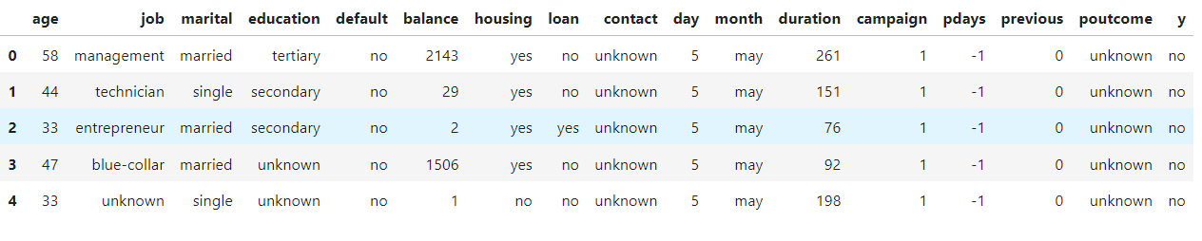
The Data
Example Dataset
Data Source: https://www.kaggle.com/datasets/abdelazizsami/bank-marketing
Notes:
Dataset was 88,000 rows and 100 columns
Measurements from 1909
250 total sites

Slide 5
Data Wrangling
The dataset, sourced from direct marketing campaigns by a Portuguese bank, includes 45,211 instances and 16 features covering:
Client data: age, job, marital status, education, balance
Campaign data: number of contacts, last contact duration
Macroeconomic data: month, previous campaign outcome
The target variable is binary, indicating whether a client subscribed to a term deposit ('yes' or 'no'). The dataset was already well-organized with no significant cleaning or tidiness issues required.

Slide 6
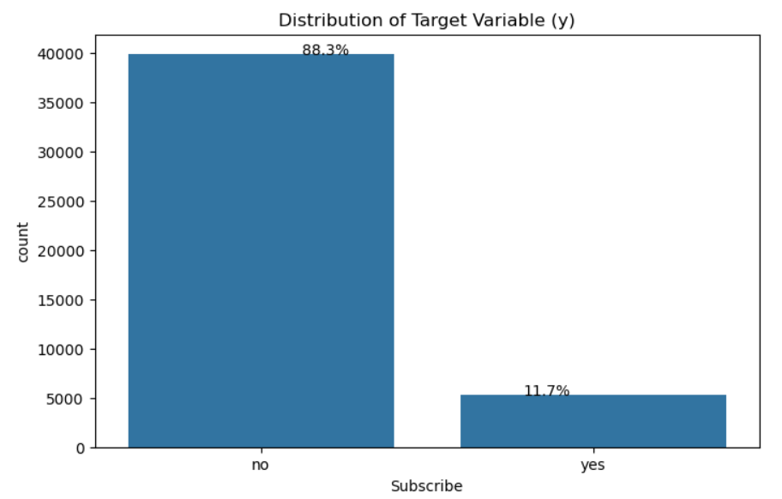
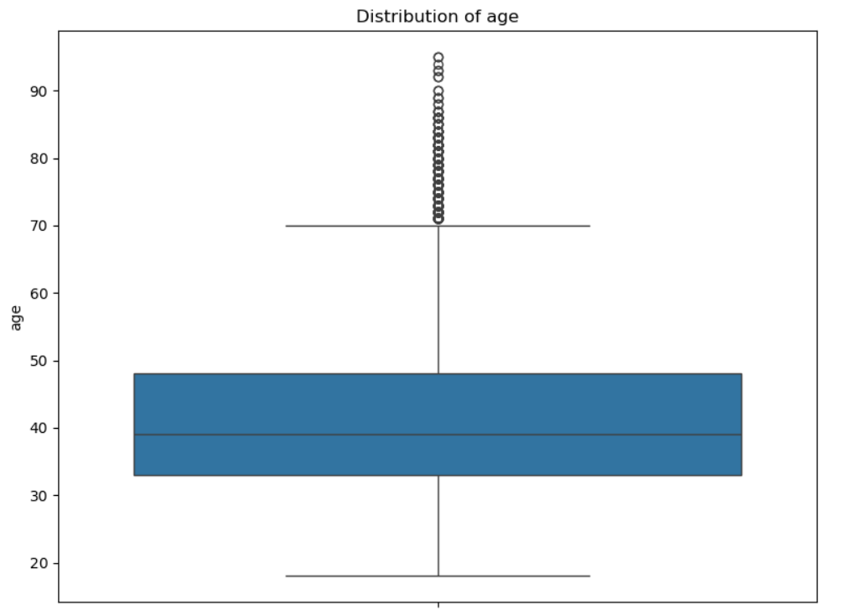
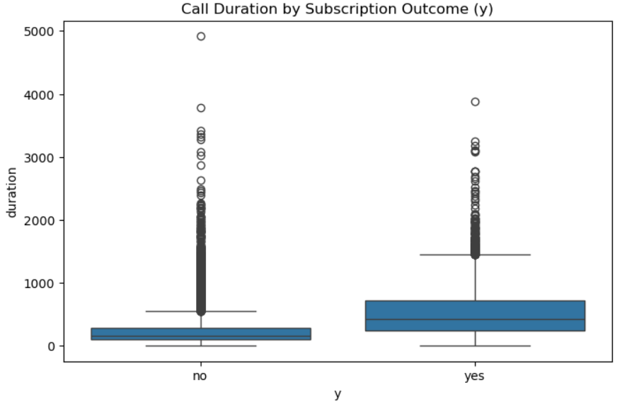
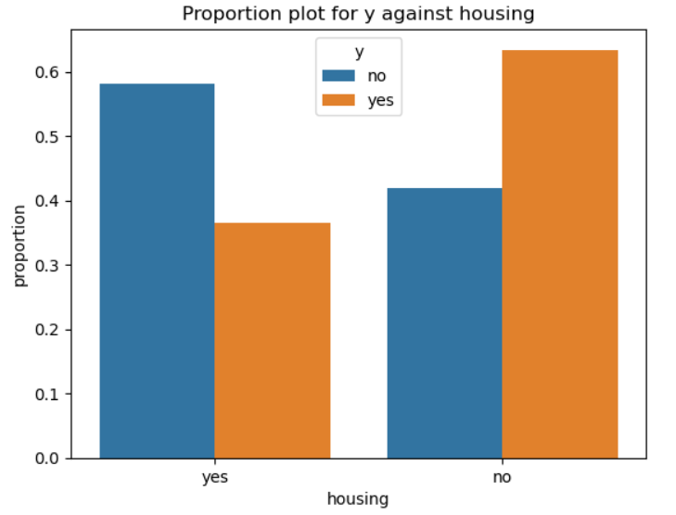
Exploratory
Data Analysis
Notes:
Top left: (Univariate exploration) Target class distribution showing imbalance dataset
Top right: (Univariate exploration) Continuous Variables indicating the presence of outliers (Age Distribution)
Bottom left: (Bivariate exploration) Call duration by subscription outcome showing that the longer the call, the higher the likelihood of subscription
Bottom right: (Bivariate exploration) The proportion plot of the housing loan status against the target variable revealing that clients without housing loans are more likely to subscribe to a term deposit than those with housing loans.

Slide 7
Data Preprocessing
Key preprocessing steps included:
Handling Outliers: Outliers in continuous variables were capped using the Interquartile Range (IQR) method to mitigate extreme values.
Categorical Encoding: Categorical variables were transformed via one-hot encoding, with label encoding for ordinal data (e.g., education).
Dropping Redundant Columns: Columns like 'previous' and 'pdays' with many zero values were removed.
Standardization: Continuous numeric variables were standardized for uniformity.
Data Splitting: The data was split into an 80% training set and a 20% test set for model evaluation.

Slide 8
Modelling and Hyperparameter Tuning
Two machine learning algorithms were tested, including Logistic Regression (LR) and Gradient Boosting Classifier (GBC).
Model performance was evaluated on the test set using key metrics: accuracy, precision, recall, and F1 score
Hyperparameter tuning was performed using “GridSearchCV” for both Logistic Regression and Gradient Boosting, optimizing for “F1 score” to balance precision and recall.

Slide 9
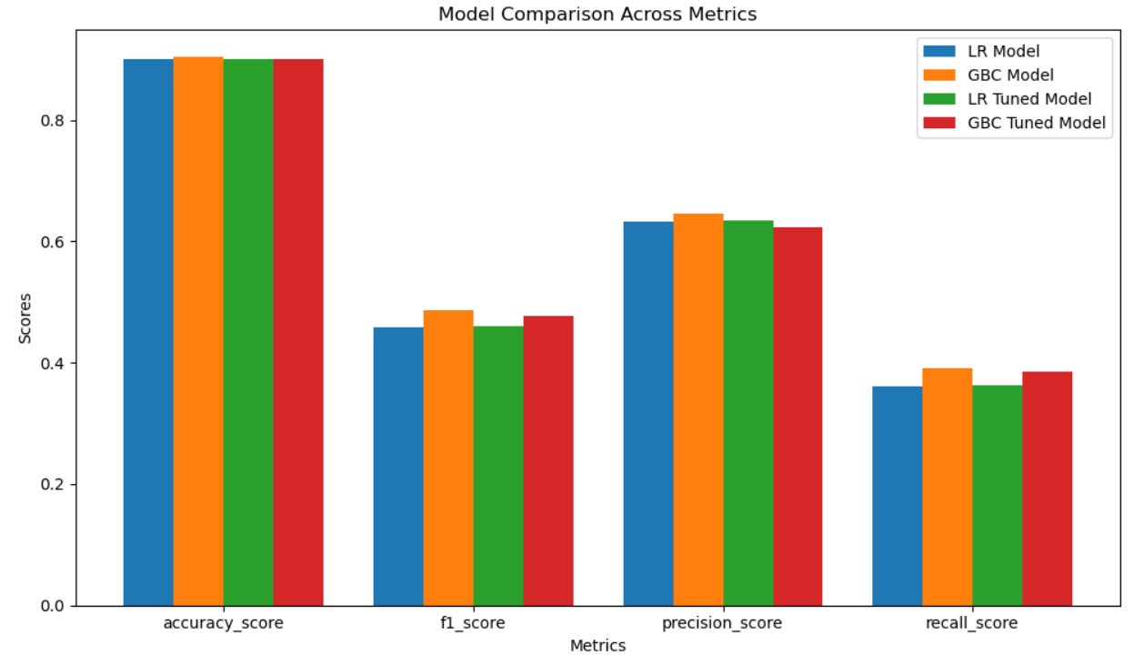
Model Performance Comparison
S/N | Model Name | Accuracy Score | F1 Score | Precision Score | Recall Score
1 | LR Model | 0.901 | 0.459 | 0.633 | 0.360
2 | GBC Model | 0.904 | 0.487 | 0.645 | 0.390
3 | Tuned LR Model | 0.901 | 0.461 | 0.635 | 0.362
4 | Tuned GBC Model | 0.901 | 0.476 | 0.623 | 0.386
Notes:
The Gradient Boosting Classifier achieved the best balance between precision and recall, providing the highest F1 score. This model was therefore selected as the best predictive model for determining term deposit subscriptions

Slide 10
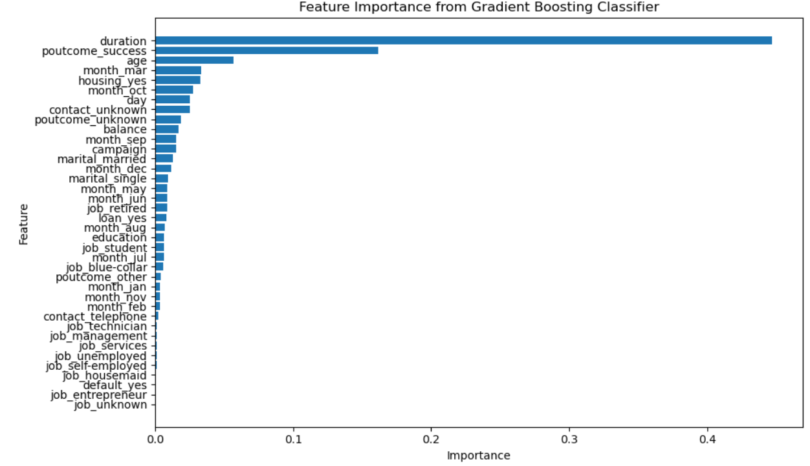
Feature Importance
Notes:
Call Duration: The length of the last phone call had the greatest influence. Clients who engage longer in a conversation are more likely to subscribe.
Previous Campaign Success: Clients who had successfully subscribed in previous campaigns were more likely to subscribe again.
Age: Older clients were more likely to subscribe than younger clients.
Month of Contact: Certain months (e.g., March, October) saw higher subscription rates, likely due to seasonal trends.
Housing Loan: Whether a client had a housing loan also impacted their likelihood to subscribe, with certain financial profiles being more inclined to invest in term deposits.
Balance: Clients with a higher bank balance were more likely to subscribe, suggesting that disposable income plays a role in term deposit investments.

Slide 11
Takeaways
Focus on High-Engagement Clients
Segmented Marketing: Personalized strategies targeting older clients and those with higher balances can improve subscription rates
Campaign Timing: Focusing marketing efforts during these high-yield periods can boost effectiveness (e.g., March, October)
Cost-Effective Targeting: By identifying clients most likely to subscribe, the bank can optimize marketing resources and reduce unnecessary contact with unlikely subscribers.
Predictive modeling, especially using Gradient Boosting, helps accurately predict client behavior, allowing banks to enhance marketing strategies, allocate resources efficiently, and boost subscription rates by targeting the right clients at the right time.
Notes:
1. Bank should focus on high engagement clients, as clients with longer call durations and those with previous successful subscriptions are more likely to subscribe, making them ideal targets for re-engagement

Slide 12
Future Research
Additional Features
Time-Series Analysis
Improved Imbalance Handling
By refining these models, banks can further enhance their ability to convert potential clients and run more cost-effective marketing campaigns.
Notes:
1 : Incorporating macroeconomic indicators like inflation and interest rates could improve prediction accuracy.
2. Analyzing client behavior over multiple campaigns can reveal long-term trends and improve targeting.
3. Exploring methods like oversampling (SMOTE) or undersampling can better address class imbalance, improving model performance.By

Slide 13
Thank You!

Slide 14
Questions?

