Slide 1
UPA
Unstructured Persistence API
Yet another OPEN SOURCE ORM challenger
Taha BEN SALAH – ENISo – Tunisia – 2015 – upa v1.2- doc v1.2.0u1

Slide 2
Agenda
Motivation
Hibernate, MyBatis, JPA, isn’t that just enough
Common features
Soft Learning curve as features from other ORM are made easy
Unique features
Challenge is yet to come…
Use cases
How not to’s…
Getting Started
First example…

Slide 3
Motivations
Dynamic (at Runtime Level) Schema Definition
Overtake traditional ORMs that permit only mappings for existing (on compile time) Entities
Provide a clean way to get customizable schema for end users
Extra fields at Runtime (Contact/Invoice custom fields)
Extra entities at runtime
Add Entities/Associations for Plug-in based applications
Should handle alter/modify/drop objects as well
Helps enforcing “Pyramid Design Pattern”

Slide 4
Motivations
SQL concepts handling
Focus on portability
Yet provide mapping to
Views
Procedures
Functions
Triggers

Slide 5
Motivations
Productivity vs Portability
Focus on productivity
Don’t loose portability
UPA? It all started as proof of concept !
On 2011
Upon lecture I presented in SFD/Software Freedom Day 2013 about “7 ORM sins”.

Slide 6
But you worry about…
Any Security issues with DDL (drop/alter) ?
May Simply be handled by RDBMS.
Any performance issues ?
Think of vertical tables (properties table, parameters table, adresses table) that will be handled horizontally.

Slide 7
UPA
Common features
So what's common about it
Taha BEN SALAH – ENISo – Tunisia - 2015

Slide 8
Common features
UPA is not exactly JPA still …
Intuitive
Almost all JPA features/concepts are maintained. Some Hibernate and Mybatis ones are bundled in a way it fits well with UPA philosophy.
Vendor Neutral Persistence Layer
Helps build a persistence layer that is vendor neutral and any persistence provider can be used. Although, UPA provides a reference implementation that is particularly ready to use.
Pluggable Providers
Supports pluggable, third party persistence providers as it is defined as an API with a reference implementation.

Slide 9
Common features
Annotations based meta-data
No deployment descriptors required
Very similar of JPA’s annotations.
Annotations defaults can be used in model class, which saves a lot of development time
Support for XML Mapping
Standardized ORM
Provides clean, easy, and standardized object-relational mapping

Slide 10
Common features
Query language
UPQL is very powerfully query language provided by UPA providing abstraction layer over the persistence model. UPQL makes it possible to avoid specific RDBMS dialects.
Similar to JPQL and HQL (almost compatible)
Model generation
UPA application can be configured to generate database schema based on persistence model
Portability
It is meant to be easy to switch to other persistence providers. You can move to any commercial persistence provider when needed. Yet there is no commercial provider planned to come.

Slide 11
UPA
Unique Features
Still don't get it why this staff has not been done yet!
Taha BEN SALAH - 2015

Slide 12
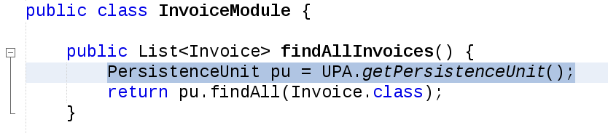
Unique Features
Inside/Outside containers
UPA application can run outside the container also. So, developers can use UPA capabilities in desktop applications, Web containers, EJB containers, Spring containers, …
The very same code runs Inside/Outside containers. NO modification is needed.
Helps Sketching and Testing JEE Apps
Depending on the current container, UPA context will be automatically created and maintained
Context aware utility method

Slide 13
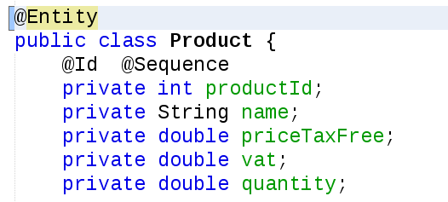
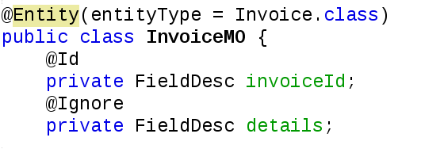
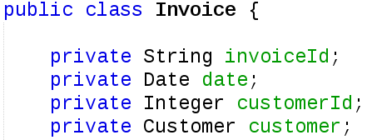
Unique Features
Annotations based meta-data
Configuration is done equally through
Model Classes (Annotation)
Mapping Classes (Partial Annotations)
Xml Files (upa.xml)
Support for override mapping, partial mapping and precedence/order.
Model Class
Plain Model Class
Mapping Object Class

Slide 14
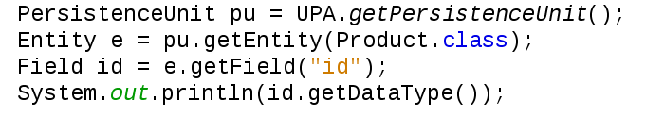
Unique Features
Reflexion API
Large applications need better reflexion mechanisms to handle general purpose use cases. This feature enables developers to be aware of used data model at runtime : entities, fields, datatypes, and perform accordingly ...
Runtime metadata retrieval

Slide 15
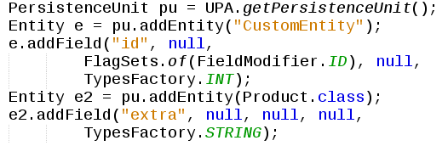
Unique Features
Dynamic data definition and alteration
Enable at runtime data structure alteration by creating new entities or altering existing entities by introducing new fields, removing some fields etc.
Helpful for dynamic model based applications that usually uses vertical tables (columns as rows) which are of very little performance.
Define Entity by name or by Type

Slide 16
Comprehensive Model Structure
Persistence Group
UPA Context supports multiple Persistence Groups, each maps to application context with one or multiple Persistence Units
Persistence Unit
Defines Schema context with Datasource definition and includes Packages , Entities, Associations, …
Package
Enforces modularity by regrouping sub Packages, Entities,… Maps well to Application Plugins with subsequent model.
Entity
Maps to Tables, Views, Procedures, Plain Queries or any combination. Maps also to custom code.
Section
Maps to Field Sets of an Entity. Maps well to Application Plugins with subsequent model (think of pay module defining custom fields on Employee Entity)
Field
Maps to standard or custom (virtual, formulas) columns.

Slide 17
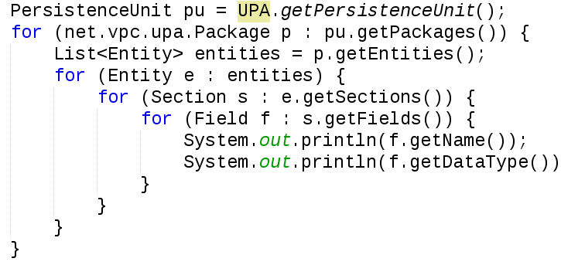
Comprehensive Model Structure
Browse Model structure (sub-packages and sub-sections are ignored here)

Slide 18
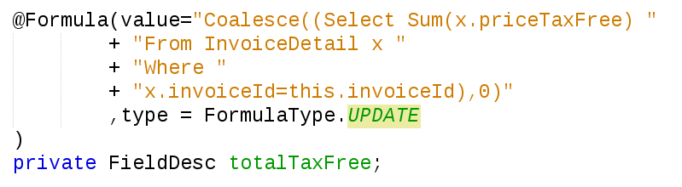
Generated Formula Fields
Supports natively customizable formula fields
Values are generated according to custom expressions and conditions. (Example : Total field)
Complex Expressions supported (almost any UPQL Expression)
Rich type set (Live formulas, persisted formulas, insert only formulas, …)
Support for formula dependency (fields formulas that depend on each other)
Define an update only persistent formula depending on subsequent asssociation

Slide 19
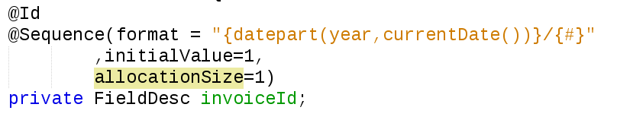
Generated Formula Fields
Support for Sequences
Incremental Fields (Includes Auto Increment ID Column but not only)
Support for wide range of types (not only integers but also Strings, dates, …)
Support for Grouped Sequences (reset on group change : think of year based sequences)
Define Sequence with values as follows 1014/1, 1014/2 … 1014/23, 1015/1, …

Slide 20
Ready to use Entity Patterns
Tree Entities
Recursive Associations
Support for Depth first Search
Singletons
Single Row entities (think of parameters entity)
Union Entities
More generic than Inheritance, Union makes it very simple to build custom Entities
Views
Portable
Defines views with simple UPQL

Slide 21
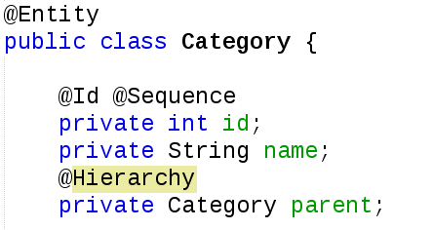
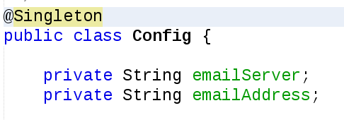
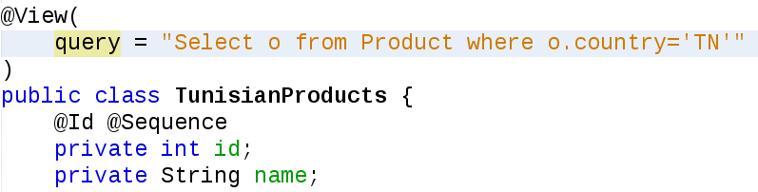
Ready to use Entity Patterns
Singleton Entity (needs no id)
Hierarchy defined on Category parent field
View Entity with Query based on existing Entity

Slide 22
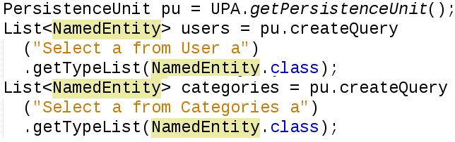
Shared Model
Classes can be mutualized for multiple Entities
Same Table can be described by multiple Entities
Examples
Generic class holder "NamedEntity" (with solely id and name) to use for all drop down components
Single Table with discriminator (semantically not an inheritance)
Dynamic mapping to mutualized types

Slide 23
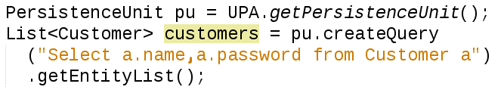
Partial Operations
Dynamic Lazy/Partial loading
Runtime selection of needed fields/associations for retrieval
In most cases, listing entities does not require retrieval of all information
Dynamic Partial updates
Better interaction with outside world
Define what fields to retrieve

Slide 24
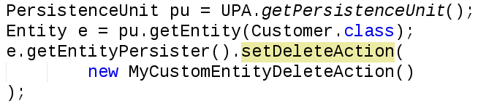
Custom Persistence processing
Very flexible persistence processing
Each operation is uniquely customizable
Example
Select from View
Insert into 2 Tables
Update using stored procedure call
Delete with custom Java call
Customize Delete Operation

Slide 25
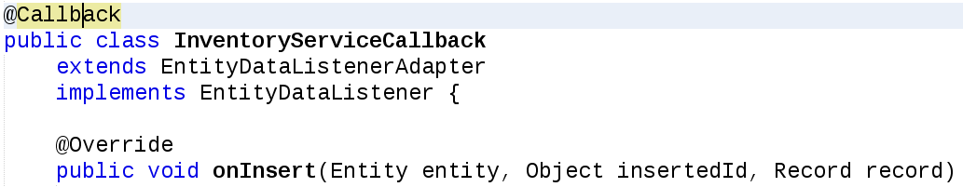
Rich Callback System
Interceptors on Data Updates and Structure Alterations
Soft (written in Java)/Hard(Java translated to PLSQL*) Triggers
Updatable data in Callback context (unlike JPA)
Soft Trigger
(*) on progress

Slide 26
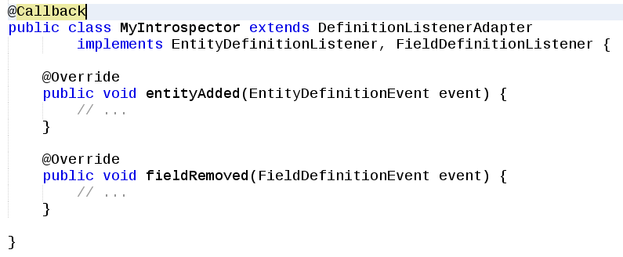
Rich Callback System
Data Definition Trigger

Slide 27
Complex Datatypes
Portable support for custom and complex datatypes
Each operation is uniquely customizable
Support for all common data types
Provides a portable manner to extend supported types with new custom/complex ones
Similar to Embedded/Embeddable features in JPA although it provides a more extensible manner

Slide 28
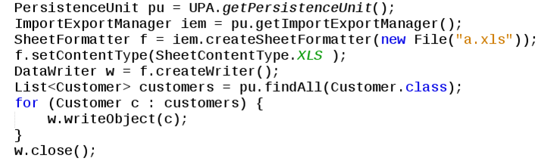
Import / Export
Import/Export API
Support for (very) large files
CSV, XML, XLS, XLSX
Support for associations
Export all Customers to a.xls file

Slide 29
UPA
Use Cases
How not to do ugly things…using beautiful UPA
Taha BEN SALAH – ENISo – Tunisia - 2015

Slide 30
Use Case 1
Use case 1 : How not to Break 3 tiers paradigm
Use case 2 : How not to Tediousely track object modifications
Use case 3 : How not to Ugly support hashed passwords in User like entities
Use case 4 : How not to Refactor entire application for multitenant support
Use case 5 : How not to Painfully rename physical model (tables...)

Slide 31
Use Case 1
How not to Break 3 tiers paradigm

Slide 32
How not to Break 3 tiers paradigm
Introduce Object Mapping (MO) Pattern
Model Class no longer has to be spoiled with DAL annotations
Example
Invoice MO adds @Id on invoiceID
FieldDesc is used not to alter original field type
Model Class no longer get spoiled with annotations

Slide 33
Use Case 2
How not to Tediousely track object modifications

Slide 34
Track objects
Although added creationDate/creationUser is a common use case, it is still tedious to generalize its use in real world applications.
Callbacks combined with formula concepts in UPA makes it very easy to face this problem
Each time a new entity is detected, new fields will be added automatically with default values interpreted as formulas (current user, and current date are retrieved from system context)

Slide 35
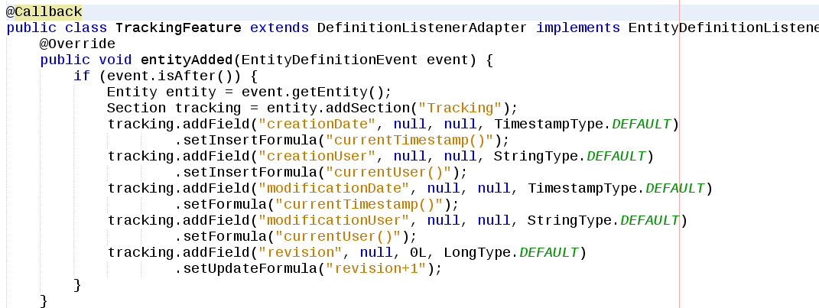
Track objects
Added 5 fields dynamically for all entities

Slide 36
Use Case 3
How not to ugly support hashed passwords in User like entities

Slide 37
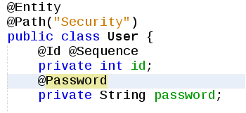
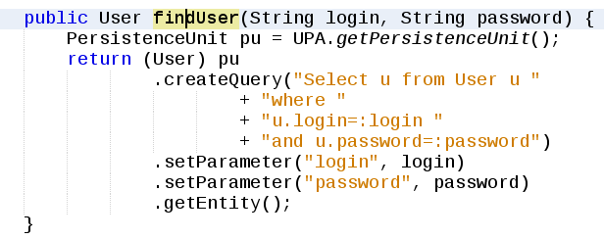
Hashed passwords
Using @Password annotation to mention hashed field
No other changes have to be made on queries
Query does not care about hash mechanism

Slide 38
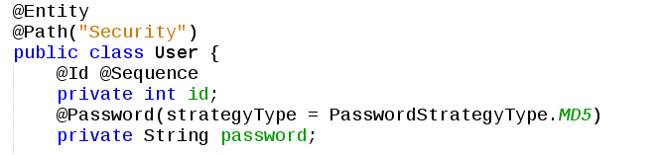
Hashed passwords
Several Hash Algorithms supported (MD5, SHA,...)
Support for custom digest
Use custom hash digest

Slide 39
Use Case 4
How not to Refactor entire application for multitenant support

Slide 40
Multi-tenant support
Need add “tenantId” field to all entities
Use @Callback feature
Need filter all queries by current “tenantId”
User Entity Filter feature
Need change all inserts to mention current “tenantId”
Use formula (persistent) feature

Slide 41
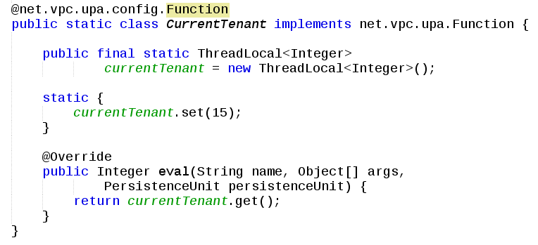
Multi-tenant support
Create CurrentTenant function
For demonstration purposes will use thread local context to store current tenant info
Custom UPQL function

Slide 42
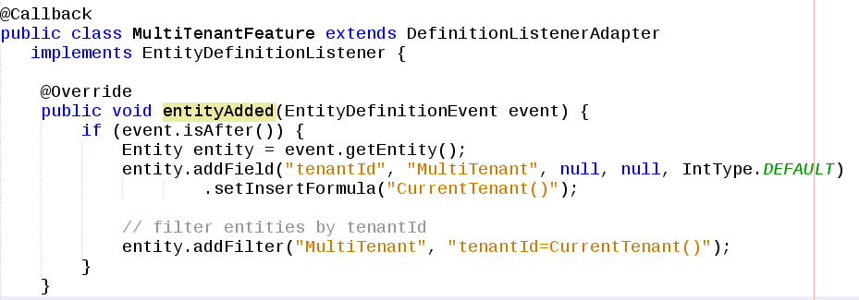
Multi-tenant support
Create MultiTenantFeature feature
Add field formula tenantId evaluated to formula “CurrentTenant()” function just defined
Add filter to Entity by tenantId
Custom tenant field and filter

Slide 43
Use Case 5
How not to Painfully rename physical model (tables...)

Slide 44
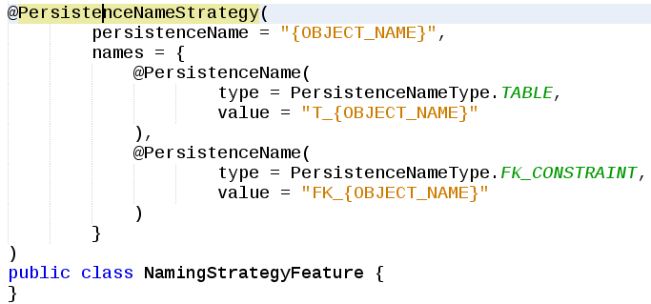
Naming strategy
Name pattern
Can be in Java Code or in xml (META-INF/upa.xml file)
In this example tables are upper cased and prefixed with “T_”
Rename Tables, and FK constraints

Slide 45
UPA
Getting started
Let’s rock!
Taha BEN SALAH – ENISo – Tunisia - 2015

Slide 46
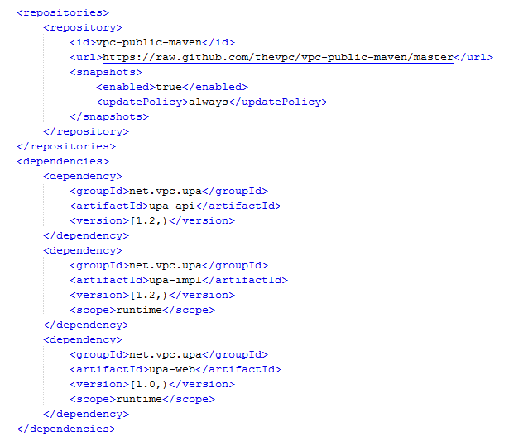
Getting Started
Configure Maven dependencies
Add github repository reference
Add « upa-api » as compile dependency
Add « upa-impl » as runtime dependency
Add « upa-web» (optional) as runtime dependency if used in web context
Maven support

Slide 47
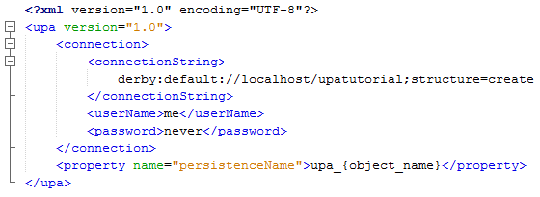
Getting Started
Create /META-INF/upa.xml resource config file
Needed to customize datasource
Dataousrce is language independant (may use jdbc format or universal connection string)
May be used to define naming strategy
Sample upa config file

Slide 48
Getting Started
All you need than need now is to create entity classes and use PersistenceUnit.
That’s it!
Model Class
Mapping Object Class
Call PU

Slide 49
UPA is more than a simple ORM
We try to think of it as next generation ORM Framework
How do you find it ? I'm curious about that...
Thank you
Taha BEN SALAH – 2015
taha.bensalah@gmail.com

