Slide 1
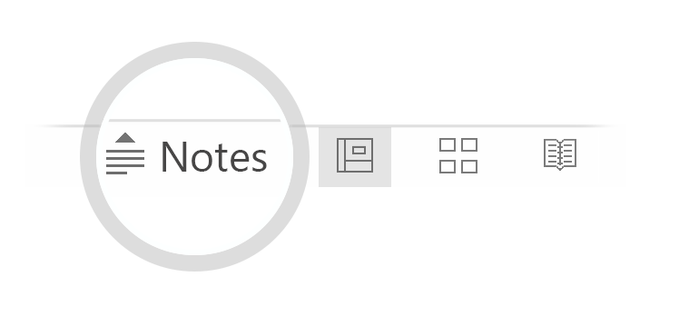
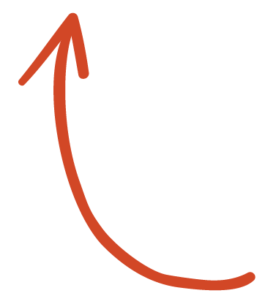
Here's your outline to get started
Key facts about your topic
Snake is the common name for a videogame concept where the player maneuvers a line which grows in length, with the line itself being a primary obstacle. The concept originated in the 1976 arcade game Blockade, and the ease of implementing Snake has led to hundreds of versions for many platforms. There are over 300 for iOS alone.
Platform: Cell
See more: Open the Notes below for more information.
Notes:
QuickStarter has created an outline to help you get started on your presentation. Some slides include information here in the notes to provide additional topics for you to research.

Slide 2
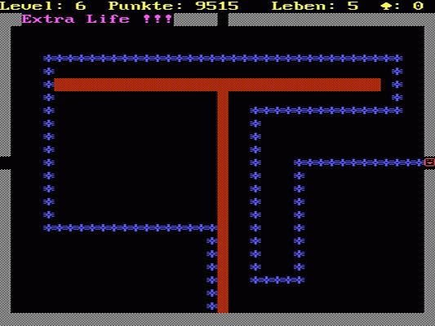
Snake 2.0
TEAM Send Help
Group 34
Lab 03
Harrison Lau
Vanessa Truong
George Mo

Slide 3
Contents
Introduction
Purpose and motivation
scope
Gameplay/Demo
Testing
Unimplemented requirements
Project Impression

Slide 4
Introduction
Snake 2.0, the remastered version of the classic Snake Game.

Slide 5
Purpose & Motivation
The purpose of our project is to reimplement the 2D snake game, analysing the monotonous aspects and adding new and modern flare to the gameplay.
The motivation for our project is to showcase how a relatively simple and ‘outdated’ classic can still entertain the modern society with some additional touchups.

Slide 6
Scope
The scope of the project will encompass the following:
- At least (2) different power ups for the ‘Snake’
- A dynamic score tracking system
- The ability to change map sizes

Slide 7
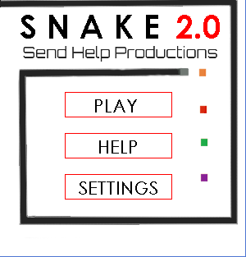
DEMO

Slide 8
TESTING
Manual testing
What was tested:
States of the board
Score
Snake movement
Pellet functions

Slide 9
UNIMPLEMENTED REQUIREMENTS
Map shape changes
Boundary invincibility
Power-up timers
Highest Scores board

Slide 10
PROJECT IMPRESSION
Main goals accomplished
Better understanding of realistic VS unrealistic
Documentation
Successful project implementation

Slide 11
FIN
Thank you for listening

