Slide 1
Notes:
Hello everyone. I am very pleased to meet you here and I am horored to share our solution on this competion.

Slide 2

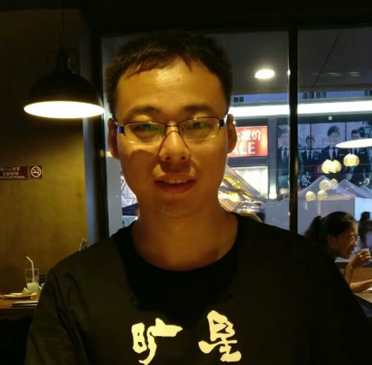
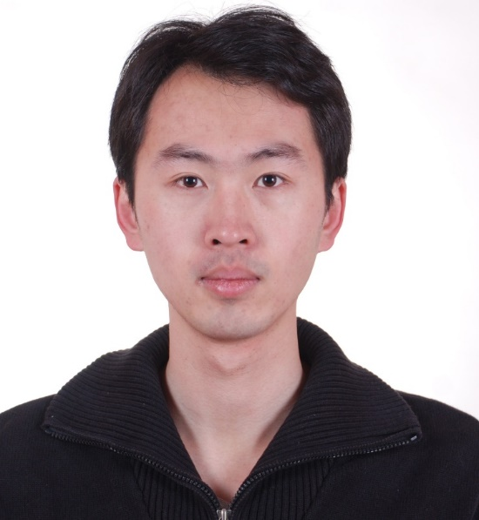
QDU Team Profile
CIKM 2019 EComm AI
Efficient User Interests Retrieval
Chuanyu Xue
Pre-final Year Student at Qingdao University,
achieved top 3 rankings in three data mining competitions
Zhuoran Zhang
Algorithm Engineer in Spring Airlines,
achieved top 10 rankings in many data mining competitions
Shunyao Wu
Assistant Professor at Qingdao University,
achieved top 2 rankings in three data mining competitions
Notes:
Let me introduce our team first. We have three members in our team. I am a pre-final year student in Qingdao university. My teammate Zhuoran is now an algorithm engineer in Spring Airline. And Shunyao is a professor in Qingdao University, we have co-operated on serval data mining competitions.

Slide 3
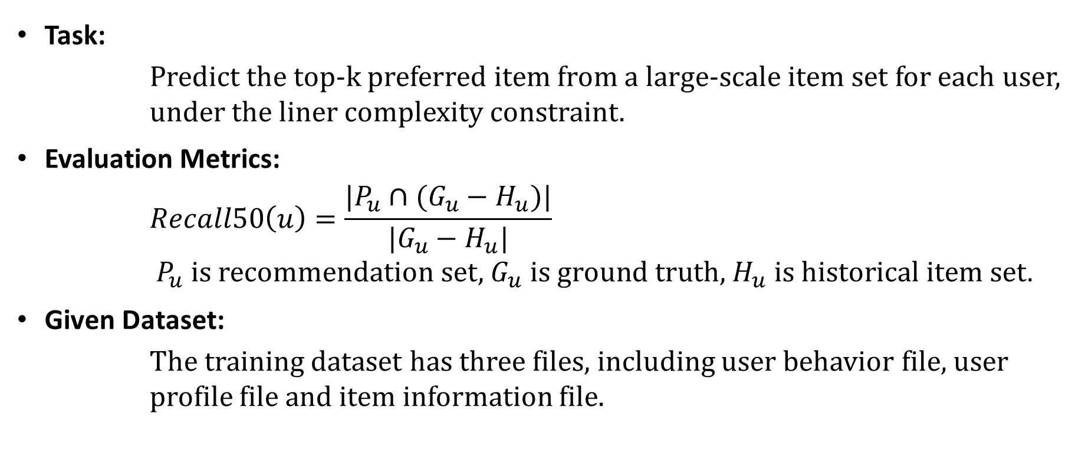
Problem Understanding
CIKM 2019 EComm AI
Efficient User Interests Retrieval
Task:
Predict the top-k preferred item from a large-scale item set for each user, under the liner complexity constraint.
Evaluation Metrics:
$$Recall50\left(u\right)=\frac{|P_{u}∩(G_{u}−H_{u})|}{|G_{u}−H_{u}|}$$
$P_{u} \text{is} \text{recommendation} \text{set}\text{,}{ G}_{u} \text{is} \text{ground} \text{truth}\text{, }H_{u} \text{is} \text{historical} \text{item} \text{set}$.
Given Dataset:
The training dataset has three files, including user behavior file, user profile file and item information file.
Notes:
Other teams has already introduced the task of competition, so let's move on to next page.

Slide 4
Exploratory Data Analysis
CIKM 2019 EComm AI
Efficient User Interests Retrieval
Some important points
Users’ behavior types
Time effect
Category / Brand of items
Popularity of items
Data Split
Notes:
Let's start with Data Analysis. In data analysis, the behaviors of first fifteen days are deemed as previous behaviors, where the behaviors in sixteen day as the future behaviors.

Slide 5
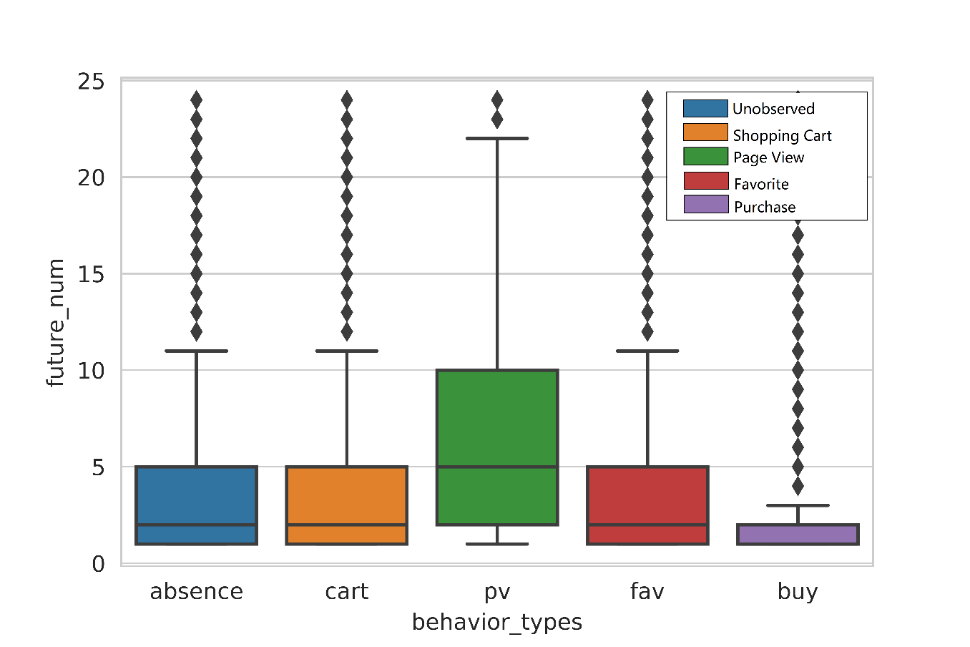
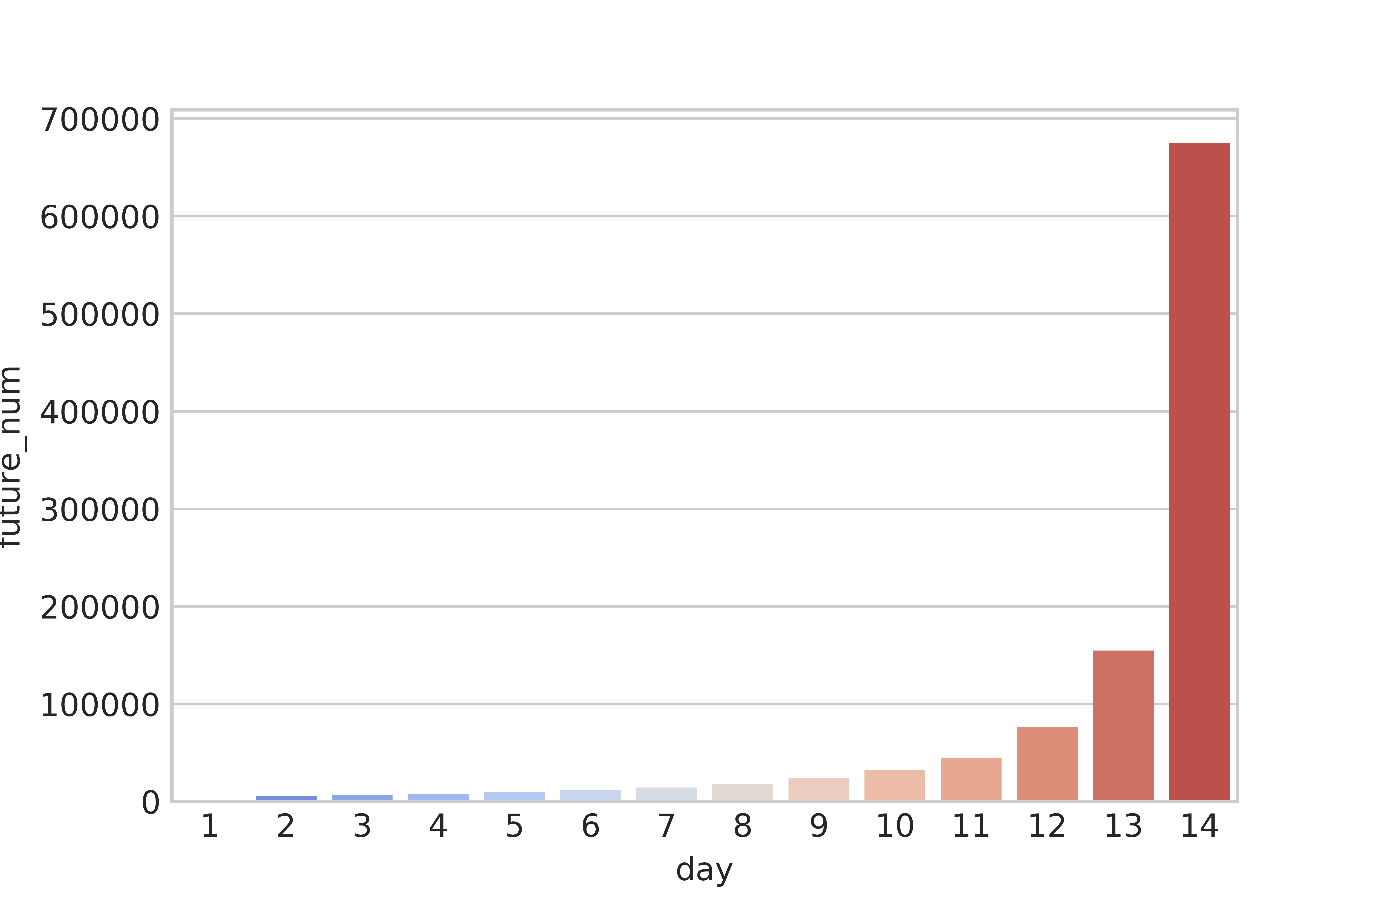
Exploratory Data Analysis
CIKM 2019 EComm AI
Efficient User Interests Retrieval
Implicit Feedback
Previous PV will be more preferred,
Previous BUY will be less preferred.
Recent behaviors will have more influence
Notes:
Let's see picture on the left, the horizontal axis indicates different behaviors of users to categories, and the vertical axis means the numbers of the categories will be preferred. It's clear to see the category with previous PV will be more prefered, but the category with previous BUY will be less preferred. so BUY behavior should be set as a smaller weight than other three behaviors.
Moreover, the picture on the right shows there is a time delay in dataset, more recent behaviors will have more influence on future preference. This situation is commen in most time series problems.

Slide 6
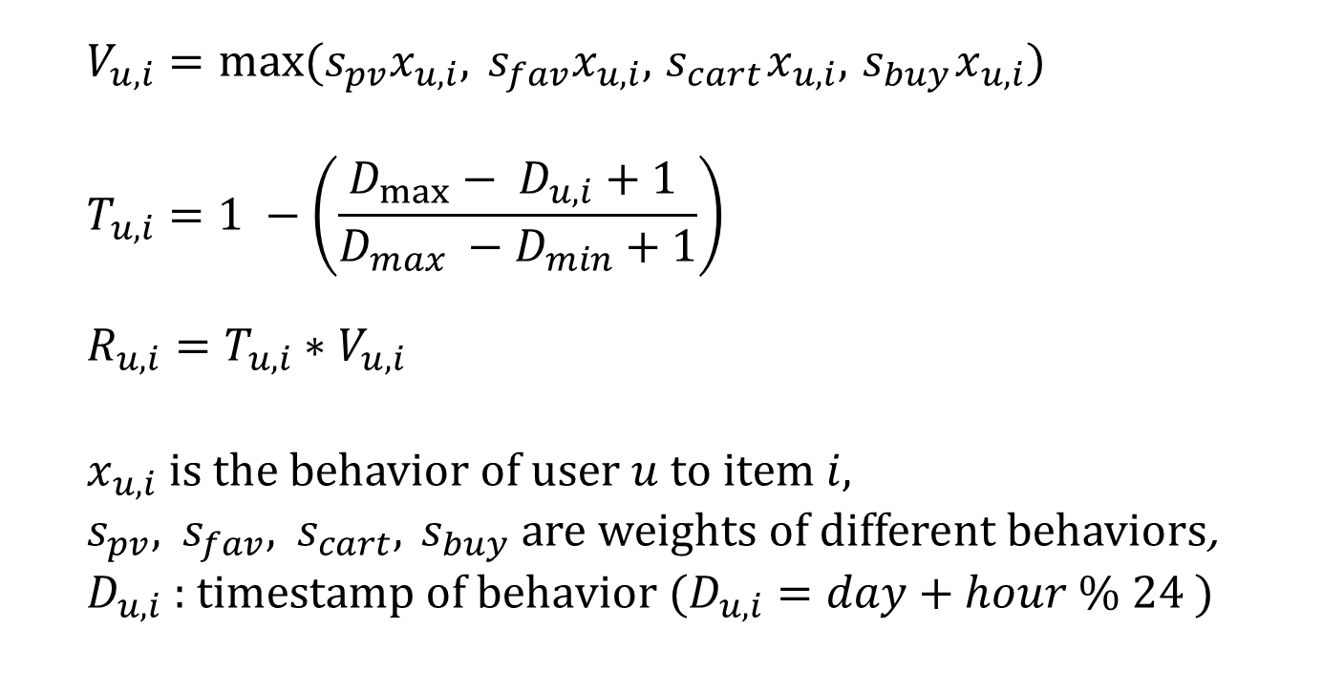
Exploratory Data Analysis
CIKM 2019 EComm AI
Efficient User Interests Retrieval
Implicit Feedback
$$V_{u,i}=max⁡(s_{pv}x_{u,i}, s_{fav}x_{u,i}, { s}_{cart}x_{u,i}, { s}_{buy}x_{u,i})$$
$$T_{u,i}=1 −\left(\frac{D_{max}− D_{u,i}+1 }{D_{max} −D_{min}+1}\right)$$
$$R_{u,i}=T_{u,i}∗V_{u,i}$$
$$x_{u,i} \text{is} \text{the} \text{behavior} \text{of} \text{user} u \text{to} \text{item} i,$$
$s_{pv}\text{,}{ s}_{fav}\text{,}{ s}_{cart},{ s}_{buy} \text{are} weights of different behaviors$,
$D_{u,i}\text{ : }\text{timestamp} \text{of} \text{behavior}$($D_{u,i}=day+hour \% 24$)
Notes:
So we settle down the weights of different types of behaviors.
We use Vui to represent the influence of different behavior types. Here if a user has many different behaviors on same item, we will select the behavior with the largest weighting.
We use the Tui to represent time factors, which means the more recent behaviors are more important.
Finally we multiply the V_ui and T_ui as the final rating Rui.

Slide 7
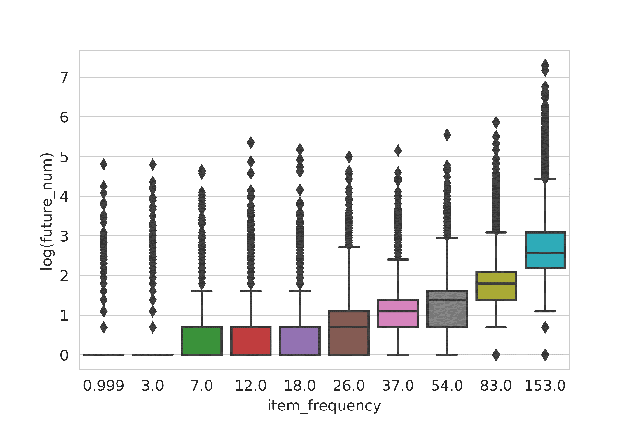
Exploratory Data Analysis
CIKM 2019 EComm AI
Efficient User Interests Retrieval
Popularity of items
Popular items will be more preferred
Notes:
Another important factor is popularity of items. we found popular items will be more preferred in the future. So when our model cannot work well for some special users, we simply recommend them with the most popular items.

Slide 8
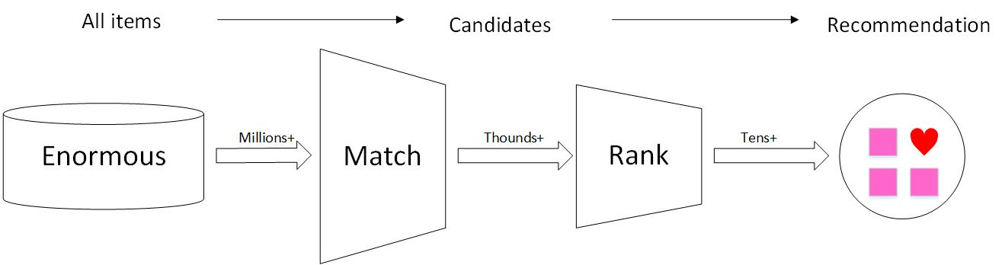
Basic Idea of Recommendation
CIKM 2019 EComm AI
Efficient User Interests Retrieval
An Advanced Similarity for Item CF
Parallel Algorithm and Data Structure for Efficient Matching
A Distribution-Free Test of Independence for Feature Selection
Liner and Power Model weighting method
Notes:
OK, then Let's talk about the main idea of our solution. In our framework, we split the online recommendation into two stages. The Matching stage can retrival thounds items into a candidate set from an enormous item-set effiencinently, then fifty items are selected by ranking stage more precisely.
Then I will introduce some critical technologies applied in our framework.

Slide 9
Matching
CIKM 2019 EComm AI
Efficient User Interests Retrieval
Main Process
Main Process
(Item-to-Item)
(User-to-Item)
Notes:
In the matching stage, we borrowed the basic idea of Item-CF, As this flow chart, we first create a large and sparse similarity matrix from the behaviors.
and then for each user, we retrieval the similar items from matrix, accoroding to their historical behaviors

Slide 10
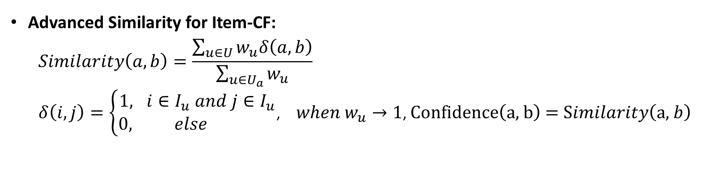
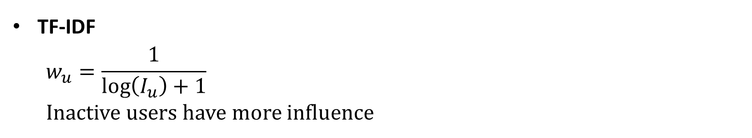
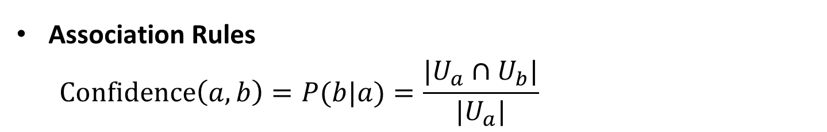
Matching
CIKM 2019 EComm AI
Efficient User Interests Retrieval
Association Rules
$$\text{Confidence}\left(a,b\right)=P(b|a)=\frac{|U_{a}∩U_{b}|}{{|U}_{a}|}$$
TF-IDF
$$w_{u}=\frac{1}{\log\left(I_{u}\right)+1}$$
Inactive users have more influence
Advanced Similarity for Item-CF:
$$Similarity\left(a,b\right)=\frac{\sum_{u∈U}{w_{u}δ\left(a, b\right)}}{\sum_{u∈U_{a}}{w_{u}}}$$
$δ\left(i, j\right)=\left\{\begin{aligned}1, i∈I_{u} and j∈I_{u} \\ 0, else \end{aligned}\right.$, $when{ w}_{u}→1$, $\text{Confidence}\left(\text{a}\text{, }\text{b}\right)\text{ =} \text{S}imilarity\left(\text{a}\text{, }b\right)$
Notes:
One important improvement in matching stage is that We proposed an advanced similarity for item-CF, which integrates the basic idea of Association Rules and TF-IDF model in Natural Language Processing. Lets look at similarity between a and b. when we ignore w_u, this similarity can be simplized as the basic confidence in association rules, which indicates the likelyhood that item B was prefered under item A was prefered. Then we introduced the user's frequency as w_u, which assumes inactive users will have more influence.
So This advanced similarity can provide almost 20% improvement than basic jaccard similarity.

Slide 11
Matching
CIKM 2019 EComm AI
Efficient User Interests Retrieval
Parallel Algorithm
for Similarity Matrix Generation
Data Structure
for Efficient Retrieval
i1 | i2 | i3 | i4 | i5 | i6 | i7 | i8
1 | 1 | 1 | 0 | 0 | 1 | 0 | 0
1 | 1 | 0 | 1 | 0 | 0 | 0 | 0
0 | 1 | 1 | 1 | 0 | 0 | 1 | 0
1 | 1 | 1 | 1 | 0 | 0 | 0 | 0
0 | 0 | 0 | 1 | 1 | 1 | 1 | 1
1 | 0 | 0 | 0 | 1 | 1 | 1 | 1
0 | 0 | 0 | 0 | 0 | 1 | 1 | 1
0 | 0 | 0 | 0 | 1 | 0 | 1 | 0
Group 1
Group 2
Group N
Hash with only 430K values
Notes:
To generate similarity matrix efficiently, we proposed a parallel algorithm. In this algorithm, we group users with there preference. Then we generate similarity matrix in each group indepently, so generated matrix is more dense. For example, in this picture, the matrix generated in group1 only contains similarity between six items instead of eight, because the columns of i5 and i8 are missing. So that we can save a lot of memories and meanwhile we can use several CPU to speed up.
To retrival efficiently. So we selected items with higher similarities and re-constructed them into a hash set, which can be retrivaled with constant time complexity. Finally, according to these algorithm and data structure, we can generate the candidate set for each user.

Slide 12
Ranking
CIKM 2019 EComm AI
Efficient User Interests Retrieval
Main Process
Positive Samples
Label
Features
Features
Notes:
Then we move on to the ranking stage. The basic idea is to find which items in candidate set will be more prefered. So in our process, we use the previous fifteen days to create offline similarities, and we use the sixteen days to create training candidates, then we train the model with GBDT algorithm. One important trick is that we only use the retrivaled items from simliarity matrix as the positive samples, which means some real positive samples in sixteen days are abundended, because they dont have statistical significance.
For online prediction, we used the previous sixteen days to generate the online similarity matrix, and used the pre-trained GBDT model to rank them for recommendation.

Slide 13
Ranking
CIKM 2019 EComm AI
Efficient User Interests Retrieval
Feature Engineering
Statistic Values of item’s ratings
Timestamps of item’s ratings
Frequency of item
Rank of item
Item Features
Category/Shop/Brand(item-set) Features
User Interaction Features
Similarity Features
Statistic Values of item-set’s ratings
Timestamps of item-set’s ratings
Frequency of item-set
Size of item-set
Number of User’s ratings on item-set
Timestamps of user’s ratings on item-set
User’s different behaviors on item-set
Item’s similarity
Rank of item’s similarity
Notes:
There are lots of features we generated accroding to the Data Analysis, and we split them into four fields. The item features, the category/shop/brand features, the user interaction features and one special feature. The first three features are common features for classical CTR problem, and they are varified to be useful in many data mining competitions. And we still have a special feature which is the itme similarity from matching stage, this feature are proved very important in feature selection process.

Slide 14
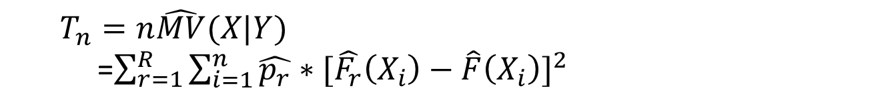
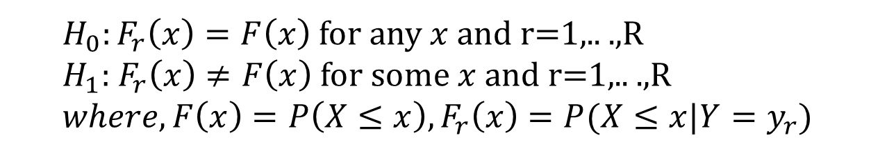
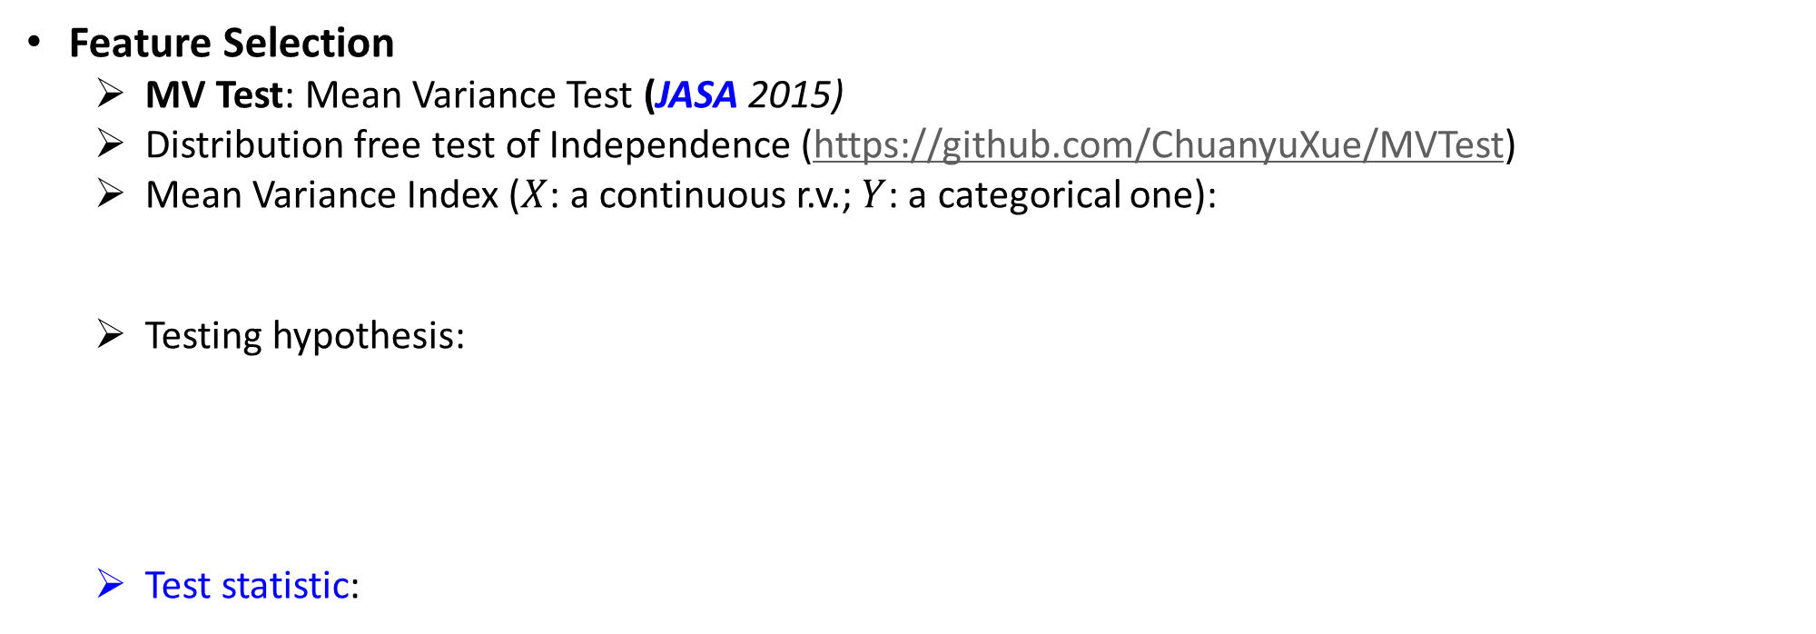
Ranking
CIKM 2019 EComm AI
Efficient User Interests Retrieval
Feature Selection
MV Test: Mean Variance Test (JASA 2015)
Distribution free test of Independence (https://github.com/ChuanyuXue/MVTest)
Mean Variance Index ($X$: a continuous r.v.; $Y$: a categorical one):
Testing hypothesis:
Test statistic:
$MV\left(X | Y\right)=E_{X}[{Var}_{Y}(F(X|Y))]$ $where F\left(x|Y\right)=P\left(X≤x|Y\right)$
$H_{0}:F_{r}\left(x\right)=F\left(x\right)$ for any $x$ and r=1,.. .,R
$H_{1}:$ $F_{r}\left(x\right)≠F\left(x\right)$ for some $x$ and r=1,.. .,R
$$where,F\left(x\right)=P\left(X≤x\right),F_{r}\left(x\right)=P(X≤x|Y=y_{r})$$
$$T_{n}=n\hat{MV}(X|Y)$$
=$\sum_{r=1}^{R}{\sum_{i=1}^{n}{\hat{p_{r}}∗{[\hat{F_{r}}\left(X_{i}\right)−\hat{F}\left(X_{i}\right)]}^{2}}}$
Notes:
And In this competition, we are supposed to make the online recommendation under the complexity and space constrant. So we need to reduce the feature dimentions into an accpectable level. Here, we introduced a feature selection method based on mean variance test.
This method can test the dependency between a continuous variable and a categorical variable by calculating the expection of variance of constraint distrubution X ON Y.
Based on this index, the testing hypothesis are proposed, H0 indicates x and y are indepent, and H1 indicates x and y are depent. The test statistic of H0 can be calculated as follow.

Slide 15
Ranking
CIKM 2019 EComm AI
Efficient User Interests Retrieval
Model Averaging
3 steps
Step 1: averaging lightgbm and catboost with Harmonic Mean
Step 2: averaging lightgbm and catboost with Geometric Mean
Step 3: Harmonic Mean * 0.5 + Geometric Mean * 0.5
Notes:
To improve presision, we integrate LightGBM and Catboost to make the final recommendaiton. We first averaging models with harmonic mean and then we averaging model with geometric mean. Finally, we average both of them as the final result.

Slide 16
Conclusion
CIKM 2019 EComm AI
Efficient User Interests Retrieval
Team | The Qualification
QDU | 0.02645 + 6.5%
聪明恬恬傻歪歪 | 0.02553 + 2.8%
去网吧里偷耳机 | 0.02543 + 2.4%
山有木兮 | 0.02516 + 1.2%
北方的郎 | 0.02484 -- baseline
Team | The Semi-Finals
江离 | 0.06246 + 10.9%
QDU | 0.06222 + 10.5%
队名已被占用 | 0.06159 + 9.4%
聪明恬恬傻歪歪 | 0.06034 + 7.1%
DeepWisdom | 0.05632 -- baseline
0.062
Model Averaging
0.061
0.054
Feature Engineering & Selection
0.053
Match & Rank
+12%
0.045
Advanced Item CF
Item CF
+18%
0.032
Category & Shop
+40%
0.029
Shop
0.023
Category
Notes:
Now I want to make a conclusion for this experience.
On leader borad, we overperformed other teams in first season. And in semi-finals, the evaluation metrics is changed, so we have to start all over again, but we are still overperformed other teams and only slightly lower than the first team,
Our framework is kind of normal compared with others, but we did a good job in some details. For example, a good matching method provides big progress in matching stage, and considering with more factors, we improved our similarity matrics and achieved better result. When we try the ranking stage first time, it seems like not working well, cause the improvment is not so obvious. But after the feature engineering and some powerful statictic methods, the result is much better. That's the main reason why we can achieve a good result.

Slide 17
References
CIKM 2019 EComm AI
Efficient User Interests Retrieval
[1] Y. Huang et al. Tencentrec: Real-time stream recommendation in practice. Proceedings of the 2015 ACM SIGMOD International Conference on Management of Data. 2015: 227-238.
[2] H. Cui et al. Model-free feature screening for ultrahigh dimensional discriminant analysis. Journal of the American Statistical Association. 2015, 110(510): 630-641.
[3] H. Cui et al. A Distribution-Free Test of Independence and Its Application to Variable Selection. arXiv preprint arXiv:1801.10559, 2018.
Notes:
That's all, thank you for your time.
And I want to make an advertisement for myself. You know I am gonna graduate from university, So Iam now looking for potential Phd positions and domestic intern jobs. If you want to work with me or hire me, please contact me at this webset.
Thankyou for your listening again

Slide 18
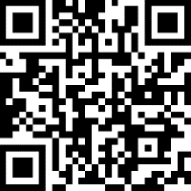
CIKM 2019 EComm AI
Efficient User Interests Retrieval
Thank You
← Contact me
Notes:
Thank you 在中间，而且要大

Slide 19
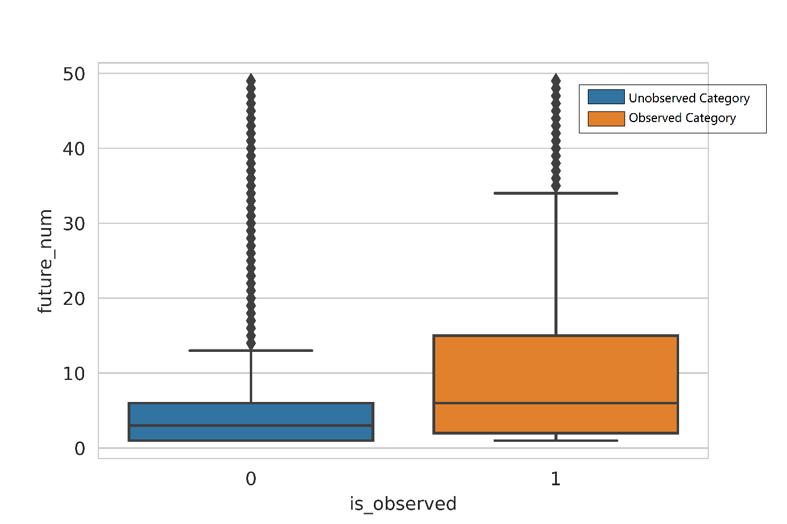
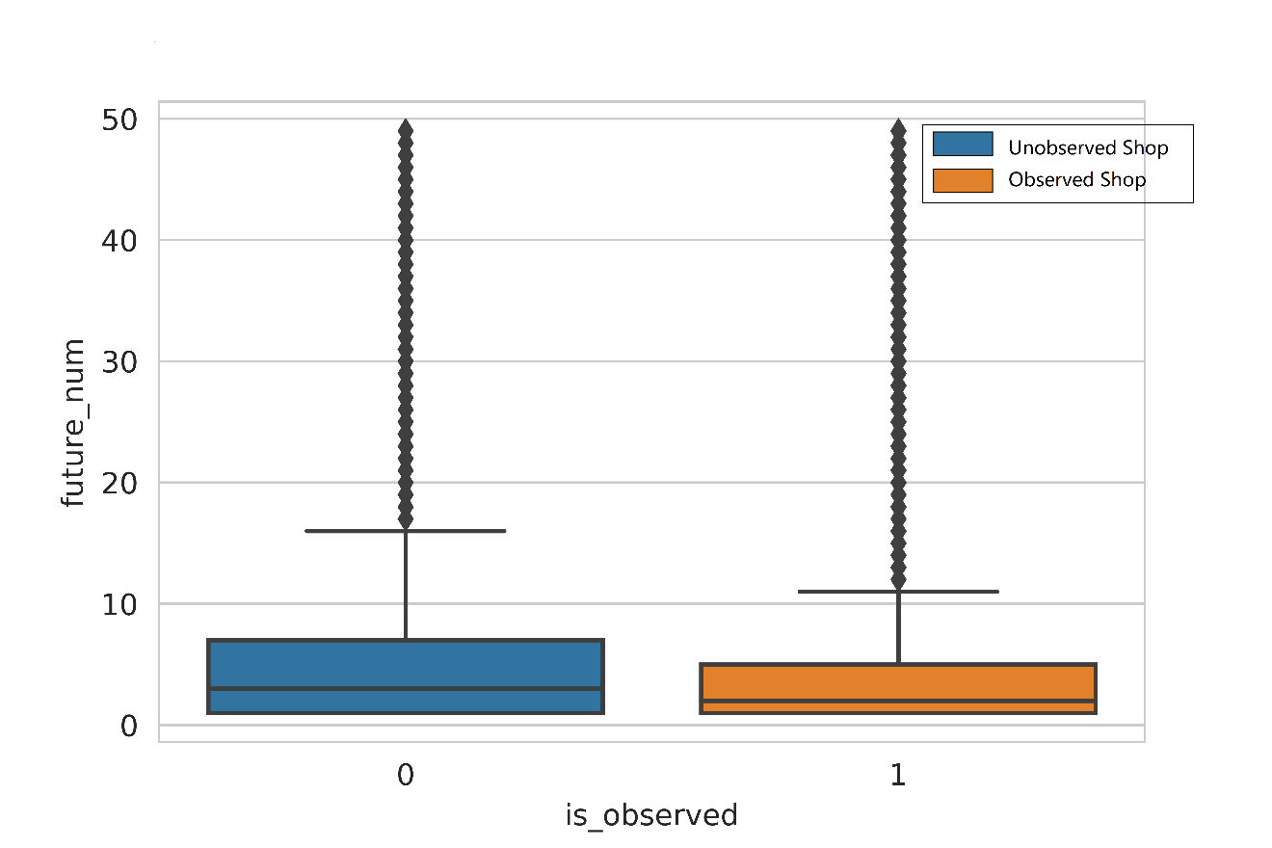
Supplementary
CIKM 2019 EComm AI
Efficient User Interests Retrieval
Category / Shop of items
Observed Categories will be more preferred
Observed Shops will be less preferred

Slide 20
Supplementary
CIKM 2019 EComm AI
Efficient User Interests Retrieval
User-to-Item
User historical behaviors:
Similarity Hash set:
Generated Candidates:
Top(500)(Pineapple(4.1 * 0.9) , Pear(4.1 * 0.6) , ……)
Item | Apple | Banana | Football
Behavior | 4.1 | 2.2 | 0.9
Item | Item(Similarity) | Item(Similarity) | Item(Similarity)
Apple | Pineapple(0.9) | Pear(0.6) | Peach(0.4)
Banana | Mango(0.8) | Lemon(0.3)
Football | Basketball(0.9) | Baseball(0.5)

Slide 21
Supplementary
CIKM 2019 EComm AI
Efficient User Interests Retrieval
Ranking
User’s Ground Truth in 16days
User’s retrievaled items in 16days
User’s training samples
Item | Pineapple | Pear | Bicycle | Burger
Without
Statistic Significance
Item | Pineapple | Pear | Mango | Lemon
Item | Pineapple | Pear | Mango | Lemon
Bicycle | Burger
Positive
Sample
Positive
Sample
Negative
Sample
Negative
Sample
Abandon
Abandon

Slide 22
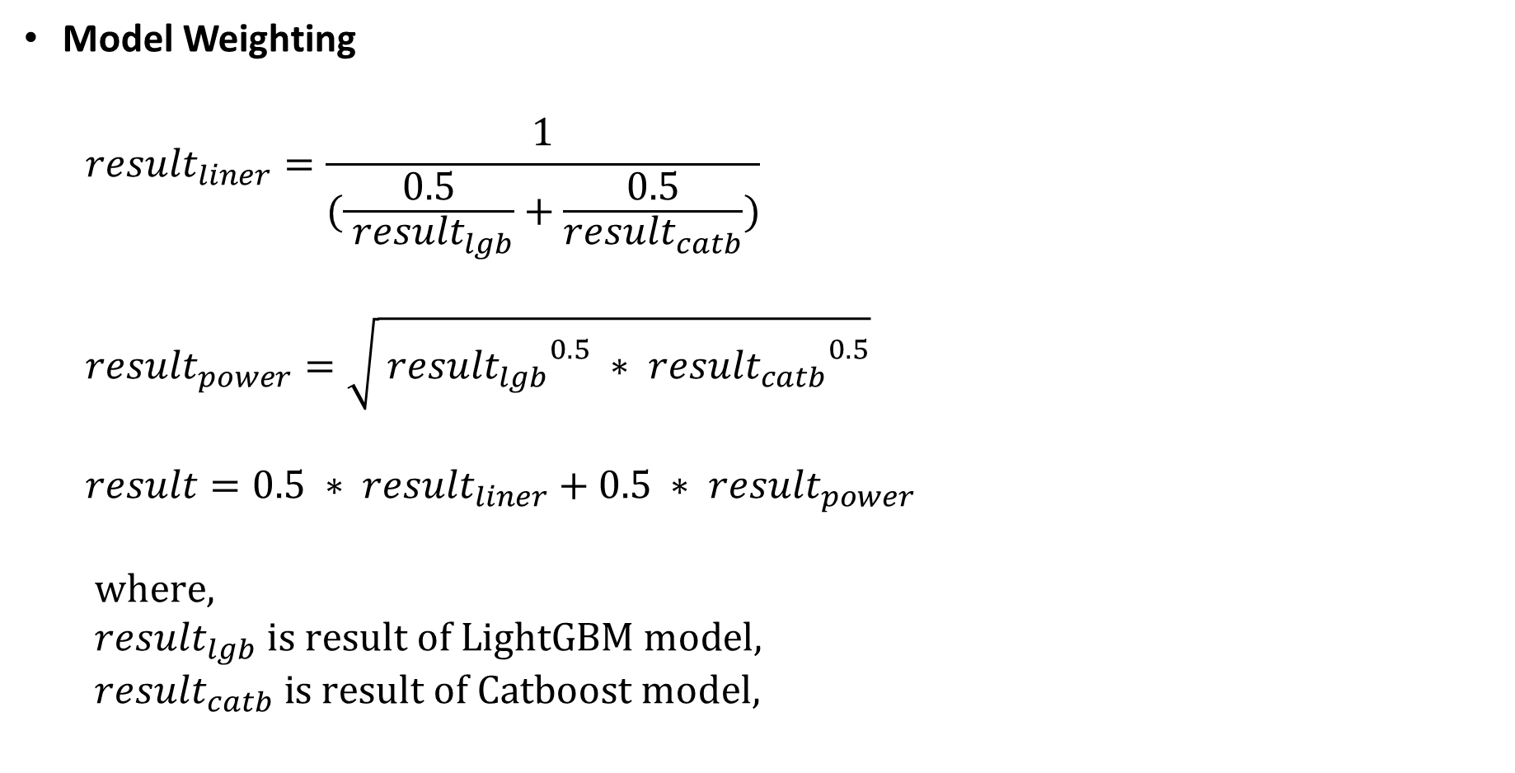
Supplementary
CIKM 2019 EComm AI
Efficient User Interests Retrieval
Model Weighting
$${result}_{liner}=\frac{1}{(\frac{0.5}{{ result}_{lgb}}+\frac{0.5}{{result}_{catb}})}$$
$${result}_{power}=\sqrt{{{ result}_{lgb}}^{0.5} ∗ {{result}_{catb}}^{0.5}}$$
$$result=0.5 ∗ {result}_{liner}+0.5 ∗ {result}_{power}$$
$$\text{where}\text{,}$$
$${ result}_{lgb} \text{is} \text{result} \text{of} \text{LightGBM} \text{model}\text{,}$$
$${ result}_{catb} \text{is} \text{result} \text{of} \text{Catboost} \text{model}\text{,}$$

Slide 23
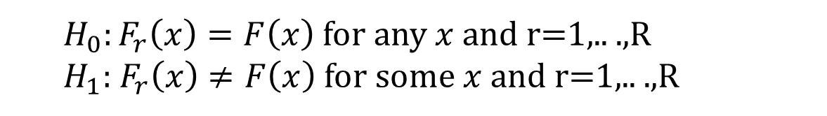
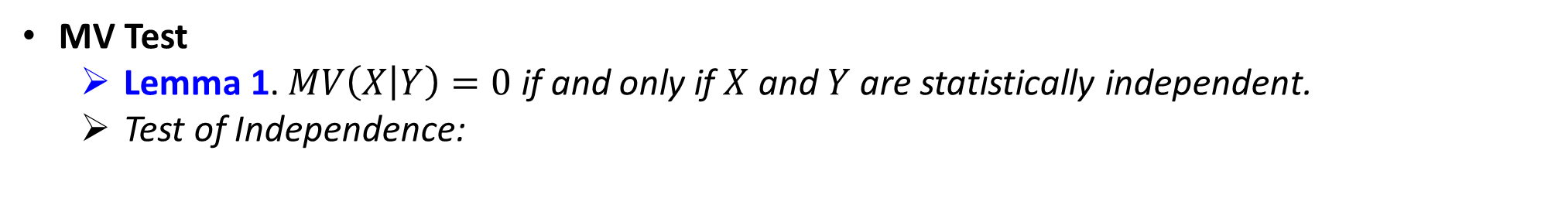
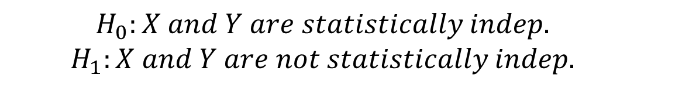
Supplementary
CIKM 2019 EComm AI
Efficient User Interests Retrieval
MV Test
Lemma 1. $MV\left(X | Y\right)=0$ if and only if $X$ and $Y$ are statistically independent.
Test of Independence:
$$H_{0}:X and Y are statistically indep.$$
$$H_{1}:X and Y are not statistically indep.$$
$H_{0}:F_{r}\left(x\right)=F\left(x\right)$ for any $x$ and r=1,.. .,R
$H_{1}:$ $F_{r}\left(x\right)≠F\left(x\right)$ for some $x$ and r=1,.. .,R

