Slide 1
0:00 — 0:40 · 40s
01 / 12
Nisaba Capital Charting
A financial intelligence platform at the intersection of astrology and Wall Street.
“Millionaires don’t use astrology. Billionaires do.”
— attributed to J.P. Morgan
Whether or not he said it, what is documented: Morgan kept the most famous astrologer in America, Evangeline Adams, on retainer for investment advice.
This intersection isn’t fringe. It’s hidden. I’m Aisling. I believe in astrology. So I built the tool these guys had to invent themselves.
AISLING LEIVA · PURSUIT NYC FELLOWSHIP · FINAL PRESENTATION
🎤 Open with the quote. Pause 3s. Then the hedge: "whether or not he said it, what is documented..." Land on Adams’ retainer. Drop the closing tag: "Not fringe. Hidden. I’m Aisling. I believe. So I built it." Pace 130 wpm — slower than instinct.

Slide 2
0:25 — 1:00 · 35s
02 / 12
THE LINEAGE
This intersection isn’t fringe. It’s hidden.
J.P. Morgan
1890s-1913
Kept astrologer Evangeline Adams on retainer. Documented in Adams’ 1926 autobiography.
W.D. Gann
1908
Founded W.D. Gann & Company. Truth of the Stock Tape (1924) praised by The Wall Street Journal.
Donald Bradley
1948
Stock Market Prediction. Bradley Siderograph — planetary index for stock turning points. Still tracked today.
Arch Crawford
1977-present
Founded Crawford Perspectives. Predicted 1987 crash to the day. #1 market timer 2008+2009 by Hulbert Financial Digest.
Existing tools serving this market are PHP scripts and Python notebooks. Newsletters charge $1,200/year. The market exists. The production-grade platform doesn’t.
🎤 Walk 3 names: Morgan, Gann, Crawford. The Crawford line is strongest — “ranked #1 market timer in 2008 and 2009 by Hulbert Financial Digest.” Hedge Morgan as “attributed.” Land on the gap: market exists, no platform.

Slide 3
1:00 — 1:25 · 25s
03 / 12
WHAT IT IS
Nisaba Capital Charting · three tiers, three audiences, one engine.
FREE
PRO
MASTER
For the curious. View any ticker’s natal chart + Lagrange score.
For paper traders. Backtest + auto-trading sim. +37% ROI verified.
For professionals. Sidecar API + OpenBB Workspace integration.
ASTROLOGY ENGINE
DATA PIPELINE
DESKTOP GUI + SIDECAR
Wave 9 · 9 modules · 65 tests
Wave 7 · 10 native providers
Iced 0.14 · wgpu · axum
· Solar Returns (Newton search)
· World Bank · IMF · ECB SDMX
· 3D natal wheel via WGSL shader
· Profections (Hellenistic time-lord)
· BLS · EIA · CFTC COT · OFR FSI
· Universal pill notification system
· Planetary returns (Saturn/Jupiter/Mars)
· Treasury Direct · CoinGecko · SEC EDGAR
· Lagrange composite (6 factors)
· Secondary progressions
· + Tiingo · Alpha Vantage · Finnhub
· Backtest with cycle-aligned mode
· 9 aspects · 7 patterns · 8 fixed stars
· + GDELT · Polymarket · 25 RSS feeds
· Paper trading engine
· Decans · Sabian Symbols · Eclipses
· SQLx compile-time SQL
· OpenBB Workspace integration
· NASA-grade Swiss Ephemeris
· Tiered priority refresh queue
· 11 REST endpoints + 7 widgets
🎤 Three tiers — Free for the curious, Pro for paper traders, Master for professionals. Three columns = three binaries. Read column headers, then the bold “what” line. Don’t list the bullets aloud.

Slide 4
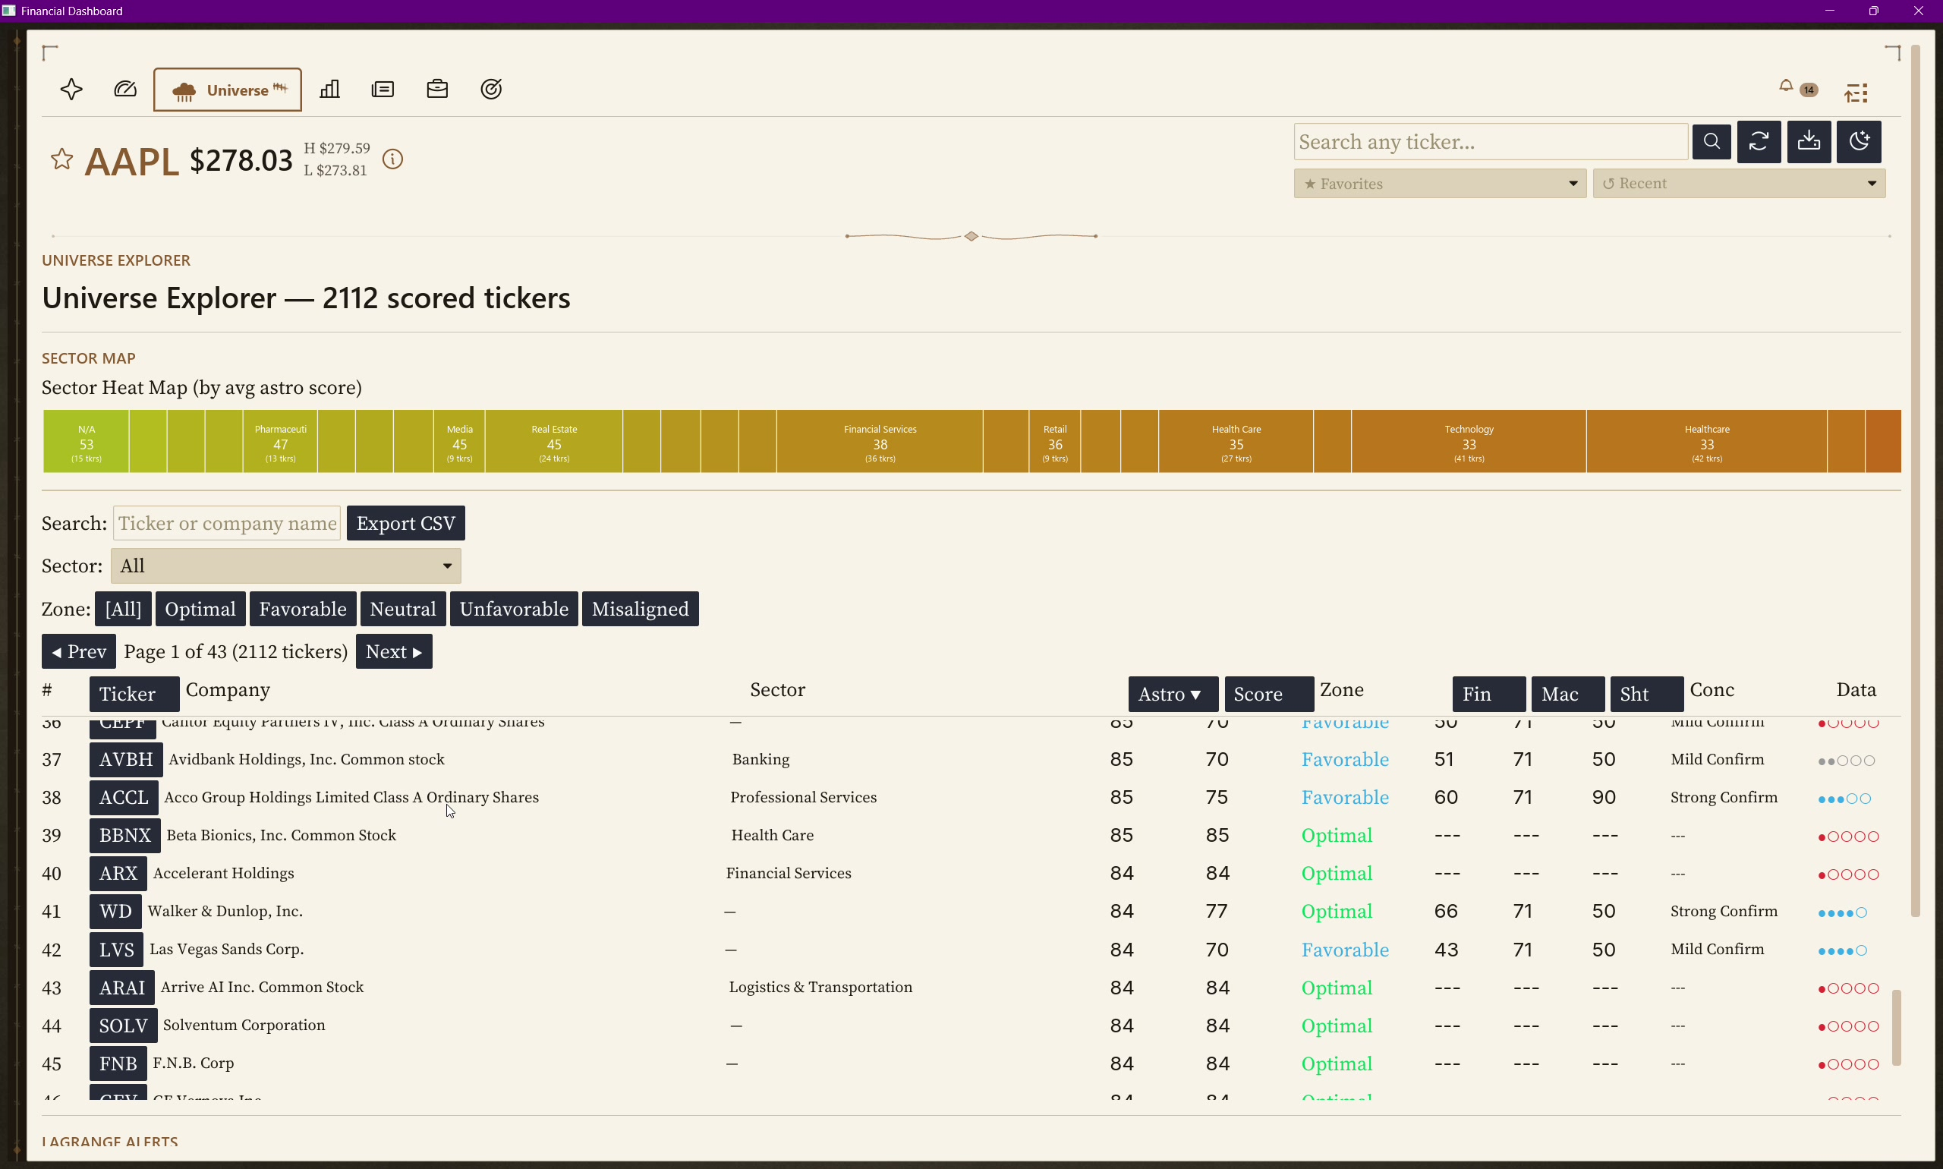
1:25 — 1:50 · 25s
04 / 12
WALKTHROUGH · STEP 1
Open the dashboard. Universe tab. 2,112 scored tickers.
▶ WORKFLOW DEMO
WHAT YOU’RE SEEING
Sector heat map at top — color-coded by average astro score. Green = optimal, orange = unfavorable.
2,112-ticker scored universe table sortable by Astro, Lagrange, Concordance, sector.
Conc column shows how many of the 6 Lagrange factors agree — that’s the high-conviction signal.
Click any ticker → full detail in <200ms.
🎤 Point to the sector heat map first. Then sweep right to the table. Highlight the Conc column — “when 4+ factors agree, that’s the high-conviction signal.” Pick CGCT or any optimal-zone ticker.

Slide 5
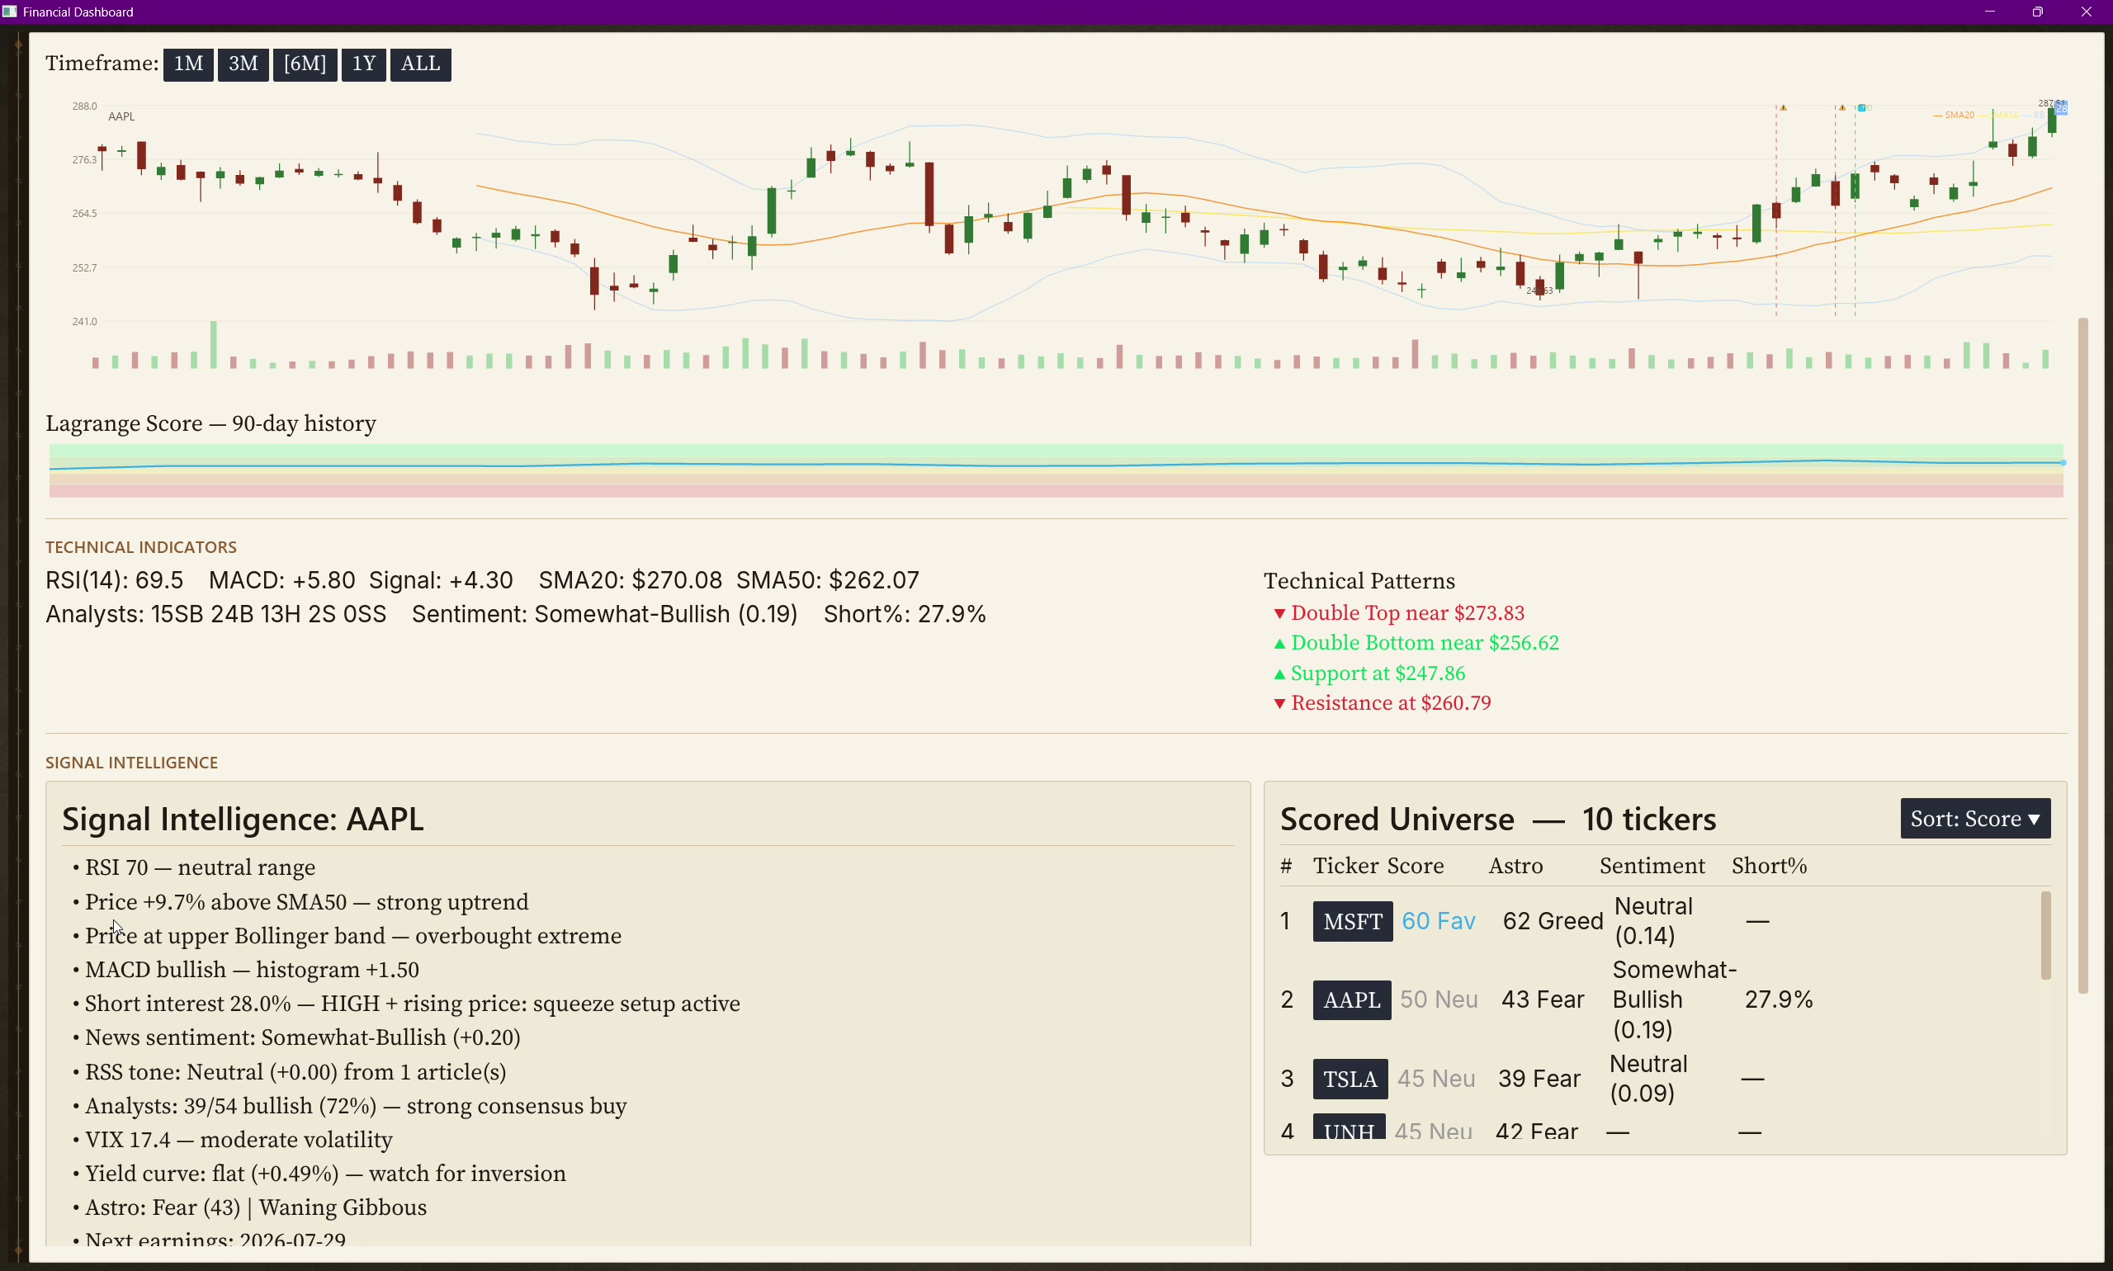
1:50 — 2:20 · 30s
05 / 12
WALKTHROUGH · STEP 2
Six factors converge into one Lagrange score.
▶ WORKFLOW DEMO
5 GAUGES, TOP-ALIGNED
Crypto F&G · Equities F&G · Technical · Astrology · ★ Lagrange composite
CHART
Bollinger Bands · SMA-20 · SMA-50 · volume bars · auto-detected technical patterns (double tops, support/resistance)
90-DAY LAGRANGE HISTORY
Green band = bullish concordance, red = bearish.
Lagrange = Tech 20% + Sentiment 20% + Short 15% + Insider 15% + Astro 15% + DCF 15%
🎤 Sweep across the 5 gauges left-to-right. Land on the Lagrange star. “This is the composite — six independent signals.” Then point to the 90-day history strip. “When this stays green for weeks, that’s structural bullishness, not noise.”

Slide 6
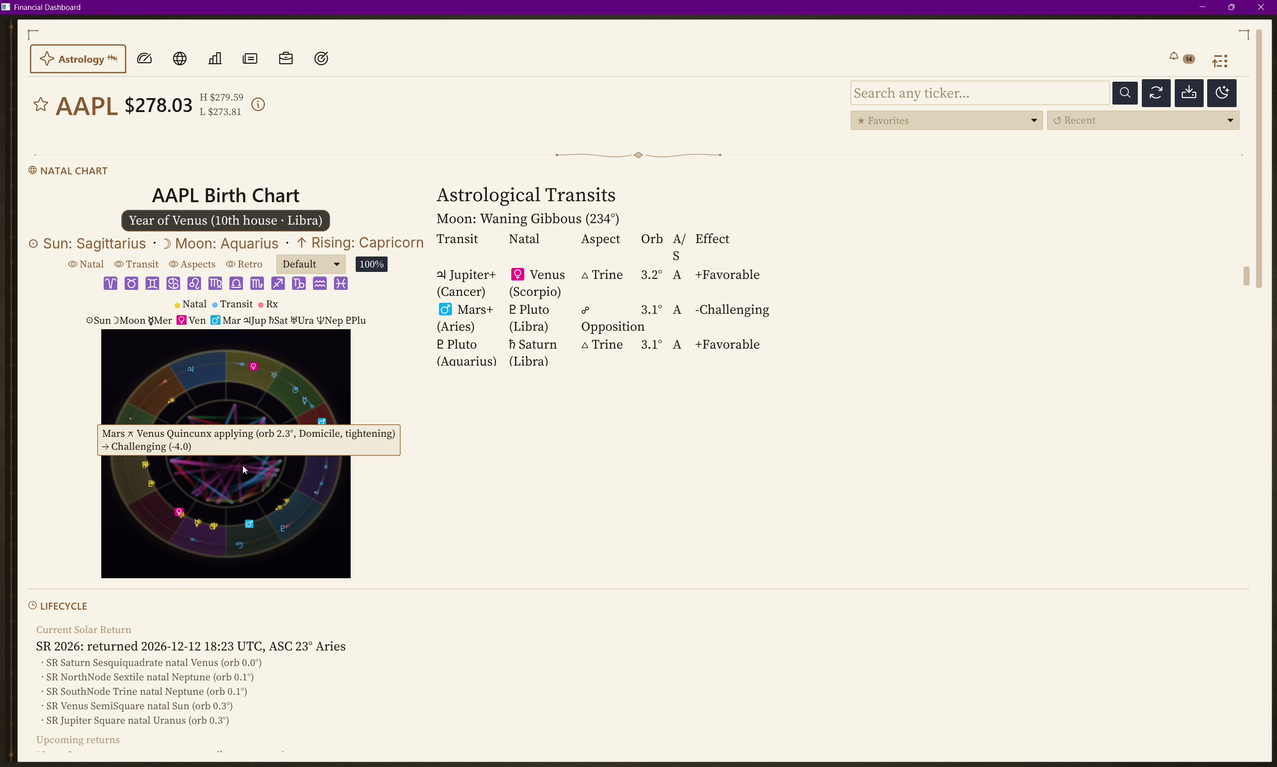
2:20 — 3:00 · 40s
06 / 12
WALKTHROUGH · STEP 3
Astrology tab — where this gets serious.
▶ WORKFLOW DEMO (HERO)
YEAR OF VENUS BADGE
AAPL is in its Year of Venus (10th house · Libra) — Hellenistic profection has rotated Venus into time-lord. Aspects involving Venus get +50% Lagrange weight all year.
3D NATAL WHEEL
Real-time WGSL shader. 13 bodies. Aspect lines glow by orb-tightness gradient. Hover any planet → tooltip with decan, Sabian, critical degree, OOB.
LIFECYCLE
Solar Return + planetary returns + progressed Sun. All cached — zero per-render compute.
🎤 Money slide. Slow down. “AAPL is in its Year of Venus right now — that’s not a number I made up. It’s a 2,000-year-old Hellenistic technique from Antiochus, first century CE.” Then the wheel: “rendered in real-time on the GPU via custom WGSL shader.”

Slide 7
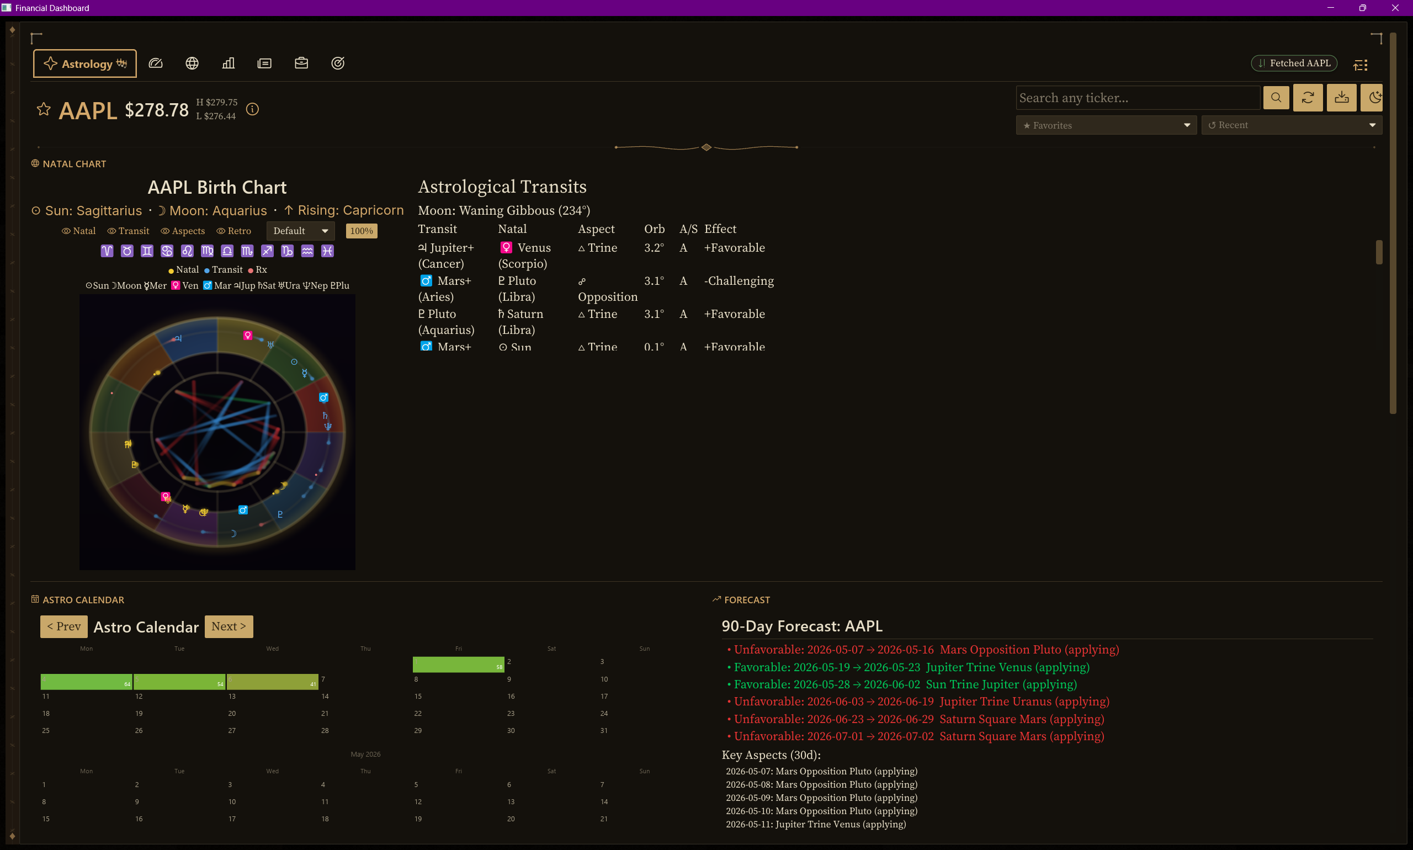
3:00 — 3:25 · 25s
07 / 12
WALKTHROUGH · STEP 4
Universal pill notifications + drawer history.
▶ WORKFLOW DEMO
THREE PILLS, THREE SIGNALS
ACLS → Optimal · MSFT → Optimal · NVDA → Optimal — Lagrange alerts firing simultaneously.
Layout NEVER reflows.Pills slot between the tab strip’s right spacer and the bell. Push-down bug killed forever.
Click pill → routes + dismisses in one click.
Click bell → 24h history. Clear all = wipe.
Bell rocks 2.4s when active count > 0. Custom Canvas widget — no Phosphor codepoint guessing.
🎤 Quick on this slide. “Three Optimal alerts firing at once — layout never moves. That’s intentional engineering. Click any pill, it routes + dismisses. Click the bell, full 24-hour history.” Move on.

Slide 8
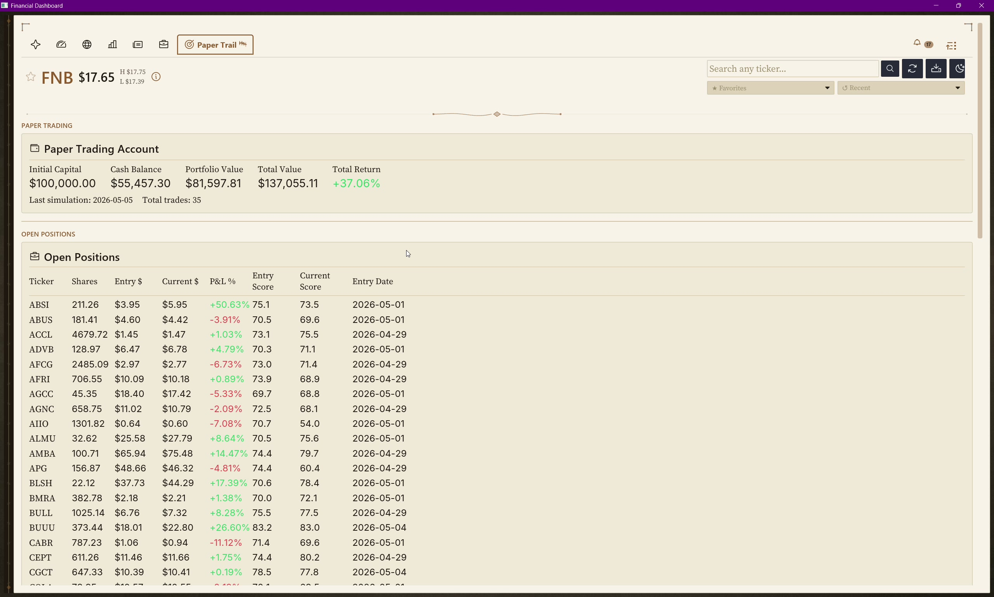
3:25 — 3:55 · 30s
08 / 12
THE PROOF
+37.06% return on $100K virtual capital. 35 trades. Live forward-test.
LIVE PAPER TRADING ENGINE
Starts with $100,000. Auto-opens at Lagrange > 65, exits at < 35 or 15% trailing stop.
Total Value: $137,055.11
Total Return: +37.06%
35 trades · last simulation 2026-05-05
Open positions visible in screenshot:
· ABSI +50.63% · BLSH +17.39% · AMBA +14.47% · BUUU +26.60%
Astrology is one of six inputs. The Lagrange strategy that produced this return uses it actively. Not cherry-picked from history — running every day on real data.
🎤 Kill shot. Slow down. “$100,000 virtual capital. Plus thirty-seven percent return. Thirty-five trades. The Lagrange strategy uses astrology as one of six inputs.” Pause. “This isn’t a backtest cherry-picked from history. It’s a live forward-testing engine.”

Slide 9
3:55 — 4:15 · 20s
09 / 12
THE THESIS
Don’t believe. Measure.
The thesis isn’t “believe in astrology.” The thesis is — financial astrology has a documented 100-year track record at the highest levels of Wall Street. Until now, the techniques weren’t reproducible at scale.
Nisaba Capital Charting is the first open implementation of Hellenistic financial astrology with engineering rigor: NASA-grade Swiss Eph precision, 132 unit tests against AAPL’s natal chart, a backtest engine with cycle-aligned mode (Saturn / Jupiter return zones).
Don’t take J.P. Morgan’s word for it. Don’t take W.D. Gann’s. Run the backtest yourself.
🎤 Slow down. Philosophical pivot. “The thesis isn’t believe — it’s measure.” Pause. Let it land. Then close: “Run the backtest yourself.”

Slide 10
4:15 — 4:35 · 20s
10 / 12
TECH DEPTH
30 days · solo · production-grade.
25k
140
10
9
LINES OF RUST
UNIT TESTS
NATIVE PROVIDERS
ASTROLOGY MODULES
46
2
3
0
SQL MIGRATIONS
GPU SHADERS
BINARIES
COMPILER WARNINGS
🎤 Read the numbers fast in sequence — they hit harder rapid. End on “zero compiler warnings.” That’s the engineering credibility punch.

Slide 11
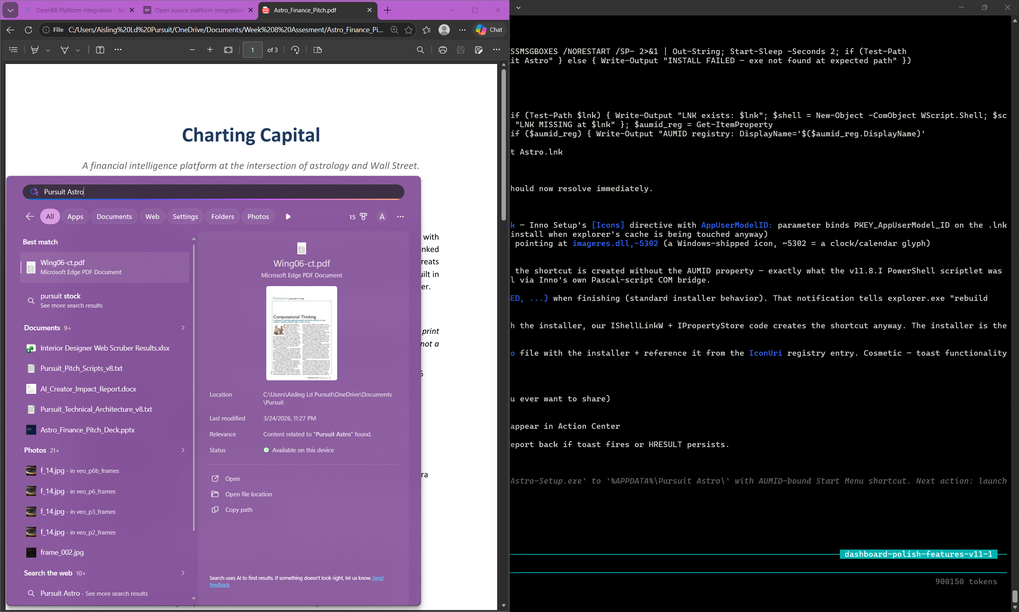
4:35 — 4:55 · 20s
11 / 12
WHAT THIS COULD BE
Nisaba Capital Charting — the platform play.
Nisaba Capital Charting is the engine. Nisaba Capital Charting is the brand — a financial intelligence platform at the intersection of astrology and Wall Street.
The infrastructure is already production-tier. The question isn’t can it ship. The question is what audience first:
▸ Retail traders — desktop tier ($29/mo)
▸ Institutional newsletters — sidecar API ($1,200/yr precedent)
▸ Astrology-curious finance professionals — the W.D. Gann tradition revived
🎤 “Nisaba Capital Charting is the engine. Nisaba Capital Charting is the brand.” Three audiences = three monetization paths. Don’t dwell — forward-looking, not prescriptive.

Slide 12
4:55 — 5:00 · 5s
12 / 12
“The stars charted the careers of Morgan, Gann, and Crawford.
They’re charting mine too.
And I’m building the tool that charts everyone else’s.”
Whether you came for the horoscope or stayed for the P&L,
the cosmos has been moving markets the whole time.
We’re just the first to put it on one screen.
AISLING LEIVA · Nisaba Capital Charting · THANK YOU
🎤 Memorize verbatim. Deliver slow. Final beat: “We’re just the first to put it on one screen.” Pause. Smile. Take questions. Don’t say “thanks for listening.”

