Slide 1
INF-743: IoT Communication Technologies

Slide 2
Activity 5 - Designing for the Internet of Things Mapping Communication Considerations and Concerns
Grupo:
Carlos Koster
Fernanda Moya
Gustavo Pampollini
Marisa Bernardo
Vanessa Marques

Slide 3
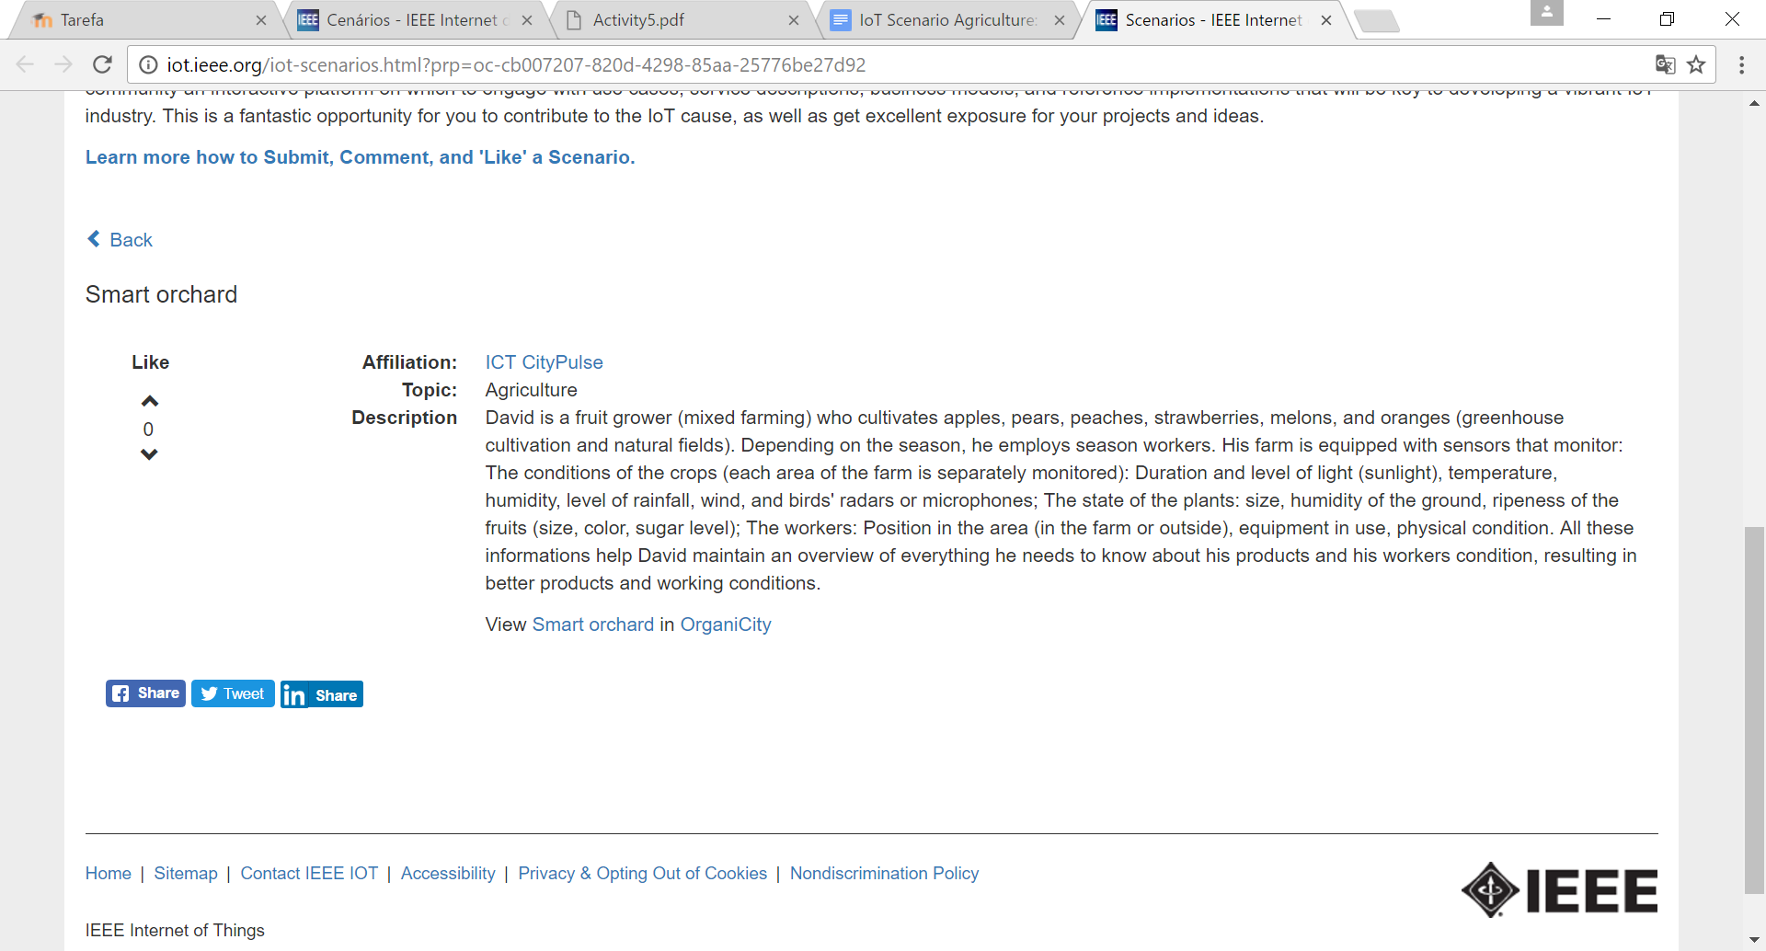
IoT Scenario Agriculture
Smart orchard

Slide 4
Actors
Things: all the sensors used to monitor the farm (Sunlight sensor, temperature, humidity, level of rainfall, wind, and birds' radars or microphones. Plants status. Workers status)
Roles: collect data and send it back to the gateway. Receive settings update.
End users: the farm administrator and the owner
Services: Cloud, Web Service with informations

Slide 5
Communication infrastructure
Communication technologies: LoRa
Protocols: LoRaWAN
Network: WAN
Topology: Star topology
LoRaWAN Devices Types: Class A
Can reach 15Km (https://www.linkedin.com/pulse/iot-fundamentals-lora-lorawan-paul-sabadin)

Slide 6
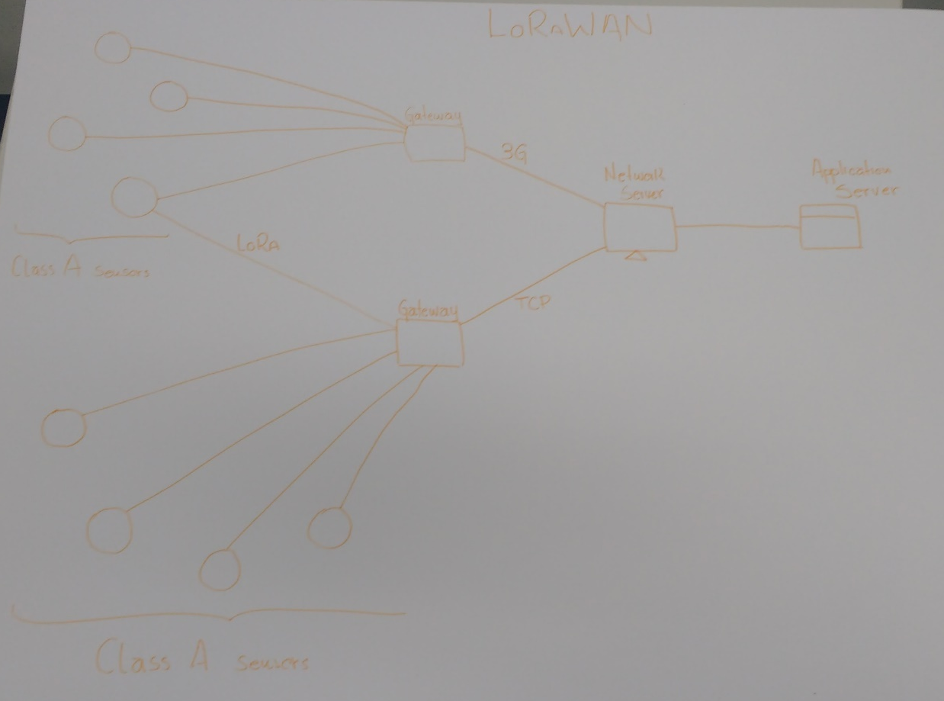

Slide 7
Considerations and concerns about designing the communication infrastructure.
Battery life
Range
Bandwidth
Free-license radio frequency
Support to mobility and localization

