Slide 1

Implementing Machine Learning to Optimize CPU Task Scheduling
Danh Pham
Operating Systems
4/16/2020

Slide 2
Initial Research Background
Since the creation of the Operating System (OS), computer engineers have been designing a variety of CPU scheduling algorithms to optimize the execution of processes for the I/O and CPU. The existing research background on CPU task scheduling right now is based on the long-term scheduler, mid-term scheduler, and short-term scheduler.

Slide 3
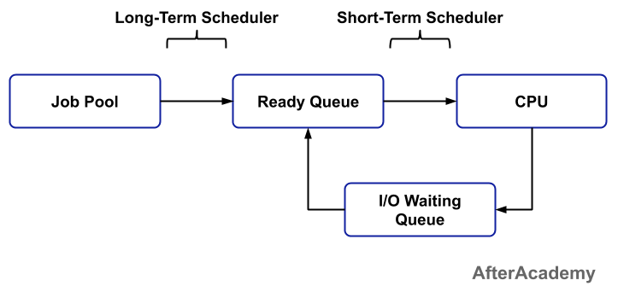
Overview of Schedulers

Slide 4
Scheduling Algorithms
Engineers now based their algorithms based on the short-term, mid-term, and long-term scheduling concepts to make:
First come First Serve
Shortest Job First
Longest Job First
Priority Scheduling
Shortest Remaining Time First

Slide 5
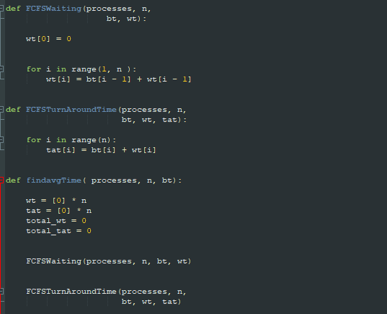
FCFS Example
One possible implementation of a Scheduling Algorithm:
Non-Preemptive Approach

Slide 6
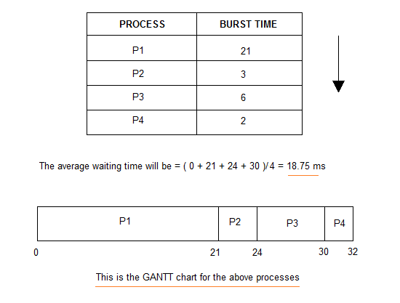
FCFS Example (Gantt Chart
For this example, we see the non-preemptive scheduling principle. The algorithm queue tasks as soon are they are in the ready queue and leave after it finishes.

Slide 7
Flaws with current Scheduling Algorithms
Each scheduling algorithm has their strengths and weaknesses. For example, Shortest Job First (SJF) and Shortest Remaining Time are favorable for processes that would only require a short burst length; However, these algorithms are not optimal for longer processes because it would starve longer processes in cases where there are a high number of short processes that need to be executed.

Slide 8
Current Solutions (Genetic Algorithms)
One current solution being explored by researchers is the implementation of Genetic Algorithm for task scheduling.
Genetic Algorithms rely on the notion of “natural selection” by testing a randomized initial population and rating them by a fitness score to determine the best algorithm to reproduce.
After selection of the ones with the best fitness scores, they test the algorithm by crossover and mutation to find the next best algorithm.

Slide 9
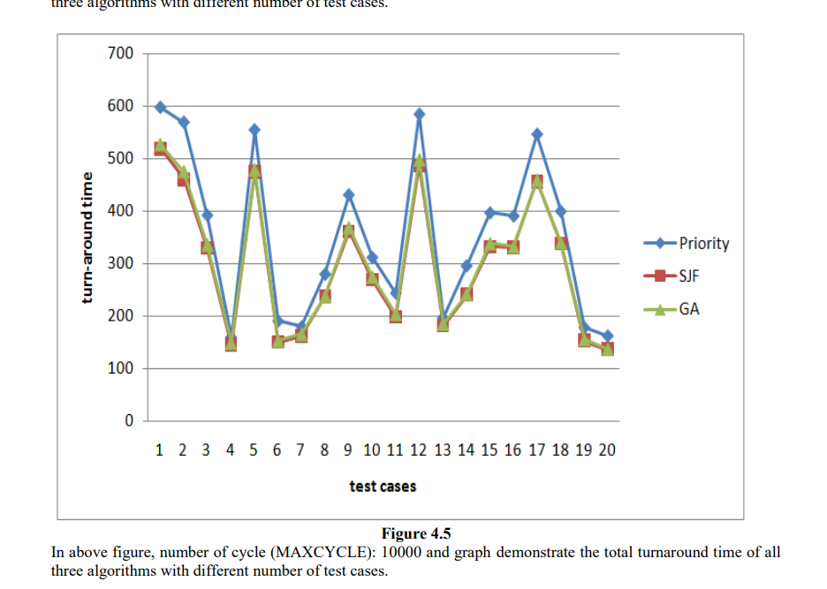
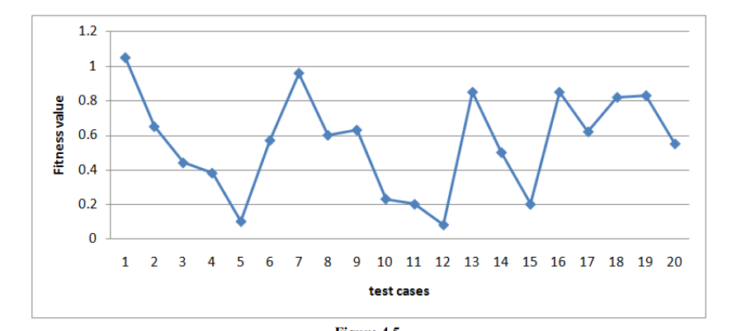
Current Solutions (Part 2)

Slide 10
My Research
The existing research relies of Genetic Algorithms rely on inputting a randomized population to obtain a more efficient function; However, this makes their results inflexible.
My Solution:
Implement a Neural Net algorithm
Refine input data to obtain readable output data
Add features until you find an optimized scheduling approach

Slide 11
Neural Nets
Methodology:
Arrange network nodes in
Input layer
Hidden Layer
Output Layer
Nodes will calculate net input from weight of its activation
Use backpropagation to minimize cost and maximize efficiency
Train the Neural Net repeating these principles
Categorize final neural nets for different types of OS users

Slide 12
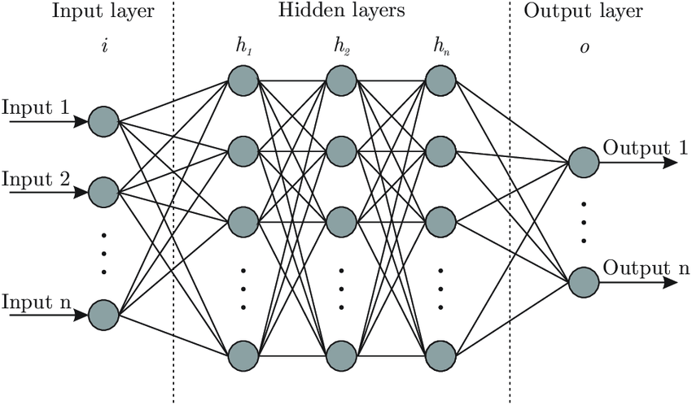
Neural Nets (Part 2)
Our input layer would be our initial dataset.
The hidden layers would be the training calculation which refines the weight and cost.
Our output layer would be the results which we propagate backwards from.

Slide 13
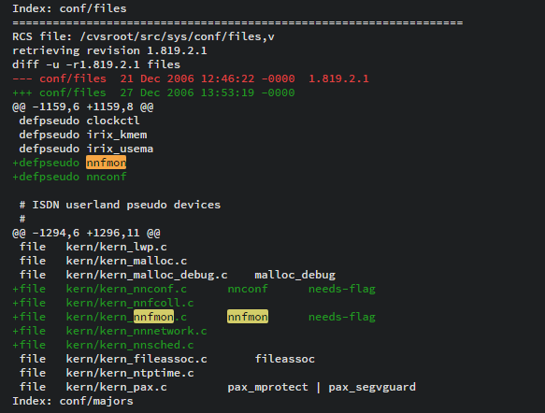
Implementation
By using a pre-built neural network scheduler, we can create our own unique datasets that are optimized for different types of computer users
For Example, we could have a scheduling network optimized for:
Family/Home Computers
Entertainment Systems
Student Computers
Work Computers
Military/Work Computers
Initializing workspace kernel

Slide 14
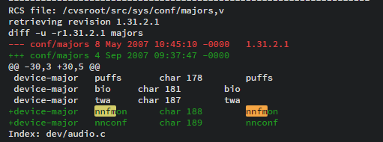
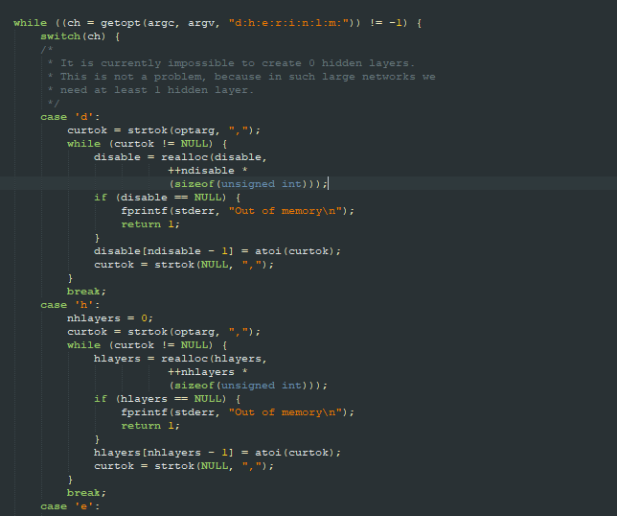
Implementation (Part 2)
Set up a specialized workspace that you want to be optimized
Initialize neural network data collection
User operates the specialized workspace over a few days to train the neural network to their liking
Review data for further optimizations if needed
Boot Neural Network data collection
Training Network from Nodes

Slide 15
Future Plans
Users will be able to select an available Neural network package to install that is optimized for their type of CPU usage
Implementing more efficient data sorting for less data noise/garbage
Utilize networks to lessen energy consumption

Slide 16
References
[1] S. M., R. R. and V. P., "An Optimum Multilevel CPU Scheduling Algorithm," 2010 International Conference on Advances in Computer Engineering, Bangalore, 2010, pp. 90-94. doi: 10.1109/ACE.2010.14 keywords: {operating systems (computers);optimisation;scheduling;optimum multilevel CPU scheduling algorithm;central processing unit;operating system;OS;Scheduling algorithm;Central Processing Unit;Operating systems;Processor scheduling;Algorithm design and analysis;Switches;Delay;Information technology;Computer science;Clocks;CPU scheduling;operating system;scheduling algorithm}, URL: http://ieeexplore.ieee.org/stamp/stamp.jsp?tp=&arnumber=5532867&isnumber=5532798
[2] A. Negi and P. K. Kumar, "Applying Machine Learning Techniques to Improve Linux Process Scheduling," TENCON 2005 - 2005 IEEE Region 10 Conference, Melbourne, Qld., 2005, pp. 1-6. doi: 10.1109/TENCON.2005.300837 keywords: {learning (artificial intelligence);Linux;machine learning techniques;Linux process scheduling;CPU time-slice utilization behaviour;TaT;turn-around-time;Linux kernel scheduler;operating systems;Machine learning;Linux;Switches;History;Processor scheduling;Genetic algorithms;Kernel;Decision trees;Operating systems;Space exploration}, URL: http://ieeexplore.ieee.org/stamp/stamp.jsp?tp=&arnumber=4085157&isnumber=4084860
[3] T. Helmy, S. Al-Azani and O. Bin-Obaidellah, "A Machine Learning-Based Approach to Estimate the CPU-Burst Time for Processes in the Computational Grids," 2015 3rd International Conference on Artificial Intelligence, Modelling and Simulation (AIMS), Kota Kinabalu, 2015, pp. 3-8. doi: 10.1109/AIMS.2015.11 keywords: {feature selection;learning (artificial intelligence);microprocessor chips;operating systems (computers);performance evaluation;CPU-burst time;computational grids;CPU-scheduling algorithms;ML-based approach;machine learning-based approach;feature selection;grid workload dataset;GWA-T-4 AuverGrid;strength linear relationship;burst CPU time;K-NN;K-nearest neighbors;Scheduling algorithms;Computational modeling;Single machine scheduling;Testing;Artificial intelligence;CPU-Burst;CPU Scheduling Algorithm;Machine Learning;Feature Selection}, URL: http://ieeexplore.ieee.org/stamp/stamp.jsp?tp=&arnumber=7604542&isnumber=7604529
[4] A. Kaur and B. S. Khehra, "CPU task scheduling using genetic algorithm," 2015 IEEE 3rd International Conference on MOOCs, Innovation and Technology in Education (MITE), Amritsar, 2015, pp. 66-71. doi: 10.1109/MITE.2015.7375290 keywords: {computational complexity;genetic algorithms;microprocessor chips;optimisation;processor scheduling;CPU task scheduling;genetic algorithm;p-processes single processor scheduling problem;total execution time;combinatorial optimization problem;NP-hard problem;meta-heuristic approach;Genetic algorithms;Processor scheduling;Job shop scheduling;Biological cells;Sociology;Statistics;CPU;scheduling;single processor;combinatorial optimization;NP-Hard;earliness;tardiness;deadline;genetic algorithm}, URL: http://ieeexplore.ieee.org/stamp/stamp.jsp?tp=&arnumber=7375290&isnumber=7375274
[5] Bex, P.J.G.I. "Implementing A Process Scheduler Using Neural Network Technology". Undefined, 2008, p. . https://www.semanticscholar.org/paper/Implementing-a-Process-Scheduler-Using-Neural-Bex/8d7352c3063fa079eaf0b3b5ae4e990ae4eddaa1. Accessed 16 Apr 2020.

