Slide 1
MIS6070
Week 9: HTTP and NODE.js

Slide 2
HTTP Introduction
HTTP stands for Hyper Text Transfer Protocol
HTTP is the underlying protocol used by the World Wide Web
It defines how web messages are transmitted between client and server
Communication between a server and a client occurs via a request/response pair
The browser initiates communication with an HTTP server by initiating a TCP connection to the server

Slide 3
HTTP
Web browsing sessions use server port 80 by default, although other ports such as 8080 could be used
The client initiates an HTTP request message which is serviced through a HTTP response message in return
HTTP is a stateless protocol - it does not keep track of previous requests
Therefore, after a web browser sends a request and the server responds with the page, the connection is usually closed

Slide 4
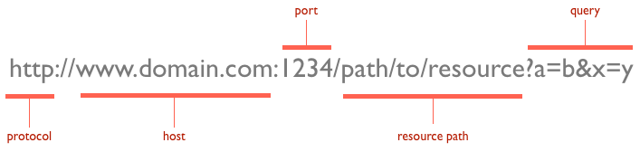
URLs
At the heart of web communications is the request message
It is sent via Uniform Resource Locators (URLs)

Slide 5
URLs (2)
The protocol is typically HTTP but it can also be HTTPS for secure communications
The default port for HTTP is 80 but a different port can be specified explicitly as illustrated in the above image
The resource path is the local path to the resource on the server

Slide 6
HTTP Actions
URLs reveal the identity of the particular host with which we want to communicate
However, the action that should be performed on the host is specified via HTTP verbs
There are several actions that a client would like the host to perform
Two of the most common actions are GET and POST

Slide 7
HTTP GET and POST
Both GET and POST actions can be used to transfer data from client to server using the HTTP protocol
However, there is a significant difference between the two
The main difference is that GET request parameters are appended in the URL string while POST request parameters are sent within the message body
The GET is usually used for fetching resources while a POST is usually used when sending data to the server

Slide 8
HTTP Status Codes
HTTP clients initiate requests to the server
In return, the server responds with status codes and message payloads
The status code is important because it tells the client how to interpret the server response
The HTTP specification defines certain number ranges for specific types of responses: 1xx, 2xx, 3xx, 4xx, 5xx

Slide 9
1xx: Informational Messages
This class of codes was introduced in HTTP/1.1 and is purely provisional
Examples include:
100: this is a continue message, telling the client to continue sending the remainder of the request

Slide 10
2xx: Successful
This class of codes tells the client that the request was successfully processed
Examples include:
200 OK: this is the most common code
202 Accepted: the request was accepted but may not include the resource in the response
204 No Content: there is no message body in the response.
206 Partial Content: indicates that the response only contains partial content

Slide 11
3xx: Redirection
This class of codes requires the client to take additional action
The most common use-case is to jump to a different URL in order to fetch the resource.
Examples include:
301 Moved Permanently: the resource is now located at a new URL.
302 Moved Temporarily: resource is temporarily located at another URL

Slide 12
4xx: Client Error
These codes are used when the server thinks that the client is at fault, either by requesting an invalid resource or making a bad request
404 Not Found: indicates that the resource is invalid and does not exist on the server
400 Bad Request: the request was malformed
401 Unauthorized: request requires authentication
403 Forbidden: server has denied access to the resource
405 Method Not Allowed: invalid HTTP verb used

Slide 13
5xx: Server Error
This class of codes are used to indicate a server failure while processing the request
500 Internal Server Error:
501 Not Implemented: the server does not yet support the requested functionality
503 Service Unavailable: this could happen if an internal system on the server has failed or the server is overloaded. Typically, the server won't even respond and the request will timeout.

Slide 14
Introduction to NODE.js
Node is an open-source, cross-platform JavaScript run-time environment that executes JavaScript code outside of a browser
Node lets developers use JavaScript to write command line tools and for server-side scripting
Consequently, Node represents a "JavaScript everywhere" paradigm
This unifies web application development around a single programming language, rather than different languages for server- and client-side scripts

Slide 15
Node Web Server
Node can be used to create a web server as follows:
Go to the command prompt and create a new folder to house your project, eg. mkdir myproject
Enter this directory: cd myproject
Once in this folder, initialize the project by entering the following command: npm init
Press enter on all questions asked to accept the default values
Create a file called index.js in the myproject folder and then enter the following code below:

Slide 16
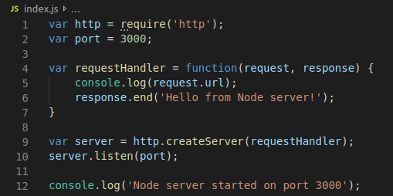
Node Web Server Code

Slide 17
Run the Web Server
To run the web server, do as follows:
From the command prompt (while in the myproject folder) type the following command: node index.js
Now go to a browser and enter the following url: http://localhost:3000
If that does not work, replace the word localhost with your IP address
To stop the web server, go back to the command prompt and press CTRL + C

Slide 18
Node Web Server
Working with the HTTP module directly as shown above in Node can be very time-consuming
For larger web applications we need to use a framework if we want to be more productive
A framework implements for us common functionality that all web applications need
This saves us from having to do it ourselves and thus saving our time
There are a number of frameworks available but the most popular one for Node is Express

Slide 19
Adding Express
We are going now to add two packages to our project: Express and handlebars
Go to the command prompt (inside the myproject folder) and type in the following command:
npm install express --save
Next, also add another package called handlebars which we will use for templating
npm install hbs --save
Change the code inside index.js to the following:

Slide 20
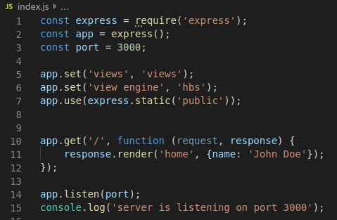
index.js

Slide 21
Templating
To see the templating in action, do the following
Inside the myproject folder, add two sub-directories. One called views and the other called public.
Go inside the directory called public and add a sub-directory called img. Inside the directory img, add an image called logo.png
Go inside the directory called views and add a file called home.hbs
Enter the following code inside home.hbs:

Slide 22
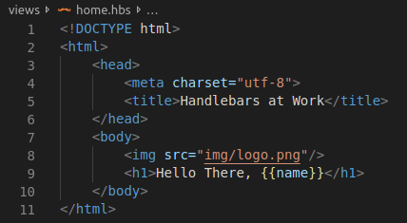
home.hbs

Slide 23
Understanding Templating
For more information on templating and just what kind of things can be done with handlebars, check out the following tutorial
https://webapplog.com/handlebars/

Slide 24
Working with POST
So far we have seen how to work with a GET request
To work with a POST request, do the following:
Add a file in the views directory called contact_us.hbs
Edit the file index.js as shown below:

Slide 25
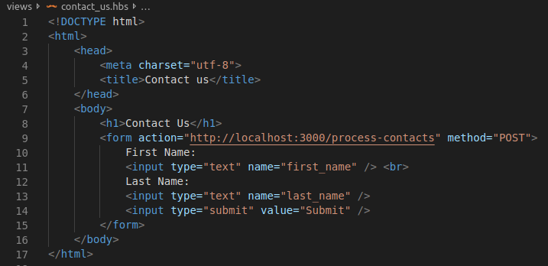
contact_us.hbs

Slide 26
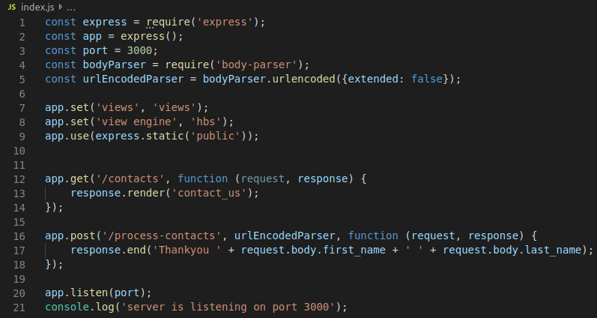
index.js

