Slide 1


Reactive programming in java world
Ihar Nestsiarenia
JANUARY, 2018

Slide 2
Agenda
What is reactive programming and why we need it?
Practical cases
How we can do it with java
Reactive stack of Spring 5

Slide 3

What is reactive programming
and why we need it

Slide 4
What is reactive programming
Reactive Programming is a paradigm in which you use declarative code (in a manner that is similar to functional programming) in order to build asynchronous processing pipelines. It is an event-based model where data is pushed to the consumer, as it becomes available: we deal with asynchronous sequences of events.
Reactive Programming is an asynchronous programming paradigm concerned with and the propagation of change.
Reactive Programming is often conflated with concurrent programming and high performance to such an extent that it’s hard to separate those concepts, when actually they are in principle completely different.
Notes:
Just like object oriented programming, functional programming, or procedural programming, reactive programming is just another programming paradigm.

Slide 5
What is reactive programming
Reactive Programming is a style of micro-architecture involving intelligent routing and consumption of events, all combining to change behavior.
The origins of Reactive Programming can probably be traced to the 1970s or even earlier, so there’s nothing new about the idea, but they are really resonating with something in the modern enterprise.
This resonance has arrived (not accidentally) at the same time as the rise of microservices, and the ubiquity of multi-core processors. Some of the reasons for that will hopefully become clear.

Slide 6
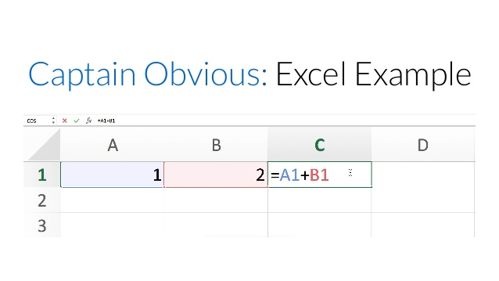
Models "pull" and "push"

Slide 7
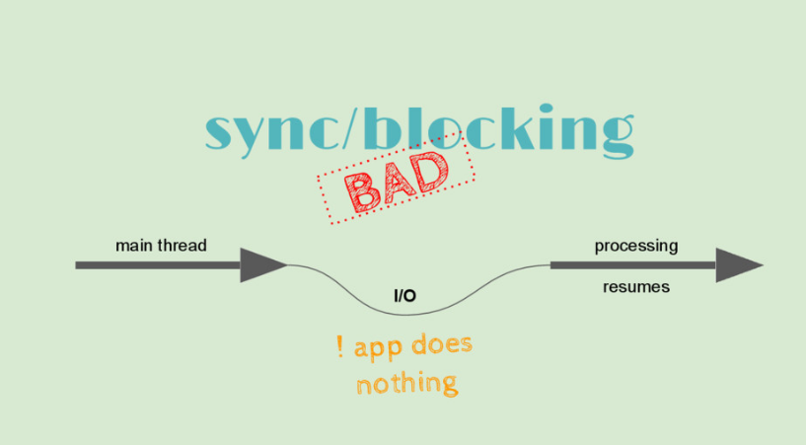
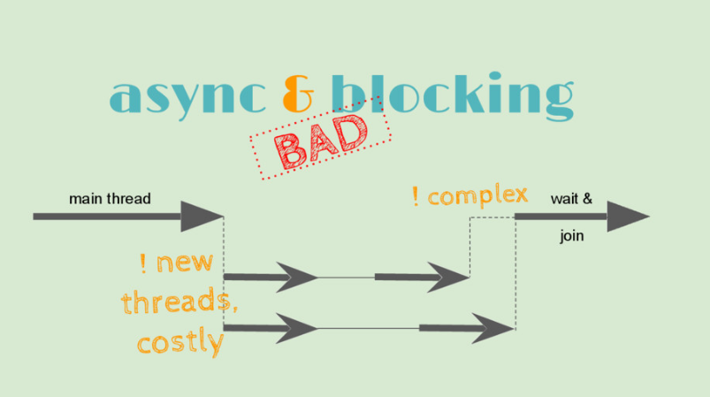
Synchronous and parallel

Slide 8
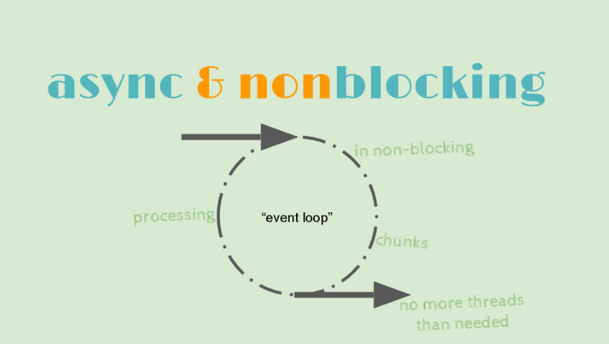
Async/Event loop

Slide 9
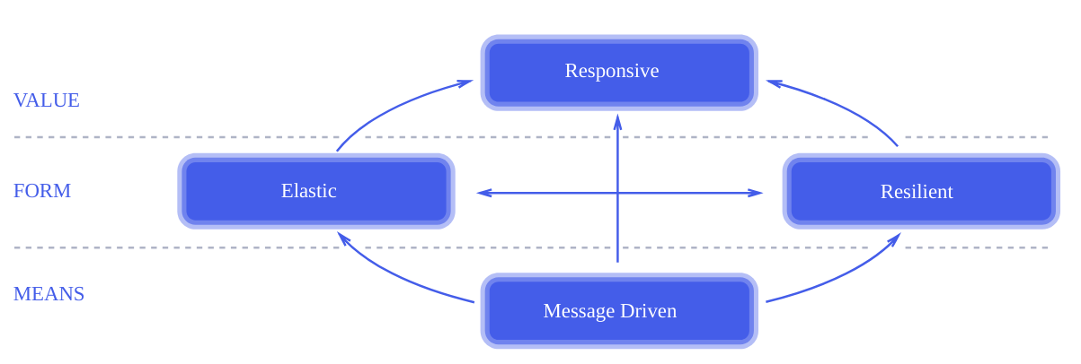
The Reactive Manifesto
https://www.reactivemanifesto.org/
Notes:
we want systems that are Responsive, Resilient, Elastic and Message Driven. We call these Reactive Systems. Systems built as Reactive Systems are more flexible, loosely-coupled and scalable. This makes them easier to develop and amenable to change.

Slide 10
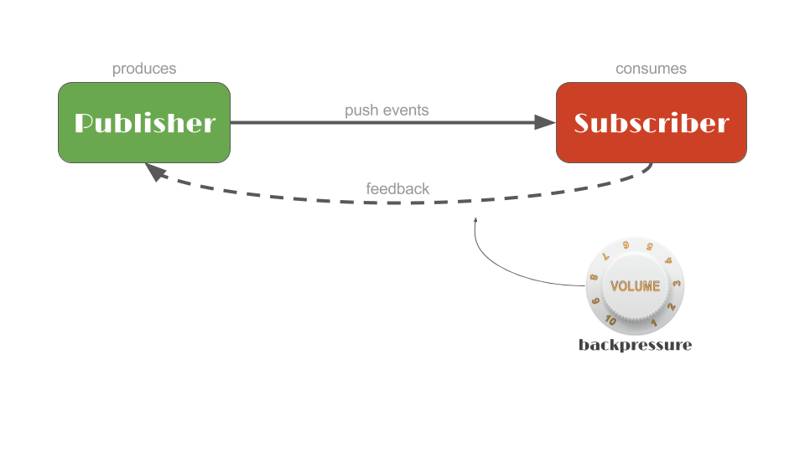
Message Driven

Slide 11
Glossary
Asynchronous
Back-Pressure
Batching
Component
Delegation
Elasticity (in contrast to Scalability)
Failure (in contrast to Error)
Isolation (and Containment)
Location-Transparency
Message-Driven (in contrast to Event-Driven)
Non-Blocking
Protocol
Replication
Resource
Scalability
System
User

Slide 12
Practical cases

Slide 13
Reactive Use Cases
External Service Calls
Highly Concurrent Message Consumers
Spreadsheets
Abstraction Over (A)synchronous Processing

Slide 14
Similar concepts
Ruby Event-Machine
Actor Model
Deferred results (Futures)
Map-reduce and fork-join
Coroutines

Slide 15
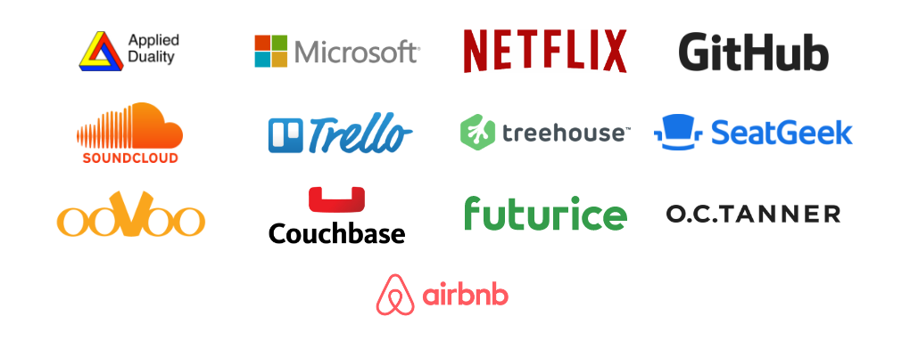
Who use ReactiveX

Slide 16
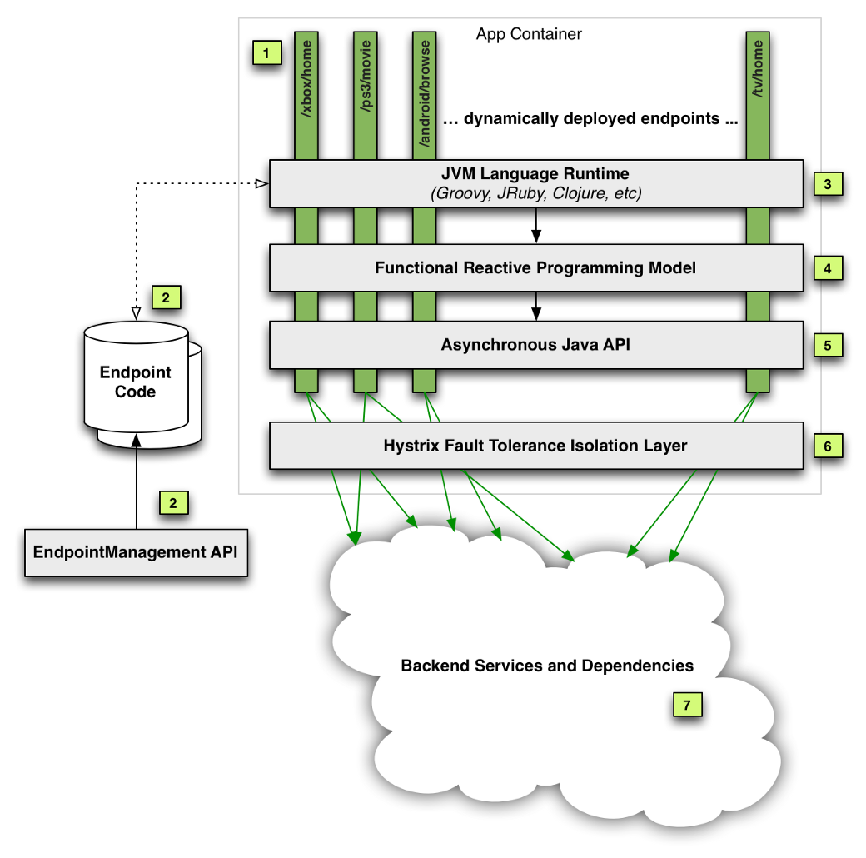

Netflix
Reactive-programming-in-the-netflix-api-with-rxjava
Netflix-techblog/optimizing-the-netflix-api

Slide 17
Why Reactive Programming? (1/2)
Simpler code, making it more readable.
Abstracts away from boiler plate code to focus on business logic.
Abstracts away from low-level threading, synchronization, and concurrency issues.
Stream processing implies memory efficient
The model can be applied almost everywhere to solve almost any kind of problem.

Slide 18
Why Reactive Programming? (2/2)
The key expected benefit of reactive and non-blocking is the ability to scale with a small, fixed number of threads and less memory.
That makes applications more resilient under load because they scale in a more predictable way.
In order to observe those benefits however you need to have some latency including a mix of slow and unpredictable network I/O.

Slide 19
How we cad do it with java

Slide 20
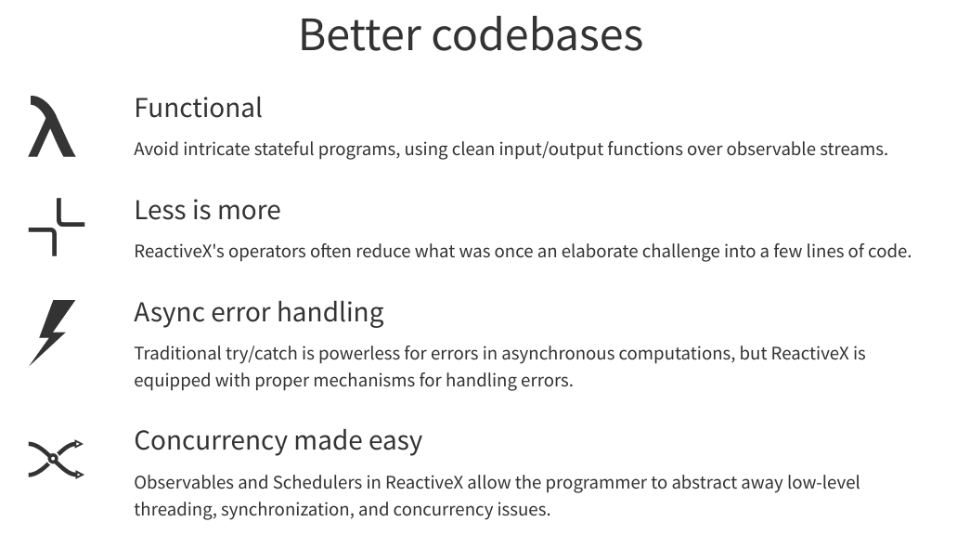
ReactiveX
http://reactivex.io/

Slide 21
Languages and platforms
RxNetty,
RxAndroid,
RxCocoa
Java: RxJava,
JavaScript: RxJS,
C#: Rx.NET,
C#(Unity): UniRx,
Scala: RxScala,
Clojure: RxClojure,
C++: RxCpp, Lua: RxLua,
Ruby: Rx.rb,
Python: RxPY,
Go: RxGo,
Groovy: RxGroovy,
JRuby: RxJRuby,
Kotlin: RxKotlin,
Swift: RxSwift,
PHP: RxPHP,
Elixir: reaxive,
Dart: RxDart

Slide 22





Java and Reactive Programming (1/2)
The Reactive Streams specification is an industry-driven effort to standardize Reactive Programming libraries on the JVM, and more importantly specify how they must behave so that they are interoperable.
Implementers include:
Reactor 3 (projectreactor.io)
RxJava 2 (github.com/ReactiveX/RJava)
Akka Streams (akka.io/)
Vert.x (vertx.io)
Ratpack (ratpack.io/)

Slide 23
Java and Reactive Programming (2/2)
By being built around the core pillars of being fully asynchronous and non-blocking, Reactive Programming is an alternative to the more limited ways of doing asynchronous code in the JDK: namely Callback based APIs and Future.
This is important in order to be more efficient with resources and increase an application's capacity to serve large number of clients, without the headache of writing low-level concurrent or and/or parallelized code.

Slide 24
Reactive stack of Spring 5

Slide 25
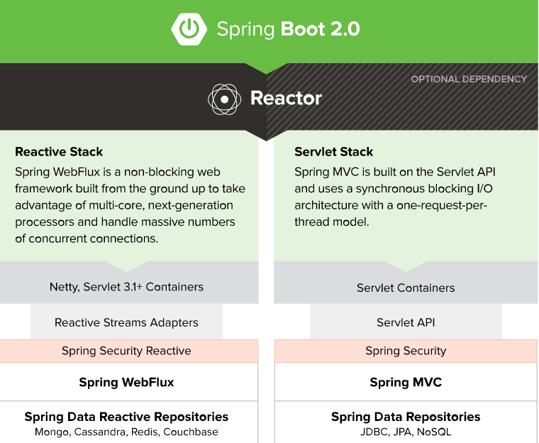
Spring Boot 2
Reactive stack, web applications built on a Reactive Streams API to run on non-blocking servers such as Netty, Undertow, and Servlet 3.1+ containers.
Reactor is a fourth-generation Reactive library for building non-blocking applications on the JVM based on the Reactive Streams Specification

Slide 26
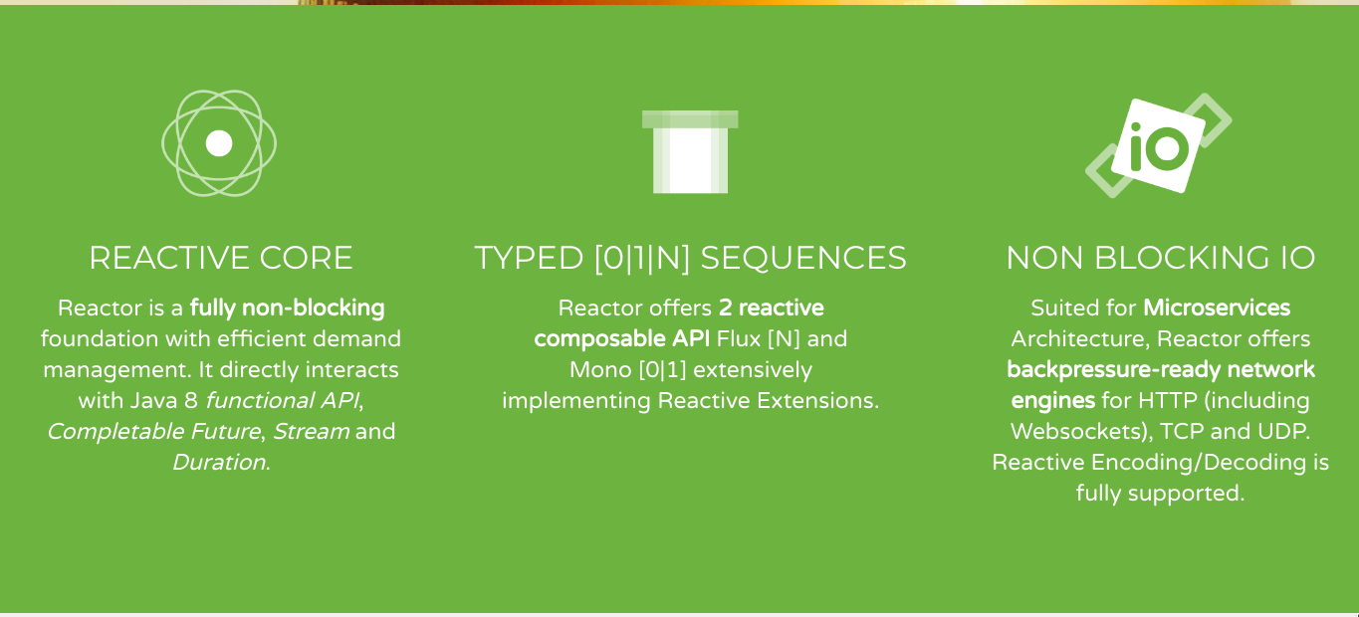
Project Reactor
Notes:
Reactor 3 is a library built around the Reactive Streams specification, bringing the paradigm of Reactive Programming on the JVM. The Spring MVC RestTemplate class is, by nature, blocking. Consequently, we don’t want to use it in a reactive application. For reactive applications, Spring offers the WebClient class, which is non-blocking.

Slide 27
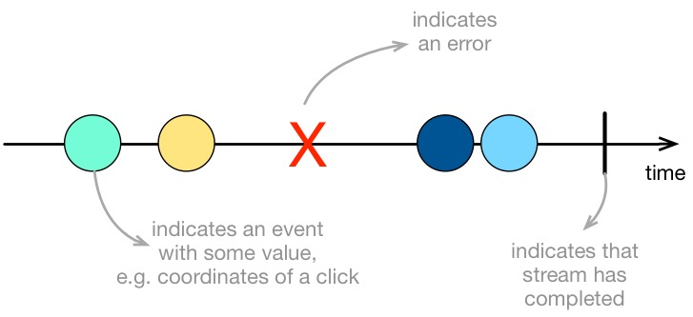
What is reactive streams
A Flux<T> and Mono<T> is a Reactive Streams Publishers

Slide 28
Flux in action
Flux.fromIterable(getSomeLongList()) .delayElements(Duration.ofMillis(100)) .doOnNext(serviceA::someObserver) .map(d -> d * 2) .take(3) .onErrorResumeWith(errorHandler::fallback) .doAfterTerminate(serviceM::incrementTerminate) .subscribe(System.out::println);
Notes:
In imperative synchronous code, it's easy to manage exceptions with familiar try-catch blocks, throw instructions...

Slide 29
Testing
@Autowired private WebTestClient webTestClient;
@Test public void testHello() { webTestClient // Create a GET request to test an endpoint .get().uri("/hello") .accept(MediaType.TEXT_PLAIN) .exchange() // and use the dedicated DSL to test assertions against the response .expectStatus() .isOk() .expectBody() .equals("Hello,Spring!"); }

Slide 30
Additional resources
Reactive streams in java
RxJava wiki
Playground Reactive Programming with reactor 3
Reactivex operators
Reactive Gems
Reactive streams in java 9

Slide 31
Demo

Slide 32



Q/A
: @nesterione
: Ihar Nestsiarenia

