Slide 1
Computer Programming Project 1

Slide 2
Project 1
Write a program “Dice Rolling Game”
Project guideline is as follows :

Slide 3
Dice Rolling Game
Functions
Dice Rolling Game with a computer
Betting user’s cash
& Recording history of game results

Slide 4
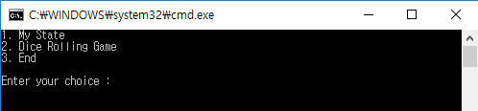
Main Menu
Firstly, the program shows a main menu.
It should include “1. My State”,
“2. Dice Rolling Game” and “3. End”.

Slide 5
Main Menu
* Program should receive an integer number only among 1, 2 and 3. Otherwise, it should receive a number again.

Slide 6
1. My State
If a user selects “1. My State”(input number 1) menu, the program shows the user’s state including current cash, the record of how many times he “wins” and “loses”.
(At first, the user has 100,000 won and the initial score is 0.)
The program goes back to main menu by entering any key.

Slide 7

1. My State

Slide 8
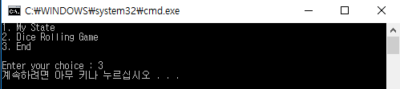
3. End
If the user selects “3. End”(input number 3), the program ends.

Slide 9
2. Dice Rolling Game
If the user selects “2. Dice Rolling Game”(input number 2), the program shows user’s current cash and starts the game.

Slide 10
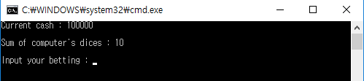
Rules of Dice Rolling Game
Rules of Dice Rolling Game
It consists of 3 dices.
First, a computer randomly rolls three dices and shows only the sum of them to the console.

Slide 11
Rules of Dice Rolling Game
After user bets some amount of cash, he then rolls three dices. In this case, the sum of dices must be equal to computer’s.
* for instance, The computer shows 15 to the users, the user can generate (4, 5, 6) or (3, 6, 6) or else.

Slide 12
Rules of Dice Rolling Game
4) Then, the program gives three options to the user
- 1. Rolling dices again (Type any key)
- 2. Start game (Type esc key)
- 3. Surrender (Type ‘s’ key)

Slide 13
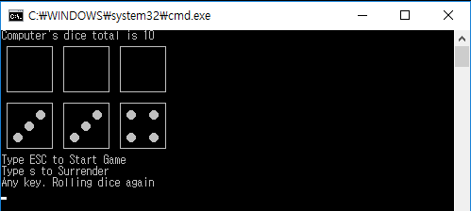
Rules of Dice Rolling Game

Slide 14
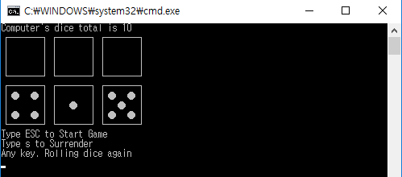
Rules of Dice Rolling Game
If the user selects “Rolling dices again”, he receives another three random dice values, the sum which is equal to computer’s. previously rolled dices are removed from the screen.

Slide 15
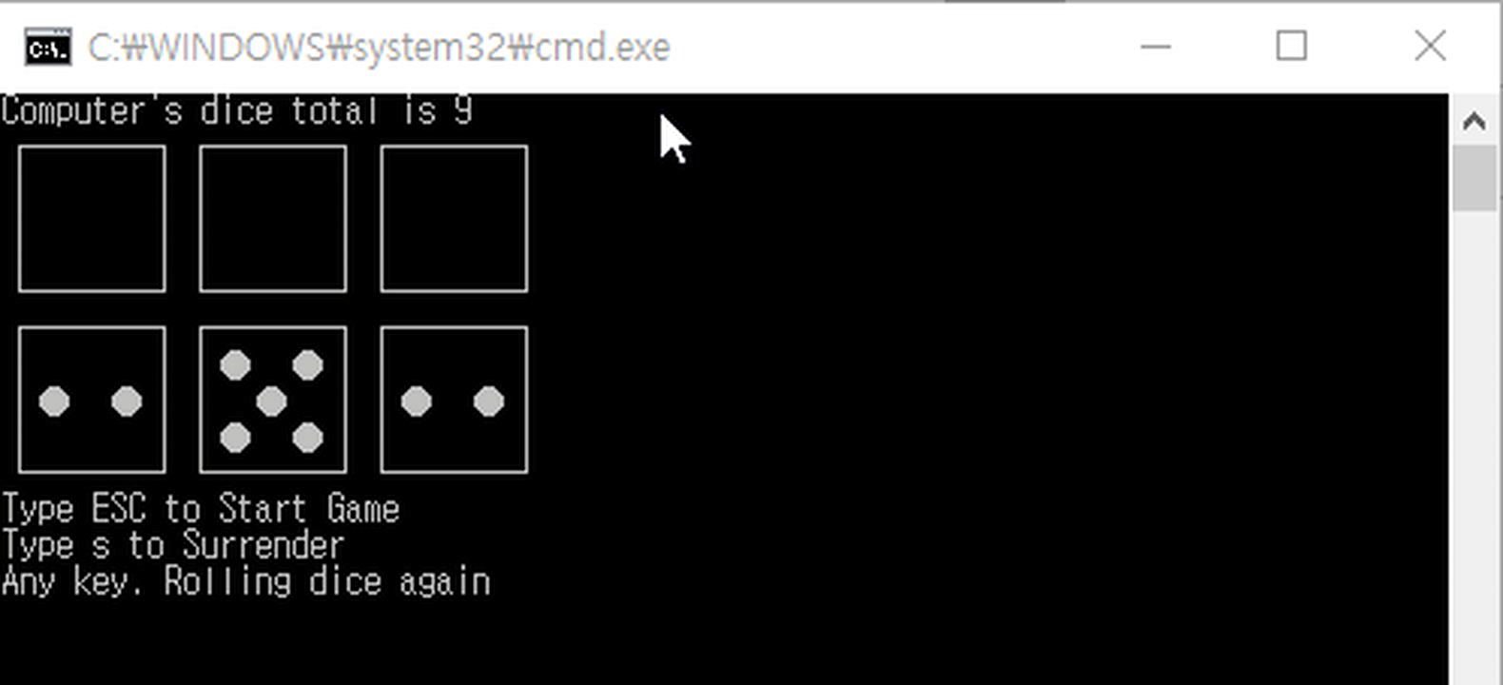
Rules of Dice Rolling Game
If the user selects “Start Game”, the program displays it’s three dices values like below figure.

Slide 16
Rules of Dice Rolling Game
Then, the program should decide who wins the game. It compares each value of dices. If the user wins more than two stages, the user finally wins the game. However, some of stages can be ended with draw. In this case, the user loses.
For instance,
Com (2, 6, 3) vs User (4, 4, 3) => result (W, L, L) Therefore, finally Lose
Com (2, 6, 3) vs User (3, 2, 6) => result (W, L, W) Therefore, finally WIN
Com (2, 6, 3) vs User (6, 4, 1) => result (W, L, L) Therefore, finally LOSE

Slide 17
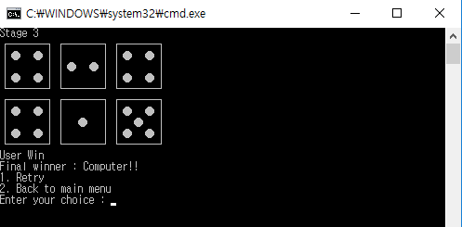
Rules of Dice Rolling Game
If the user selects “3. Surrender”, the user immediately loses and also loses 5,000 cash
If the game is ended, the program shows the result and gives two options
- 1. Retry
- 2. Back to main menu.

Slide 18
Rules of Dice Rolling Game
If the user selects “1. Retry”, program restarts the game. And if the user selects “2. Back to main menu”, the program shows main menu.

Slide 19
Calculating cash
If a user finally win the game,
1) he can get double the cash he bet
If a user finally lose the game,
1) he loses the cash
In both cases, program should record the score to “My state”

Slide 20
Exception
Any exceptions must be handled like invalid inputs.

Slide 21
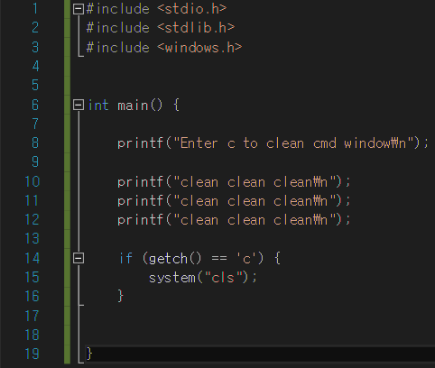
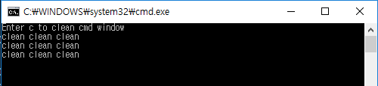
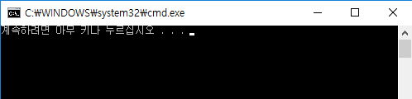
Hint : Window API
When you want to clean CMD, you can use
system(“cls”);. windows.h includes this function.
Type c

Slide 22
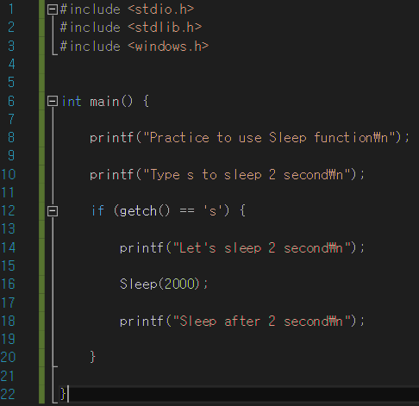
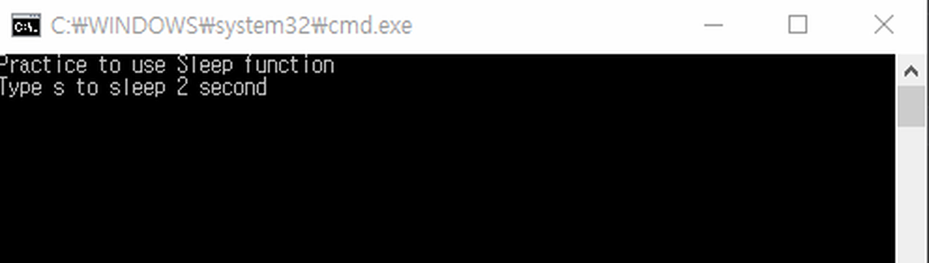
Hint : Window API
When you want to delay program for some times, you can use Sleep(time). windows.h includes this function.

Slide 23
drawDice
We provide “drawDice” function for your convenience
Function takes two arguments, i.e., 5 procedures to draw dice and the value of the throw

Slide 24
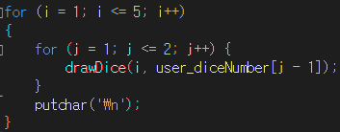
drawDice
DrawDice prototype
void drawDice(int _i, int _number);
int_i : 5 procedures to draw number
int_number : value of the throw
For example, if you want to draw 2 dices and values of throws are 4 and 5,
user_diceNumber[0] = 4
user_diceNumber[1] = 5

