Slide 1

The Terminators
Killing the Markets with our A.I Bot
Matt Hennis, Nestor Ramirez, Brett Hudson, Victor Ng

Slide 2
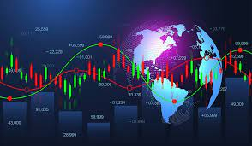
Summary
Analyze the FOREX Markets.
We created a Bot using Trality cloud services.
The Bot was programmed to analyze candlesticks from historical data on the FOREX.
Shooting star and hammer patterns were programmed into the Bot to train it to look for these patterns for our buy & sell signals.
FOREX WORLD MARKETS

Slide 3

How it Relates to Fintech
The efficacy of machine learning
Utilizes Trality cloud Services
Coding to find patterns in a Data Frame for predictive trades

Slide 4

Project Goals
Download data from yfinance for the FOREX
Specifically look at the performance of the OHLCV for the Euro, Japanese Yen, British Pound, and US Dollar
Test our Bot on the different currency data & see on which one it is most effective.

Slide 5
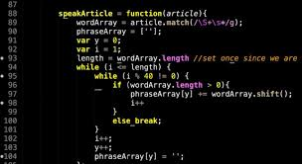
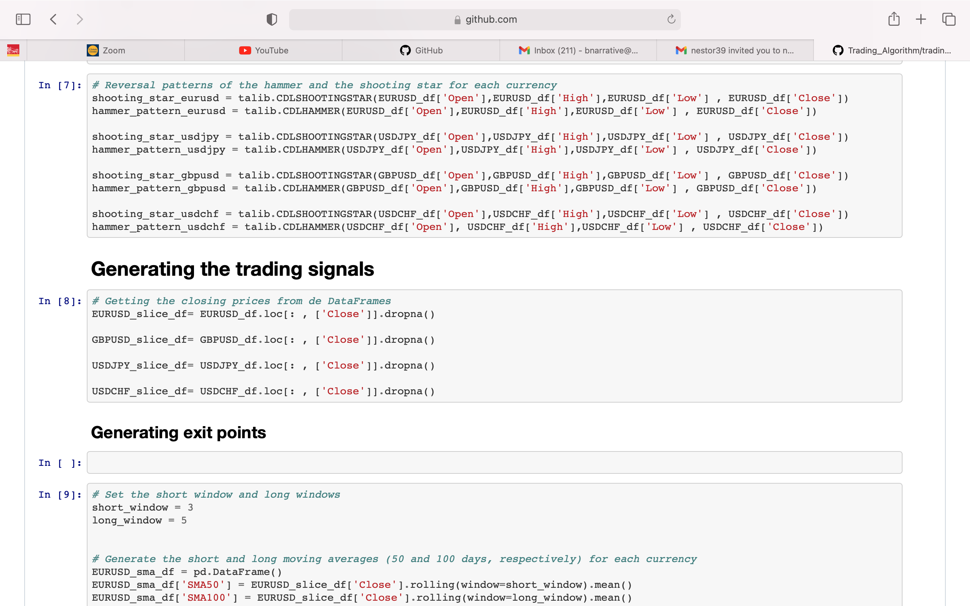
Computer Code Demonstration
Trading Bot
Techniques used
Unanticipated problems or Insights

Slide 6

Trality Trading Bot Demonstration

Slide 7
What We Saw in the Application of the Bot
Results:
The EURUSD & the USDJPY had the highest returns.
The GBPUSD has the lowest daily return
Standard Deviation: USDJPY has the highest volatility, while the USDCHF has the lowest.

Slide 8
Next Steps/Lessons Learned
Apply it to cryptocurrency
Program in other buy and sell markers
The importance of the coding

