Slide 1

The Terminators
Killing the Markets with our A.I Algorithm
Matt Hennis, Nestor Ramirez, Brett Hudson, Victor Ng

Slide 2
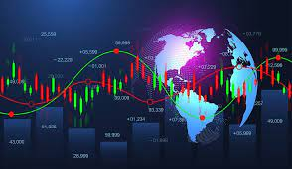
Summary
Analyze the FOREX Markets.
We created a Algorithm using Trality cloud services and Python.
The algorithm was programmed to analyze candlesticks from historical data on the FOREX.
Shooting star and hammer patterns were programmed into the algorithm to train it to look for these patterns for our buy & sell signals.
FOREX WORLD MARKETS

Slide 3

How it Relates to Fintech
The efficacy of machine learning
Utilizes Trality cloud Services
Coding to find patterns in a Data Frame for predictive trades

Slide 4
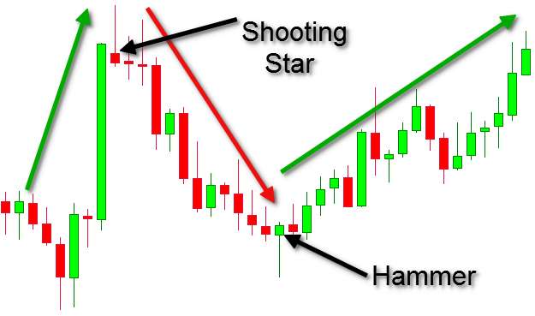
Japanese Candlestick
Originated in Japan over 100 years before the West developed the bar and point-and-figure charts.
Candlesticks show that emotion by visually representing the size of price moves with different colors.

Slide 5
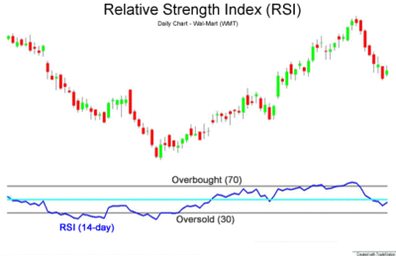

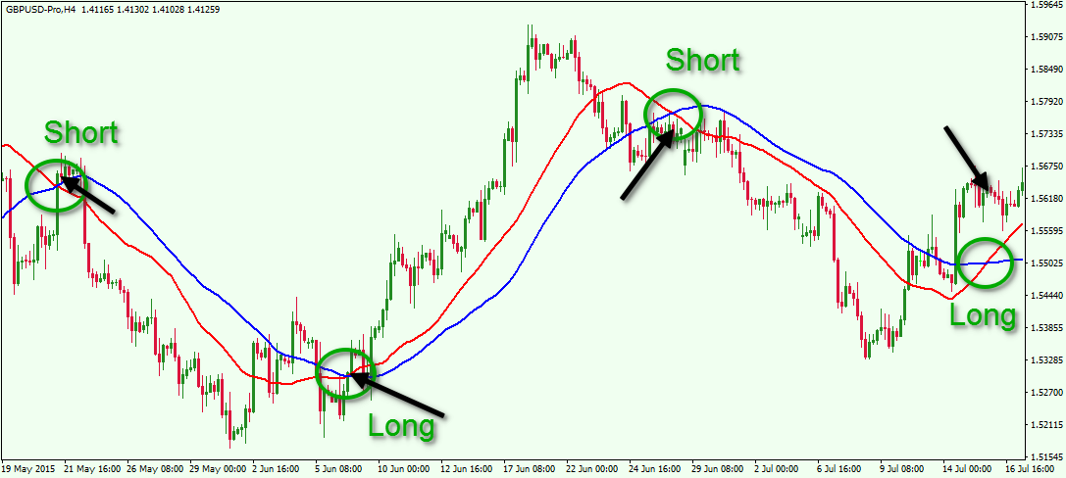

Indicators
Relative Strengh Index(RSI): It is a momentum indicator used in technical analysis that measures the magnitude of recent price changes to evaluate overbought or oversold conditions in the price of a asset.
Simple Moving Averages (SMA): moving average is a calculation used to analyze data points by creating a series of averages of different subsets of the full data set.
It helps to smooth out the price data by creating a constantly updated average price.

Slide 6

Project Goals
Download data from yfinance for the FOREX
Specifically look at the performance of the OHLC for the Euro, Japanese Yen, British Pound, and US Dollar
Test our algorithm on the different currency data & see on which one it is most effective.

Slide 7
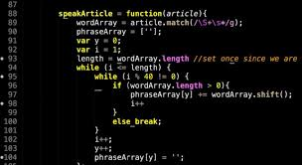
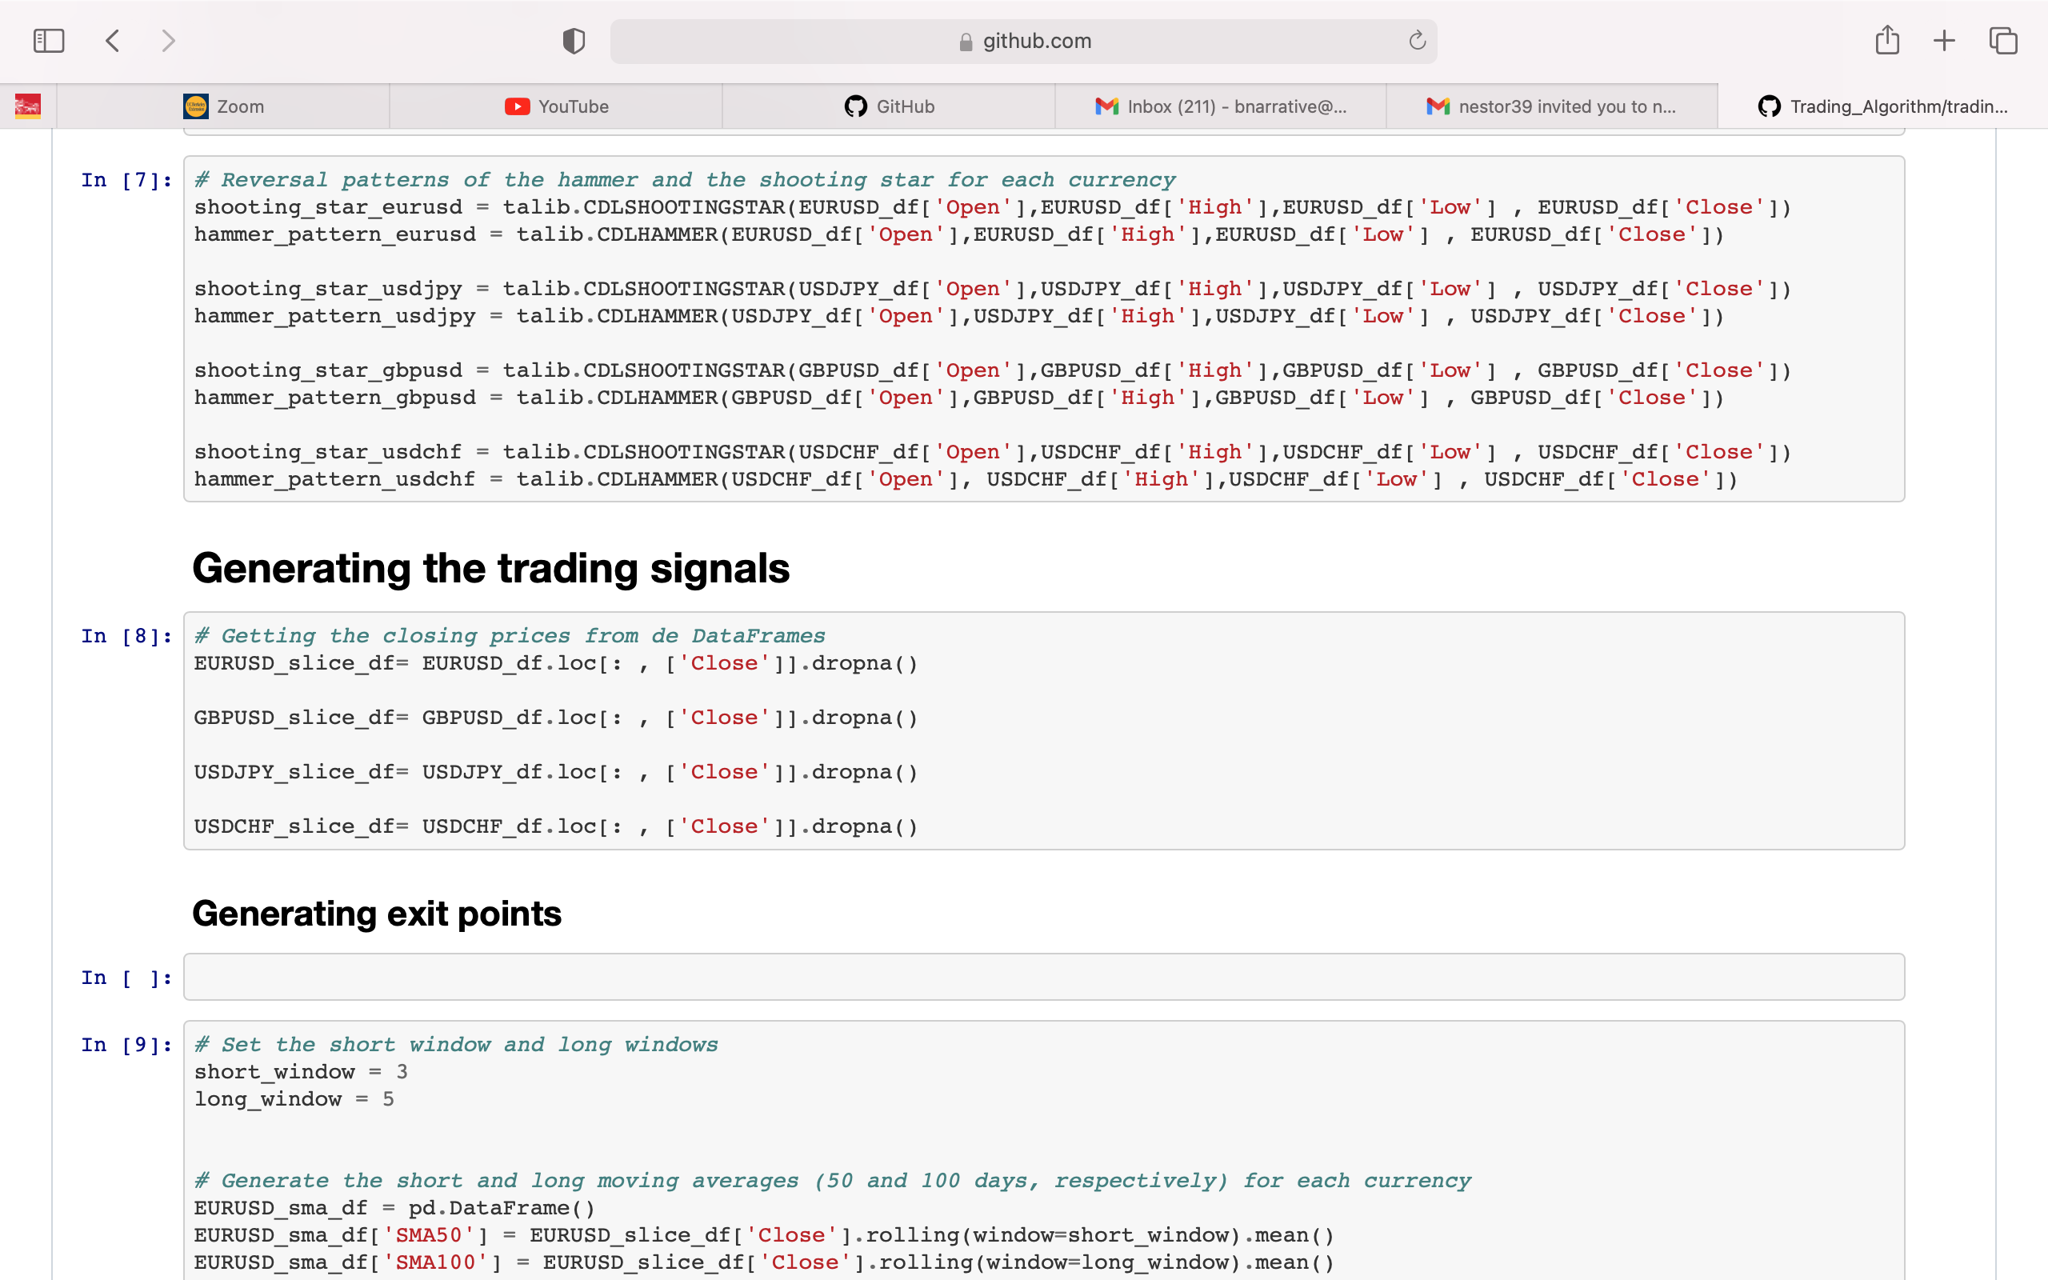
Computer Code Demonstration
Trading Algorithm
Techniques used
Unanticipated problems or Insights

Slide 8
What We Saw in the Application of the Algorithm
Results:
The EURUSD & the USDJPY had the highest returns.
The GBPUSD has the lowest daily return
Standard Deviation: USDJPY has the highest volatility, while the USDCHF has the lowest.

Slide 9
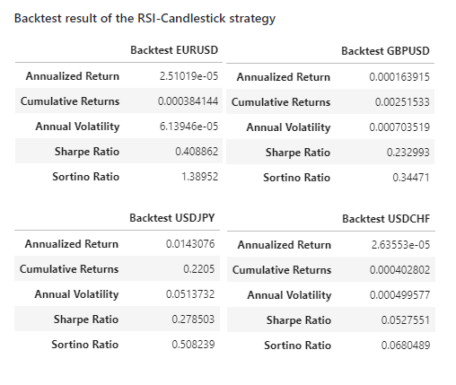
What We Saw in the Application of the Algorithm

Slide 10

Trality Trading Algorithm Demonstration

Slide 11
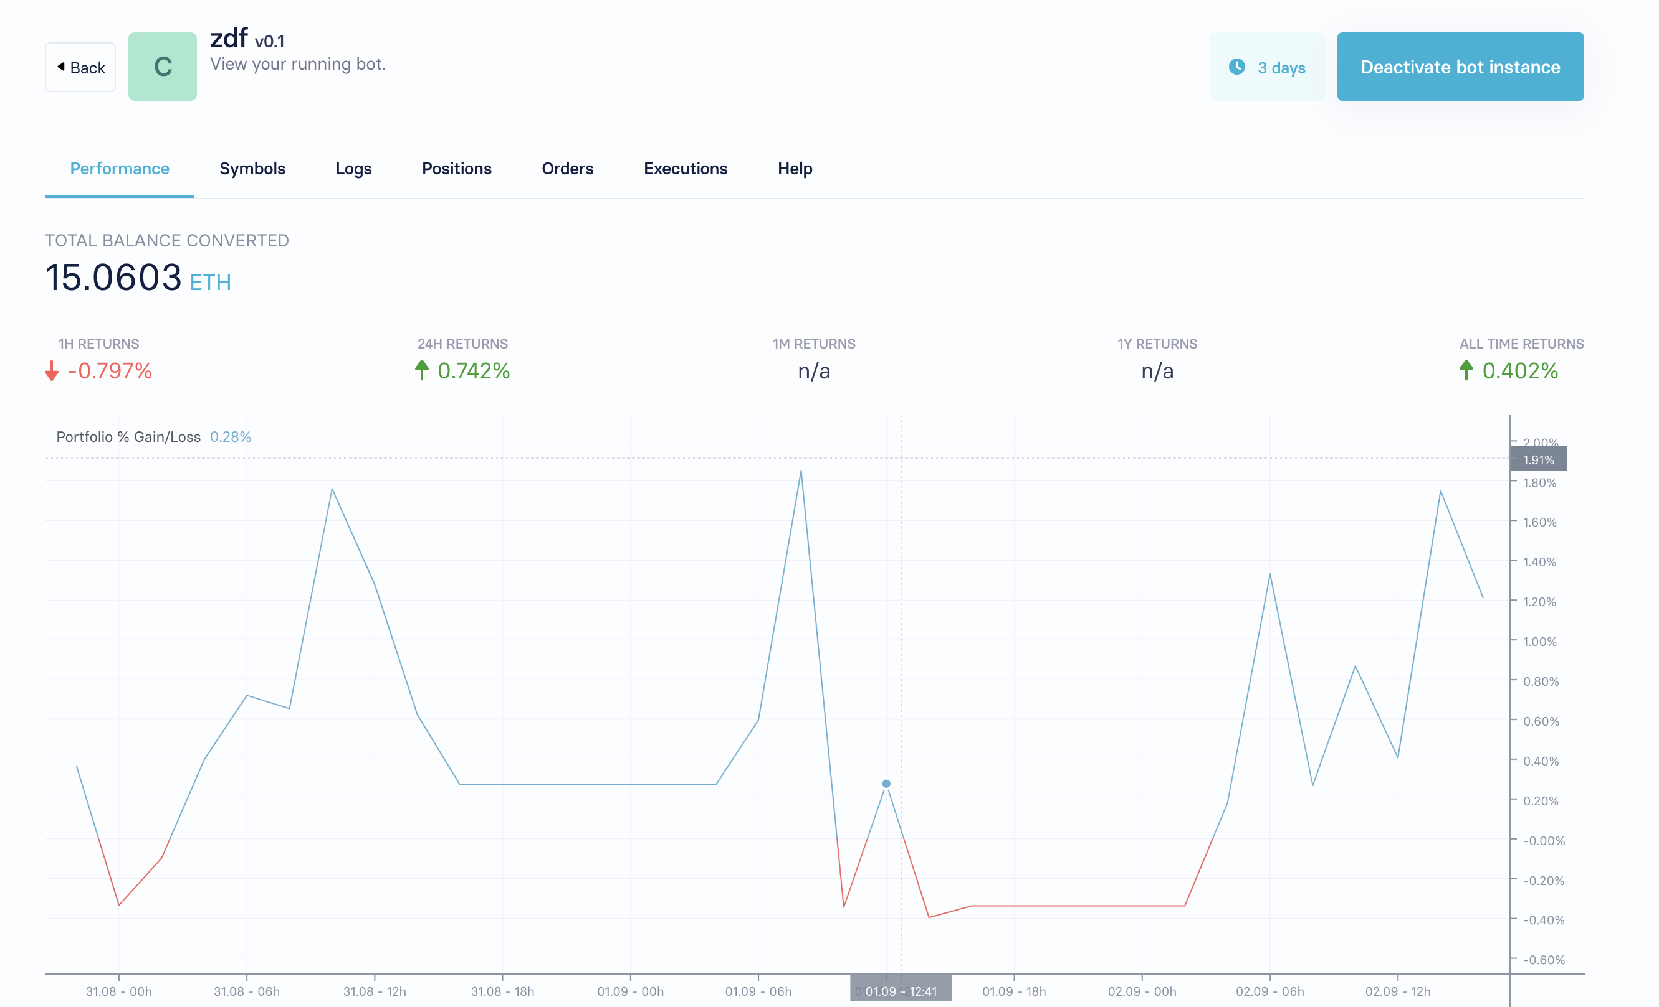
What We Saw in the Application of the Algorithm

Slide 12
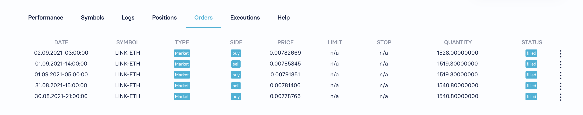
What We Saw in the Application of the Algorithm

Slide 13
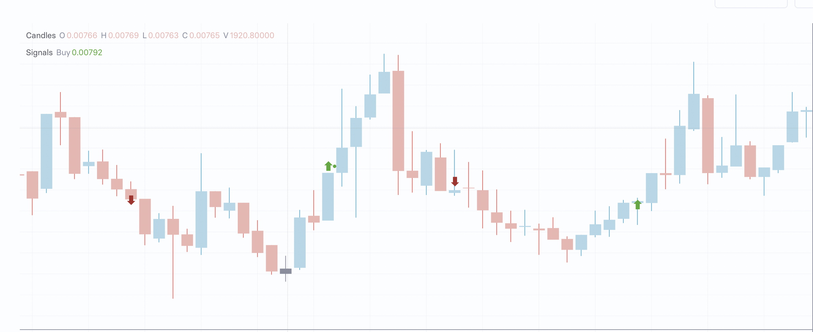
What We Saw in the Application of the Algorithm

Slide 14
Next Steps/Lessons Learned
Program in other buy and sell markers
The importance of the coding
Automatization of the ForEx algorithm

