Slide 1
A tabu search algorithm for the min-max k-Chinese postman problem
Dino Ahr, Gerhard Reinelt*
Computers & Operations Research 33 (2006) 3403–3422
報告人: 陳政謙

Slide 2
Outline
The min-max k-Chinese postman problem
Merging and separating edges
Improving tours
The tabu search algorithm
Computational results

Slide 3
k-Chinese postman tour
For a given graph G=(V, E), k-Chinese postman tour is k closed walks(tours) which each tour starts and ends at the depot node and each edge e ∈ E is covered by at least one tour.
13
v₂
v₅
10
2
1
38
8
7
v₆
7
8
v₁
v₃
v₄
v₈
1
26
1
2
24
27
v₇

Slide 4
k-Chinese postman tour
For a given graph G=(V, E), k-Chinese postman tour is k closed walks(tours) which each tour starts and ends at the depot node and each edge e ∈ E is covered by at least one tour.
13
v₂
v₅
10
2
1
38
8
7
v₆
7
8
v₁
v₃
v₄
v₈
1
26
1
2
24
depot node = v₁
27
v₇

Slide 5
k-Chinese postman tour
For a given graph G=(V, E), k-Chinese postman tour is k closed walks(tours) which each tour starts and ends at the depot node and each edge e ∈ E is covered by at least one tour.
13
v₂
v₅
10
2
1
38
8
7
v₆
7
8
v₁
v₃
v₄
v₈
1
26
1
2
24
depot node = v₁
27
k = 2
v₇

Slide 6
k-Chinese postman tour
For a given graph G=(V, E), k-Chinese postman tour is k closed walks(tours) which each tour starts and ends at the depot node and each edge e ∈ E is covered by at least one tour.
13
v₂
v₅
10
2
1
38
8
7
v₆
7
8
v₁
v₃
v₄
v₈
1
26
1
2
24
depot node = v₁
27
k = 2
v₇

Slide 7
k-Chinese postman tour
For a given graph G=(V, E), k-Chinese postman tour is k closed walks(tours) which each tour starts and ends at the depot node and each edge e ∈ E is covered by at least one tour.
13
v₂
v₅
10
2
1
38
8
7
v₆
7
8
v₁
v₃
v₄
v₈
1
26
1
2
24
depot node = v₁
27
k = 2
v₇

Slide 8
The min-max k-Chinese postman problem
The aim for the min-max k-Chinese postman problem (MM k-CPP) is to minimize the length of the longest tour of k-Chinese postman tour.
13
v₂
v₅
10
2
1
38
8
7
v₆
7
8
v₁
v₃
v₄
v₈
1
26
1
2
24
27
v₇

Slide 9
The min-max k-Chinese postman problem
The aim for the min-max k-Chinese postman problem (MM k-CPP) is to minimize the length of the longest tour of k-Chinese postman tour.
13
v₂
v₅
10
2
1
38
8
7
v₆
7
8
v₁
v₃
v₄
v₈
1
26
1
2
24
C₁:
27
v₇

Slide 10
The min-max k-Chinese postman problem
The aim for the min-max k-Chinese postman problem (MM k-CPP) is to minimize the length of the longest tour of k-Chinese postman tour.
13
v₂
v₅
10
2
1
38
8
7
v₆
7
8
v₁
v₃
v₄
v₈
1
26
1
2
24
C₁:
27
C₂:
v₇

Slide 11
The min-max k-Chinese postman problem
The aim for the min-max k-Chinese postman problem (MM k-CPP) is to minimize the length of the longest tour of k-Chinese postman tour.
13
v₂
v₅
10
2
1
38
8
7
v₆
7
8
v₁
v₃
v₄
v₈
1
26
1
2
24
C₁:
w(C₁) = 107
27
C₂:
v₇

Slide 12
The min-max k-Chinese postman problem
The aim for the min-max k-Chinese postman problem (MM k-CPP) is to minimize the length of the longest tour of k-Chinese postman tour.
13
v₂
v₅
10
2
1
38
8
7
v₆
7
8
v₁
v₃
v₄
v₈
1
26
1
2
24
C₁:
w(C₁) = 107
27
C₂:
w(C₂) = 78
v₇

Slide 13
The min-max k-Chinese postman problem
The aim for the min-max k-Chinese postman problem (MM k-CPP) is to minimize the length of the longest tour of k-Chinese postman tour.
13
v₂
v₅
10
2
1
38
8
7
v₆
7
8
v₁
v₃
v₄
v₈
1
26
1
2
24
C₁:
w(C₁) = 107
27
C₂:
w(C₂) = 78
v₇
The maximum weight is 107

Slide 14
The min-max k-Chinese postman problem
The aim for the min-max k-Chinese postman problem (MM k-CPP) is to minimize the length of the longest tour of k-Chinese postman tour.
13
v₂
v₅
10
2
1
38
8
7
v₆
7
8
v₁
v₃
v₄
v₈
1
26
1
2
24
C₁:
w(C₁) = 93
27
C₂:
w(C₂) = 94
v₇
The maximum weight is 94

Slide 15
Merging and separating edges
Two Algorithms
SeparateWalkFromTour
MergeWalkWithTour

Slide 16

Algorithm: SeparateWalkFromTour
Input: The tour C_{i} and the walk H to be separated.
Output: The tour represents a feasible tour formed from the remaining of edges of C_{i} after removing edges from H and possibly additional edges needed to re-establish feasibility.

Slide 17
Algorithm: SeparateWalkFromTour
Step1: Let u and v be the endnodes of H (u = v is possible). Check whether the depot node v₁ is an internal node of H.
13
v₂
v₅
10
2
1
38
8
7
v₆
7
8
v₁
v₃
v₄
v₈
1
26
1
2
24
C₁:
C₂:
27
v₇

Slide 18
Algorithm: SeparateWalkFromTour
Step1: Let u and v be the endnodes of H (u = v is possible). Check whether the depot node v₁ is an internal node of H.
13
u = v₄
v₂
v₅
10
2
1
38
8
7
v₆
7
8
v₁
v₃
v₄
v₈
1
26
1
2
24
C₁:
C₂:
27
v₇

Slide 19
Algorithm: SeparateWalkFromTour
Step1: Let u and v be the endnodes of H (u = v is possible). Check whether the depot node v₁ is an internal node of H.
13
u = v₄
v₂
v₅
10
2
1
38
8
7
v₆
7
8
v₁
v₃
v₄
v₈
1
26
1
2
24
C₁:
C₂:
H:
27
v₇

Slide 20
Algorithm: SeparateWalkFromTour
Step1: Let u and v be the endnodes of H (u = v is possible). Check whether the depot node v₁ is an internal node of H.
13
u = v₄
v₂
v₅
10
2
1
38
8
7
v₆
7
8
v₁
v₃
v₄
v₈
1
26
1
2
24
C₁:
C₂:
H:
27
v₇

Slide 21
Algorithm: SeparateWalkFromTour
Step1: Let u and v be the endnodes of H (u = v is possible). Check whether the depot node v₁ is an internal node of H.
13
u = v₄
v₂
v₅
10
2
v = v₈
1
38
8
7
v₆
7
8
v₁
v₃
v₄
v₈
1
26
1
2
24
C₁:
C₂:
H:
27
v₇

Slide 22
Algorithm: SeparateWalkFromTour
Step1: Let u and v be the endnodes of H (u = v is possible). Check whether the depot node v₁ is an internal node of H.
13
u = v₄
v₂
v₅
10
2
v = v₈
1
38
8
7
v₆
7
8
v₁
v₃
v₄
v₈
1
26
1
2
24
C₁:
C₂:
H:
27
v₁ is not an internal node of H.
v₇

Slide 23
Algorithm: SeparateWalkFromTour
Step2: Remove all edges of H from C_{i} to yield Ĉ_{i}. Check whether the depot node v₁ is contained in Ĉ_{i}.
13
u = v₄
v₂
v₅
10
2
v = v₈
1
38
8
7
v₆
7
8
v₁
v₃
v₄
v₈
1
26
1
2
24
C₁:
C₂:
H:
27
v₇

Slide 24
Algorithm: SeparateWalkFromTour
Step2: Remove all edges of H from C_{i} to yield Ĉ_{i}. Check whether the depot node v₁ is contained in Ĉ_{i}.
13
u = v₄
v₂
v₅
10
2
v = v₈
1
38
8
7
v₆
7
8
v₁
v₃
v₄
v₈
1
26
1
2
24
C₁:
C₂:
H:
27
v₇

Slide 25
Algorithm: SeparateWalkFromTour
Step2: Remove all edges of H from C_{i} to yield Ĉ_{i}. Check whether the depot node v₁ is contained in Ĉ_{i}.
13
u = v₄
v₂
v₅
10
2
v = v₈
1
38
8
7
v₆
7
8
v₁
v₃
v₄
v₈
1
26
1
2
24
C₁:
C₂:
H:
27
v₇

Slide 26
Algorithm: SeparateWalkFromTour
Step2: Remove all edges of H from C_{i} to yield Ĉ_{i}. Check whether the depot node v₁ is contained in Ĉ_{i}.
13
u = v₄
v₂
v₅
10
2
v = v₈
1
38
8
7
v₆
7
8
v₁
v₃
v₄
v₈
1
26
1
2
24
Ĉ₁:
C₂:
H:
27
v₇

Slide 27
Algorithm: SeparateWalkFromTour
Step2: Remove all edges of H from C_{i} to yield Ĉ_{i}. Check whether the depot node v₁ is contained in Ĉ_{i}.
13
u = v₄
v₂
v₅
10
2
v = v₈
1
38
8
7
v₆
7
8
v₁
v₃
v₄
v₈
1
26
1
2
24
Ĉ₁:
C₂:
H:
27
v₁ is contained in Ĉ₁.
v₇

Slide 28
Algorithm: SeparateWalkFromTour
Step3: We have to consider two cases when we connect u and v:
If v₁ is an internal node of H and v₁ is not contained in Ĉ_{i} , then we let evolves from Ĉ_{i} by connecting u and v with SP(u, v₁), SP(v₁, v).
Otherwise we let evolves from Ĉ_{i} by connecting u and v with SP(u, v).
13
u = v₄
v₂
v₅
10
2
v = v₈
1
38
8
7
v₆
7
8
v₁
v₃
v₄
v₈
1
26
1
2
24
Ĉ₁:
C₂:
H:
27
v₇

Slide 29
Algorithm: SeparateWalkFromTour
Step3: We have to consider two cases when we connect u and v:
If v₁ is an internal node of H and v₁ is not contained in Ĉ_{i} , then we let evolves from Ĉ_{i} by connecting u and v with SP(u, v₁), SP(v₁, v).
Otherwise we let evolves from Ĉ_{i} by connecting u and v with SP(u, v).
13
u = v₄
v₂
v₅
10
2
v = v₈
1
38
8
7
v₆
7
8
v₁
v₃
v₄
v₈
1
26
1
2
24
Ĉ₁:
C₂:
H:
27
v₇

Slide 30

Algorithm: MergeWalkWithTour
Input: The tour C_{i} and the walk H to be merged.
Output: The tour represents a feasible tour formed from edges contained in C_{i} and H and possibly additional edges.

Slide 31
Algorithm: MergeWalkWithTour
Step1: Remove those edges from the beginning and the end of H which also occur in C_{i} to yield the result Ĥ.
13
v₂
v₅
10
2
1
38
8
7
v₆
7
8
v₁
v₃
v₄
v₈
1
26
1
2
24
C₁:
C₂:
27
v₇

Slide 32
Algorithm: MergeWalkWithTour
Step1: Remove those edges from the beginning and the end of H which also occur in C_{i} to yield the result Ĥ.
13
v₂
v₅
10
2
1
38
8
7
v₆
7
8
v₁
v₃
v₄
v₈
1
26
1
2
24
C₁:
C₂:
H:
27
v₇

Slide 33
Algorithm: MergeWalkWithTour
Step1: Remove those edges from the beginning and the end of H which also occur in C_{i} to yield the result Ĥ.
13
v₂
v₅
10
2
1
38
8
7
v₆
7
8
v₁
v₃
v₄
v₈
1
26
1
2
24
C₁:
C₂:
Ĥ:
27
v₇

Slide 34
Algorithm: MergeWalkWithTour
Step2: Let u and v be the endnodes of Ĥ. Determine the node t on C_{i} which minimizes w(SP(u, t)) + w(SP(v, t)).
13
v₂
v₅
10
2
1
38
8
7
v₆
7
8
v₁
v₃
v₄
v₈
1
26
1
2
24
C₁:
C₂:
Ĥ:
27
v₇

Slide 35
Algorithm: MergeWalkWithTour
Step2: Let u and v be the endnodes of Ĥ. Determine the node t on C_{i} which minimizes w(SP(u, t)) + w(SP(v, t)).
13
u = v₄
v₂
v₅
10
2
1
38
8
7
v₆
7
8
v₁
v₃
v₄
v₈
1
26
1
2
24
C₁:
C₂:
Ĥ:
27
v₇

Slide 36
Algorithm: MergeWalkWithTour
Step2: Let u and v be the endnodes of Ĥ. Determine the node t on C_{i} which minimizes w(SP(u, t)) + w(SP(v, t)).
13
u = v₄
v₂
v₅
10
2
v = v₈
1
38
8
7
v₆
7
8
v₁
v₃
v₄
v₈
1
26
1
2
24
C₁:
C₂:
Ĥ:
27
v₇

Slide 37
Algorithm: MergeWalkWithTour
Step2: Let u and v be the endnodes of Ĥ. Determine the node t on C_{i} which minimizes w(SP(u, t)) + w(SP(v, t)).
13
u = v₄
v₂
v₅
10
2
v = v₈
1
t = v₄
38
8
7
v₆
7
8
v₁
v₃
v₄
v₈
1
26
1
2
24
C₁:
C₂:
Ĥ:
27
v₇

Slide 38
Algorithm: MergeWalkWithTour
Step3: The result evolves from splicing SP(t, u), Ĥ, SP(v, t) into C_{i} at node t.
13
u = v₄
v₂
v₅
10
2
v = v₈
1
t = v₄
38
8
7
v₆
7
8
v₁
v₃
v₄
v₈
1
26
1
2
24
C₁:
C₂:
Ĥ:
27
v₇

Slide 39
Algorithm: MergeWalkWithTour
Step3: The result evolves from splicing SP(t, u), Ĥ, SP(v, t) into C_{i} at node t.
13
u = v₄
v₂
v₅
10
2
v = v₈
1
t = v₄
38
8
7
v₆
7
8
v₁
v₃
v₄
v₈
1
26
1
2
24
C₁:
C₂:
Ĥ:
27
v₇

Slide 40
Algorithm: MergeWalkWithTour
Step3: The result evolves from splicing SP(t, u), Ĥ, SP(v, t) into C_{i} at node t.
13
u = v₄
v₂
v₅
10
2
v = v₈
1
t = v₄
38
8
7
v₆
7
8
v₁
v₃
v₄
v₈
1
26
1
2
24
C₁:
C₂:
Ĥ:
27
v₇

Slide 41

Required edge and redundant edge
Ø_{i}(e) denote the frequency of e which occurs in C_{i}.
Ø(e) = Ø_{i}(e)
An edge e is called required for C_{i} if Ø_{i}(e) ≥ 1 and Ø(e) = Ø_{i}(e).
An edge e is called redundant for C_{i} if Ø_{i}(e) ≥ 1 and Ø(e) > Ø_{i}(e).
13
v₂
v₅
10
2
1
38
8
7
v₆
7
8
v₁
v₃
v₄
v₈
1
26
1
2
24
27
C₁:
C₂:
v₇

Slide 42
Required edge and redundant edge
Ø_{i}(e) denote the frequency of e which occurs in C_{i}.
Ø(e) = Ø_{i}(e)
An edge e is called required for C_{i} if Ø_{i}(e) ≥ 1 and Ø(e) = Ø_{i}(e).
An edge e is called redundant for C_{i} if Ø_{i}(e) ≥ 1 and Ø(e) > Ø_{i}(e).
13
v₂
v₅
10
2
1
38
8
7
v₆
7
8
v₁
v₃
v₄
v₈
1
26
1
2
24
27
C₁:
C₂:
v₇
(v₁, v₇) is a required edge for C_{1.}

Slide 43
Required edge and redundant edge
Ø_{i}(e) denote the frequency of e which occurs in C_{i}.
Ø(e) = Ø_{i}(e)
An edge e is called required for C_{i} if Ø_{i}(e) ≥ 1 and Ø(e) = Ø_{i}(e).
An edge e is called redundant for C_{i} if Ø_{i}(e) ≥ 1 and Ø(e) > Ø_{i}(e).
13
v₂
v₅
10
2
1
38
8
7
v₆
7
8
v₁
v₃
v₄
v₈
1
26
1
2
24
27
C₁:
C₂:
v₇
(v₄, v₆) is a redundant edge for C_{1.}

Slide 44
Improving tours
Three improvement procedures
RemoveReplicateEdgesKeepingParity
RemoveEvenRedundantEdges
ShortenRequiredEdgeConnections

Slide 45
RemoveReplicateEdgesKeepingParity
For edge e which occurs n ≥ 3 times in C_{i}, we can remove n – 2 times (n – 1 times) e if n is even(odd).
13
v₂
v₅
10
2
1
38
8
7
v₆
7
8
v₁
v₃
v₄
v₈
1
26
1
2
24
C₁:
27
C₂:
v₇

Slide 46
RemoveReplicateEdgesKeepingParity
For edge e which occurs n ≥ 3 times in C_{i}, we can remove n – 2 times (n – 1 times) e if n is even(odd).
13
v₂
v₅
10
2
1
38
8
7
v₆
7
8
v₁
v₃
v₄
v₈
1
26
1
2
24
C₁:
27
C₂:
v₇

Slide 47
RemoveReplicateEdgesKeepingParity
For edge e which occurs n ≥ 3 times in C_{i}, we can remove n – 2 times (n – 1 times) e if n is even(odd).
13
v₂
v₅
10
2
1
38
8
7
v₆
7
8
v₁
v₃
v₄
v₈
1
26
1
2
24
C₁:
27
C₂:
v₇

Slide 48
RemoveEvenRedundantEdges
If edge e is a redundant edge with even frequency, e will be removed completely from C_{i} if the remaining of C_{i} remains connected and still contains the depot node.
13
v₂
v₅
10
2
1
38
8
7
v₆
7
8
v₁
v₃
v₄
v₈
1
26
1
2
24
C₁:
C₂:
27
v₇

Slide 49
RemoveEvenRedundantEdges
If edge e is a redundant edge with even frequency, e will be removed completely from C_{i} if the remaining of C_{i} remains connected and still contains the depot node.
13
v₂
v₅
10
2
1
38
8
7
v₆
7
8
v₁
v₃
v₄
v₈
1
26
1
2
24
C₁:
C₂:
27
v₇

Slide 50
RemoveEvenRedundantEdges
If edge e is a redundant edge with even frequency, e will be removed completely from C_{i} if the remaining of C_{i} remains connected and still contains the depot node.
13
v₂
v₅
10
2
1
38
8
7
v₆
7
8
v₁
v₃
v₄
v₈
1
26
1
2
24
C₁:
C₂:
27
v₇

Slide 51
ShortenRequiredEdgeConnections
Step1: Construct the longest possible walk P (while traversing C_{i}) which consists of redundant edges. Let v_{h} be the origin and v_{j} be the terminus of walk P.
13
v₂
v₅
10
2
1
38
8
7
v₆
7
8
v₁
v₃
v₄
v₈
1
26
1
2
24
C₁:
C₂:
27
C₁: {v₁, v₂, v₃, v₅, v₆, v₄, v₆, v₈, v₇, v₁, v₃, v₄, v₇, v₁}
v₇

Slide 52
ShortenRequiredEdgeConnections
Step1: Construct the longest possible walk P (while traversing C_{i}) which consists of redundant edges. Let v_{h} be the origin and v_{j} be the terminus of walk P.
13
v₂
v₅
10
2
1
38
8
7
v₆
7
8
v₁
v₃
v₄
v₈
1
26
1
2
24
C₁:
C₂:
P:
27
C₁: {v₁, v₂, v₃, v₅, v₆, v₄, v₆, v₈, v₇, v₁, v₃, v₄, v₇, v₁}
v₇

Slide 53
ShortenRequiredEdgeConnections
Step1: Construct the longest possible walk P (while traversing C_{i}) which consists of redundant edges. Let v_{h} be the origin and v_{j} be the terminus of walk P.
13
v₂
v₅
10
2
1
38
8
7
v₆
7
8
v₁
v₃
v₄
v₈
1
26
1
2
24
C₁:
C₂:
P:
27
C₁: {v₁, v₂, v₃, v₅, v₆, v₄, v₆, v₈, v₇, v₁, v₃, v₄, v₇, v₁}
v₇

Slide 54
ShortenRequiredEdgeConnections
Step1: Construct the longest possible walk P (while traversing C_{i}) which consists of redundant edges. Let v_{h} be the origin and v_{j} be the terminus of walk P.
v_{h} = v₁
13
v₂
v₅
10
2
1
38
8
7
v₆
7
8
v₁
v₃
v₄
v₈
1
26
1
2
24
C₁:
C₂:
P:
27
C₁: {v₁, v₂, v₃, v₅, v₆, v₄, v₆, v₈, v₇, v₁, v₃, v₄, v₇, v₁}
v₇

Slide 55
ShortenRequiredEdgeConnections
Step1: Construct the longest possible walk P (while traversing C_{i}) which consists of redundant edges. Let v_{h} be the origin and v_{j} be the terminus of walk P.
v_{h} = v₁
13
v₂
v₅
v_{j} = v₃
10
2
1
38
8
7
v₆
7
8
v₁
v₃
v₄
v₈
1
26
1
2
24
C₁:
C₂:
P:
27
C₁: {v₁, v₂, v₃, v₅, v₆, v₄, v₆, v₈, v₇, v₁, v₃, v₄, v₇, v₁}
v₇

Slide 56
ShortenRequiredEdgeConnections
Step2: Traverse the tour C_{i} further on to build up walk Q until a redundant edge (v_{l}, v_{j}) entering v_{j} is found. If such a walk Q = {v_{j}, ..., v_{l}, v_{j}} is found, reverse the orientation of Q in C_{i} and continue with step 1 starting again at v_{h}
v_{h} = v₁
13
v₂
v₅
v_{j} = v₃
10
2
1
38
8
7
v₆
7
8
v₁
v₃
v₄
v₈
1
26
1
2
24
C₁:
C₂:
P:
27
C₁: {v₁, v₂, v₃, v₅, v₆, v₄, v₆, v₈, v₇, v₁, v₃, v₄, v₇, v₁}
v₇

Slide 57
ShortenRequiredEdgeConnections
Step2: Traverse the tour C_{i} further on to build up walk Q until a redundant edge (v_{l}, v_{j}) entering v_{j} is found. If such a walk Q = {v_{j}, ..., v_{l}, v_{j}} is found, reverse the orientation of Q in C_{i} and continue with step 1 starting again at v_{h}
v_{h} = v₁
13
v₂
v₅
v_{j} = v₃
10
2
1
38
8
7
v₆
7
8
v₁
v₃
v₄
v₈
1
26
1
2
24
C₁:
C₂:
P:
Q:
27
C₁: {v₁, v₂, v₃, v₅, v₆, v₄, v₆, v₈, v₇, v₁, v₃, v₄, v₇, v₁}
v₇

Slide 58
ShortenRequiredEdgeConnections
Step2: Traverse the tour C_{i} further on to build up walk Q until a redundant edge (v_{l}, v_{j}) entering v_{j} is found. If such a walk Q = {v_{j}, ..., v_{l}, v_{j}} is found, reverse the orientation of Q in C_{i} and continue with step 1 starting again at v_{h}
v_{h} = v₁
13
v₂
v₅
v_{j} = v₃
10
2
1
38
8
7
v₆
7
8
v₁
v₃
v₄
v₈
1
26
1
2
24
C₁:
C₂:
P:
Q:
27
C₁: {v₁, v₂, v₃, v₅, v₆, v₄, v₆, v₈, v₇, v₁, v₃, v₄, v₇, v₁}
v₇

Slide 59
ShortenRequiredEdgeConnections
Step2: Traverse the tour C_{i} further on to build up walk Q until a redundant edge (v_{l}, v_{j}) entering v_{j} is found. If such a walk Q = {v_{j}, ..., v_{l}, v_{j}} is found, reverse the orientation of Q in C_{i} and continue with step 1 starting again at v_{h}
v_{h} = v₁
13
v₂
v₅
v_{j} = v₃
10
2
1
38
8
7
v₆
7
8
v₁
v₃
v₄
v₈
1
26
1
2
24
C₁:
C₂:
P:
Q:
27
C₁: {v₁, v₂, v₃, v₅, v₆, v₄, v₆, v₈, v₇, v₁, v₃, v₄, v₇, v₁}
v₇

Slide 60
ShortenRequiredEdgeConnections
Step2: Traverse the tour C_{i} further on to build up walk Q until a redundant edge (v_{l}, v_{j}) entering v_{j} is found. If such a walk Q = {v_{j}, ..., v_{l}, v_{j}} is found, reverse the orientation of Q in C_{i} and continue with step 1 starting again at v_{h}
v_{h} = v₁
13
v₂
v₅
v_{j} = v₃
10
2
1
38
8
7
v₆
7
8
v₁
v₃
v₄
v₈
1
26
1
2
24
C₁:
C₂:
P:
Q:
27
C₁: {v₁, v₂, v₃, v₅, v₆, v₄, v₆, v₈, v₇, v₁, v₃, v₄, v₇, v₁}
v₇

Slide 61
ShortenRequiredEdgeConnections
Step2: Traverse the tour C_{i} further on to build up walk Q until a redundant edge (v_{l}, v_{j}) entering v_{j} is found. If such a walk Q = {v_{j}, ..., v_{l}, v_{j}} is found, reverse the orientation of Q in C_{i} and continue with step 1 starting again at v_{h}
v_{h} = v₁
13
v₂
v₅
v_{j} = v₃
10
2
1
38
8
7
v₆
7
8
v₁
v₃
v₄
v₈
1
26
1
2
24
C₁:
C₂:
P:
Q:
27
C₁: {v₁, v₂, v₃, v₅, v₆, v₄, v₆, v₈, v₇, v₁, v₃, v₄, v₇, v₁}
v₇

Slide 62
ShortenRequiredEdgeConnections
Step2: Traverse the tour C_{i} further on to build up walk Q until a redundant edge (v_{l}, v_{j}) entering v_{j} is found. If such a walk Q = {v_{j}, ..., v_{l}, v_{j}} is found, reverse the orientation of Q in C_{i} and continue with step 1 starting again at v_{h}
v_{h} = v₁
13
v₂
v₅
v_{j} = v₃
10
2
1
38
8
7
v₆
7
8
v₁
v₃
v₄
v₈
1
26
1
2
24
C₁:
C₂:
P:
Q:
27
C₁: {v₁, v₂, v₃, v₅, v₆, v₄, v₆, v₈, v₇, v₁, v₃, v₄, v₇, v₁}
v₇

Slide 63
ShortenRequiredEdgeConnections
Step2: Traverse the tour C_{i} further on to build up walk Q until a redundant edge (v_{l}, v_{j}) entering v_{j} is found. If such a walk Q = {v_{j}, ..., v_{l}, v_{j}} is found, reverse the orientation of Q in C_{i} and continue with step 1 starting again at v_{h}
v_{h} = v₁
13
v₂
v₅
v_{j} = v₃
10
2
1
38
8
7
v₆
7
8
v₁
v₃
v₄
v₈
1
26
1
2
24
C₁:
C₂:
P:
Q:
27
C₁: {v₁, v₂, v₃, v₅, v₆, v₄, v₆, v₈, v₇, v₁, v₃, v₄, v₇, v₁}
v₇

Slide 64
ShortenRequiredEdgeConnections
Step2: Traverse the tour C_{i} further on to build up walk Q until a redundant edge (v_{l}, v_{j}) entering v_{j} is found. If such a walk Q = {v_{j}, ..., v_{l}, v_{j}} is found, reverse the orientation of Q in C_{i} and continue with step 1 starting again at v_{h}
v_{h} = v₁
13
v₂
v₅
v_{j} = v₃
10
2
1
38
8
7
v₆
7
8
v₁
v₃
v₄
v₈
1
26
1
2
24
C₁:
C₂:
P:
Q:
27
C₁: {v₁, v₂, v₃, v₅, v₆, v₄, v₆, v₈, v₇, v₁, v₃, v₄, v₇, v₁}
v₇

Slide 65
ShortenRequiredEdgeConnections
Step2: Traverse the tour C_{i} further on to build up walk Q until a redundant edge (v_{l}, v_{j}) entering v_{j} is found. If such a walk Q = {v_{j}, ..., v_{l}, v_{j}} is found, reverse the orientation of Q in C_{i} and continue with step 1 starting again at v_{h}
v_{h} = v₁
13
v₂
v₅
v_{j} = v₃
10
2
1
38
8
7
v₆
7
8
v₁
v₃
v₄
v₈
1
26
1
2
24
C₁:
C₂:
P:
Q:
27
C₁: {v₁, v₂, v₃, v₅, v₆, v₄, v₆, v₈, v₇, v₁, v₃, v₄, v₇, v₁}
v₇

Slide 66
ShortenRequiredEdgeConnections
Step2: Traverse the tour C_{i} further on to build up walk Q until a redundant edge (v_{l}, v_{j}) entering v_{j} is found. If such a walk Q = {v_{j}, ..., v_{l}, v_{j}} is found, reverse the orientation of Q in C_{i} and continue with step 1 starting again at v_{h}
v_{h} = v₁
13
v₂
v₅
v_{j} = v₃
10
2
1
38
8
7
v₆
7
8
v₁
v₃
v₄
v₈
1
26
1
2
24
C₁:
C₂:
P:
Q:
27
C₁: {v₁, v₂, v₃, v₁, v₇, v₈, v₆, v₄, v₆, v₅, v₃, v₄, v₇, v₁}
v₇

Slide 67
ShortenRequiredEdgeConnections
Step1: Construct the longest possible walk P (while traversing C_{i}) which consists of redundant edges. Let v_{h} be the origin and v_{j} be the terminus of walk P.
13
v₂
v₅
10
2
1
38
8
7
v₆
7
8
v₁
v₃
v₄
v₈
1
26
1
2
24
C₁:
C₂:
27
C₁: {v₁, v₂, v₃, v₁, v₇, v₈, v₆, v₄, v₆, v₅, v₃, v₄, v₇, v₁}
v₇

Slide 68
ShortenRequiredEdgeConnections
Step1: Construct the longest possible walk P (while traversing C_{i}) which consists of redundant edges. Let v_{h} be the origin and v_{j} be the terminus of walk P.
13
v₂
v₅
10
2
1
38
8
7
v₆
7
8
v₁
v₃
v₄
v₈
1
26
1
2
24
C₁:
C₂:
P:
27
C₁: {v₁, v₂, v₃, v₁, v₇, v₈, v₆, v₄, v₆, v₅, v₃, v₄, v₇, v₁}
v₇

Slide 69
ShortenRequiredEdgeConnections
Step1: Construct the longest possible walk P (while traversing C_{i}) which consists of redundant edges. Let v_{h} be the origin and v_{j} be the terminus of walk P.
13
v₂
v₅
10
2
1
38
8
7
v₆
7
8
v₁
v₃
v₄
v₈
1
26
1
2
24
C₁:
C₂:
P:
27
C₁: {v₁, v₂, v₃, v₁, v₇, v₈, v₆, v₄, v₆, v₅, v₃, v₄, v₇, v₁}
v₇

Slide 70
ShortenRequiredEdgeConnections
Step1: Construct the longest possible walk P (while traversing C_{i}) which consists of redundant edges. Let v_{h} be the origin and v_{j} be the terminus of walk P.
13
v₂
v₅
10
2
1
38
8
7
v₆
7
8
v₁
v₃
v₄
v₈
1
26
1
2
24
C₁:
C₂:
P:
27
C₁: {v₁, v₂, v₃, v₁, v₇, v₈, v₆, v₄, v₆, v₅, v₃, v₄, v₇, v₁}
v₇

Slide 71
ShortenRequiredEdgeConnections
Step1: Construct the longest possible walk P (while traversing C_{i}) which consists of redundant edges. Let v_{h} be the origin and v_{j} be the terminus of walk P.
v_{h} = v₁
13
v₂
v₅
10
2
1
38
8
7
v₆
7
8
v₁
v₃
v₄
v₈
1
26
1
2
24
C₁:
C₂:
P:
27
C₁: {v₁, v₂, v₃, v₁, v₇, v₈, v₆, v₄, v₆, v₅, v₃, v₄, v₇, v₁}
v₇

Slide 72
ShortenRequiredEdgeConnections
Step1: Construct the longest possible walk P (while traversing C_{i}) which consists of redundant edges. Let v_{h} be the origin and v_{j} be the terminus of walk P.
v_{h} = v₁
13
v₂
v₅
v_{j} = v₁
10
2
1
38
8
7
v₆
7
8
v₁
v₃
v₄
v₈
1
26
1
2
24
C₁:
C₂:
P:
27
C₁: {v₁, v₂, v₃, v₁, v₇, v₈, v₆, v₄, v₆, v₅, v₃, v₄, v₇, v₁}
v₇

Slide 73
ShortenRequiredEdgeConnections
Step2: Traverse the tour C_{i} further on to build up walk Q until a redundant edge (v_{l}, v_{j}) entering v_{j} is found. If such a walk Q = {v_{j}, ..., v_{l}, v_{j}} is found, reverse the orientation of Q in C_{i} and continue with step 1 starting again at v_{h}
v_{h} = v₁
13
v₂
v₅
v_{j} = v₁
10
2
1
38
8
7
v₆
7
8
v₁
v₃
v₄
v₈
1
26
1
2
24
C₁:
C₂:
P:
27
C₁: {v₁, v₂, v₃, v₁, v₇, v₈, v₆, v₄, v₆, v₅, v₃, v₄, v₇, v₁}
v₇

Slide 74
ShortenRequiredEdgeConnections
Step2: Traverse the tour C_{i} further on to build up walk Q until a redundant edge (v_{l}, v_{j}) entering v_{j} is found. If such a walk Q = {v_{j}, ..., v_{l}, v_{j}} is found, reverse the orientation of Q in C_{i} and continue with step 1 starting again at v_{h}
v_{h} = v₁
13
v₂
v₅
v_{j} = v₁
10
2
1
38
8
7
v₆
7
8
v₁
v₃
v₄
v₈
1
26
1
2
24
C₁:
C₂:
P:
Q:
27
C₁: {v₁, v₂, v₃, v₁, v₇, v₈, v₆, v₄, v₆, v₅, v₃, v₄, v₇, v₁}
v₇

Slide 75
ShortenRequiredEdgeConnections
Step2: Traverse the tour C_{i} further on to build up walk Q until a redundant edge (v_{l}, v_{j}) entering v_{j} is found. If such a walk Q = {v_{j}, ..., v_{l}, v_{j}} is found, reverse the orientation of Q in C_{i} and continue with step 1 starting again at v_{h}
v_{h} = v₁
13
v₂
v₅
v_{j} = v₁
10
2
1
38
8
7
v₆
7
8
v₁
v₃
v₄
v₈
1
26
1
2
24
C₁:
C₂:
P:
Q:
27
C₁: {v₁, v₂, v₃, v₁, v₇, v₈, v₆, v₄, v₆, v₅, v₃, v₄, v₇, v₁}
v₇

Slide 76
ShortenRequiredEdgeConnections
Step2: Traverse the tour C_{i} further on to build up walk Q until a redundant edge (v_{l}, v_{j}) entering v_{j} is found. If such a walk Q = {v_{j}, ..., v_{l}, v_{j}} is found, reverse the orientation of Q in C_{i} and continue with step 1 starting again at v_{h}
v_{h} = v₁
13
v₂
v₅
v_{j} = v₁
10
2
1
38
8
7
v₆
7
8
v₁
v₃
v₄
v₈
1
26
1
2
24
C₁:
C₂:
P:
Q:
27
C₁: {v₁, v₂, v₃, v₁, v₇, v₈, v₆, v₄, v₆, v₅, v₃, v₄, v₇, v₁}
v₇

Slide 77
ShortenRequiredEdgeConnections
Step2: Traverse the tour C_{i} further on to build up walk Q until a redundant edge (v_{l}, v_{j}) entering v_{j} is found. If such a walk Q = {v_{j}, ..., v_{l}, v_{j}} is found, reverse the orientation of Q in C_{i} and continue with step 1 starting again at v_{h}
v_{h} = v₁
13
v₂
v₅
v_{j} = v₁
10
2
1
38
8
7
v₆
7
8
v₁
v₃
v₄
v₈
1
26
1
2
24
C₁:
C₂:
P:
Q:
27
C₁: {v₁, v₂, v₃, v₁, v₇, v₈, v₆, v₄, v₆, v₅, v₃, v₄, v₇, v₁}
v₇

Slide 78
ShortenRequiredEdgeConnections
Step2: Traverse the tour C_{i} further on to build up walk Q until a redundant edge (v_{l}, v_{j}) entering v_{j} is found. If such a walk Q = {v_{j}, ..., v_{l}, v_{j}} is found, reverse the orientation of Q in C_{i} and continue with step 1 starting again at v_{h}
v_{h} = v₁
13
v₂
v₅
v_{j} = v₁
10
2
1
38
8
7
v₆
7
8
v₁
v₃
v₄
v₈
1
26
1
2
24
C₁:
C₂:
P:
Q:
27
C₁: {v₁, v₂, v₃, v₁, v₇, v₈, v₆, v₄, v₆, v₅, v₃, v₄, v₇, v₁}
v₇

Slide 79
ShortenRequiredEdgeConnections
Step2: Traverse the tour C_{i} further on to build up walk Q until a redundant edge (v_{l}, v_{j}) entering v_{j} is found. If such a walk Q = {v_{j}, ..., v_{l}, v_{j}} is found, reverse the orientation of Q in C_{i} and continue with step 1 starting again at v_{h}
v_{h} = v₁
13
v₂
v₅
v_{j} = v₁
10
2
1
38
8
7
v₆
7
8
v₁
v₃
v₄
v₈
1
26
1
2
24
C₁:
C₂:
P:
Q:
27
C₁: {v₁, v₂, v₃, v₁, v₇, v₈, v₆, v₄, v₆, v₅, v₃, v₄, v₇, v₁}
v₇

Slide 80
ShortenRequiredEdgeConnections
Step2: Traverse the tour C_{i} further on to build up walk Q until a redundant edge (v_{l}, v_{j}) entering v_{j} is found. If such a walk Q = {v_{j}, ..., v_{l}, v_{j}} is found, reverse the orientation of Q in C_{i} and continue with step 1 starting again at v_{h}
v_{h} = v₁
13
v₂
v₅
v_{j} = v₁
10
2
1
38
8
7
v₆
7
8
v₁
v₃
v₄
v₈
1
26
1
2
24
C₁:
C₂:
P:
Q:
27
C₁: {v₁, v₂, v₃, v₁, v₇, v₈, v₆, v₄, v₆, v₅, v₃, v₄, v₇, v₁}
v₇

Slide 81
ShortenRequiredEdgeConnections
Step2: Traverse the tour C_{i} further on to build up walk Q until a redundant edge (v_{l}, v_{j}) entering v_{j} is found. If such a walk Q = {v_{j}, ..., v_{l}, v_{j}} is found, reverse the orientation of Q in C_{i} and continue with step 1 starting again at v_{h}
v_{h} = v₁
13
v₂
v₅
v_{j} = v₁
10
2
1
38
8
7
v₆
7
8
v₁
v₃
v₄
v₈
1
26
1
2
24
C₁:
C₂:
P:
Q:
27
C₁: {v₁, v₂, v₃, v₁, v₇, v₈, v₆, v₄, v₆, v₅, v₃, v₄, v₇, v₁}
v₇

Slide 82
ShortenRequiredEdgeConnections
Step2: Traverse the tour C_{i} further on to build up walk Q until a redundant edge (v_{l}, v_{j}) entering v_{j} is found. If such a walk Q = {v_{j}, ..., v_{l}, v_{j}} is found, reverse the orientation of Q in C_{i} and continue with step 1 starting again at v_{h}
v_{h} = v₁
13
v₂
v₅
v_{j} = v₁
10
2
1
38
8
7
v₆
7
8
v₁
v₃
v₄
v₈
1
26
1
2
24
C₁:
C₂:
P:
Q:
27
C₁: {v₁, v₂, v₃, v₁, v₇, v₈, v₆, v₄, v₆, v₅, v₃, v₄, v₇, v₁}
v₇

Slide 83
ShortenRequiredEdgeConnections
Step2: Traverse the tour C_{i} further on to build up walk Q until a redundant edge (v_{l}, v_{j}) entering v_{j} is found. If such a walk Q = {v_{j}, ..., v_{l}, v_{j}} is found, reverse the orientation of Q in C_{i} and continue with step 1 starting again at v_{h}
v_{h} = v₁
13
v₂
v₅
v_{j} = v₁
10
2
1
38
8
7
v₆
7
8
v₁
v₃
v₄
v₈
1
26
1
2
24
C₁:
C₂:
P:
Q:
27
C₁: {v₁, v₂, v₃, v₁, v₇, v₈, v₆, v₄, v₆, v₅, v₃, v₄, v₇, v₁}
v₇

Slide 84
ShortenRequiredEdgeConnections
Step3: Replace P by the shortest path SP(v_{h}, v_{j}) if w(SP(v_{h}, v_{j})) < w(P). Continue with step 1 with the edge following the last edge of P.
v_{h} = v₁
13
v₂
v₅
v_{j} = v₁
10
2
1
38
8
7
v₆
7
8
v₁
v₃
v₄
v₈
1
26
1
2
24
C₁:
C₂:
P:
Q:
27
C₁: {v₁, v₂, v₃, v₁, v₇, v₈, v₆, v₄, v₆, v₅, v₃, v₄, v₇, v₁}
v₇

Slide 85
ShortenRequiredEdgeConnections
Step3: Replace P by the shortest path SP(v_{h}, v_{j}) if w(SP(v_{h}, v_{j})) < w(P). Continue with step 1 with the edge following the last edge of P.
v_{h} = v₁
13
v₂
v₅
v_{j} = v₁
10
2
1
38
8
7
v₆
7
8
v₁
v₃
v₄
v₈
1
26
1
2
24
C₁:
C₂:
P:
Q:
27
C₁: {v₁, v₂, v₃, v₁, v₇, v₈, v₆, v₄, v₆, v₅, v₃, v₄, v₇, v₁}
v₇

Slide 86
ShortenRequiredEdgeConnections
Step3: Replace P by the shortest path SP(v_{h}, v_{j}) if w(SP(v_{h}, v_{j})) < w(P). Continue with step 1 with the edge following the last edge of P.
v_{h} = v₁
13
v₂
v₅
v_{j} = v₁
10
2
1
38
8
7
v₆
7
8
v₁
v₃
v₄
v₈
1
26
1
2
24
C₁:
C₂:
P:
Q:
27
C₁: {v₁, v₂, v₃, v₁, v₇, v₈, v₆, v₄, v₆, v₅, v₃, v₄, v₇, v₁}
v₇

Slide 87
ShortenRequiredEdgeConnections
Step3: Replace P by the shortest path SP(v_{h}, v_{j}) if w(SP(v_{h}, v_{j})) < w(P). Continue with step 1 with the edge following the last edge of P.
v_{h} = v₁
13
v₂
v₅
v_{j} = v₁
10
2
1
38
8
7
v₆
7
8
v₁
v₃
v₄
v₈
1
26
1
2
24
C₁:
C₂:
P:
Q:
27
C₁: {v₁, v₂, v₃, v₁, v₇, v₈, v₆, v₄, v₆, v₅, v₃, v₄, v₇, v₁}
v₇

Slide 88
What is Tabu search?
Tabu search is created by Fred W. Glover in 1986.
Tabu search is used for optimization problem.
Neighborhood is a solution set which improves the current solution.
If a potential solution has been previously visited within a certain short-term period or if it has violated a rule, it is marked as "tabu" (forbidden) so that the algorithm does not consider that possibility repeatedly.

Slide 89
Neighborhoods
Three Neighborhood structures
TwoEdgeExchange
RequiredEdgeWalkExchange
SingleRequiredEdgeExchange

Slide 90
The flow of exchange
The longest tour C_{i}
another tour C_{j}

Slide 91
The flow of exchange
Separate
The longest tour C_{i}
Walk H
another tour C_{j}

Slide 92
The flow of exchange
Separate
The longest tour C_{i}
Walk H
another tour C_{j}
Apply improvement procedure

Slide 93
The flow of exchange
Separate
Merge
The longest tour C_{i}
Walk H
another tour C_{j}
Apply improvement procedure

Slide 94
The flow of exchange
Separate
Merge
The longest tour C_{i}
Walk H
another tour C_{j}
Apply improvement procedure
Apply improvement procedure

Slide 95
TwoEdgeExchange
The TwoEdgeExchange neighborhood considers two consecutive edges e and f in the longest tour C_{i}.
13
v₂
v₅
10
2
1
38
8
7
v₆
7
8
v₁
v₃
v₄
v₈
1
26
1
2
24
C₁:
w(C₁) = 93
27
C₂:
w(C₂) = 94
v₇

Slide 96
TwoEdgeExchange
The TwoEdgeExchange neighborhood considers two consecutive edges e and f in the longest tour C_{i}.
13
v₂
v₅
10
2
1
38
8
7
v₆
7
8
v₁
v₃
v₄
v₈
1
26
1
2
24
C₁:
w(C₁) = 93
27
C₂:
w(C₂) = 94
v₇

Slide 97
TwoEdgeExchange
The TwoEdgeExchange neighborhood considers two consecutive edges e and f in the longest tour C_{i}.
13
v₂
v₅
10
2
1
38
8
7
v₆
7
8
v₁
v₃
v₄
v₈
1
26
1
2
24
C₁:
w(C₁) = 93
27
C₂:
w(C₂) = 94
v₇

Slide 98
RequiredEdgeWalkExchange
P is composed of redundant edges.
e is a required edge.
The RequiredEdgeWalkExchange neighborhood considers walks H = {P₁, e, P₂} in the longest tour C_{i}.
13
v₂
v₅
10
2
1
38
8
7
v₆
7
8
v₁
v₃
v₄
v₈
1
26
1
2
24
C₁:
w(C₁) = 93
27
C₂:
w(C₂) = 94
v₇

Slide 99
RequiredEdgeWalkExchange
P is composed of redundant edges.
e is a required edge.
The RequiredEdgeWalkExchange neighborhood considers walks H = {P₁, e, P₂} in the longest tour C_{i}.
13
v₂
v₅
10
2
1
38
8
7
v₆
7
8
v₁
v₃
v₄
v₈
1
26
1
2
24
C₁:
w(C₁) = 93
27
C₂:
w(C₂) = 94
v₇

Slide 100
RequiredEdgeWalkExchange
P is composed of redundant edges.
e is a required edge.
The RequiredEdgeWalkExchange neighborhood considers walks H = {P₁, e, P₂} in the longest tour C_{i}.
13
v₂
v₅
10
2
1
38
8
7
v₆
7
8
v₁
v₃
v₄
v₈
1
26
1
2
24
C₁:
w(C₁) = 93
27
C₂:
w(C₂) = 94
v₇

Slide 101
RequiredEdgeWalkExchange
P is composed of redundant edges.
e is a required edge.
The RequiredEdgeWalkExchange neighborhood considers walks H = {P₁, e, P₂} in the longest tour C_{i}.
13
v₂
v₅
10
2
1
38
8
7
v₆
7
8
v₁
v₃
v₄
v₈
1
26
1
2
24
C₁:
w(C₁) = 93
27
C₂:
w(C₂) = 94
v₇

Slide 102
RequiredEdgeWalkExchange
P is composed of redundant edges.
e is a required edge.
The RequiredEdgeWalkExchange neighborhood considers walks H = {P₁, e, P₂} in the longest tour C_{i}.
13
v₂
v₅
10
2
1
38
8
7
v₆
7
8
v₁
v₃
v₄
v₈
1
26
1
2
24
C₁:
w(C₁) = 93
27
C₂:
w(C₂) = 94
v₇

Slide 103
SingleRequiredEdgeExchange
The SingleRequiredEdgeExchange neighborhood considers required edges e in the longest tour C_{i}.
13
v₂
v₅
10
2
1
38
8
7
v₆
7
8
v₁
v₃
v₄
v₈
1
26
1
2
24
C₁:
w(C₁) = 93
27
C₂:
w(C₂) = 94
v₇

Slide 104
SingleRequiredEdgeExchange
The SingleRequiredEdgeExchange neighborhood considers required edges e in the longest tour C_{i}.
13
v₂
v₅
10
2
1
38
8
7
v₆
7
8
v₁
v₃
v₄
v₈
1
26
1
2
24
C₁:
w(C₁) = 93
27
C₂:
w(C₂) = 94
v₇

Slide 105
The tabu search algorithm
Input: A k-postman tour, the maximum number of iterations without improvement called maxNOfItsWithoutImprovement, a tabu tenure called tabuTenure and a flag called improvementProcedure.
Output: A possibly improved k-postman tour

Slide 106
The tabu search algorithm
A k-postman tour

Slide 107
The tabu search algorithm
A k-postman tour
Compute a list of neighborhood solutions N in decreasing order of improvement value.

Slide 108
The tabu search algorithm
A k-postman tour
Compute a list of neighborhood solutions N in decreasing order of improvement value.
Select the first solution of the list as current solution if it is non-tabu or tabu but better than the best solution. (if no such solution then the algorithm terminates)

Slide 109
The tabu search algorithm
A k-postman tour
Compute a list of neighborhood solutions N in decreasing order of improvement value.
Select the first solution of the list as current solution if it is non-tabu or tabu but better than the best solution. (if no such solution then the algorithm terminates)
If current solution value < best solution value then best solution = current solution.

Slide 110
The tabu search algorithm
A k-postman tour
Compute a list of neighborhood solutions N in decreasing order of improvement value.
Select the first solution of the list as current solution if it is non-tabu or tabu but better than the best solution. (if no such solution then the algorithm terminates)
If current solution value < best solution value then best solution = current solution.
If the number of iterations < the max number of iterations then continue this algorithm, or the algorithm terminates.

Slide 111
Computational results
Parameters
tabuTenure = 20
maxNOfIterationsWithoutImprovement = 100

Slide 112
Computational results
Two improvement index
Let x be the value of the best heuristic solution from [2]
Let y be the best solution value obtained by the tabu search algorithm for all possible configurations of neighborhood structures and improvement procedures.
Let z be the best lower bound obtained by the lower bounds SPT-LB and CPP/k-LB presented in [2].
Average impr.(%) = (x - y) * 100 / x
Average gap(%) = (y - z) * 100 / y

Slide 113
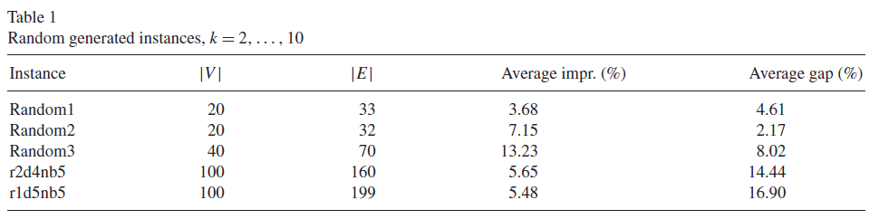
Computational results

Slide 114
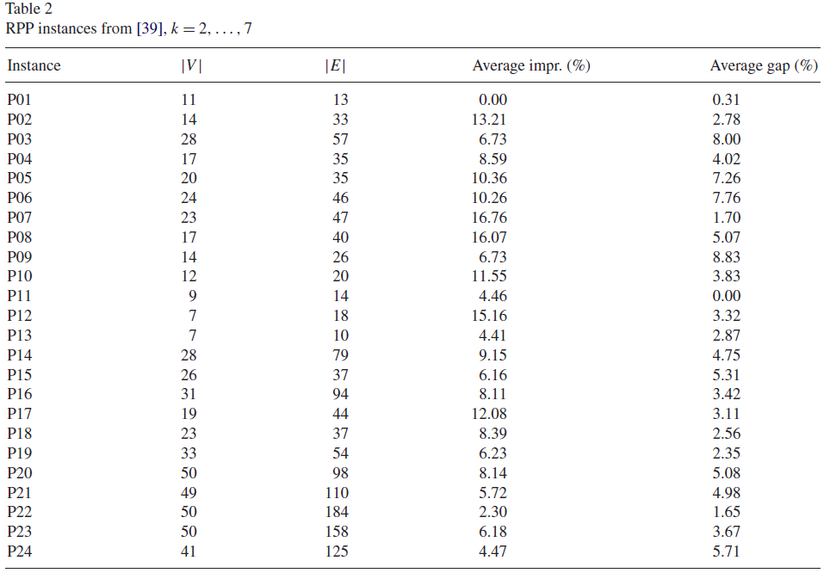
Computational results

Slide 115
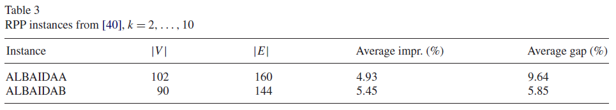
Computational results

Slide 116
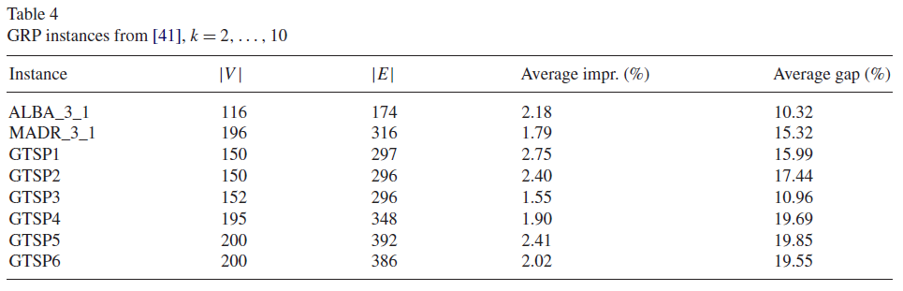
Computational results

Slide 117
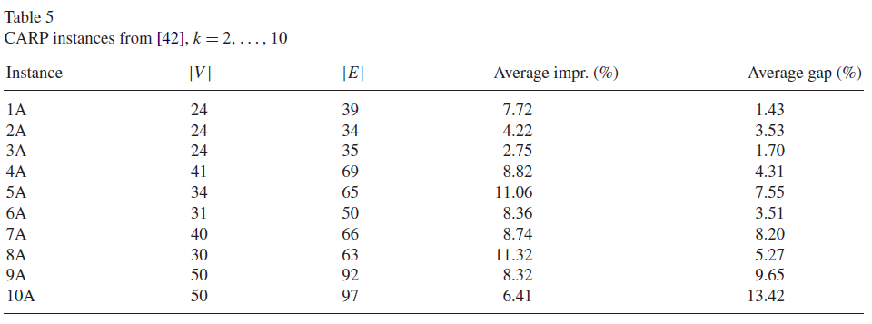
Computational results

Slide 118
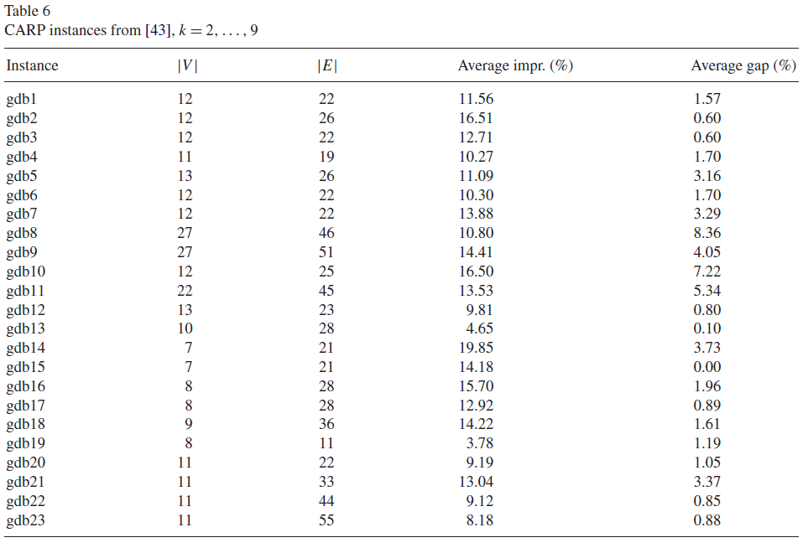
Computational results

Slide 119
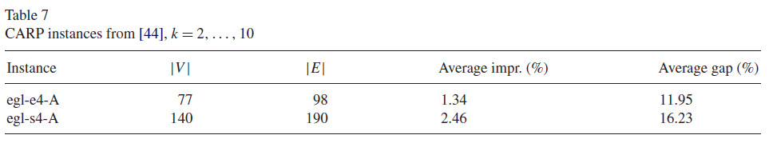
Computational results

Slide 120
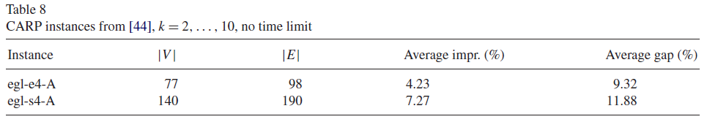
Computational results

Slide 121
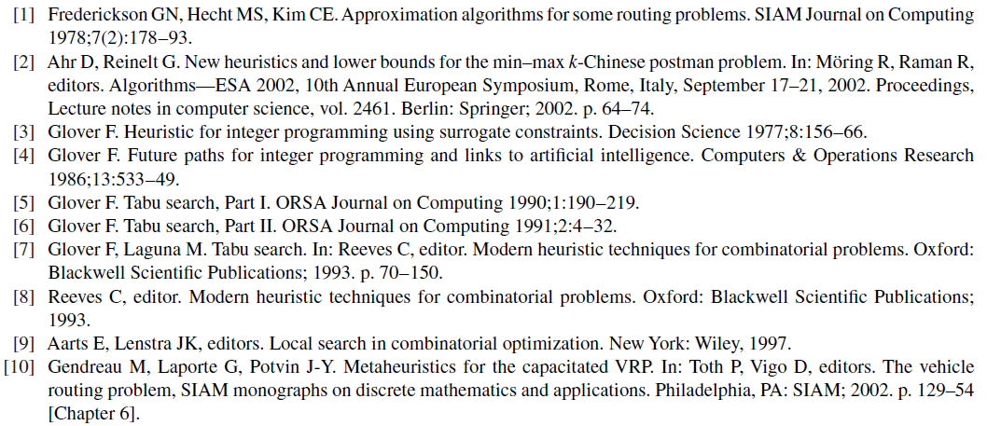
References

Slide 122
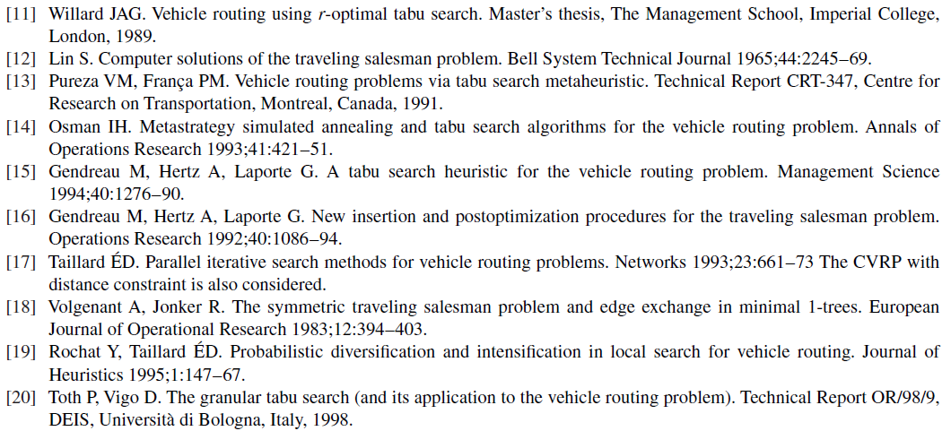
References

Slide 123
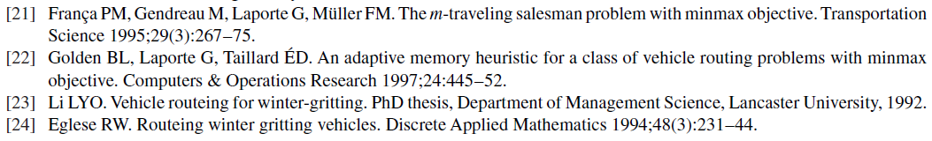
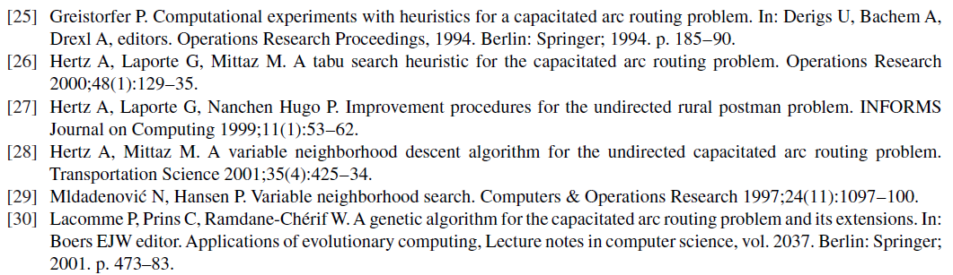
References

Slide 124
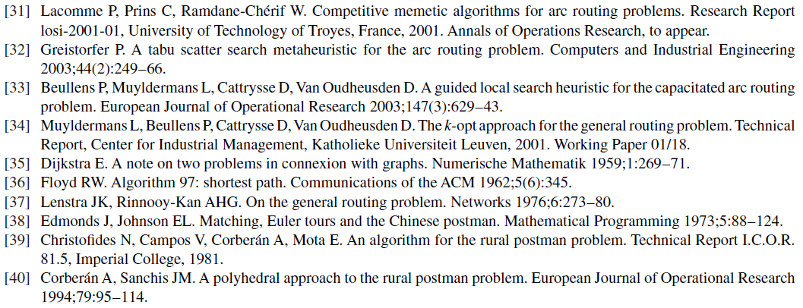
References

Slide 125
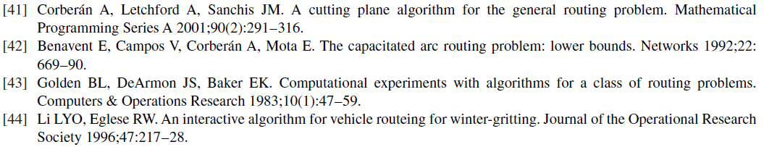
References

