Slide 1

RAPPI AI BUILDER CHALLENGE — CASE 02
Proactive Risk Detection
Agent for Rappi KAMs
PRESENTED BY
Néstor Martínez Ostoa
nestor.martinez.ostoa@gmail.com
April 2026

Slide 2
THE CHALLENGE
01 / CHALLENGE
The problem, in one line.
A Rappi KAM manages 300–600 restaurants.
They can only engage with ~30 per week.
93%
43.5%
Weeks
of a KAM's portfolio is unmonitored at any given time
of restaurants already sit in risk or critical status
is the current time-to-detection for deteriorating accounts
Rappi AI Builder Challenge · Case 02
02 / 11

Slide 3
APPROACH
02 / APPROACH
My thought process.
Three sequential questions, answered before writing a line of code.
01
02
03
Define the
business case
Design the
solution architecture
Design the
agent architecture
Who is the user, what do they need,
how is value measured?
Which layers, which contracts,
which trade-offs?
How does the AI actually reason,
route and act?
Rappi AI Builder Challenge · Case 02
03 / 11

Slide 4
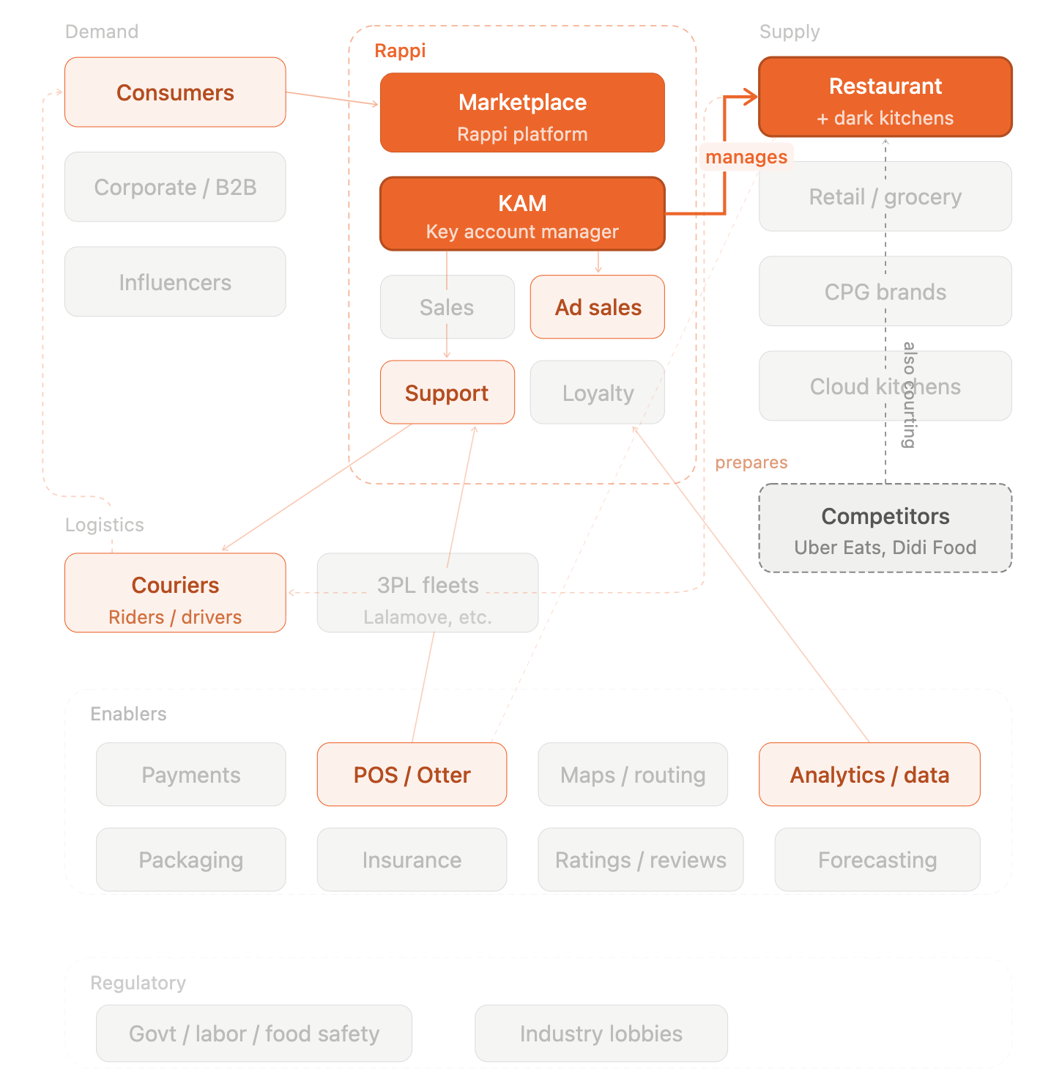
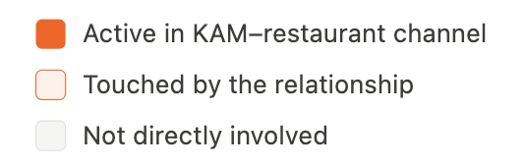
BUSINESS CASE
03 / BUSINESS CASE
A marketplace of tensions.
Every actor pulls in a different direction. The KAM is in the middle.
KAM
Competitors
Pressured, stretched thin.
93% of portfolio unmonitored.
Aggressive, opportunistic.
Any gap is an opening.
Restaurant
Consumers
Dependent but resentful.
Silent churn to the next KAM.
Impatient, disloyal.
They leave before they complain.
Rappi AI Builder Challenge · Case 02
04 / 11

Slide 5
BUSINESS CASE
03 / BUSINESS CASE
Health × Value.
Two axes replace the traditional traffic light — what's wrong and what to grow.
VALUE
↑ High Value
GROW
RESCUE
Protect and expand
Stop the bleeding
↓ Low Value
NURTURE
TRIAGE
Help them scale
Evaluate viability
↑ High Health
↓ Low Health
HEALTH
Rappi AI Builder Challenge · Case 02
05 / 11

Slide 6
BUSINESS CASE
03 / BUSINESS CASE
Six signals, one Health Score.
Signals selected via hierarchical clustering. Weights are business-driven.
delta_rating
Rating trajectory — earliest warning
25%
tasa_cancelacion_pct
Most directly actionable signal
20%
quejas_7d
Real-time complaint intensity
20%
rating_actual
Current consumer perception
15%
tiempo_entrega_avg_min
Silent killer — consumers leave first
10%
var_ordenes_pct
Demand trajectory
10%
Rappi AI Builder Challenge · Case 02
06 / 11

Slide 7
SOLUTION ARCHITECTURE
04 / SOLUTION ARCHITECTURE
Deterministic math, LLM reasoning.
Two principles that govern every technical decision.
Deterministic scoring,
LLM for strategy only
Provider-agnostic
LLM layer
Health scores, quadrants and velocity overrides are computed in pandas — fast, reproducible and auditable. Agents consume structured results via tool calls and generate natural language, never raw metrics.
All LLM calls flow through a thin adapter. Ships with Gemini, swaps to OpenAI or Anthropic without touching agent logic — and each agent can run on the provider where it performs best.
Rappi AI Builder Challenge · Case 02
07 / 11

Slide 8
SOLUTION ARCHITECTURE
04 / SOLUTION ARCHITECTURE
The stack.
Frontend
Next.js 14 · Tailwind · shadcn/ui
API
FastAPI · SSE streaming · per-request agents
LLM Abstraction
Unified Provider protocol · Gemini / OpenAI / Anthropic
Agents
Router → Diagnostic · RGM Strategy · Budget
Engine
pandas / numpy — scoring, quadrants, velocity
Observability
LangFuse — traces · tokens · latency · evals
Deployment
Vercel · Railway
Rappi AI Builder Challenge · Case 02
08 / 11

Slide 9
AGENT ARCHITECTURE
05 / AGENT ARCHITECTURE
One router, three specialists.
The KAM sees a single chat. The router delegates; each specialist owns its own prompt, tools and evals.
ROUTER
classify · delegate
DIAGNOSTIC
RGM STRATEGY
BUDGET
Portfolio overviews,
briefings, drill-down
Recovery plans,
growth playbooks
Spend, balance,
ROI, escalations
Rappi AI Builder Challenge · Case 02
09 / 11

Slide 10
AGENT ARCHITECTURE
05 / AGENT ARCHITECTURE
The tool-calling loop.
Every agent extends the same BaseAgent — bounded, traced, streaming on the final answer.
01
02
03
04
05
KAM message
Router classifies
Sub-agent runs
Loop or answer
Stream response
Arrives at /api/chat with {kam, messages}.
LLM decides: diagnostic, RGM, budget.
Calls deterministic engine tools.
Bounded 10 iterations; returns to router.
Final answer streamed over SSE.
Rappi AI Builder Challenge · Case 02
10 / 11

Slide 11
LIVE DEMO
Vayamos al demo.
Diagnostic → Strategy → Budget, in one conversation.
https://rappi-kam-agent.vercel.app/dashboard
Rappi AI Builder Challenge · Case 02 · Néstor Martínez Ostoa

