Slide 1




Let’s talk about Functional Programming

Slide 2
Summary
Goals and overview
Features and patterns
Code snippets

Slide 3
Goals and overview
What is functional programming?
stateless architecture
pure functions
immutable structures

Slide 4
Main goals of FP are:
Creating concise and testable modules
Writing readable and coherent code
Speeding up software development
Improve application scalability

Slide 5
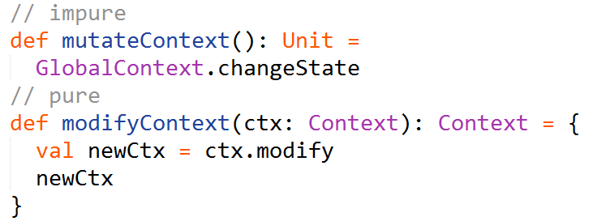
Features and patterns
Pure function
Has no side-effects
Is referentially transparent

Slide 6

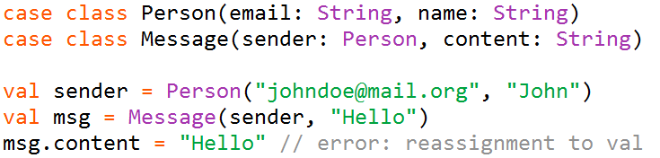
Immutability
A val (final) is always preferred to a var (non-final)
Collections are immutable by default
Case classes (useful functional data structure) are
immutable by default

Slide 7
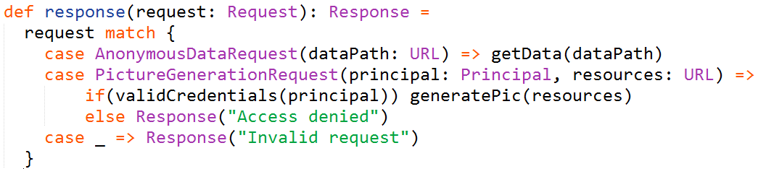
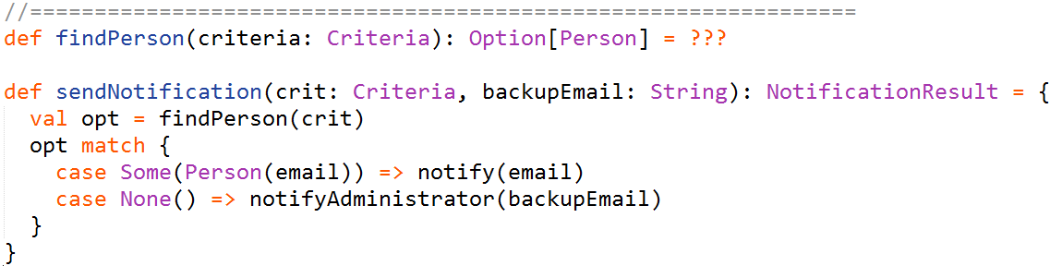
Pattern matching
Examples:

Slide 8
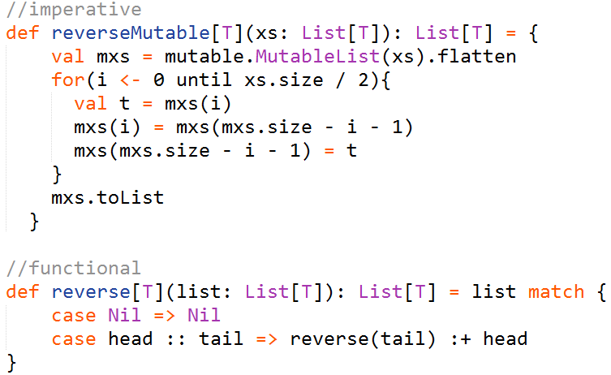
Looping is recursion
The purely functional way of making any iteration is recursion.

Slide 9
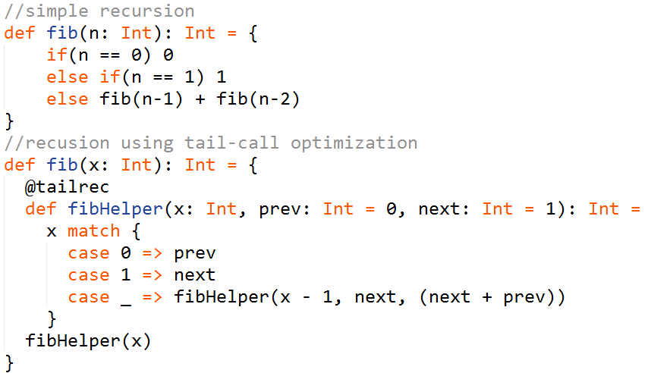
Tail recursion
Significantly boost performance
Avoid StackOverflowException

Slide 10
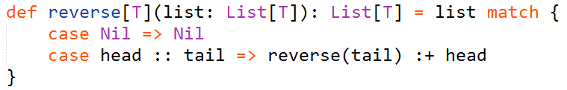
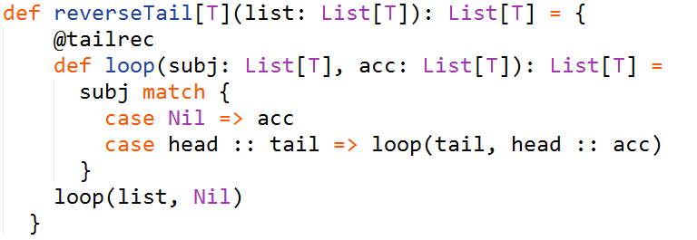
Tail recursion
Recall our list reverting example:
It could also use tail recursion:
When passing a list of 1000 integers we get a 100x performance boost.
Should you pass a list of 10000 elements the first implementation would fail
with a StackOverflowException.

Slide 11
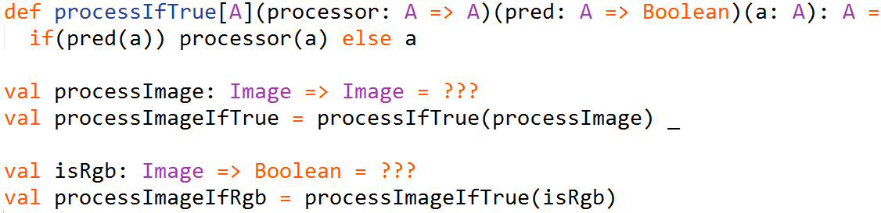
Currying
A technique of evaluating a function with multiple arguments as a sequence of
functions with single argument.

Slide 12

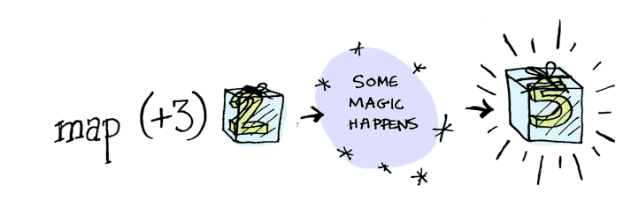
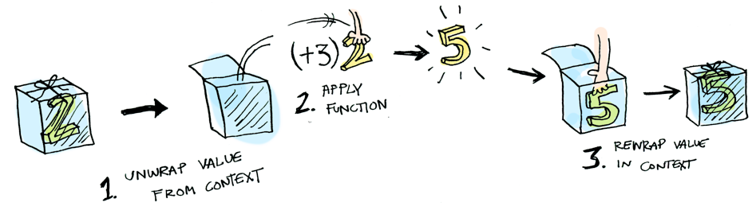
Functor

Slide 13
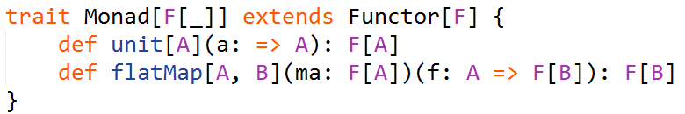
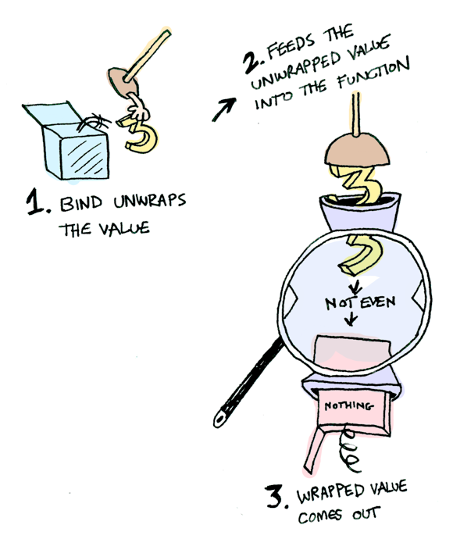
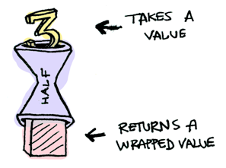
Monad
For example if function ‘half’
returns a wrapped value then a Monad knows how
to apply it to its value (to flatMap it or to bind).

Slide 14
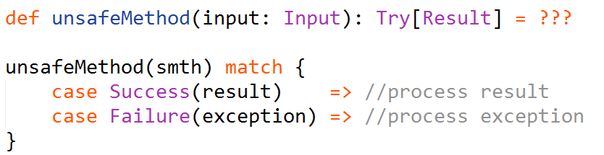
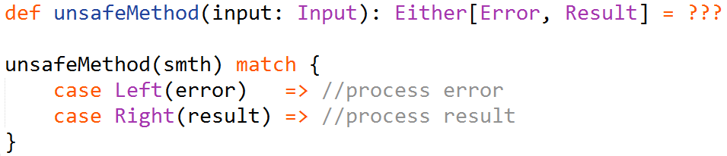
Exception handling
Using Try:
Using Either:

Slide 15
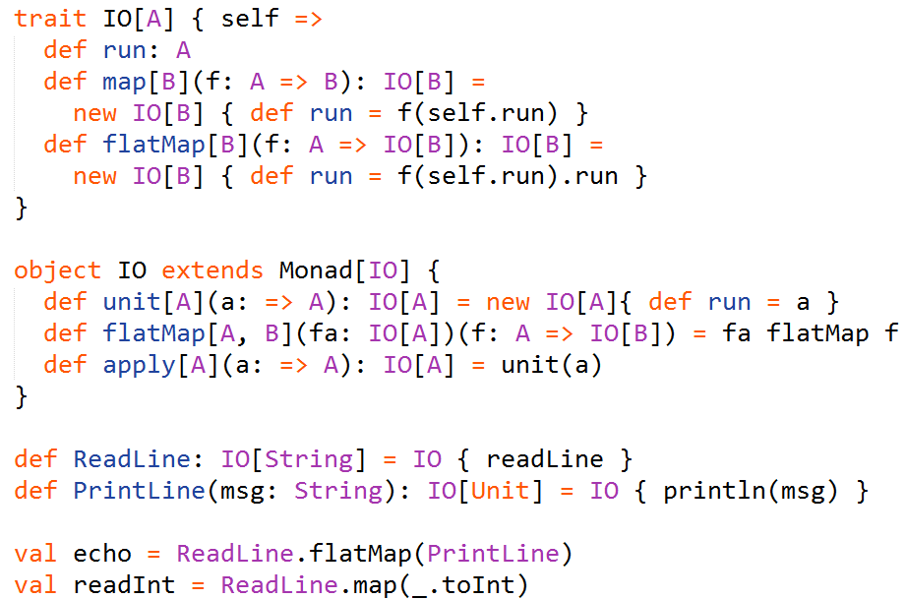
Input and Output

Slide 16

Code Snippets
Let’s write a function that counts code lines given a project’s root folder.
The signature of the function is defined as follows:
All the following code would be defined inside this function.

Slide 17
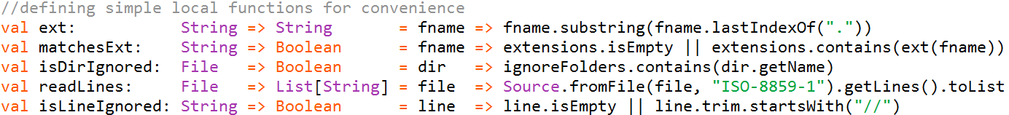
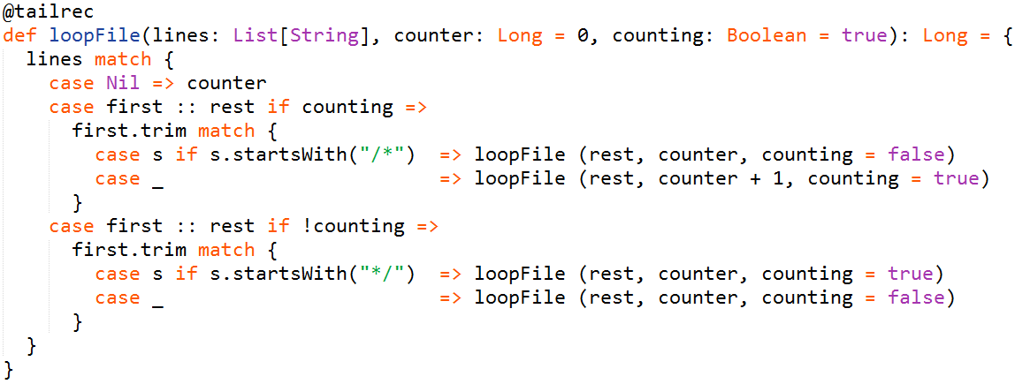
Function to iterate through file lines and ignore the multi-line comments:

Slide 18
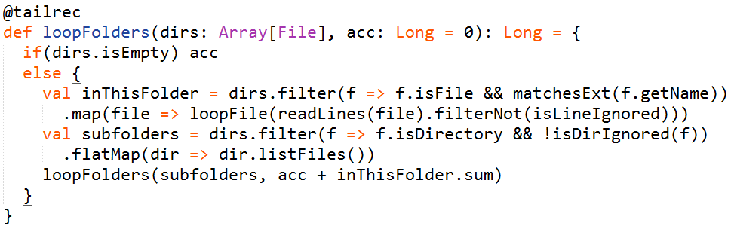
Iterate through directories:
Finally, a simple invocation of this function:

Slide 19
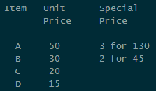
Let’s try another example.
Here we provide a functional-friendly implementation of a simple checkout system
that handles the logic due to rules that look like this:
Seems like a simple object-oriented task, but now we will create a functional
implementation blending it with some of the Scala’s object-oriented features.

Slide 20
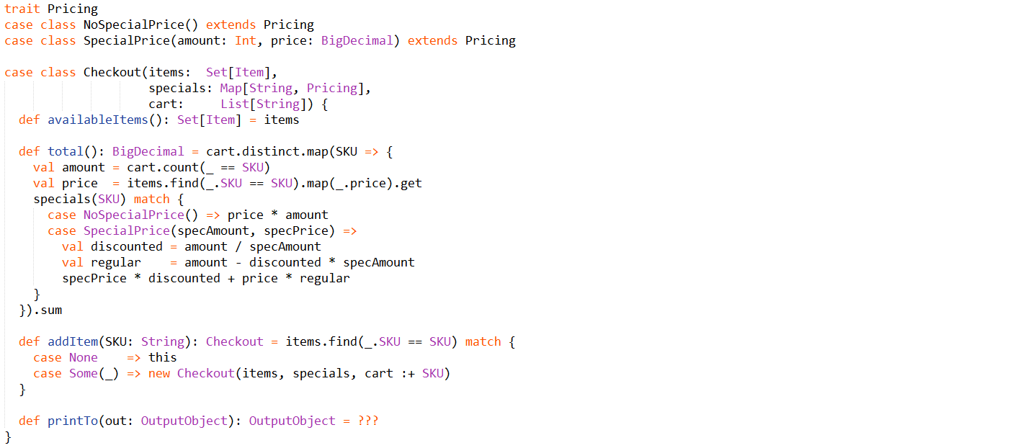

Slide 21
Useful links
http://danielwestheide.com/scala/neophytes.html
http://twitter.github.io/scala_school/index.html
http://twitter.github.io/effectivescala/index.html
http://eed3si9n.com/learning-scalaz/
http://adit.io/posts/2013-04-17-functors,_applicatives,_and_monads_in_pictures.html
http://iloveponies.github.io/120-hour-epic-sax-marathon/index.html
Related literature:
https://drive.google.com/open?id=0B2Re1JYCm9aNM2hzTU1QWGVLNms

