Slide 1




Let’s talk about Functional Programming

Slide 2
Agenda
Goals and overview
Features and patterns
Code snippets

Slide 3
Goals and overview
What is functional programming?
stateless architecture
pure functions
immutable structures

Slide 4
Main goals of FP are:
Creating concise and testable modules
Writing readable and coherent code
Speeding up software development
Improve application scalability

Slide 5
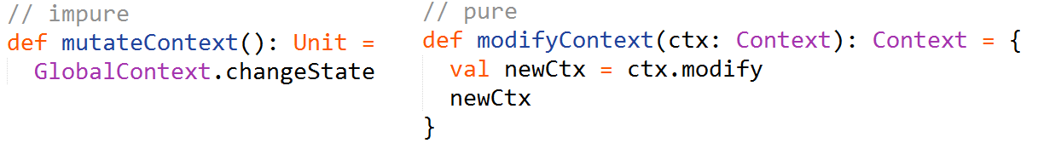


Features and patterns
Pure function
Has no side-effects
Is referentially transparent

Slide 6

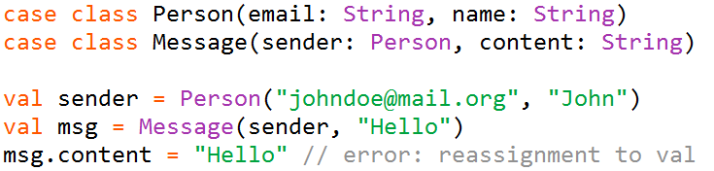
Immutability
A val (final) is always preferred to a var (non-final)
Collections are immutable by default
Case classes (useful functional data structure) are
immutable by default

Slide 7
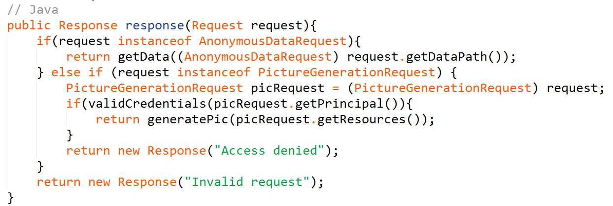
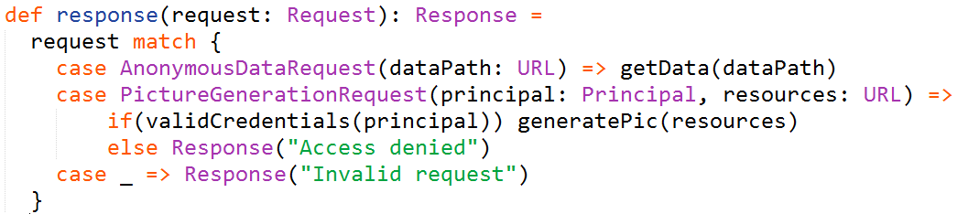
Pattern matching

Slide 8
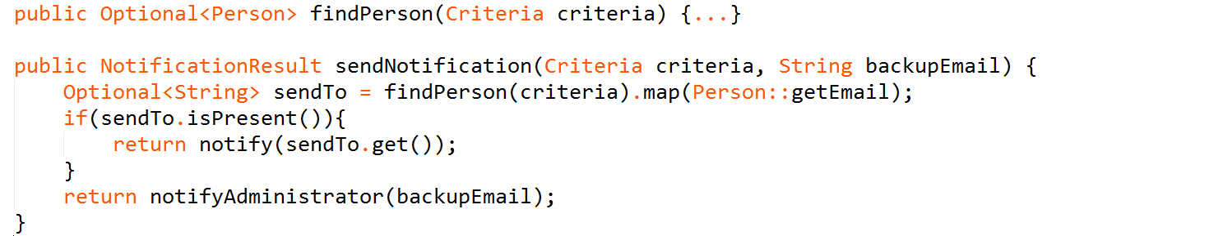
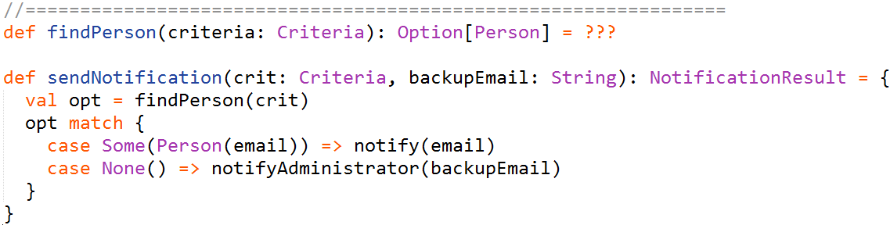

Slide 9
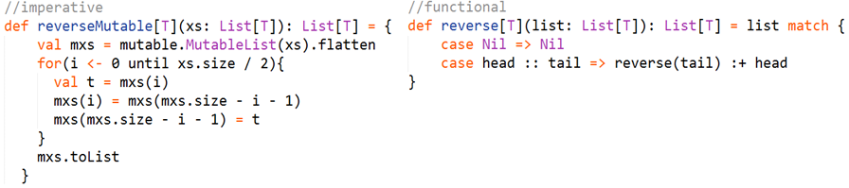
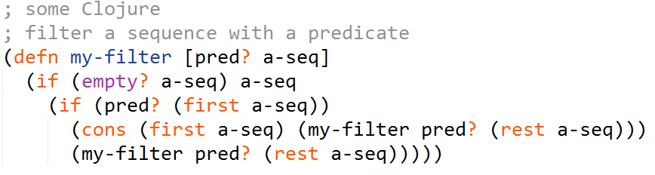
Looping is recursion
The purely functional way of making any iteration is recursion.

Slide 10
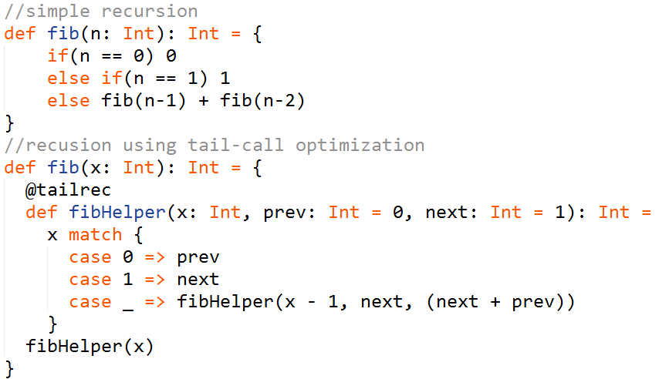
Tail recursion
Significantly boost performance
Avoid StackOverflowException

Slide 11
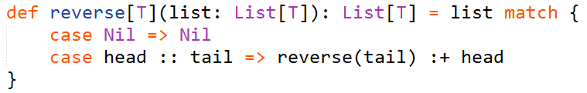
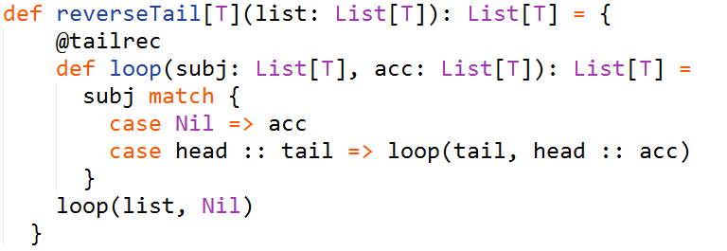
Tail recursion
Recall our list reverting example:
It could also use tail recursion:
When passing a list of 1000 integers we get a 100x performance boost.
Should you pass a list of 10000 elements the first implementation would fail
with a StackOverflowException.

Slide 12
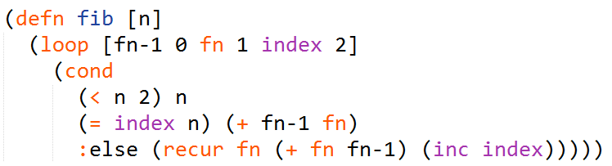
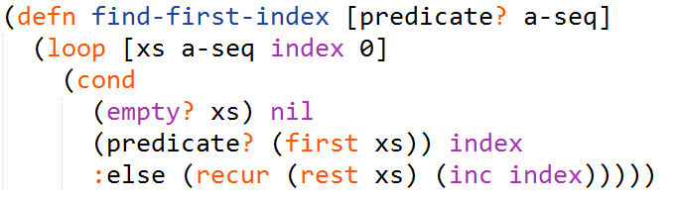
Tail recursion
This pattern with an inner helper function is so common that Clojure defines a special
(anonymous) form for this called loop-recur:

Slide 13
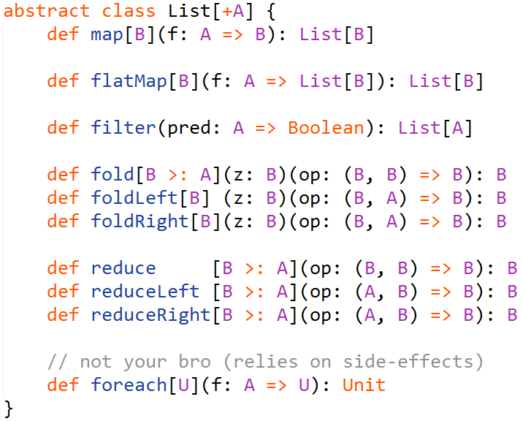
Common operations on collections

Slide 14
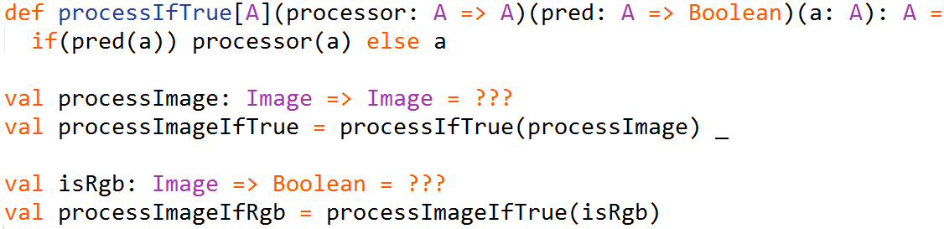
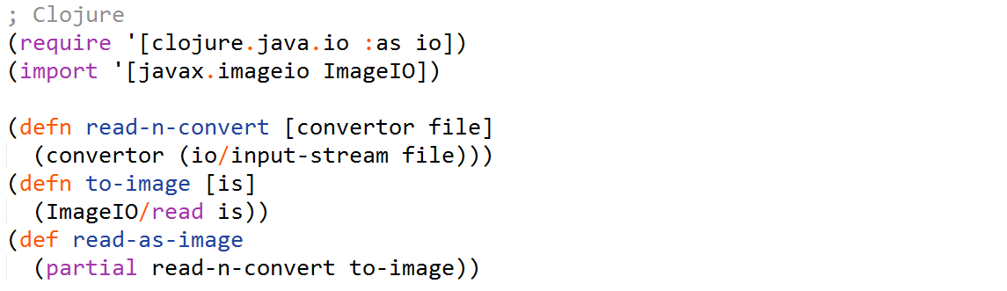
Currying
A technique of evaluating a function with multiple arguments as a sequence of
functions with single argument.

Slide 15

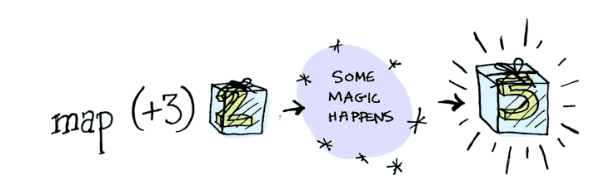
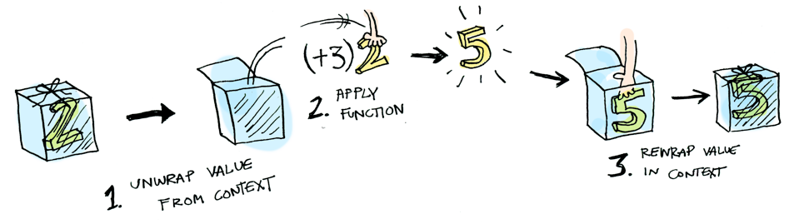
Functor

Slide 16
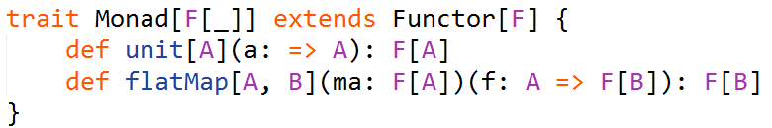
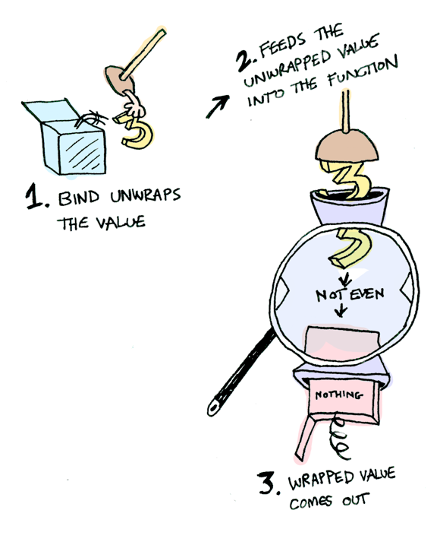
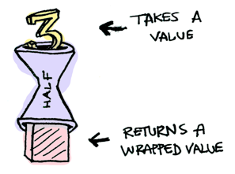
Monad
For example if function ‘half’
returns a wrapped value then a Monad knows how
to apply it to its value (to flatMap it or to bind).

Slide 17
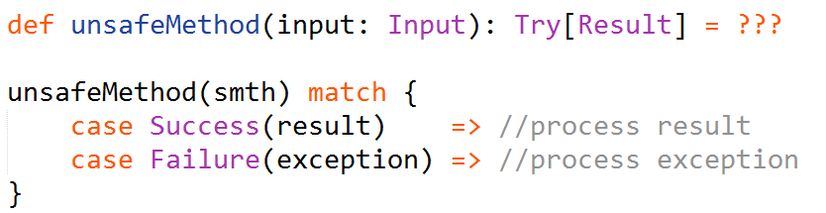
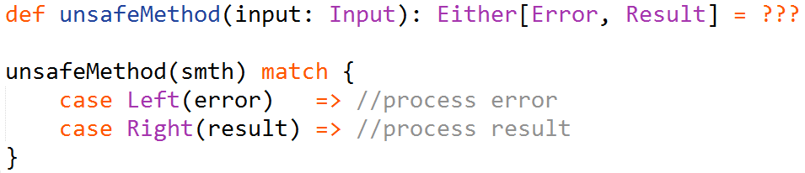
Exception handling
Using Try:
Using Either:

Slide 18
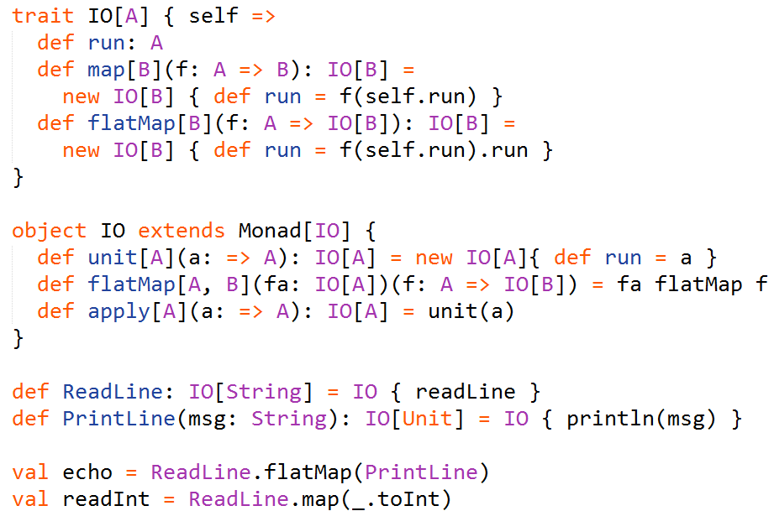
Input and Output

Slide 19

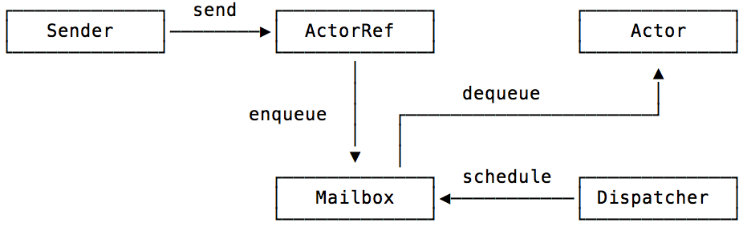
Concurrency with actors
Akka is a toolkit for building highly concurrent, distributed, and resilient message-driven applications on the JVM that is based on actor model. Akka is written in Scala and, as of Scala 2.10, Akka's actor implementation is included as part of the Scala standard library.

Slide 20
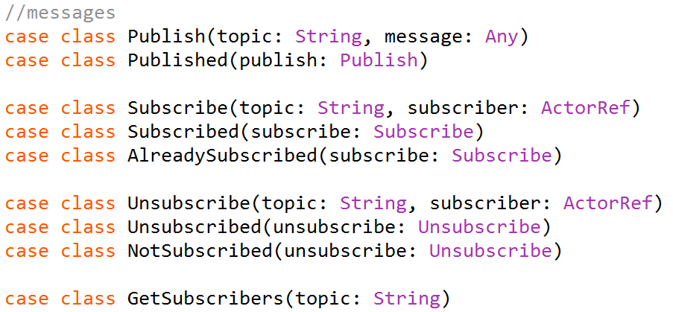
Concurrency with actors
Any object is suitable as a message for an actor, but typically you would want
to define your own meaningful classes. A module akka-typed, that provides type-safety
is currently under development.

Slide 21
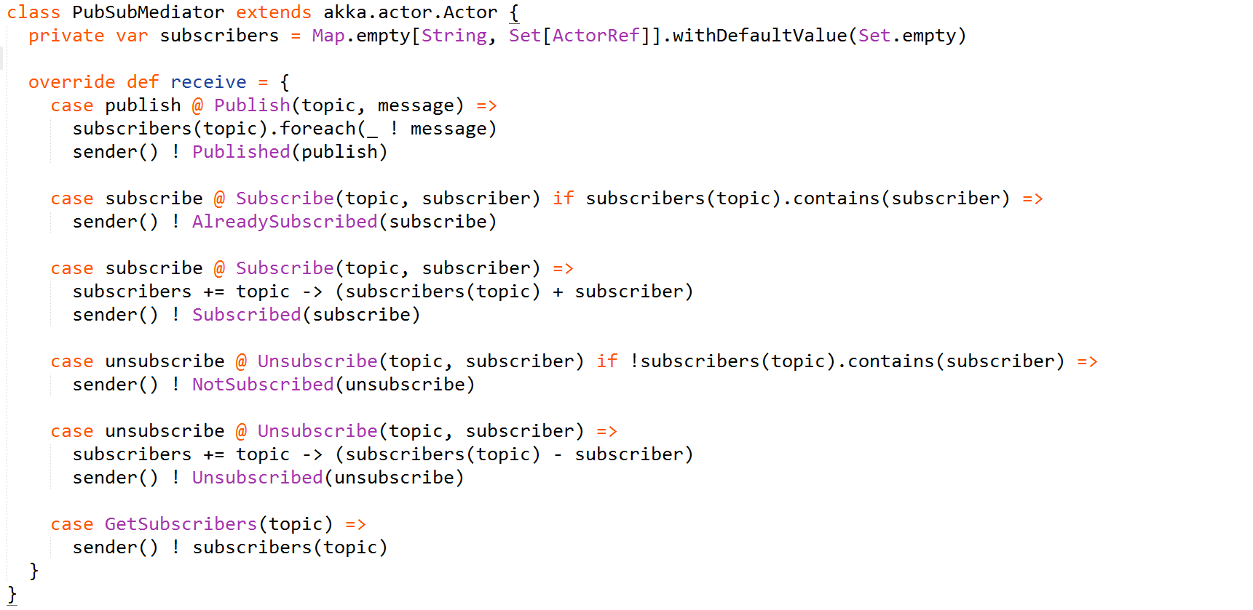

Slide 22

Code Snippets
Let’s write a function that counts code lines given a project’s root folder.
The signature of the function is defined as follows:
All the following code would be defined inside this function.

Slide 23
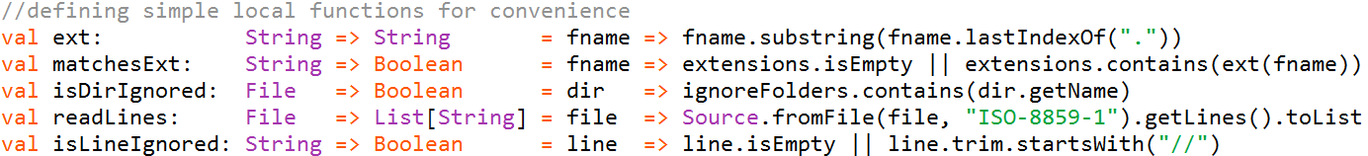
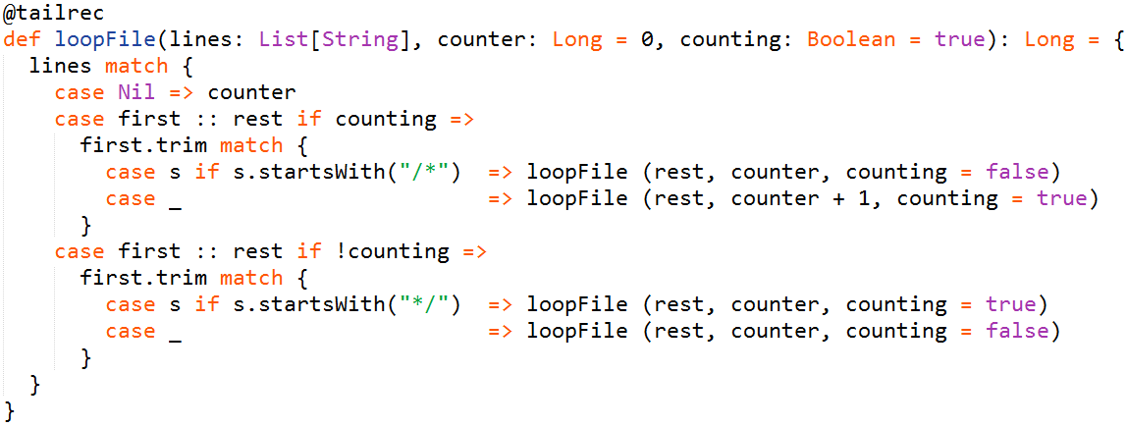
Function to iterate through file lines and ignore the multi-line comments:

Slide 24
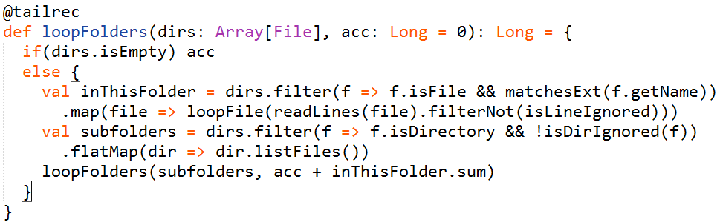
Iterate through directories:
Finally, a simple invocation of this function:

Slide 25
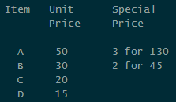
Let’s try another example.
Here we provide a functional-friendly implementation of a simple checkout system
that handles the logic due to rules that look like this:
Seems like a simple object-oriented task, but now we will create a functional
implementation blending it with some of the Scala’s object-oriented features.

Slide 26
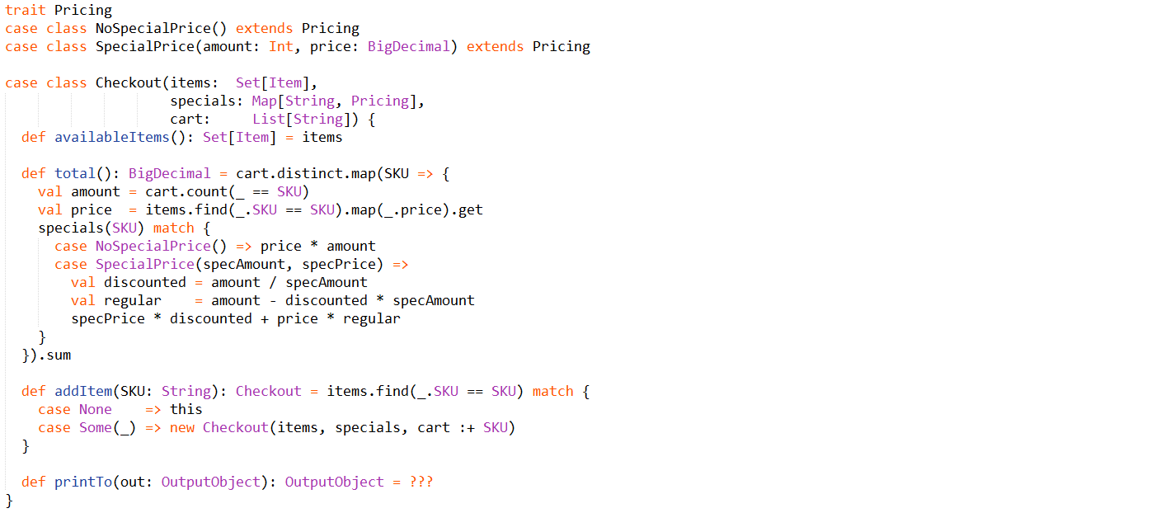

Slide 27
Useful links
http://danielwestheide.com/scala/neophytes.html
http://twitter.github.io/scala_school/index.html
http://twitter.github.io/effectivescala/index.html
http://eed3si9n.com/learning-scalaz/
http://adit.io/posts/2013-04-17-functors,_applicatives,_and_monads_in_pictures.html
http://iloveponies.github.io/120-hour-epic-sax-marathon/index.html
Related literature:
https://drive.google.com/open?id=0B2Re1JYCm9aNM2hzTU1QWGVLNms

