Slide 1




Let’s talk about Functional Programming

Slide 2
Agenda
Goals and overview
Features and patterns
Code snippets

Slide 3
Goals and overview
What is functional programming?
stateless architecture
pure functions
immutable structures

Slide 4
Main goals of FP are:
Creating concise and testable modules
Writing readable and coherent code
Speeding up software development
Improve application scalability

Slide 5
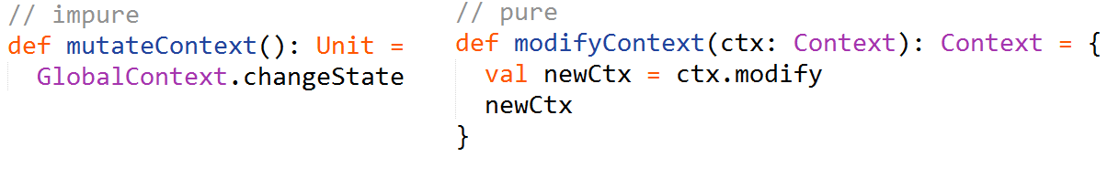


Features and patterns
Pure function
Has no side-effects
Is referentially transparent

Slide 6

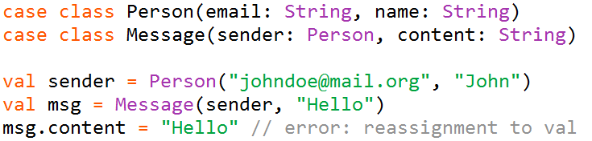
Immutability
A val (final) is always preferred to a var (non-final)
Collections are immutable by default
Case classes (useful functional data structure) are
immutable by default

Slide 7
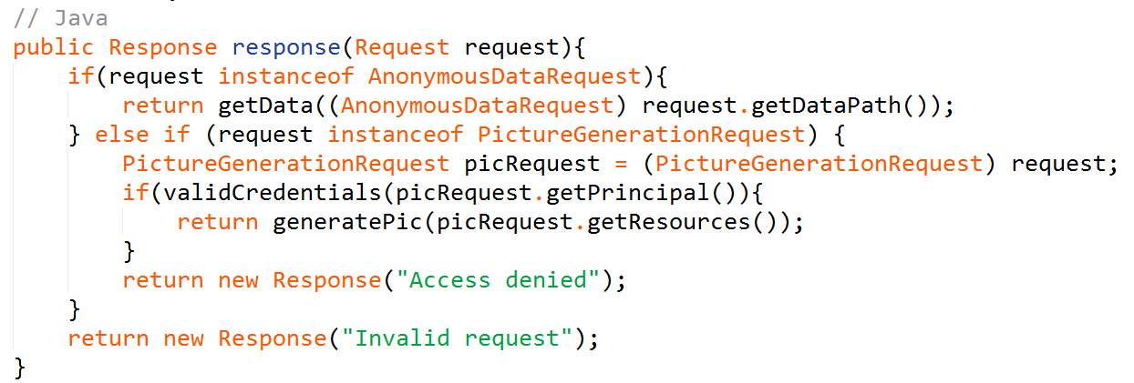
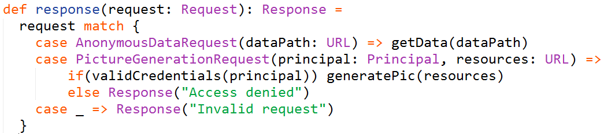
Pattern matching

Slide 8
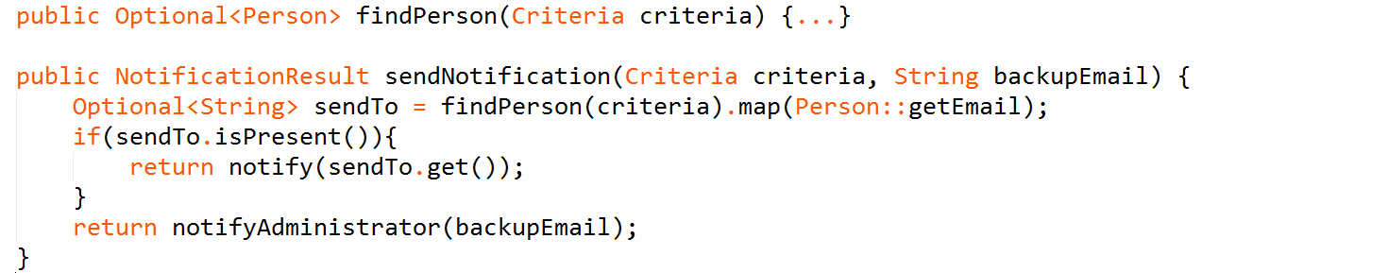
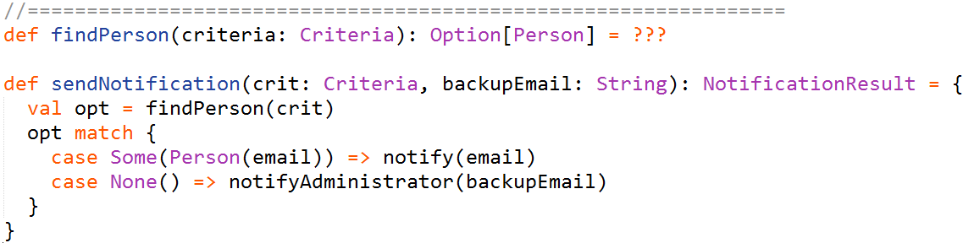

Slide 9
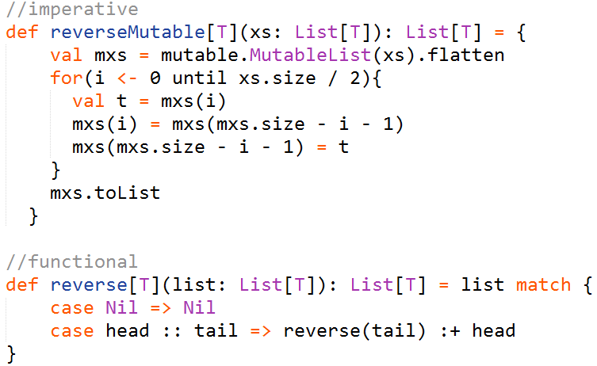
Looping is recursion
The purely functional way of making any iteration is recursion.

Slide 10
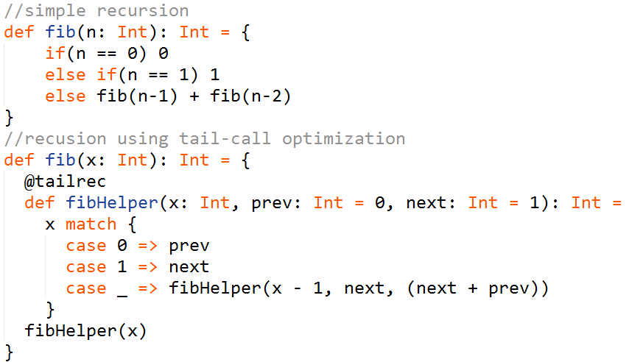
Tail recursion
Significantly boost performance
Avoid StackOverflowException

Slide 11
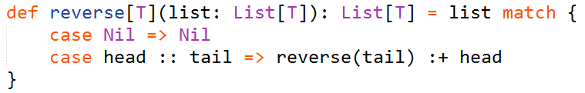
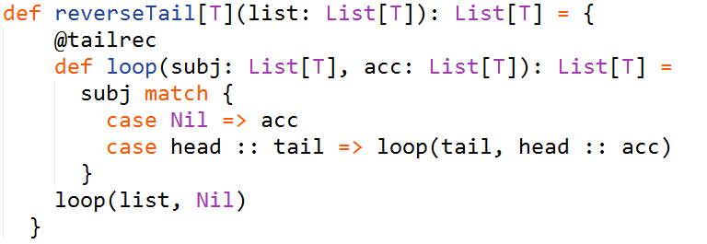
Tail recursion
Recall our list reverting example:
It could also use tail recursion:
When passing a list of 1000 integers we get a 100x performance boost.
Should you pass a list of 10000 elements the first implementation would fail
with a StackOverflowException.

Slide 12
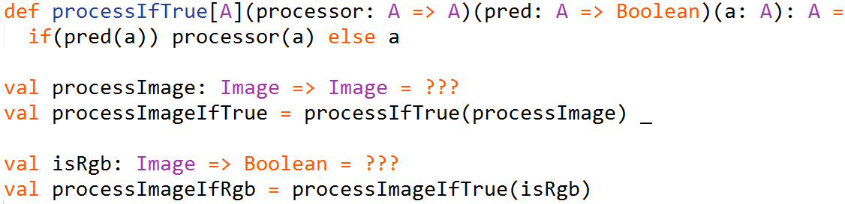
Currying
A technique of evaluating a function with multiple arguments as a sequence of
functions with single argument.

Slide 13

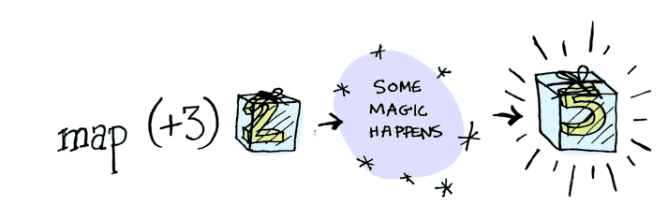
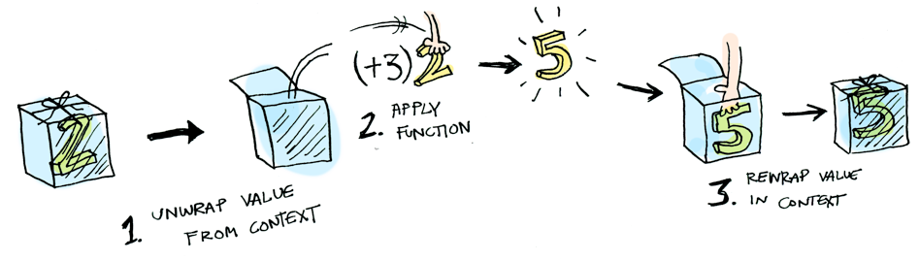
Functor

Slide 14
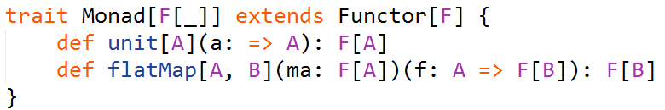
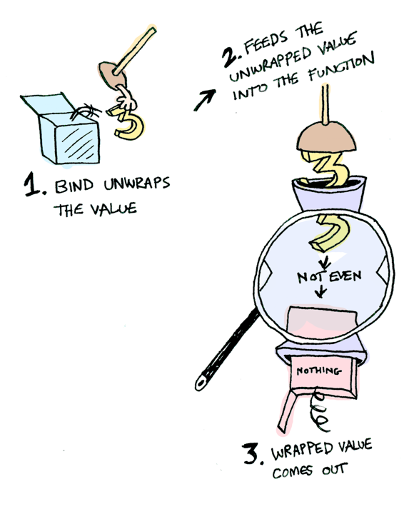
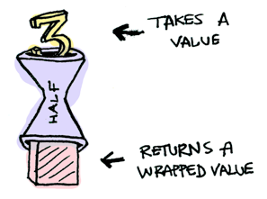
Monad
For example if function ‘half’
returns a wrapped value then a Monad knows how
to apply it to its value (to flatMap it or to bind).

Slide 15
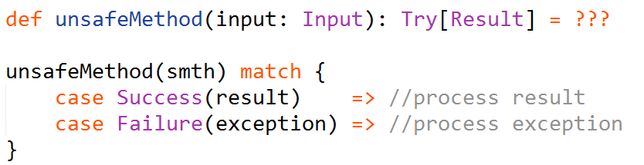
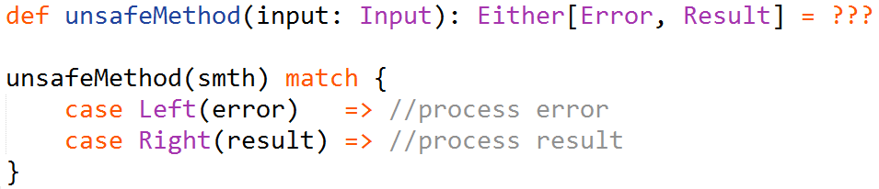
Exception handling
Using Try:
Using Either:

Slide 16
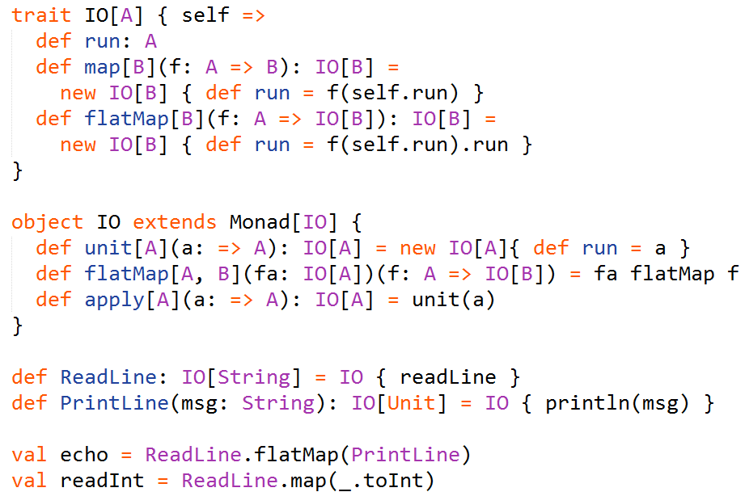
Input and Output

Slide 17

Code Snippets
Let’s write a function that counts code lines given a project’s root folder.
The signature of the function is defined as follows:
All the following code would be defined inside this function.

Slide 18
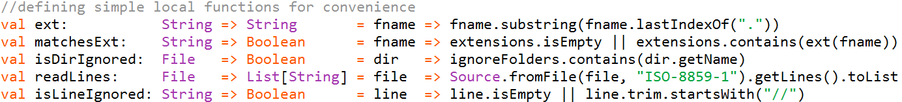
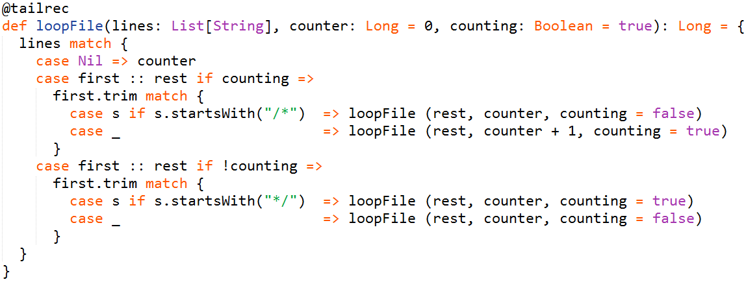
Function to iterate through file lines and ignore the multi-line comments:

Slide 19
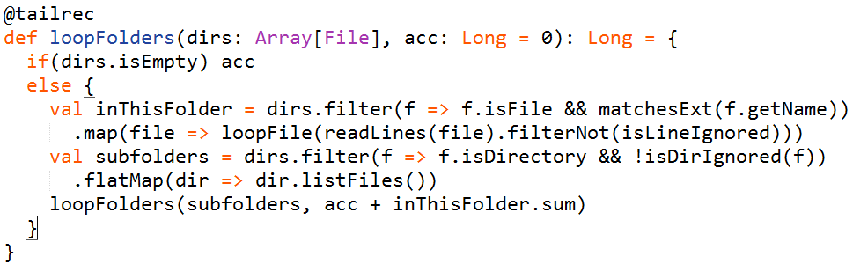
Iterate through directories:
Finally, a simple invocation of this function:

Slide 20
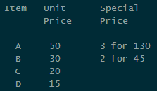
Let’s try another example.
Here we provide a functional-friendly implementation of a simple checkout system
that handles the logic due to rules that look like this:
Seems like a simple object-oriented task, but now we will create a functional
implementation blending it with some of the Scala’s object-oriented features.

Slide 21
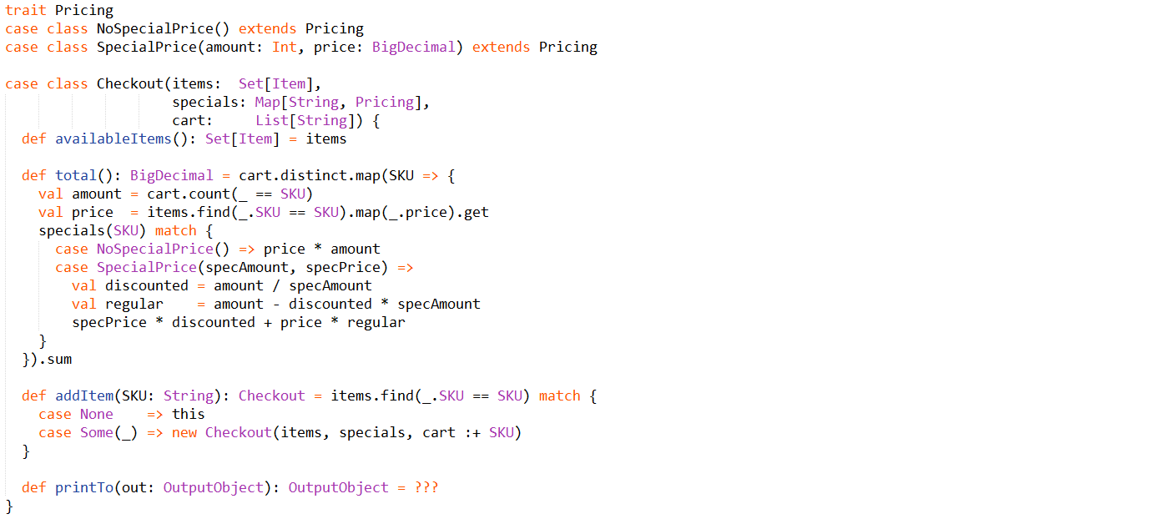

Slide 22
Useful links
http://danielwestheide.com/scala/neophytes.html
http://twitter.github.io/scala_school/index.html
http://twitter.github.io/effectivescala/index.html
http://eed3si9n.com/learning-scalaz/
http://adit.io/posts/2013-04-17-functors,_applicatives,_and_monads_in_pictures.html
http://iloveponies.github.io/120-hour-epic-sax-marathon/index.html
Related literature:
https://drive.google.com/open?id=0B2Re1JYCm9aNM2hzTU1QWGVLNms

