Slide 1
Import data from one SQL server to other

Slide 2
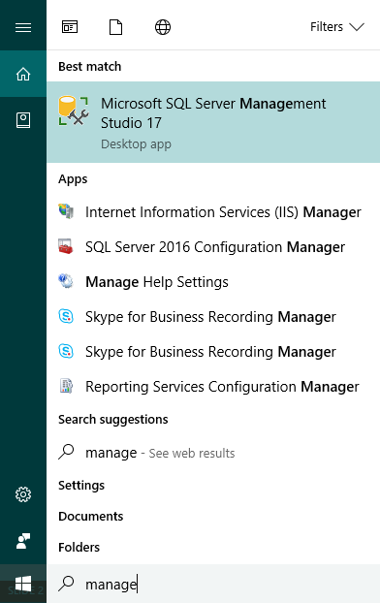
Open SQL management studio

Slide 3
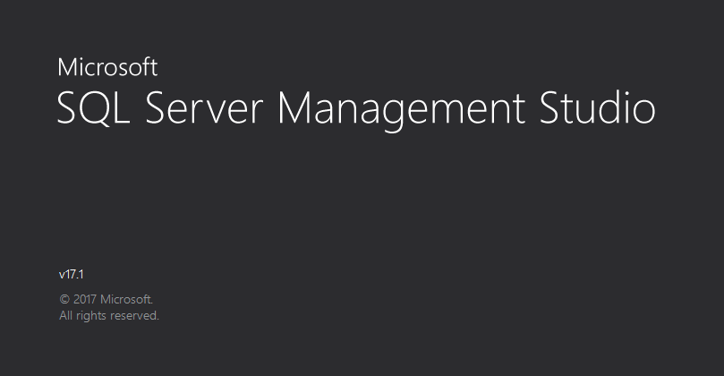

Slide 4
You should have the IP address of two SQL servers-
Copy from one server
Copy to second server
Or if you are importing data from your local machine, the you should have one IP address of the second server and Username and password.
Here I have the screen shots of coping data from SQL server of IP-tcp:13.92.99.166 to my local machine database.

Slide 5
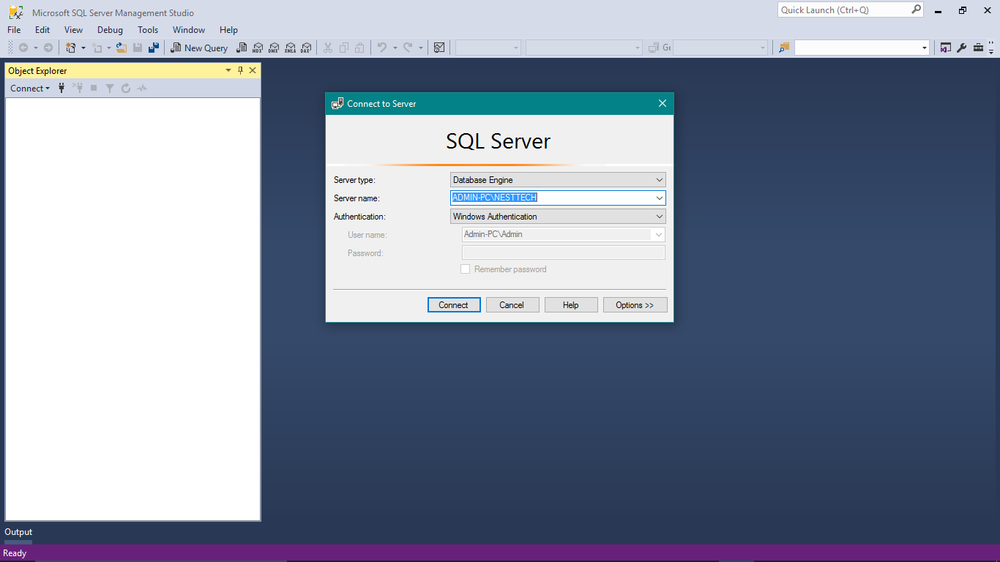
Fill in your local server details and click connect

Slide 6
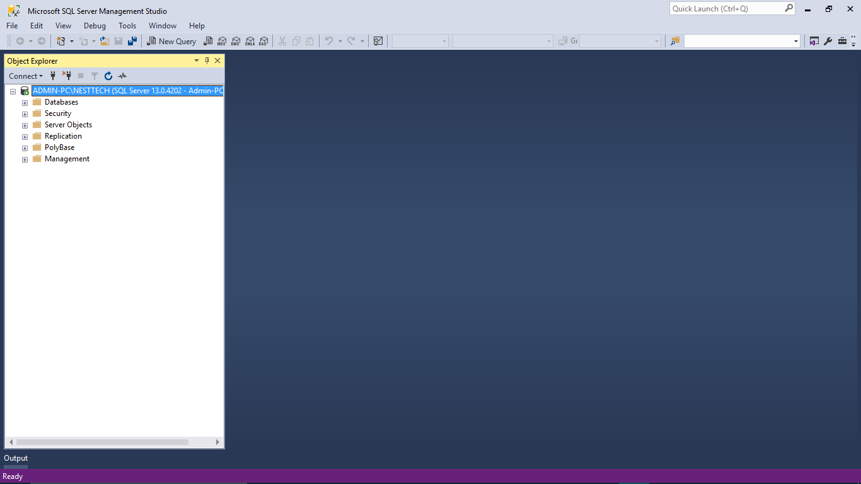
Click connect or plug symbol in the object explorer

Slide 7
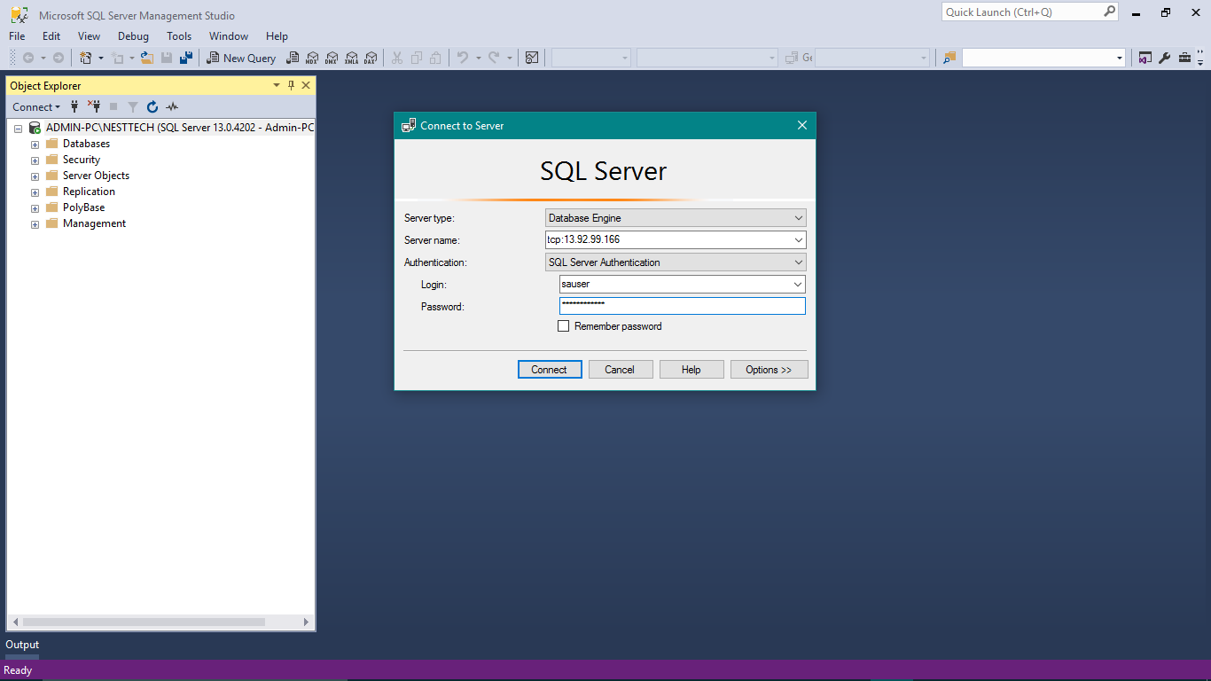
Input the second server details you want to connect and click connect.

Slide 8
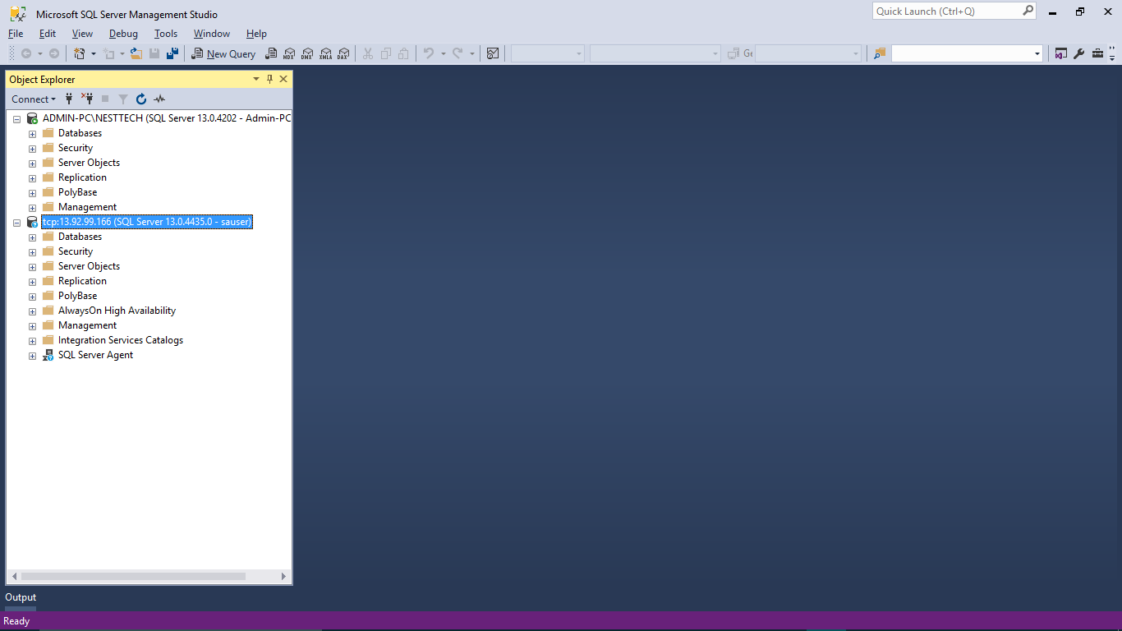
Now you have two servers in your management studio

Slide 9
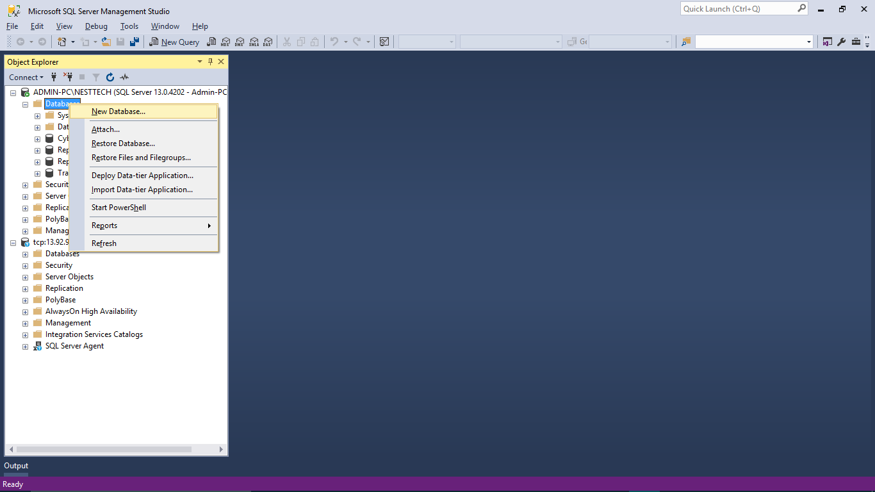
Create a new database in your local server.

Slide 10
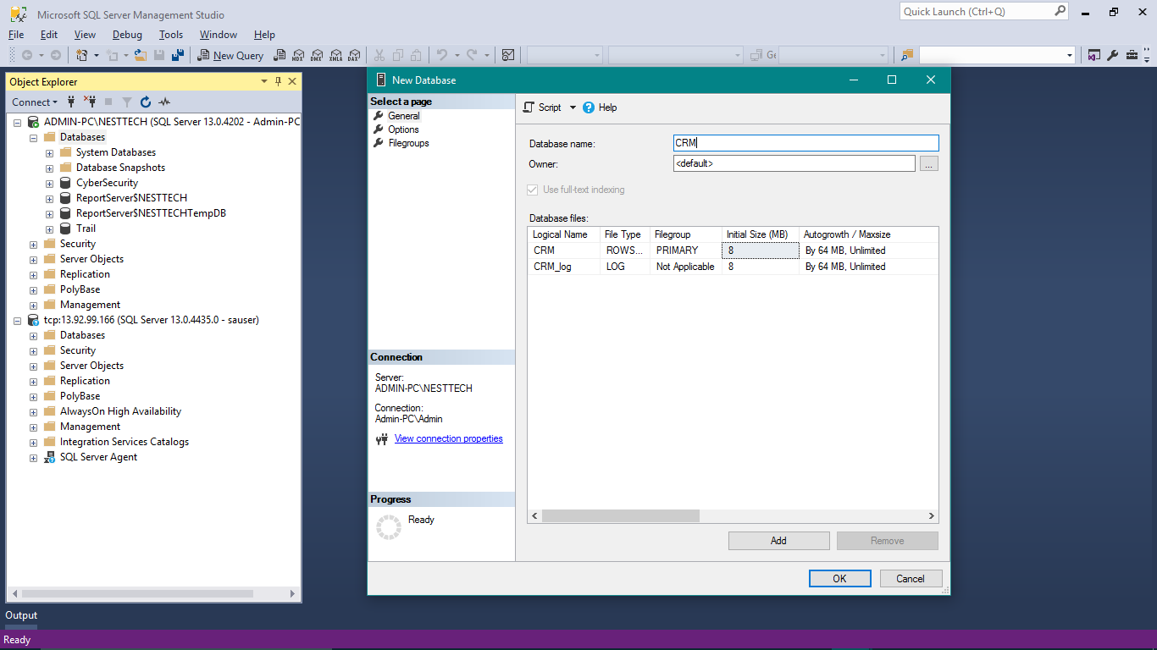
I am creating a database with name as CRM and click ok

Slide 11
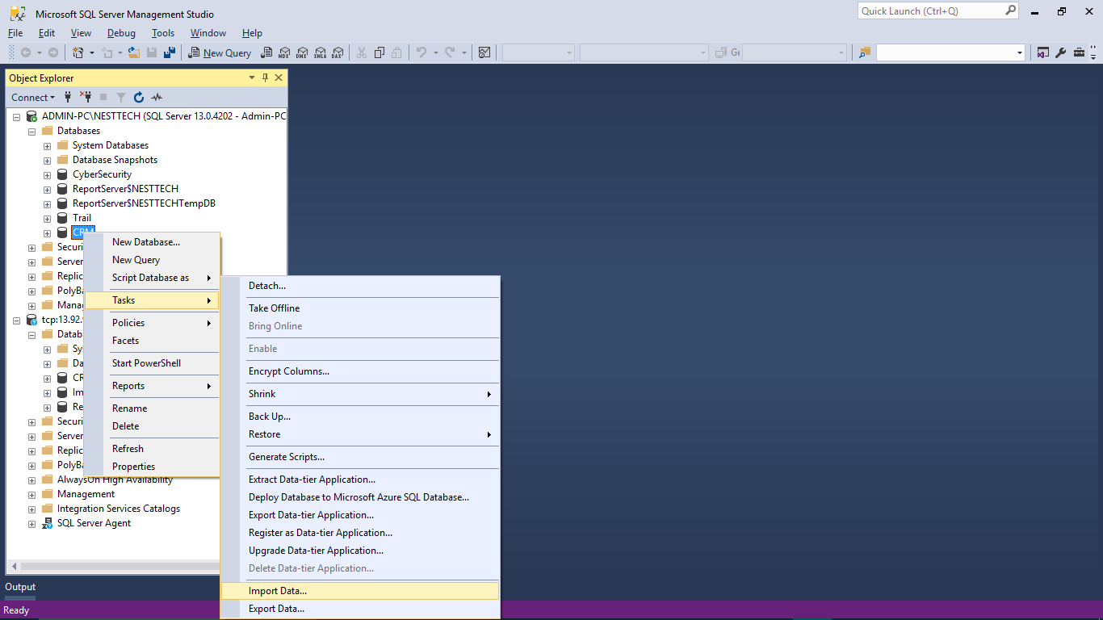
Now right click on the database you created – CRM here and goto Task->Import Data.

Slide 12
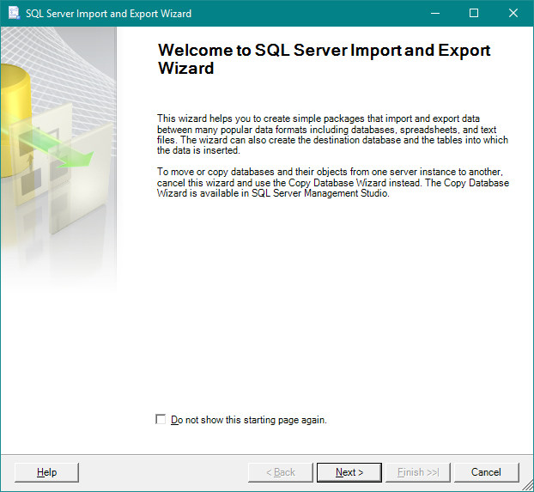
Click next here

Slide 13
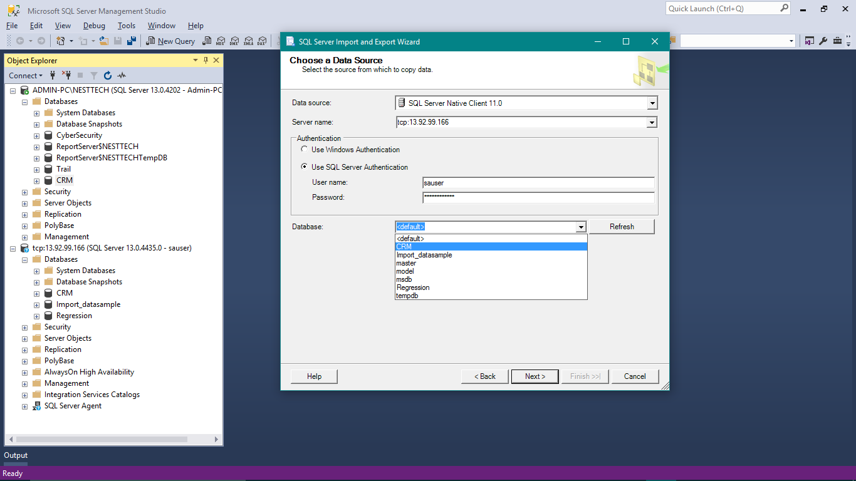
In this window
Data source tab→ select SQL Server Native Client 11.0. from the dropdown box.
Enter your Second server details and select the database to copy and click next

Slide 14
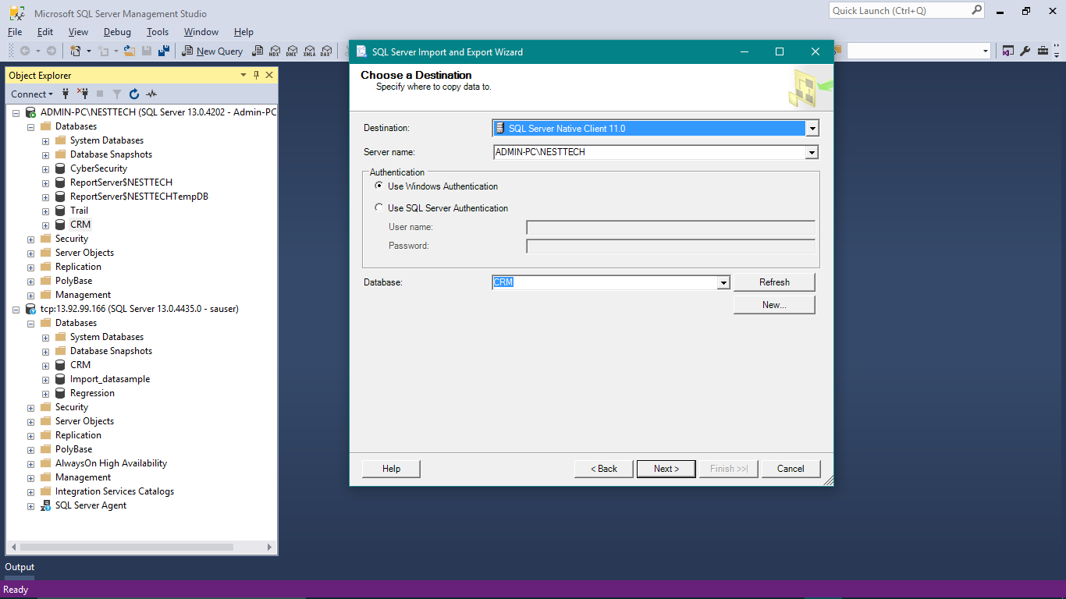
Destination :
Here the destination is the local server and select the database from the dropdown, or you can create a new one here too
Then click next

Slide 15
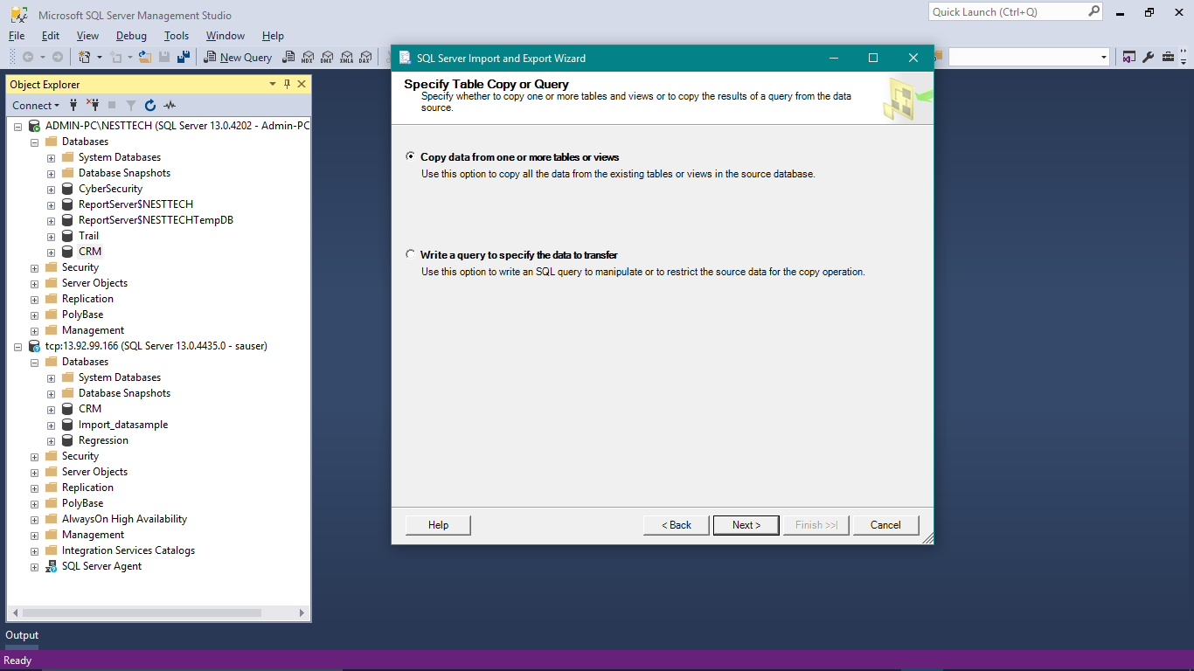
Choose Copy data from one or more tables or views
Then click Next

Slide 16
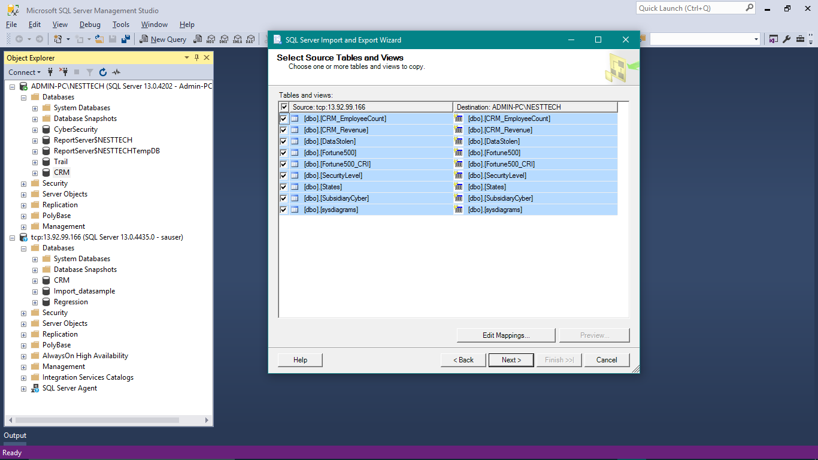
Choose the tables you want to copy from the source to destination.
I am choosing all the tables
Click next

Slide 17
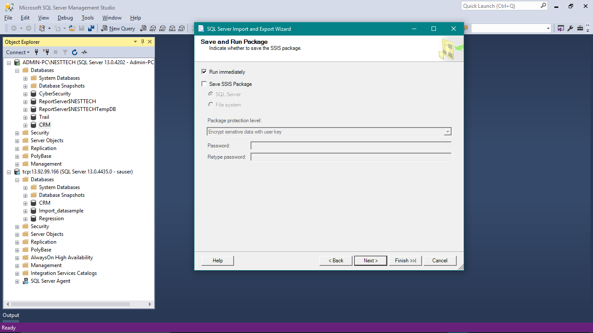
Select Run immediately option and click Next

Slide 18
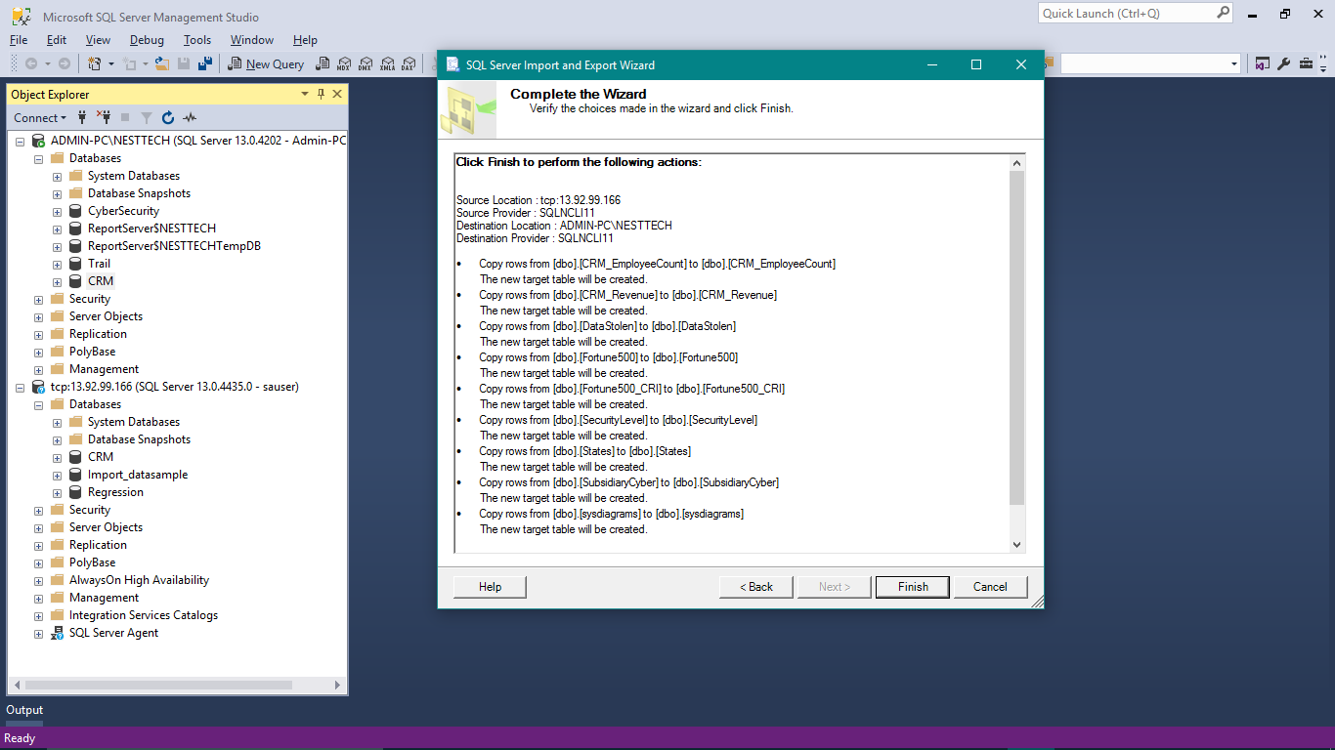
Click Finish here

Slide 19
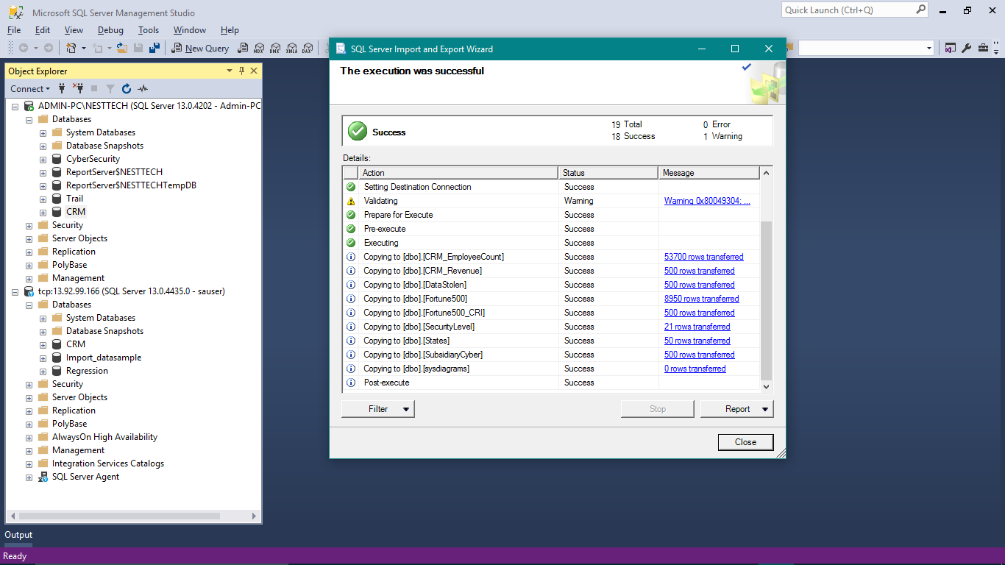
This window will appear then close.

Slide 20
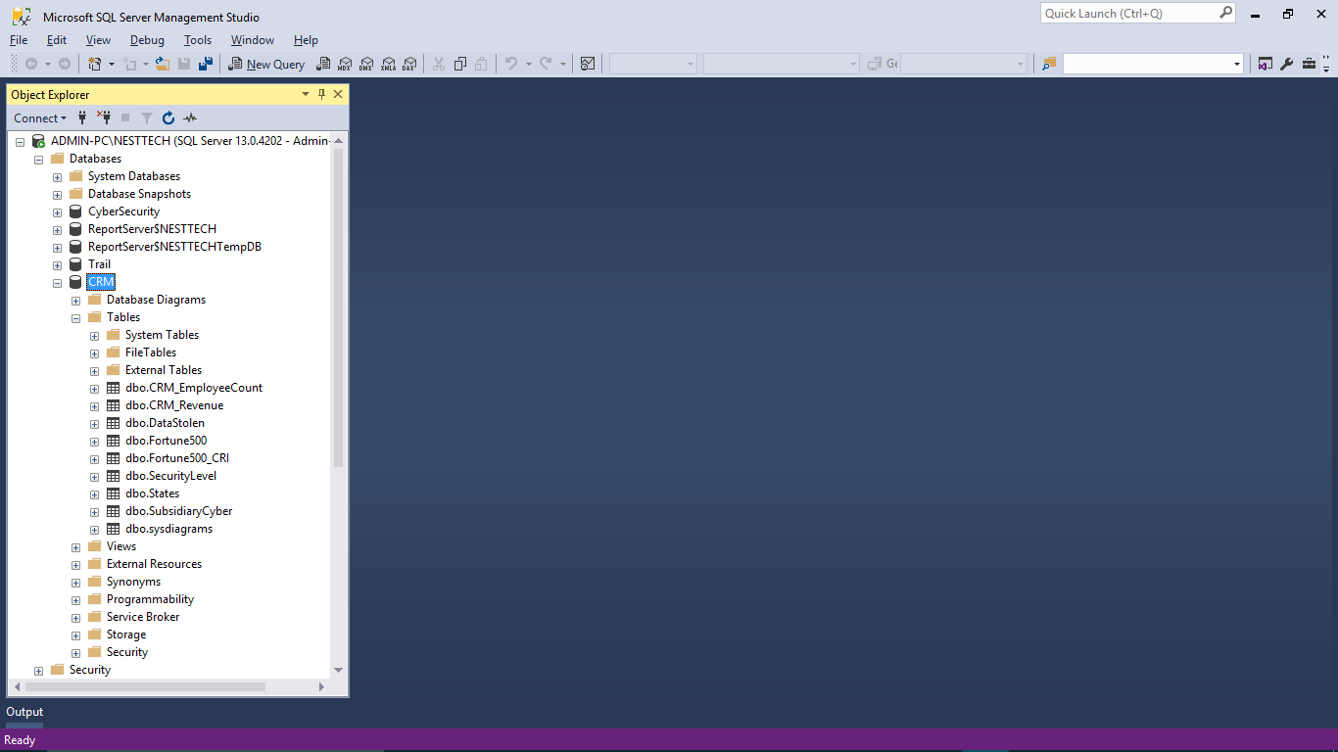
You have successfully imported data from one sql server to other.

