Slide 1
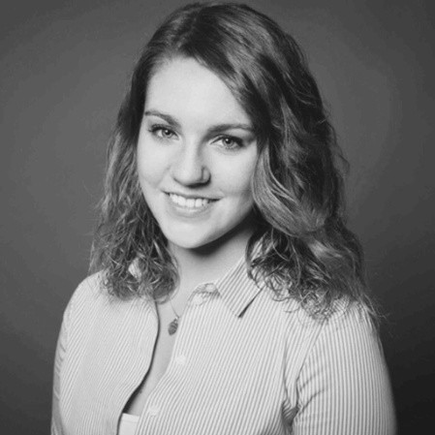








ABOUT ME
Laura Richardt
BI Developer (BWT Wassertechnik GmbH)
B.A. BWL Industrie (DHBW Mannheim)
Mannheim
laura.richardt@bwt.de
Laura Richardt

