Slide 1
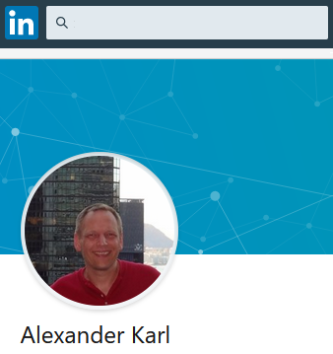


about me
https://www.linkedin.com/in/alexander-karl-44561012a/

