Slide 1
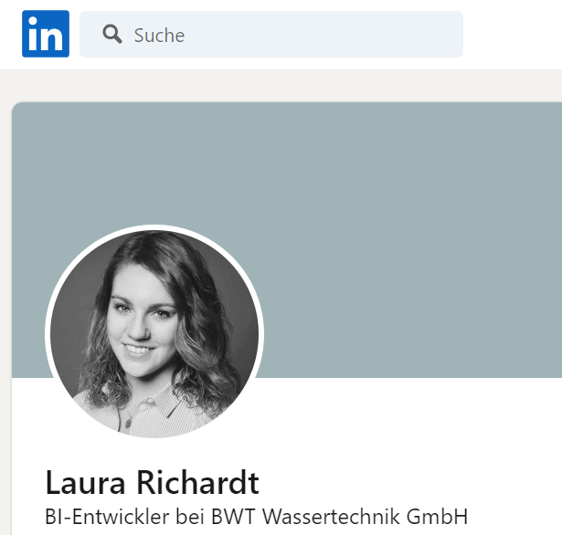


about me
https://www.linkedin.com/in/laura-richardt-550ba4154/

