Slide 1
Quantifier Instantiation Ideas

Slide 2
Small Models
Example | Core Instantiations Model Size | All Instantiations Model Size
SequenceSetsMod | 2 | 8-66
PagedBetree.BetreeNode.Child | 1 | 7
PivotBetree.BetreeNode.Flush | 3 | 9-660
PivotBetree.Path.ReplacedChildren | 2 | 7
$⇒$ We want instantiations that keep the model size small

Slide 3

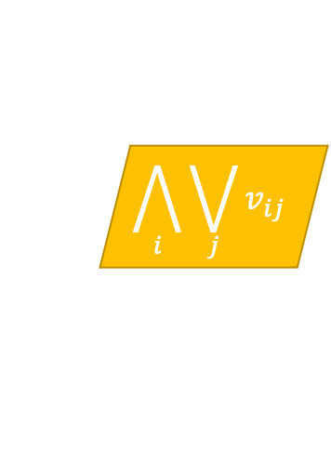

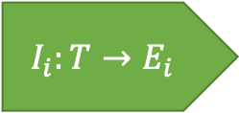
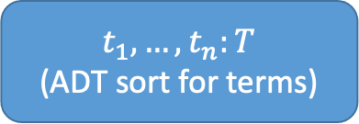

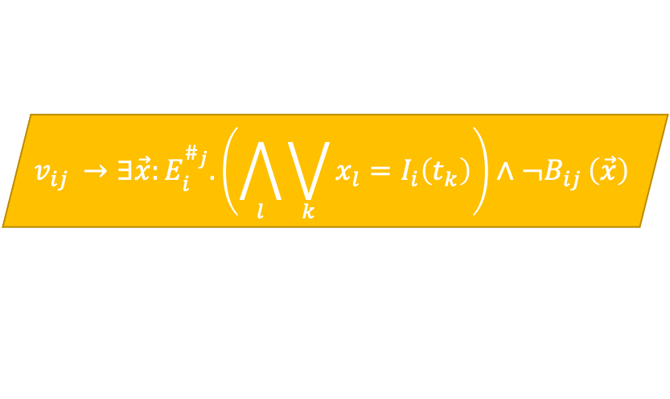

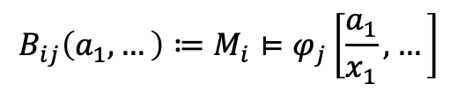

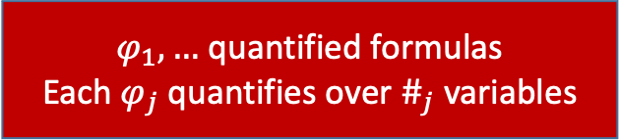
“Generalized” SyGuS
Number of terms is a proxy for model size
$$M_{1}$$
$$M_{m}$$
$φ_{1},…$ quantified formulas
Each $φ_{j}$ quantifies over $\#_{j}$ variables
$t_{1},…,t_{n}:T$
(ADT sort for terms)
Models
…
$$B_{ij}:E_{i}^{\#_{j}}→Bool$$
$$E_{1}$$
$$E_{m}$$
$$B_{ij}\left(a_{1},…\right)≔M_{i}⊨φ_{j}\left[\frac{a_{1}}{x_{1}},…\right]$$
Enum Sorts
…
$$v_{ij }→∃\vec{x}:E_{i}^{\#_{j}}.\left(\bigwedge_{l}{\bigvee_{k}{x_{l}=I_{i}\left(t_{k}\right)}}\right)∧¬B_{ij }\left(\vec{x}\right)$$
$$I_{i}:T→E_{i}$$
Interpretations
$v_{ij }$: Model $i$ violates quantifier $j$ instantiated with terms from $t_{1},…,t_{n}$
$$\bigwedge_{i}{\bigvee_{j}{v_{ij}}}$$
Every model violates some quantifier instantiation:

Slide 4
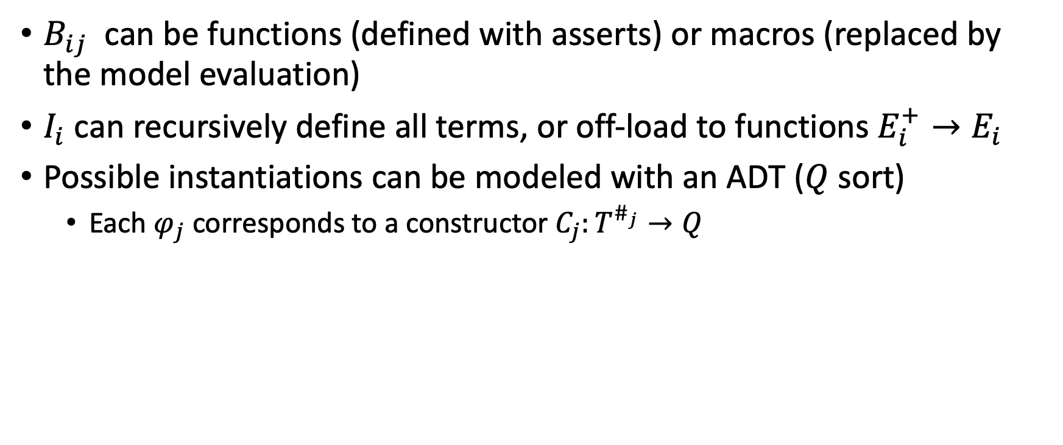
Further Ideas
$B_{ij}$ can be functions (defined with asserts) or macros (replaced by the model evaluation)
$I_{i}$ can recursively define all terms, or off-load to functions $E_{i}^{+}→E_{i}$
Possible instantiations can be modeled with an ADT ($Q$ sort)
Each $φ_{j}$ corresponds to a constructor $C_{j}:T^{\#_{j}}→Q$

