Slide 1
Analyzing and Improving Quantifier Instantiation for Systems Verification
Notes:
A lot of people here write big systems and verify them
Verification can be hard: which rules should you apply in order to prove, and how to apply them?
Automation treads a thin line between fast and automatic

Slide 2
Agenda
Background
Motivation
Methodology
Results
Future Ideas

Slide 3
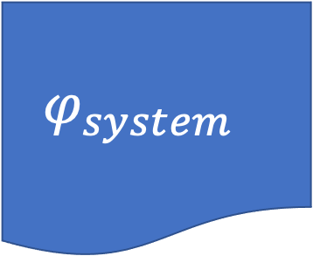
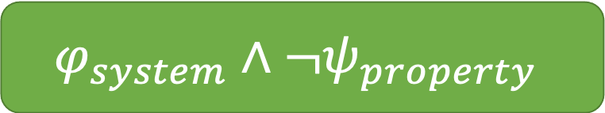

Background
System
$$φ_{system}$$
FOL
Property
$$ψ_{property}$$
Quantifier Instantiations
Quantified
Verified!
UNSAT
$$φ_{system}∧¬ψ_{property}$$
SMT Solver
SAT
Counter-model

Slide 4
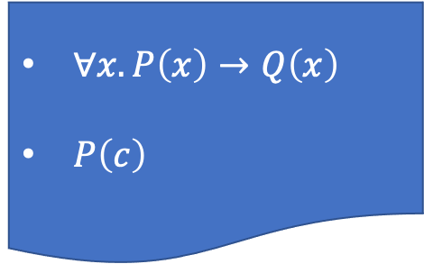
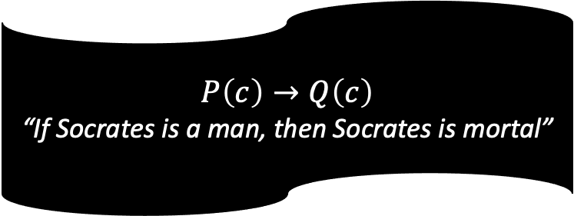
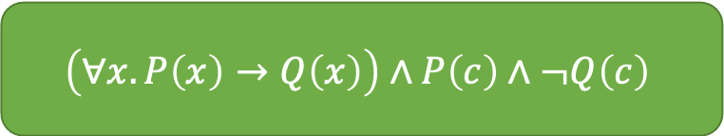

Quantifier Instantiation
All men are mortal
Socrates is a man
$∀x.P\left(x\right)→Q\left(x\right)$
$P\left(c\right)$
FOL
Socrates is mortal
$$Q\left(c\right)$$
$$P\left(c\right)→Q\left(c\right)$$
“If Socrates is a man, then Socrates is mortal”
$$\left(∀x.P\left(x\right)→Q\left(x\right)\right)∧P\left(c\right)∧¬Q\left(c\right)$$
SMT Solver
UNSAT
Verified!

Slide 5
Motivation
Too many quantifiers and terms to instantiate
So we limit the search space
But now we are less automated
Notes:
~800 quantifiers in a Dafny SMT file
~500 ground terms
We rely on the user, but the user can be less informed to guide the search
I.e., they can point us to a large pile of quantifiers that we should consider
But even when that pile contains what we need, it usually contains much more

Slide 6
Motivation
How can we improve automation?
We start by ”profiling” what we have now
Where do we rely on user help?
How do these instantiations look?
Which quantifiers are important?
Notes:
Without reverting to slow processes
Can we use the “time budget” more effectively?
Take advantage of the large corpus of verified code that we have

Slide 7
Example – PagedBetree
function Child(key: Key) : BetreeNode
requires WF()
requires BetreeNode?
{
assert children.WF();
children.mapp[key]
}
Notes:
User adds this (superfluous) assertion to help automation

Slide 8
Methodology
Core
Dafny file
Remove User Help
Dafny
SMT file
Z3 + Tracer
Raw data
Broken Dafny file
Notes:
We have a codebase where are the user-added assertions are marked by comments
The last step was harder than anticipated, and requires a lot of manual work, so we only did it for one file

Slide 9
Methodology – Comparing Instantiations
Compare instantiations of broken files to their originals
Categorize the different kinds of quantifiers
Examine the distribution of instantiations across quantifiers
Notes:
For each broken file, find the delta between the instantiations of the original file and its.
(or compare with the core, if we have it)
I.e., get a set of instantiations we needed to look at, but didn’t (without the user help)

Slide 10
Case Study: PagedBetree – Categorized Instantiations
Notes:
First three are user code
SAME_FILE - Business logic within the same source file as the verification target
USER – Business logic without the same file
LIB – Lower level user code
Next four are Dafny stuff
PRELUDE – Dafny’s boogie prelude
FUN_TYPE – Special quantifiers to represent the type of a function’s return value
BUILTIN – Other Dafny/boogie builtin not appearing in the prelude
UNKNOWN – Quantifiers that Dafny didn’t assign a quantifier ID to

Slide 11
Case Study: PagedBetree – Instantiations per Quantifier

Slide 12
Categorized Instantiations – Broken Files
Notes:
We this analysis for 25 other verification targets, but without the core

Slide 13
Categorized Instantiations – Original Files

Slide 14
Categorized Instantiations – Delta

Slide 15
Categorized Instantiations – Combined

Slide 16
Instantiations per Quantifier – Broken Files

Slide 17
Instantiations per Quantifier – Original Files

Slide 18
Instantiations per Quantifier – Delta

Slide 19
Instantiations per Quantifier – Combined

Slide 20
Insights
User and ”Same file” are good targets for more eager instantiation
Some quantifiers are over-triggered
Unsat cores are very small
And flat (less instantiations per quantifier)
Notes:
Especially in lib we have over-eager quantifiers (since they don’t have optimized triggers)
The small unsat core is an opportunity: we only need to find a few good quantifiers, and a few good terms

Slide 21
Future Ideas
We want to “hit” certain quantifiers, but we can’t be too eager
Limit terms: type info + terms in file
Limit/rank quantifiers: “proximity”, “probability”
Model-based techniques:
Minimal hitting sets
Generalize from small models
Notes:
Explain what is type info, and how to utilize it
Stability vs. automation

