Slide 1
Quantifier Instantiation Ideas

Slide 2
”Core” Instantiations – Small Models
UNSAT
SAT
QF part
Main (QF) Assert
Instantiations
QF part
Instantiations
Remove Main Assert
Unsat Core
Core QF part
Main (QF) Assert
Core Instantiations
Core QF part
Core Instantiations

Slide 3
Motivating Results
Example | Core Instantiations | Core Instantiations Terms | Core Instantiations Model Size | All Instantiations | All Instantiations Terms | All Instantiations Model Size
SequenceSetsMod | 137 | 413 | 2 | 2557 | 3504 | 8-66
PagedBetree.BetreeNode.Child | 15 | 82 | 1 | 115 | 460 | 7
PivotBetree.BetreeNode.Flush | 132 | 351 | 3 | 577 | 1641 | 9-660
PivotBetree.Path.ReplacedChildren | 157 | 428 | 2 | 1001 | 1851 | 7
$⇒$ We want instantiations that use less terms and keep the model small

Slide 4

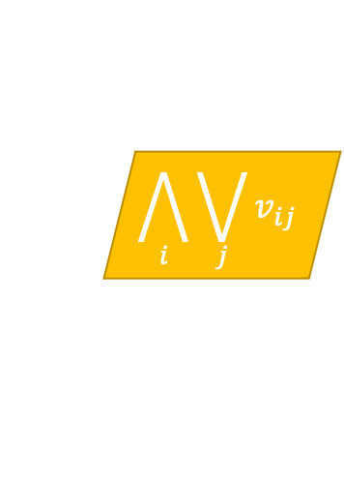

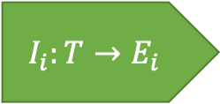
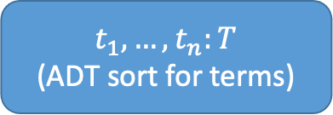
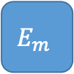
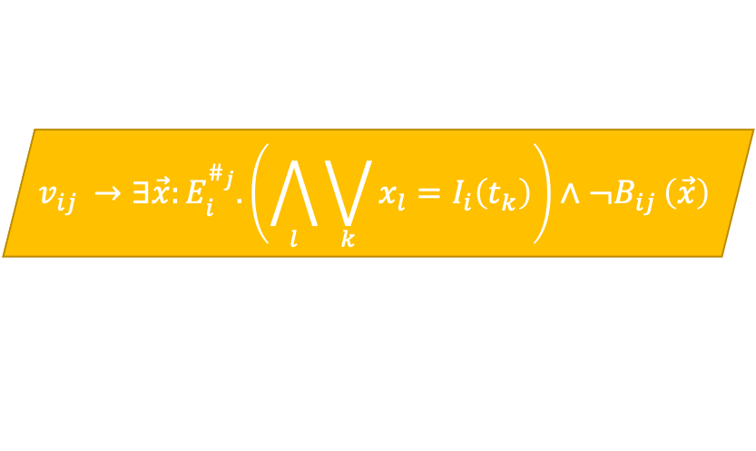

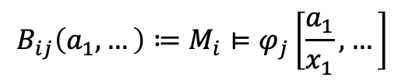

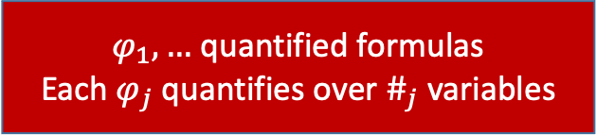
“Generalized” SyGuS
Number of terms is a proxy for model size
$$M_{1}$$
$$M_{m}$$
$φ_{1},…$ quantified formulas
Each $φ_{j}$ quantifies over $\#_{j}$ variables
$t_{1},…,t_{n}:T$
(ADT sort for terms)
Models
…
$$B_{ij}:E_{i}^{\#_{j}}→Bool$$
$$E_{1}$$
$$E_{m}$$
$$B_{ij}\left(a_{1},…\right)≔M_{i}⊨φ_{j}\left[\frac{a_{1}}{x_{1}},…\right]$$
Enum Sorts
…
$$v_{ij }→∃\vec{x}:E_{i}^{\#_{j}}.\left(\bigwedge_{l}{\bigvee_{k}{x_{l}=I_{i}\left(t_{k}\right)}}\right)∧¬B_{ij }\left(\vec{x}\right)$$
$$I_{i}:T→E_{i}$$
Interpretations
$v_{ij }$: Model $i$ violates quantifier $j$ instantiated with terms from $t_{1},…,t_{n}$
$$\bigwedge_{i}{\bigvee_{j}{v_{ij}}}$$
Every model violates some quantifier instantiation:

Slide 5
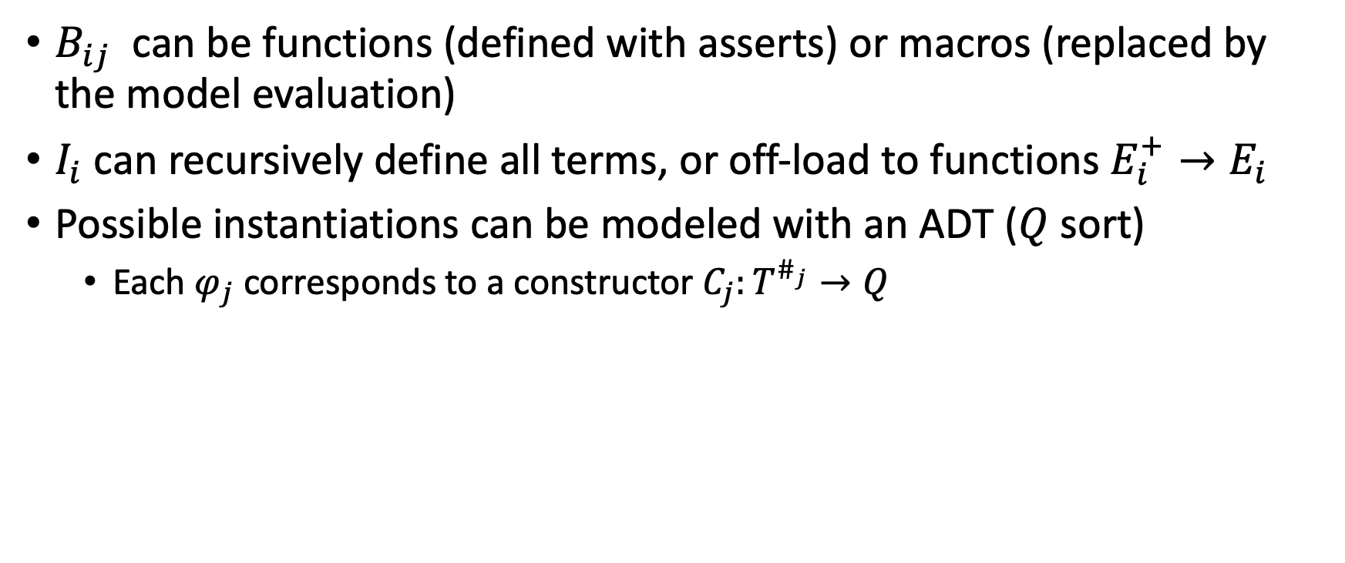
Further Ideas
$B_{ij}$ can be functions (defined with asserts) or macros (replaced by the model evaluation)
$I_{i}$ can recursively define all terms, or off-load to functions $E_{i}^{+}→E_{i}$
Possible instantiations can be modeled with an ADT ($Q$ sort)
Each $φ_{j}$ corresponds to a constructor $C_{j}:T^{\#_{j}}→Q$

Slide 6
Questions
What do you think of this scheme of using ADTs?
How to enforce a small model for all instantiations?
CEGAR loop
Incorporate into the query: find instantiations + small model
Is it a good idea to use an ADT for instantiations (>1000 constructors)
How to encode the models? Relations/functions vs. ITE terms
How would cvc5 search for the ADT terms?
Enumeration by depth?
Clever heuristics?

Slide 7
Quantified axioms: forall x: A1; … forall x: An
Have only an infinite model
Quantified free: phi
Hypothesis: phi && A_i1[t1] && … && A_im[tm] unsat
A_i1[t1] && … && A_im[tm] sat with model of size <= 3
Initially empty set of models SM, empty set of instantiations SI
While phi && SI is sat:
Get model M for phi && SI and add to SM
Find a small set of instantiations SI’ such that for every model M in SM there exists some instantiation I in SI’ such that M violates I,
And SI’ have a small model
And SI U SI’ have a small model
Add SI’ to SI

