Slide 1
Models and Instantiations
We have a (small) set of (small) models
Each model violates some quantifier instantiations
We want to find a hitting set
Previously talked about using ADTs
We don’t need all terms, since some are equivalent
They will hit the same tuple of elements across models

Slide 2
Equivalence Classes
For each tuple of elements across all models we know if and how we can represent it with a single term
We have equivalence classes of terms mapped to the same tuple of elements across models
The number of equivalence classes is much smaller than the number of possible terms
Since we have a relatively small number of models with small number of elements
Even when considering other techniques such as the “generations” of enumerative instantiation

Slide 3








Example
$$M_{1}$$
$$M_{2}$$
$$M_{3 }$$
$$c_{1}$$
$$c_{2}$$
$$f\left(c_{1}\right)$$
$$f\left(c_{2}\right)$$
$$f\left(f\left(c_{1}\right)\right)$$

Slide 4
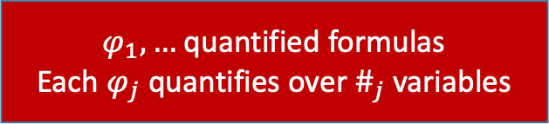
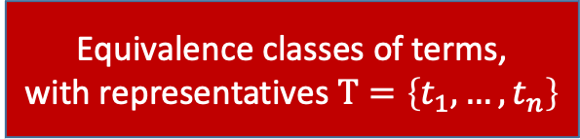


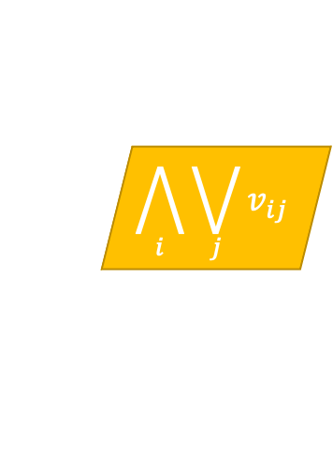
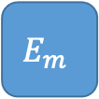
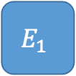

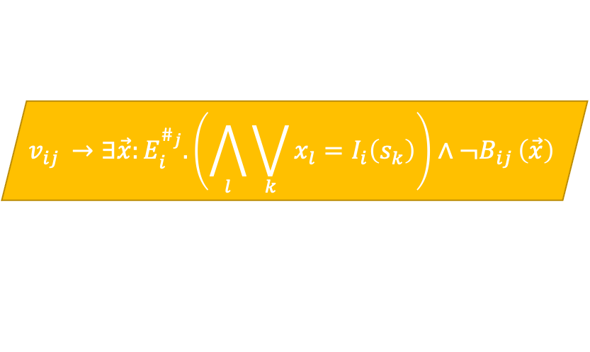

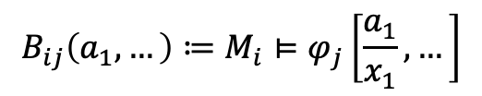
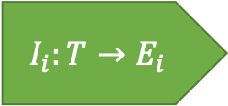
“Generalized” MBQI
$$M_{1}$$
$$M_{m}$$
$φ_{1},…$ quantified formulas
Each $φ_{j}$ quantifies over $\#_{j}$ variables
Equivalence classes of terms,
with representatives $T=\left\{t_{1},…,t_{n}\right\}$
Models
…
Variables $s_{1},…,s_{5}∈T$
$$B_{ij}:E_{i}^{\#_{j}}→Bool$$
$$E_{1}$$
$$E_{m}$$
$$B_{ij}\left(a_{1},…\right)≔M_{i}⊨φ_{j}\left[\frac{a_{1}}{x_{1}},…\right]$$
Enum Sorts
…
$$v_{ij }→∃\vec{x}:E_{i}^{\#_{j}}.\left(\bigwedge_{l}{\bigvee_{k}{x_{l}=I_{i}\left(s_{k}\right)}}\right)∧¬B_{ij }\left(\vec{x}\right)$$
$$I_{i}:T→E_{i}$$
$v_{ij }$: Model $i$ violates quantifier $j$ instantiated with terms from $t_{1},…,t_{n}$
Interpretations
$$\bigwedge_{i}{\bigvee_{j}{v_{ij}}}$$
Every model violates some quantifier instantiation:

Slide 5

“Generalized” MBQI
$$M_{1}$$
$$M_{m}$$
$φ_{1},…$ quantified formulas
Each $φ_{j}$ quantifies over $\#_{j}$ variables
Equivalence classes of terms,
with representatives $T=\left\{t_{1},…,t_{n}\right\}$
Models
…
$$B_{ij}:E_{i}^{\#_{j}}→Bool$$
$$E_{1}$$
$$E_{m}$$
$$B_{ij}\left(a_{1},…\right)≔M_{i}⊨φ_{j}\left[\frac{a_{1}}{x_{1}},…\right]$$
Enum Sorts
…
$$v_{ij }→¬B_{ij }\left(I_{i}\left(\vec{s_{j} }\right)\right)$$
$$I_{i}:T→E_{i}$$
$v_{ij }$: Model $i$ violates quantifier $j$ instantiated with terms from $t_{1},…,t_{n}$
Interpretations
$$\bigwedge_{i}{\bigvee_{j}{v_{ij}}}$$
Every model violates some quantifier instantiation:

Slide 6
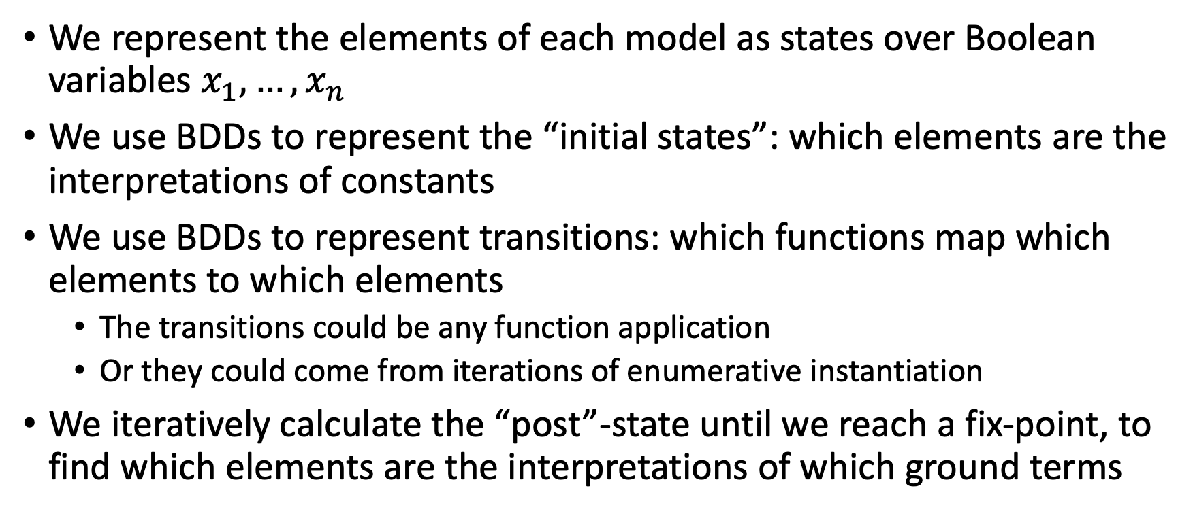
Computing Equivalence Classes with BDDs
We represent the elements of each model as states over Boolean variables $x_{1},…,x_{n}$
We use BDDs to represent the “initial states”: which elements are the interpretations of constants
We use BDDs to represent transitions: which functions map which elements to which elements
The transitions could be any function application
Or they could come from iterations of enumerative instantiation
We iteratively calculate the “post”-state until we reach a fix-point, to find which elements are the interpretations of which ground terms

