Slide 1
Deep Learning Model for Automated Detection of Meniscus Tears in Knee MRI Images
Capstone Project Phase A-24-1-R-22
Supervisor: Prof. Miri Weiss Cohen
Students: Neta Amzalag, Vital Marciano

Slide 2
Table of content
1. Introduction
The meniscus and its importance
2. The problem
Challenges in Meniscus Tear Diagnosis
Meniscus Tear Types
3. Proposed research plan
Research plan
Expected Achievements
Product
Evaluation/ Verification plan
Current state
Background and Suggested solution

Slide 3
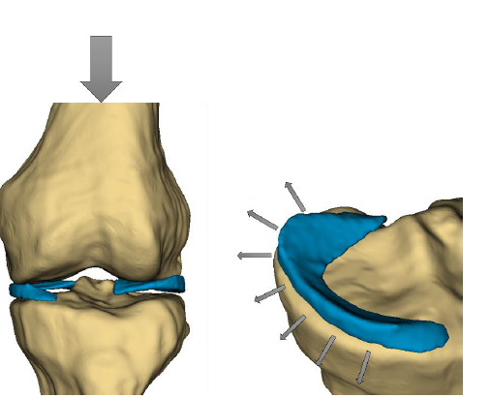
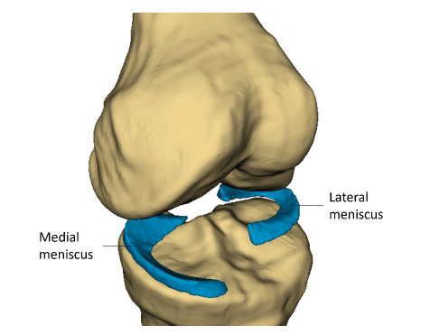
The meniscus and its importance
Introduction
Femur
The meniscus is a crescent-shaped cartilage structure in the knee joint.
It acts as a shock absorber and stabilizer for the knee.
Meniscus tears are a common knee injury, causing pain, swelling, and instability.
2nd most common knee injury in the UK and the USA, with 60-70 people per 100,000.
Tibia

Slide 4
Meniscus Tear Types
Introduction
Tear patterns- vertical longitudinal, horizontal, radial, flap and complex tears*.
Tear Thickness- partial or full.
Location- the posterior horn, anterior horn, or midbody
*Complex tears include a combination of radial, horizontal, and longitudinal tear components, with any two or all three of these patterns present.

Slide 5
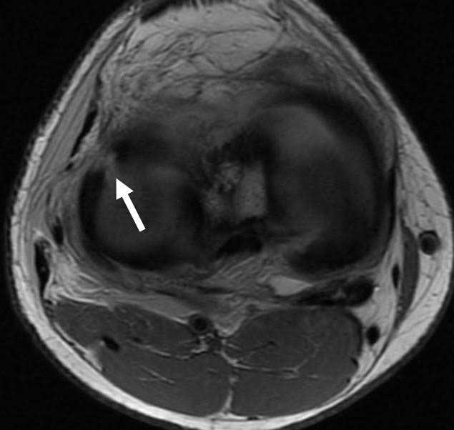
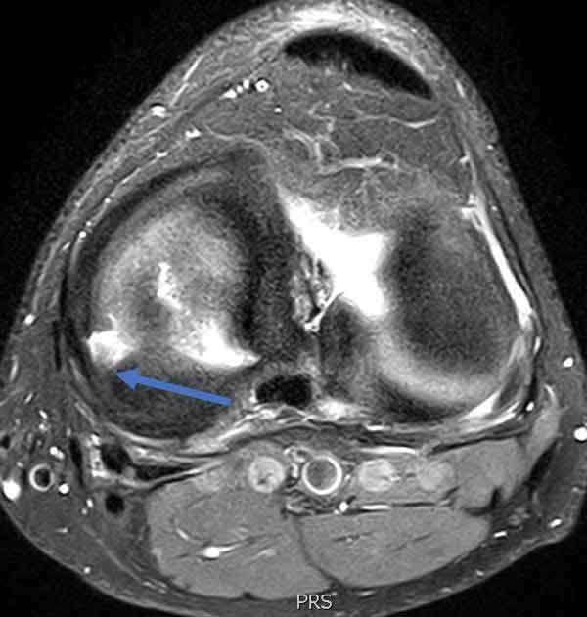
Current State
Introduction
Lateral Meniscus Radial Tear
Tear Detection using MRI (Magnetic Resonance Imaging)
MRI is currently the tool for detecting tears and calling for a surgery decision.
Radiologists uses the MRI scans for detecting a tear, during work loads, in a time consuming process.
Radial Tear of Medial Meniscus

Slide 6
Challenges in Meniscus Tear Diagnosis
The problem
Subjectivity and Variability:
Inter-observer variability can lead to misdiagnoses and inconsistent tear classification.
Need for a more objective and consistent diagnostic tool.
Time Constraints:
Traditional diagnosis can be a time-consuming process, potentially delaying treatment.
Challenges for CNN's:
Color and size variations of the meniscus in MRI scans are complex for traditional CNN's to learn effectively.
Small spatial footprint of the meniscus in MRI scan
Existing CNN-based methods often have limited accuracy (around 80%)
Surgery?

Slide 7
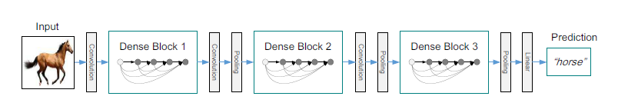
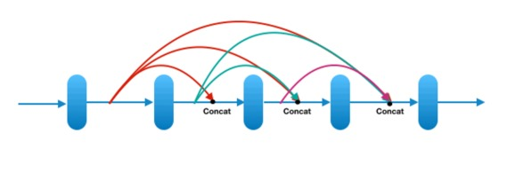
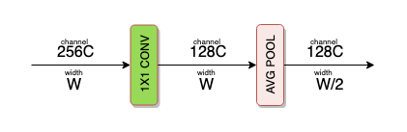
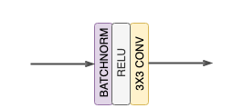
Dens Net
Dense Block
Transition Layer
Composite function

Slide 8
Transfer learning
Proposed research plan
Transfer learning works by reusing a pre-trained model on a new task.
Using a pre-trained model on a vast dataset (source task) can transfer its learned features to a new, related task (target task) with less data.
Benefits:
Faster Training
Improved Performance
Reduced Data Requirements

Slide 9
Suggested solution
Proposed research plan
Optimize DenseNet for classification.
DenseNets are proven to be reliable during classification of MRI scans
DenseNets holds Enhanced Feature Learning and Efficient Feature Extraction, due to its dense connections.
We predict that these traits will serve the meniscus tear detection because of the variety of meniscus tear types and locations.

Slide 10
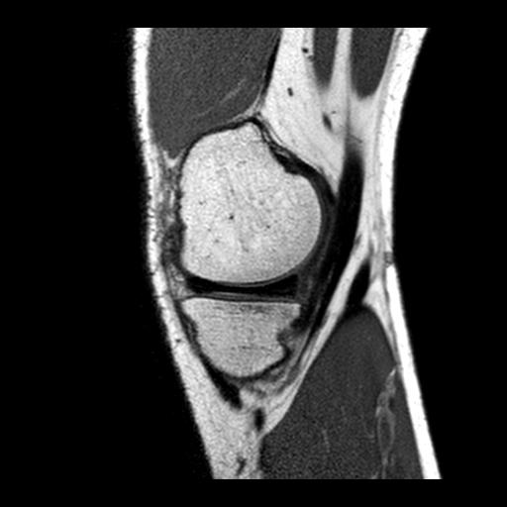
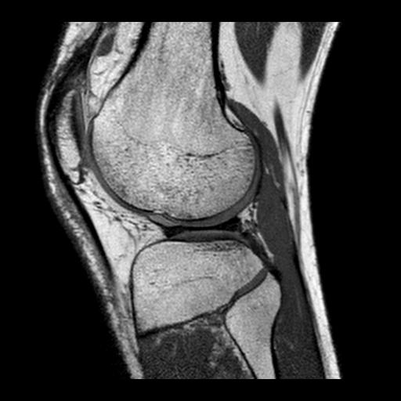
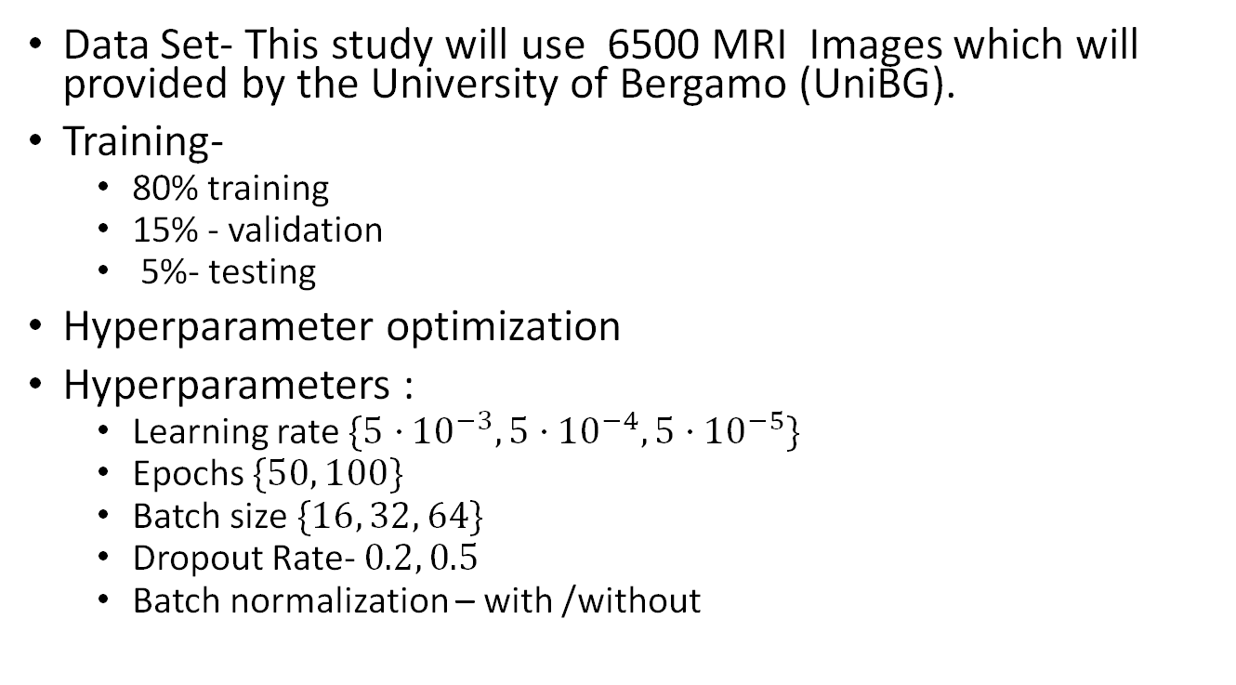
Research plan
Proposed research plan
Data Set- This study will use 6500 MRI Images which will provided by the University of Bergamo (UniBG).
Training-
80% training
15% - validation
5%- testing
Hyperparameter optimization
Hyperparameters:
Learning rate $\{5⋅{10}^{−3}, 5⋅{10}^{−4},5⋅{10}^{−5}\}$
Epochs $\{50, 100\}$
Batch size $\{16, 32, 64\}$
Dropout Rate- $0.2, 0.5$
Batch normalization – with/ without

Slide 11

Expected Achievements
Proposed research plan
Development of a deep learning model for classifying meniscal tears in MRI scans.
Increasing diagnostic accuracy and efficiency of meniscal tear classification.
Minimized inter-observer variability among radiologists leading to consistent diagnoses.
A faster and more accurate MRI analysis that enables earlier intervention and better patient outcomes and assists doctors.
Improve the current success rate.
Notes:
We aim to develop a system that can accurately classify meniscal tears and their types from MRI scans.
By utilizing deep learning, we expect significant improvements in diagnostic accuracy and efficiency compared to traditional methods. Additionally, the model minimizes inter-observer variability among radiologists, leading to more consistent diagnoses and ultimately, better patient care.
Faster and more accurate MRI analysis through deep learning allows for earlier intervention and treatment planning, which is crucial for achieving better patient outcomes. Overall, this deep learning approach has the potential to revolutionize meniscal tear diagnosis in MRI scans.

Slide 12
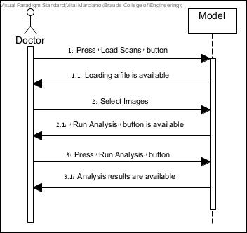
Sequence diagram
Proposed research plan

Slide 13
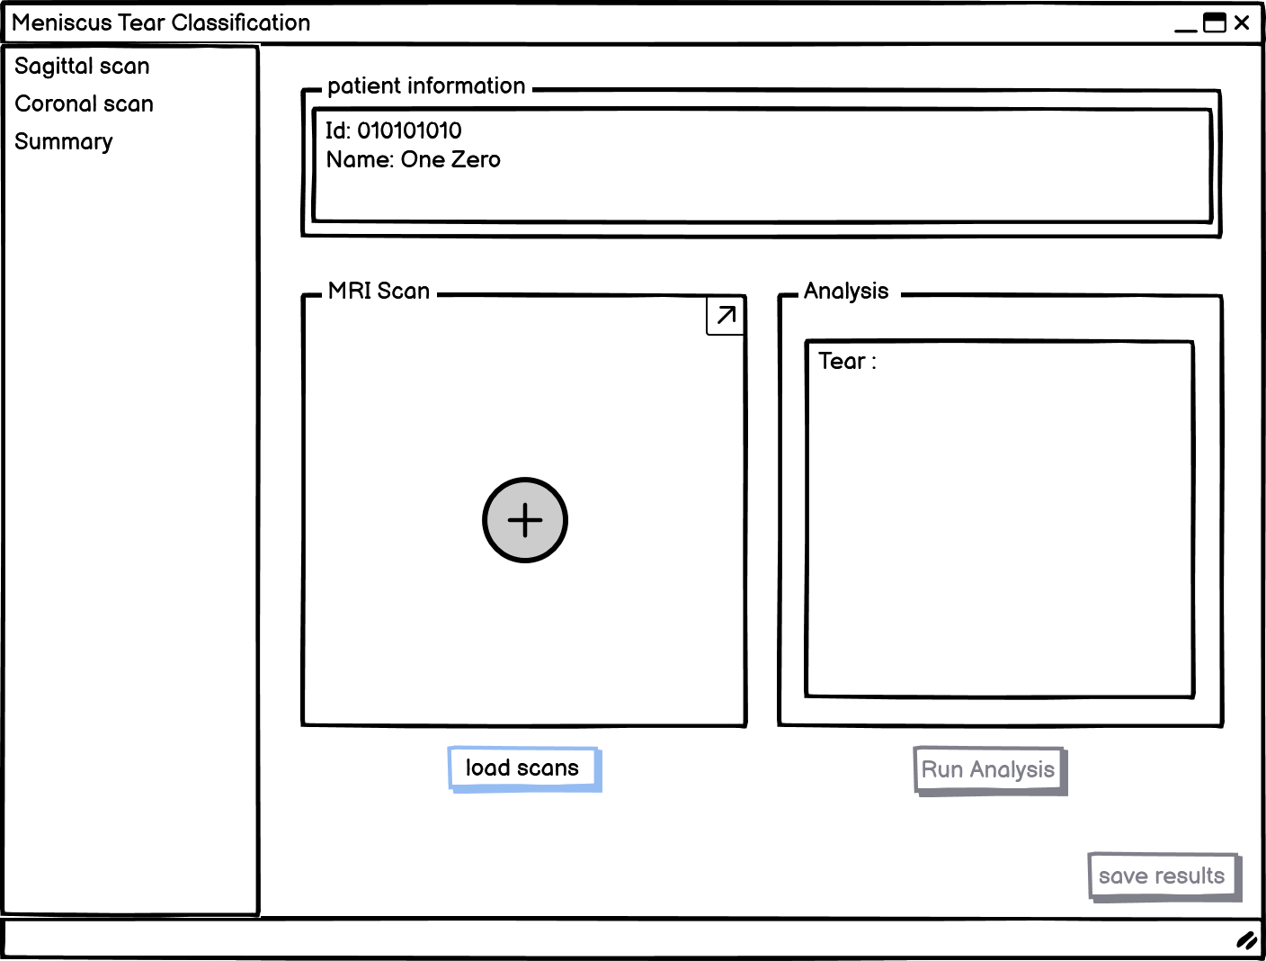
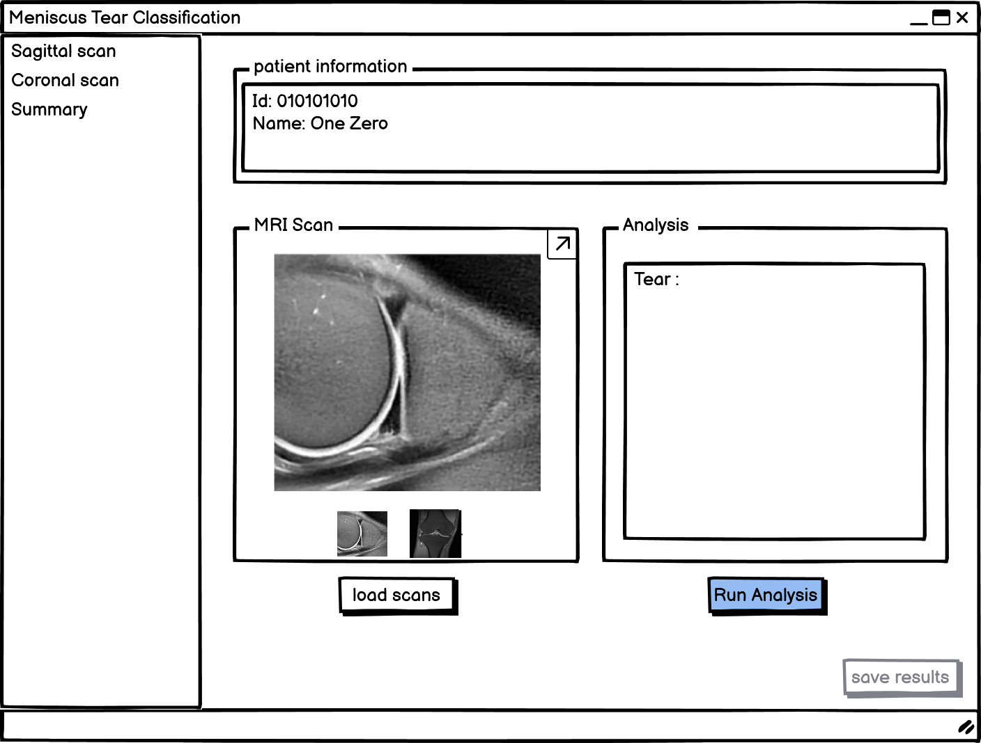
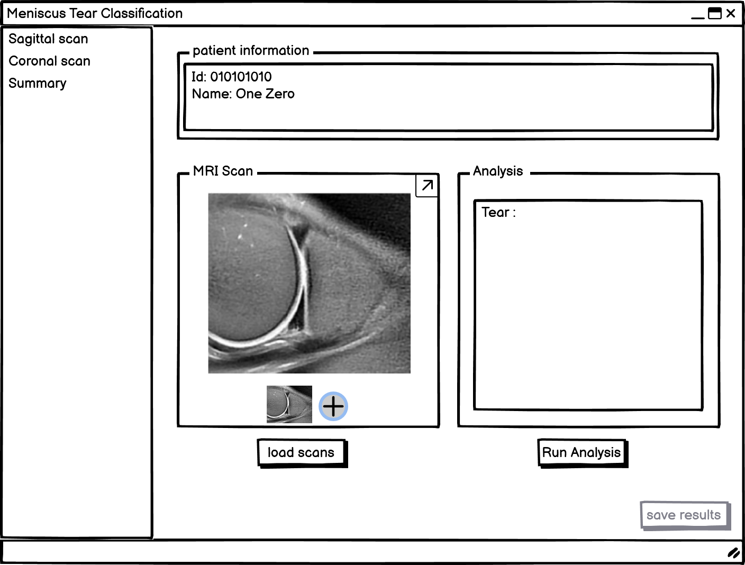
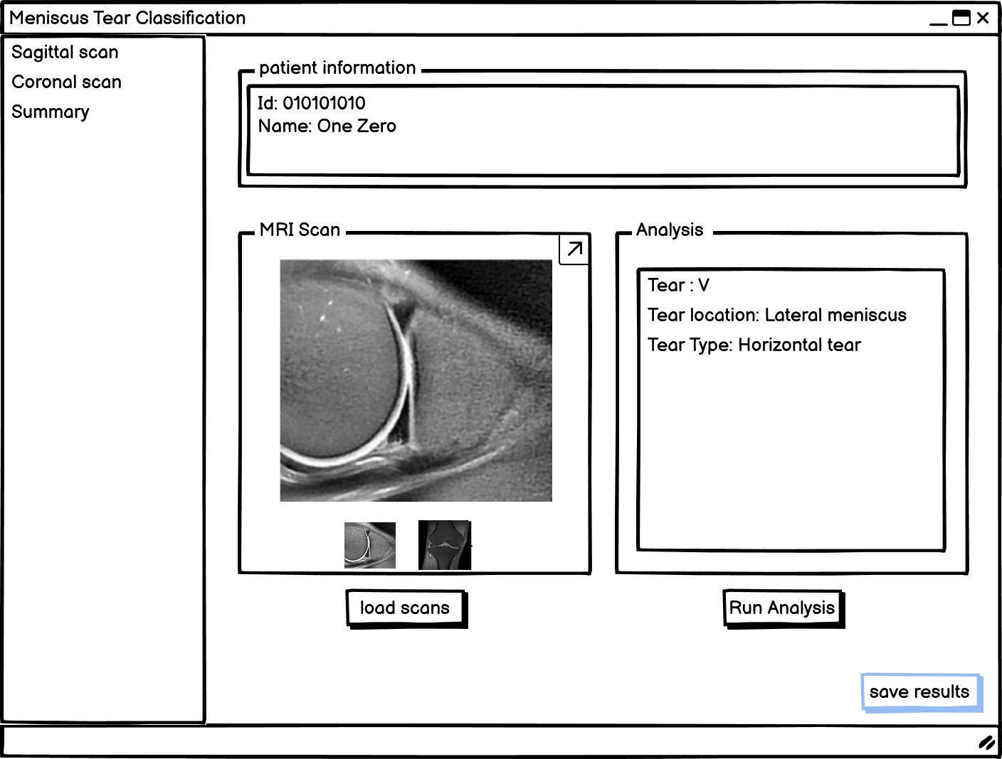
GUI
Proposed research plan

Slide 14
Evaluation/ Verification plan
Proposed research plan
Case | Test Case | Expected Result
1 | Press "load scans" button | An image is loaded on MRI scans box.
2 | Press "Run Analysis" button | The classification results will appear in the analysis box
3 | Press "save results" button | A document with the classification results is saved in the file system
4 | Press "+" button | An image is loaded on MRI scans box
5 | Press "Run Analysis" button without loading an image | Display error message: "Please load image"

Slide 15
Thank you for listening
Any Questions?

