Slide 1

PLAN OF PRESENTATION
ALGORITHMS
Matrix operations
Determinant
Finding coefficients of characteristic polynomial
SVD
QR decomposition
Schur decomposition
Finding eigenvectors
Gram-Schmidt
Polar
Power of matrix
Solving SLE
QR method
LDU & PLU
SELF-STUDY

Slide 2
Finding coefficients of characteristic polynomial

Slide 4
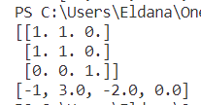
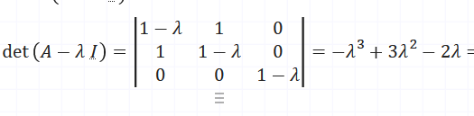
Coefficients: comparison with exact/online solution 3x3 matrix
import alg
import numpy as np
mat = np.array([[1,1,0], [1,1,0], [0,0,1]], dtype = float)
a = alg.decompositions(mat)
coef = a.coefficients()
print(mat)
print(coef)

Slide 5
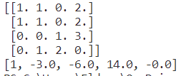
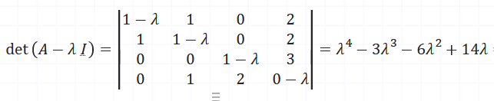
Coefficients: comparison with exact/online solution 4x4 matrix
import alg
import numpy as np
mat=np.array([[1,1,0,2],
[1,1,0,2],
[0,0,1,3],
[0,1,2,0]], dtype = float)
a = alg.decompositions(mat)
coef = a.coefficients()
print(mat)
print(coef)

Slide 6
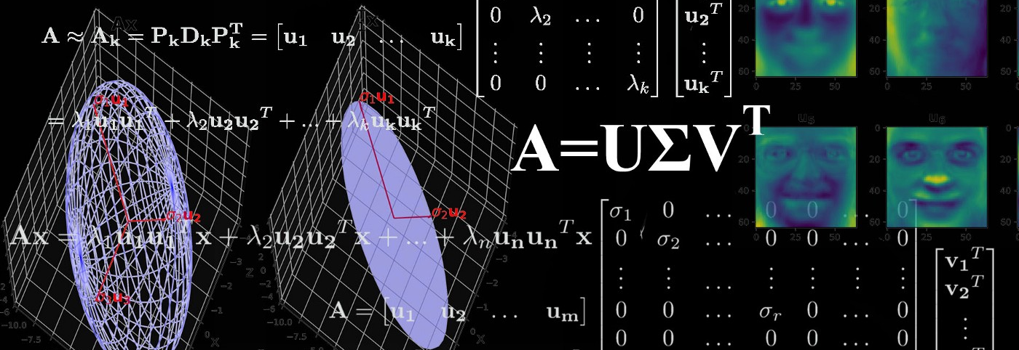
SINGULAR VALUE DECOMPOSITION

Slide 7
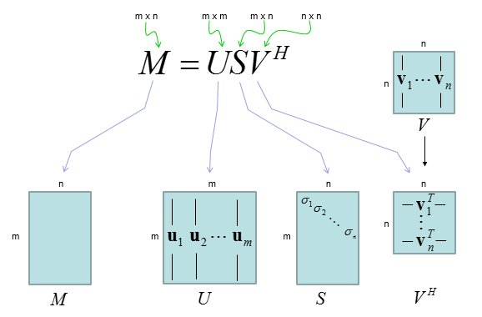
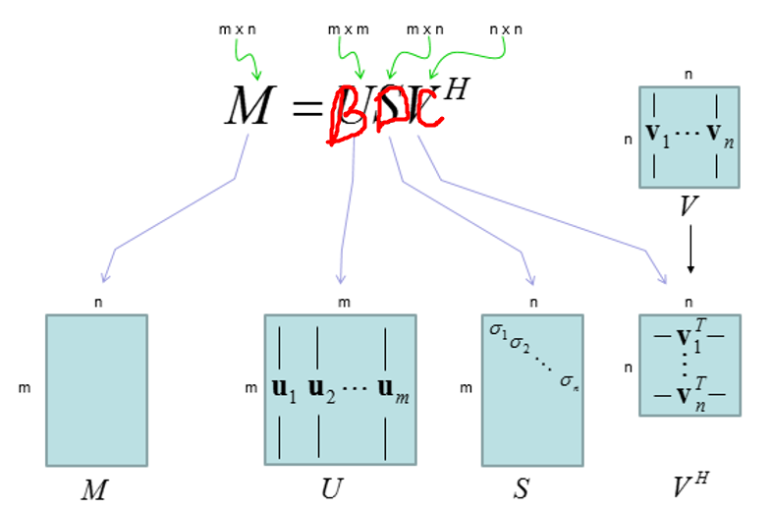
What is SVD

Slide 8
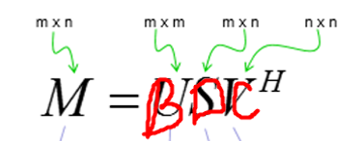
SVD Function
def SVD(self):
self.D_find()
self.C_find()
self.B_find()

Slide 9
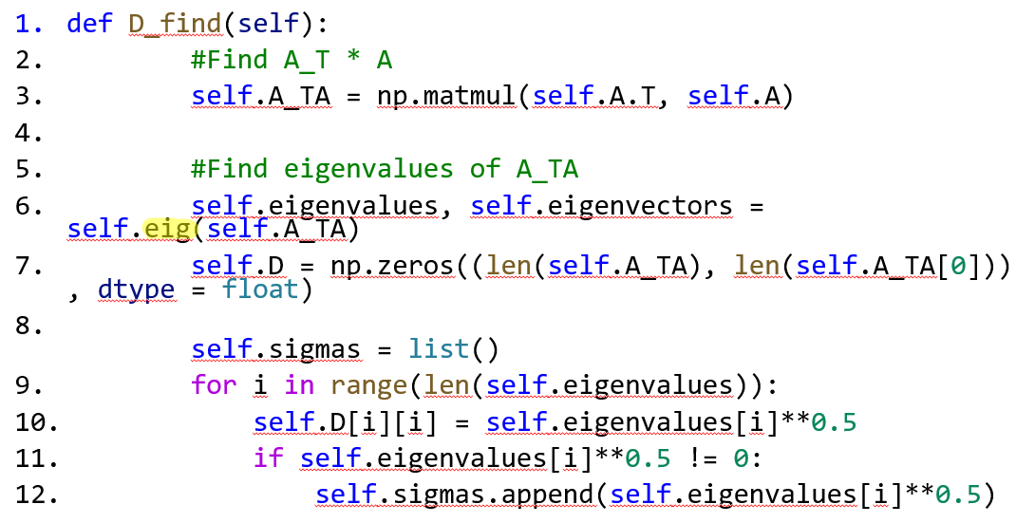
1. D_find() function
.

Slide 10
1.1 Finding eigenvalues 1.1.1 Algorithm
Find QR decomposition
Find Schur decomposition(main diagonal stores eigenvalues)

Slide 11
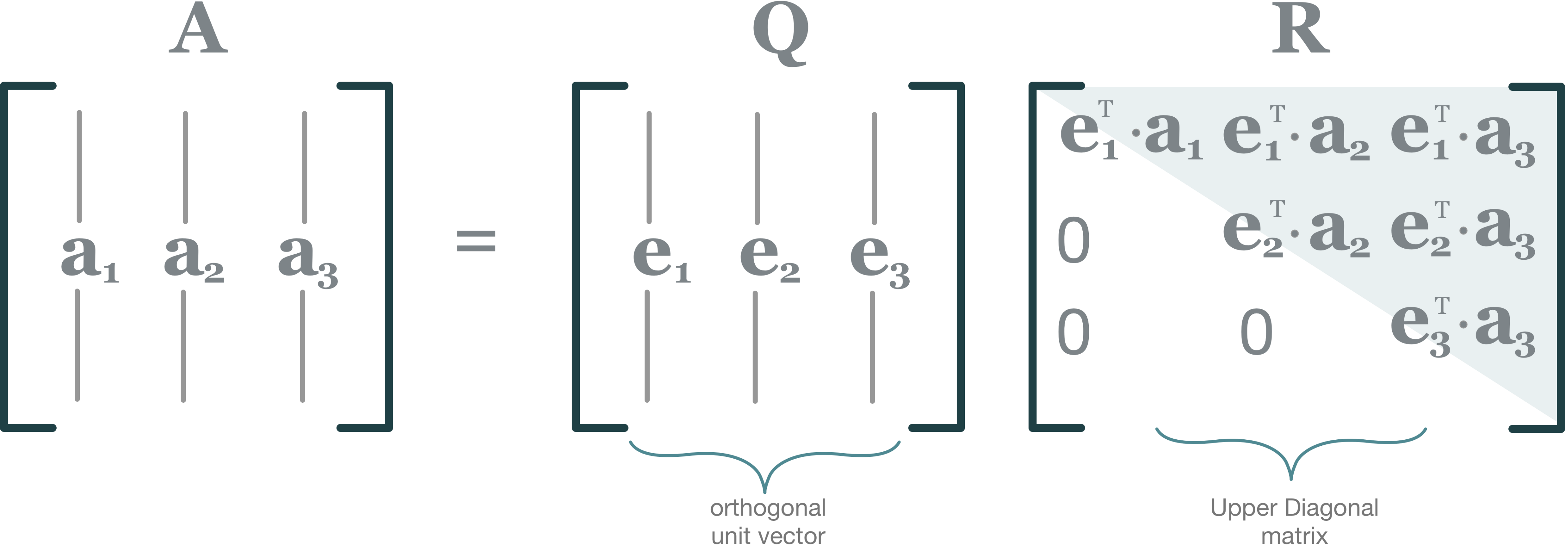
1.1 Finding eigenvalues 1.1.2 QR decomposition

Slide 12
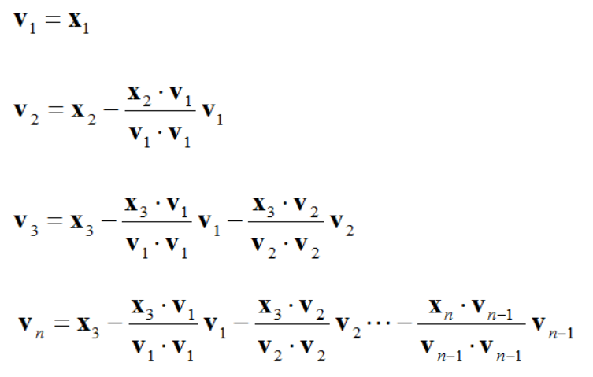
1.1 Finding eigenvalues 1.1.2 QR decomposition 1.1.2.1 Q matrix
Gram-Schmidt procedure

Slide 13
1.1 Finding eigenvalues 1.1.2 QR decomposition 1.1.2.1 Q matrix
def ortogonalize(self):
k = list()
for i in range(1, len(self.eigenvectors)):
for j in range(i):
if np.dot(self.eigenvectors[j], self.eigenvectors[j]) != 0:
temp = np.dot(self.eigenvectors[i], self.eigenvectors[j])/np.dot(self.eigenvectors[j], self.eigenvectors[j])
else:
temp = 1
k.append(temp)
for j in range(len(k)):
self.eigenvectors[i] -= k[j] * self.eigenvectors[j]
k.clear()

Slide 14
1.1 Finding eigenvalues 1.1.2 QR decomposition 1.1.2.1 Q matrix
def normalize(self):
for i in range(len(self.eigenvectors)):
length_v = 0
for j in range(len(self.eigenvectors[i])):
length_v += self.eigenvectors[i][j]**2
length_v = length_v ** 0.5
for k in range(len(self.eigenvectors[i])):
if length_v != 0:
self.eigenvectors[i][k] = self.eigenvectors[i][k]/length_v

Slide 15
1.1 Finding eigenvalues 1.1.2 QR decomposition 1.1.2.1 Q matrix
def Q_find(self):
self.eigenvectors = self.A.copy()
self.eigenvectors = self.eigenvectors.T
self.ortogonalize()
self.normalize()
self.Q = self.eigenvectors.copy()
self.Q = self.Q.T

Slide 16
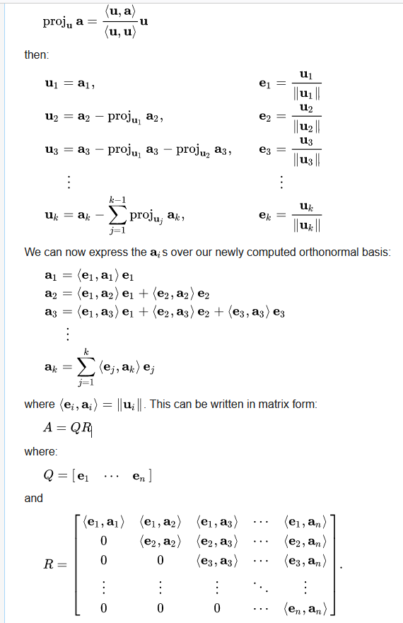
1.1 Finding eigenvalues 1.1.2 QR decomposition 1.1.2.2 R matrix
def R_find(self):
k = 0
self.R = np.zeros((len(self.eigenvectors), len(self.eigenvectors)))
for i in range(k, len(self.eigenvectors)):
for j in range(k, len(self.eigenvectors)):
self.R[i][j] = np.dot(self.eigenvectors[i].T, self.A.T[j])
k+=1

Slide 17
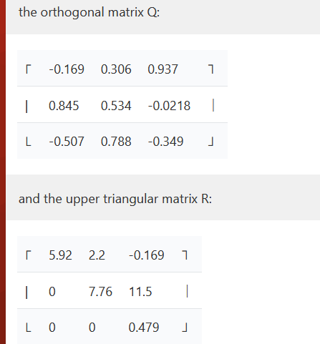
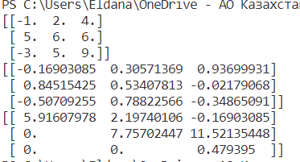
QR: comparison with exact/online solution 3x3 matrix
import alg
import numpy as np
mat = np.array([[-1, 2, 4], [5, 6, 6], [-3, 5, 9]], dtype = float)
a = alg.decompositions(mat)
Q, R = a.QR()
print(mat)
print(Q)
print(R)

Slide 18
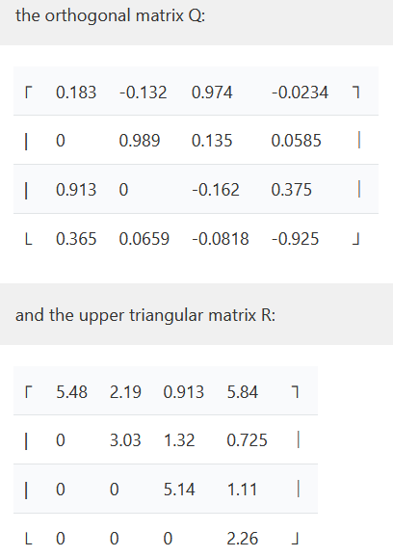
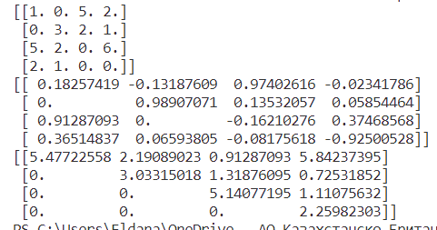
QR: comparison with exact/online solution 4x4 matrix
import alg
import numpy as np
mat=np.array([[1.,0.,5., 2.],
[0.,3.,2., 1.],
[5.,2.,0., 6.],
[2, 1, 0, 0.]])
a = alg.decompositions(mat)
Q, R = a.QR()
print(mat)
print(Q)
print(R)

Slide 19
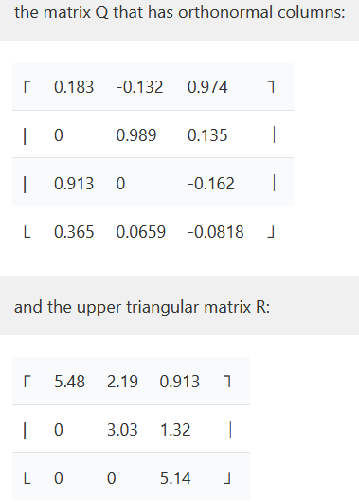
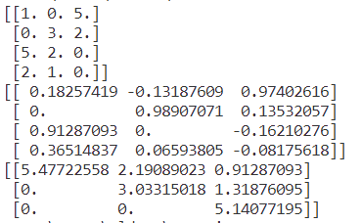
QR: comparison with exact/online solution 4x3 matrix
import alg
import numpy as np
mat = np.array([[-1, 2, 4], [5, 6, 6], [-3, 5, 9]], dtype = float)
a = alg.decompositions(mat)
Q, R = a.QR()
print(mat)
print(Q)
print(R)

Slide 20

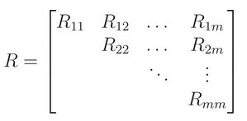
1.1 Finding eigenvalues 1.1.3 Schur decomposition

Slide 21
1.1 Finding eigenvalues 1.1.3 Schur decomposition
def isuppertriangular(self, M):
for i in range(1, len(M)):
for j in range(0, i):
if abs(M[i][j]) > 0.001:
return False
return True
def round_matrix(self, M):
for i in range(len(M)):
for j in range(len(M)):
M[i][j] = round(M[i][j], 2)
return M

Slide 22
1.1 Finding eigenvalues 1.1.3 Schur decomposition
def schur(self):
while not self.isuppertriangular(self.A):
Q, R = self.QR()
self.A = np.matmul(R, Q)
else:
return self.round_matrix(self.A)

Slide 23
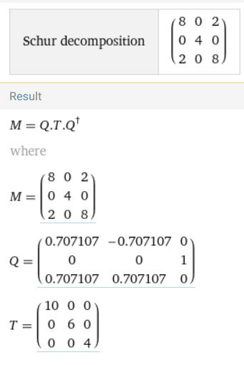
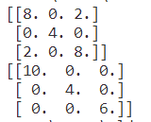
Schur: comparison with exact/online solution 3x3 matrix
import alg
import numpy as np
mat = np.array([[8, 0, 2], [0, 4, 0], [2, 0, 8]], dtype = float)
a = alg.decompositions(mat)
Shur = a.schur()
print(mat)
print(Shur)

Slide 24
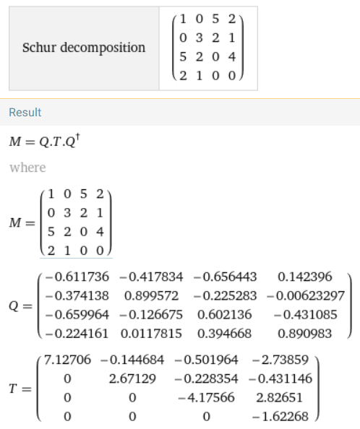
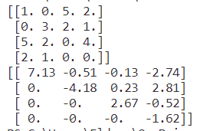
Schur: comparison with exact/online solution 4x4 matrix
import alg
import numpy as np
mat = np.array([[1, 0, 5, 2],
[0, 3, 2, 1],
[5, 2, 0, 4],
[2, 1, 0, ,]], dtype = float)
a = alg.decompositions(mat)
Shur = a.schur()
print(mat)
print(Shur)

Slide 25
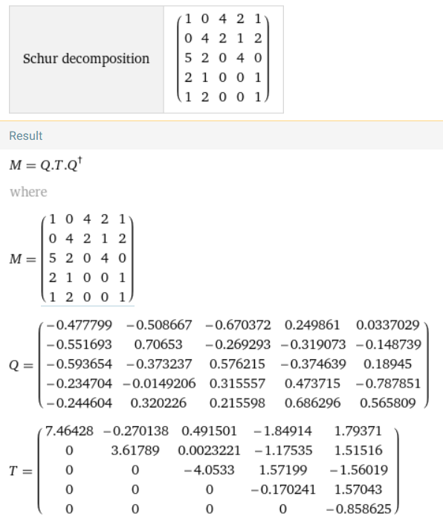
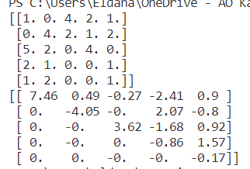
Schur: comparison with exact/online solution 5x5 matrix
import alg
import numpy as np
mat=np.array([[1,0,4,2,1],
[0,4,2,1,2],
[5,2,0,4,0],
[2,1,0,0,1]
[1,2,0,0,1])
a = alg.decompositions(mat)
Shur = a.schur()
print(mat)
print(Shur)

Slide 26
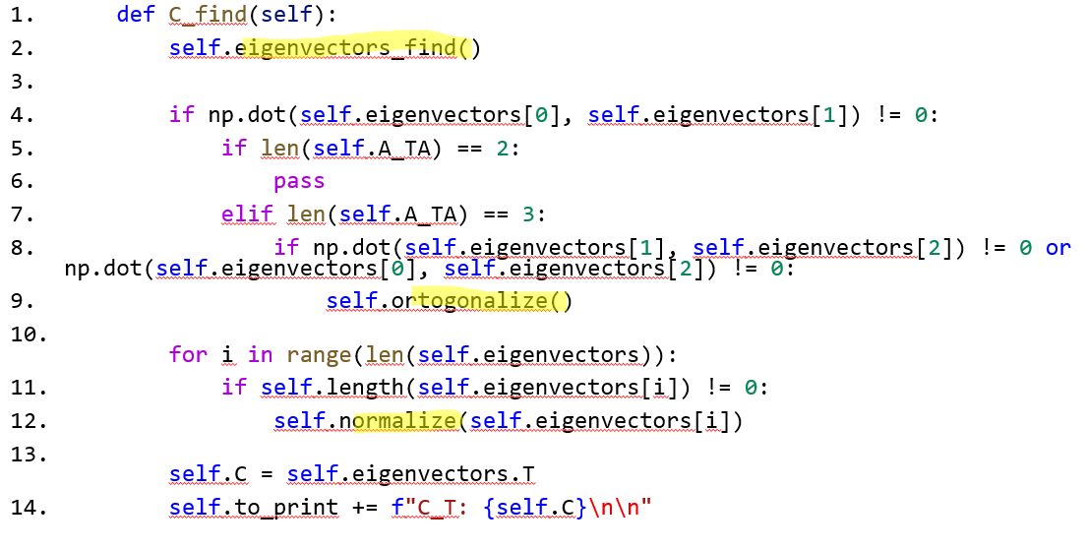
2. C_find() function

Slide 27
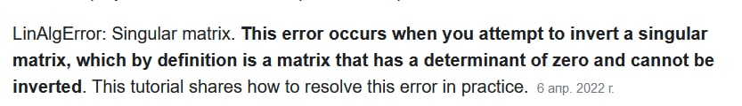
2.1 Finding eigenvectors 2.1.2 Theory&problems
Methods to solve SLE:
Method of inverse matrix
Cramer’s method
Gauss method
Problem :
Zero Determinant matrix → Free Variable

Slide 28
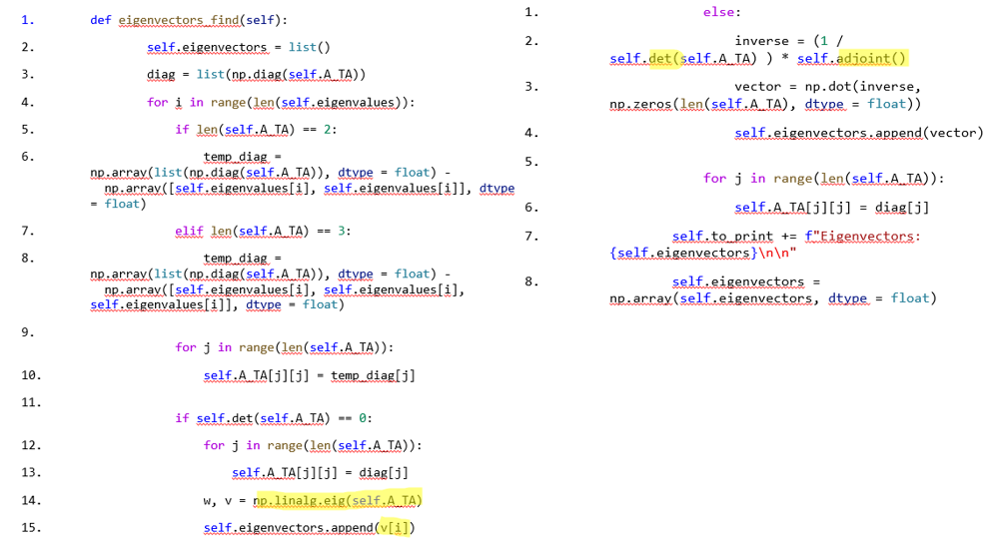
2.1 Finding eigenvectors 2.1.2 Function

Slide 29
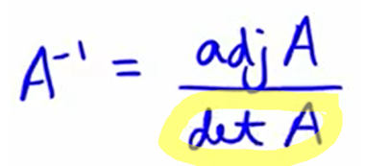
2.1 Finding eigenvectors 2.1.2.1 Determinant of matrix
def det(self, A):
det = 0
det += math.prod(np.diag(A))
det -= math.prod(np.diag(np.fliplr(A)))
if len(A) == 3:
det += (math.prod([A[2][0], A[0][1], A[1][2]]) + math.prod([A[1][0], A[2][1], A[0][2]]))
det -= (math.prod([A[0][1], A[1][0], A[2][2]]) + math.prod([A[0][0], A[2][1], A[1][2]]))
return det
return det

Slide 30
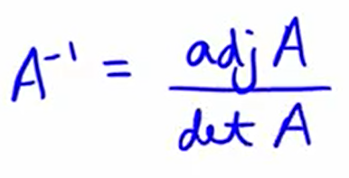
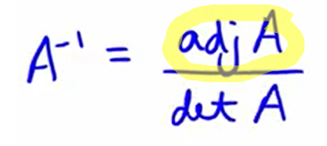
2.1 Finding eigenvectors 2.1.2.2 Adjoint Matrix
def adjoint(self):
temp = list()
if len(self.A_TA) == 2:
temp.append(self.A_TA[1][1])
temp.append(-1 * self.A_TA[1][0] )
temp.append(-1 * self.A_TA[0][1] )
temp.append(self.A_TA[0][0] )
return np.array(np.array(temp).reshape(2, 2), dtype = float)
elif len(self.A_TA) == 3:
temp.append(self.det(self.A_TA[1:3, 1:3]))
temp.append(-1 *self.det(self.A_TA[::2, ::2]))
temp.append(self.det(self.A_TA[1:3, :2]))
temp.append(-1*self.det(self.A_TA[:3:2, 1:3]))
temp.append(self.det(self.A_TA[:3:2, :3:2]))
temp.append(-1 * self.det(self.A_TA[:3:2, :2]))
temp.append(self.det(self.A_TA[:2, 1:3]))
temp.append(-1 * self.det(self.A_TA[:2, :3:2]))
temp.append(self.det(self.A_TA[:2, :2]))
return np.array(np.array(temp).reshape(3, 3), dtype = float)

Slide 31
2. C_find() function
def C_find(self):
self.eigenvectors = self.eigenvectors.T
self.ortogonalize()
self.normalize()
self.C = self.eigenvectors.T

Slide 32
2. C_find() function 2.2.2 Finding eigenvectors
Idea:
1 0 0
0 1 0
0 0 1 CEF REF 2 4 2 1 0 0
2 3 4 3 5 1 0 1 0
4 5 0 4 0 0 0 0 1
2 1 0

Slide 33
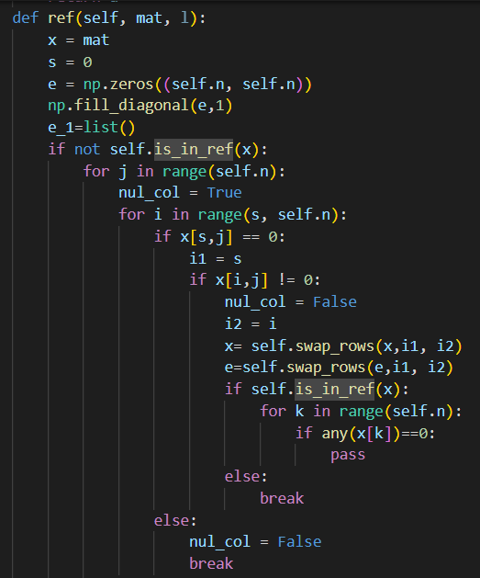
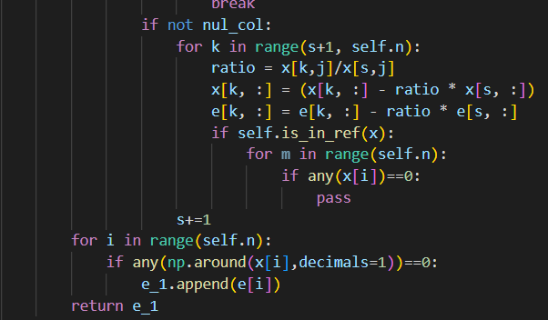
2. C_find() function 2.2.2 Finding eigenvectors

Slide 34
2. C_find() function 2.2.1 Ortogonalization Theory
Gram-Shmidt procedure

Slide 35
2. C_find() function 2.3 Normalization Function
def normalize(self, v):
length_v = 0
for i in range(len(v)):
length_v += v[i]**2
length_v = length_v ** 0.5
for i in range(len(v)):
v[i] = v[i]/length_v

Slide 36
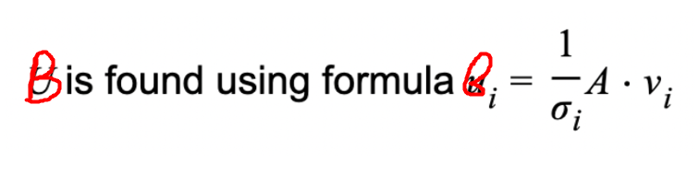
3. B_find() function 3.1 Theory

Slide 37
3. B_find() function 3.2 Function
def B_find(self):
temp = list()
for i in range(len(self.sigmas)):
a = 1/self.sigmas[i]
matrix = a * self.A
vector = np.matmul(matrix, self.eigenvectors[i])
temp.append(vector)
self.B = np.array(temp, dtype = float)

Slide 38
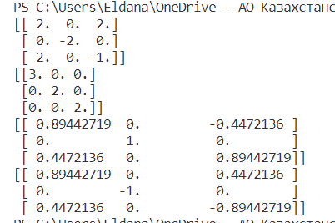
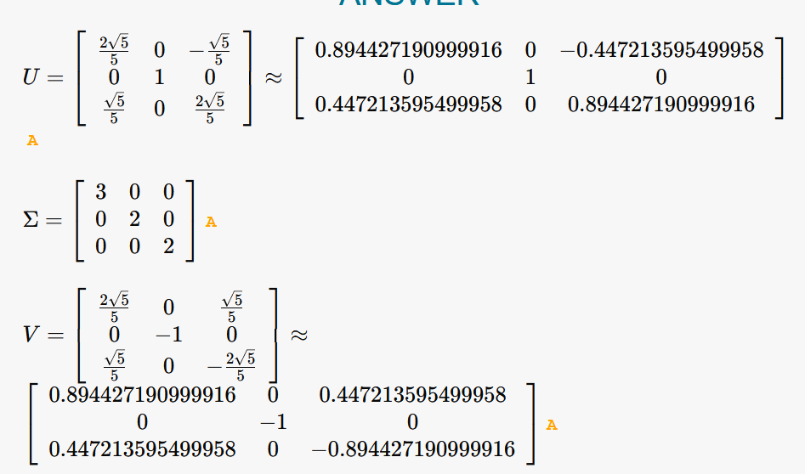
SVD: comparison with exact/online solution 3x3 matrix
import alg
import numpy as np
mat = np.array([[2, 0, 2], [0, -2, 0], [2, 0, -1]], dtype = float)
a = alg.decompositions(mat)
D, C, B = a.SVD()
print(mat)
print(C)
print(D)
print(B)

Slide 39
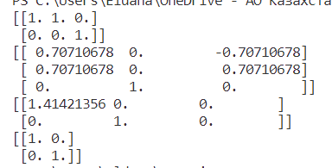
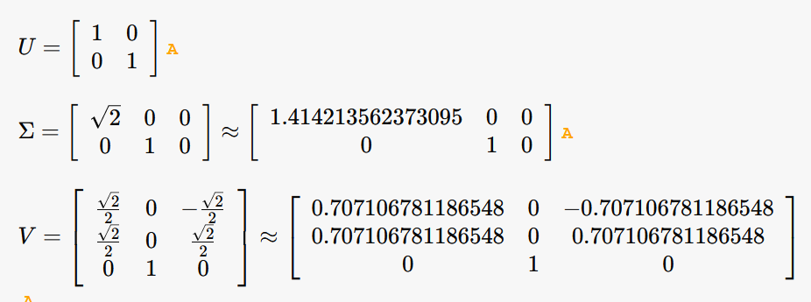
SVD: comparison with exact/online solution 2x3 matrix
import alg
import numpy as np
mat = np.array([[1, 1, 0], [0, 0, 1]], dtype = float)
a = alg.decompositions(mat)
D, C, B = a.SVD()
print(mat)
print(C)
print(D)
print(B)

Slide 40
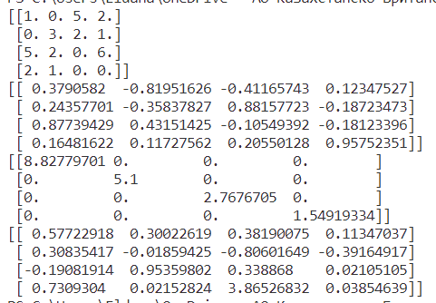
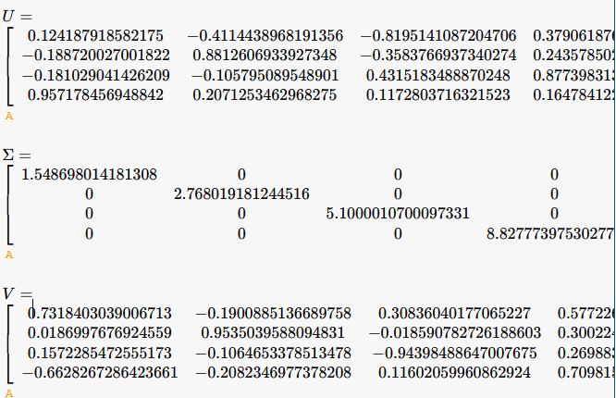
SVD: comparison with exact/online solution 4x4 matrix
import alg
import numpy as np
mat = np.array([[1, 0, 5, 2], [0, 3, 2, 1], [5, 2, 0, 6], [2, 1, 0, 0]], dtype = float)
a = alg.decompositions(mat)
D, C, B = a.SVD()
print(mat)
print(C)
print(D)
print(B)

Slide 41
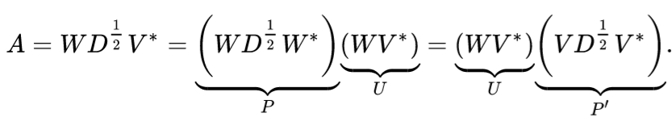
Polar decomposition
def Polar(self):
self.SVD()
self.U = np.matmul(self.B, self.C.T)
self.H = np.matmul(np.matmul(self.C, self.D), self.C.T)
return self.U, self.H

Slide 42
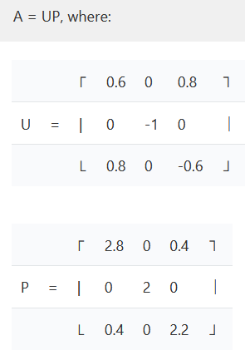
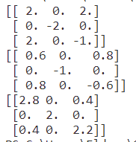
Polar decomposition: comparison with exact/online solution 2x3 matrix
import alg
import numpy as np
mat = np.array([[2, 0, 2], [0, -2, 0], [2, 0, -1]], dtype = float)
a = alg.decompositions(mat)
U, H = a.Polar()
print(mat)
print(U)
print(H)

Slide 43
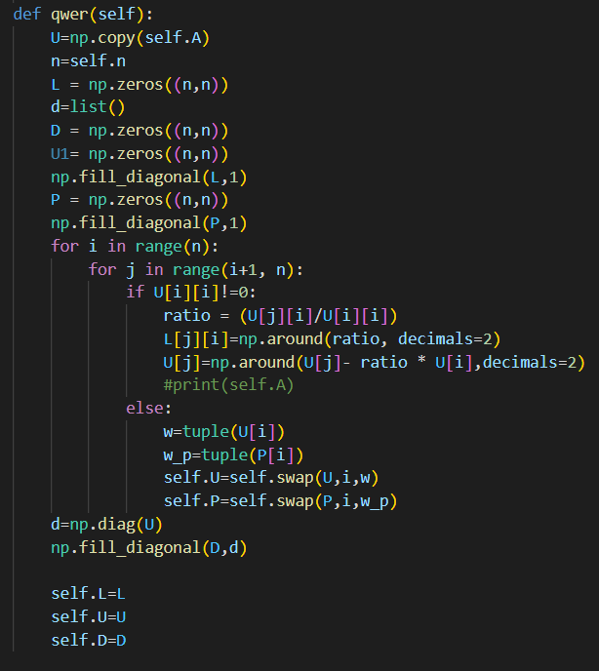
LU decomposition
Decompose a matrix to Lower and Upper-triangular matrixes

Slide 44
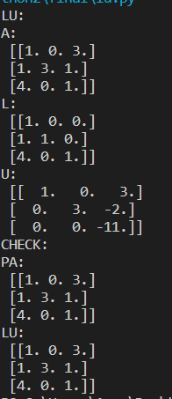
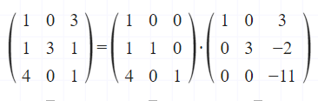
LU decomposition: comparison with exact/online solution 3x3 matrix
import alg
import numpy as np
mat = np.array([[1, 0, 3], [1, 3, 1], [4, 0, 1]], dtype = float)
a = alg.decompositions2(mat)
a.LU()

Slide 45
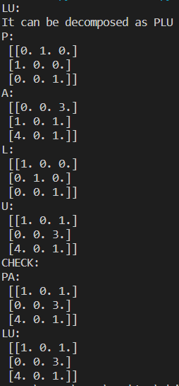
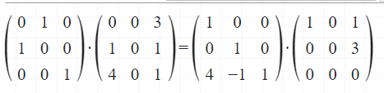
PLU decomposition: comparison with exact/online solution 3x3 matrix
import alg​
import numpy as np​
mat = np.array([[0, 0, 3], [1, 0, 1], [4, 0, 1]], dtype = float)​
a = alg.decompositions2(mat)​
a.LU()

Slide 46
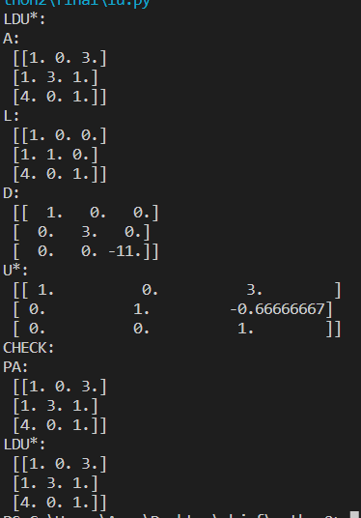
LDU decomposition: comparison with exact/online solution 3x3 matrix
import alg
import numpy as np
mat = np.array([[1, 0, 3], [1, 3, 1], [4, 0, 1]], dtype = float)
a = alg.decompositions2(mat)
a.LDU()

Slide 47
Self-study
QR decomposition
QR algorithm for Schur decomposition
Faddeev-LeVerrier algorithm to find inverse and coefficient of characteristic polynomial.
Practical implementation of mathematical knowledge

Slide 48

Thank you for your attention

