Slide 1
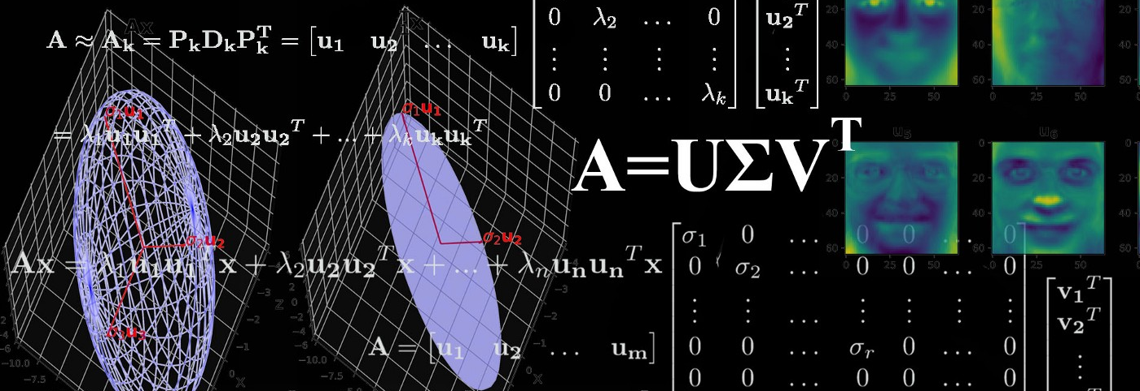
SINGULAR VALUE DECOMPOSITION
BY NETALIYEVA YELDANA

Slide 2
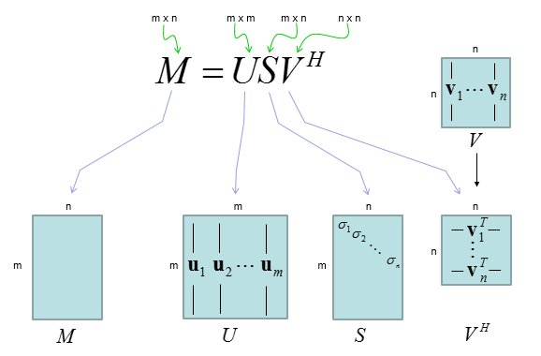
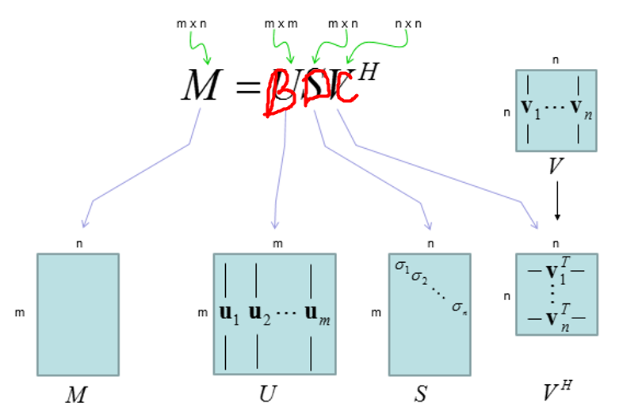
What is SVD

Slide 3
PLAN OF PRESENTATION
GUI
ALGORITHM
SELF-STUDY

