Slide 1

PLAN OF PRESENTATION
ALGORITHMS
Matrix operations
Addition, subtraction, multiplication
Determinant
Rank
Transpose, swap rows
Ref, rref
Col space, null space
Solving SLE
Finding coefficients of characteristic polynomial
SVD
QR decomposition
Schur decomposition
Finding eigenvectors
Gram-Schmidt
Diagonal form
Polar
Power of matrix
LDU & PLU
SELF-STUDY

Slide 2
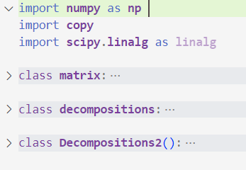
Main classes

Slide 3
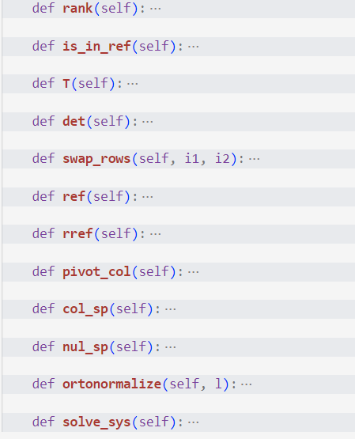
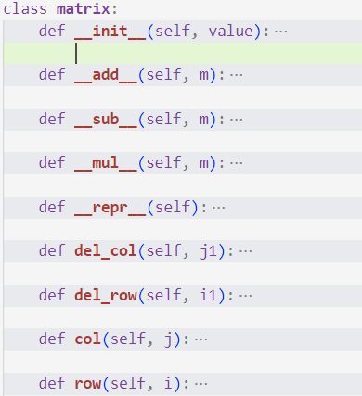
Matrix operations

Slide 4
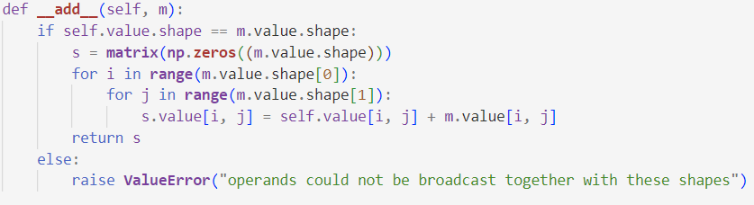
Addition

Slide 5
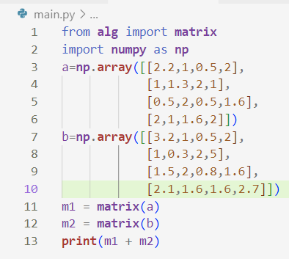
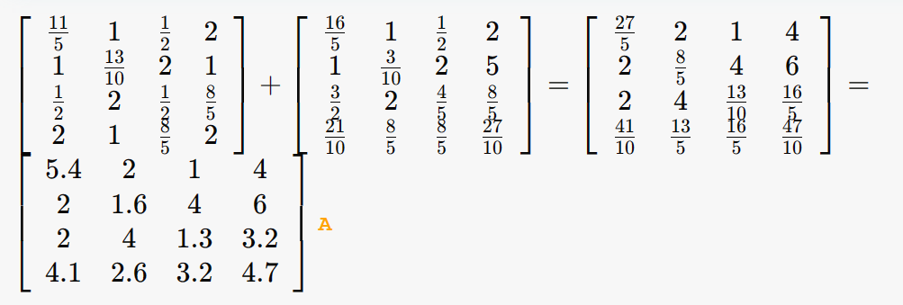
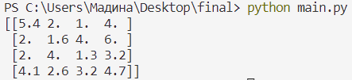
Addition of matrices 4x4
Online calculator

Slide 6
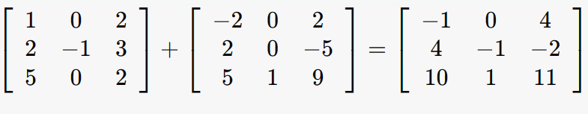
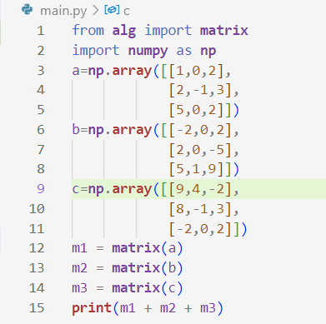
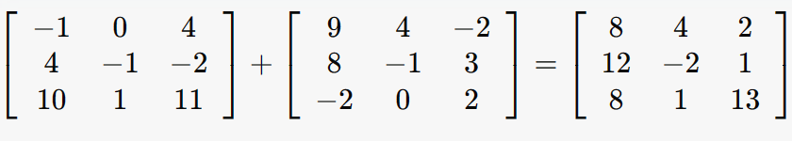

Addition of three matrices of size 3x3
Online calculator

Slide 7
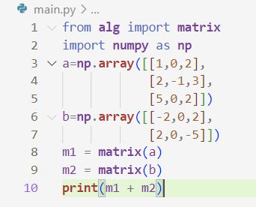
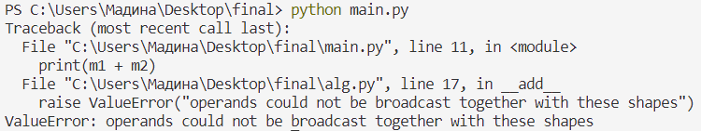
Addition of matrices 3x3 and 2x3

Slide 8
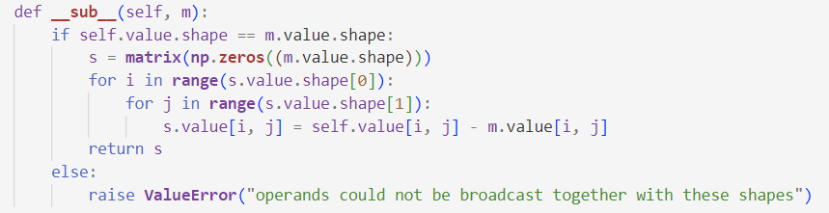
Subtraction

Slide 9
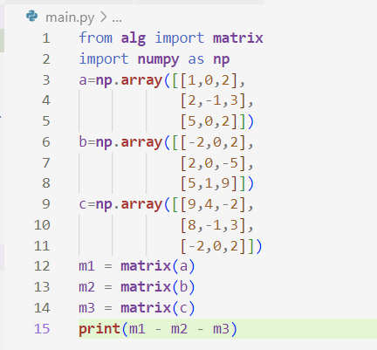
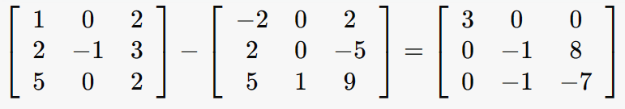
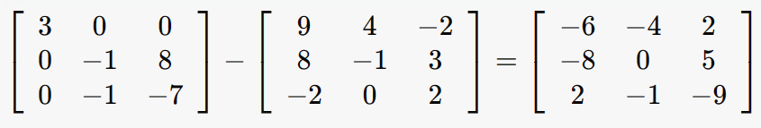

Subtraction of matrices 4x4
Online calculator

Slide 10
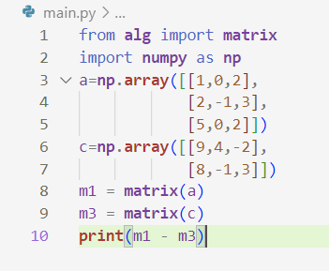
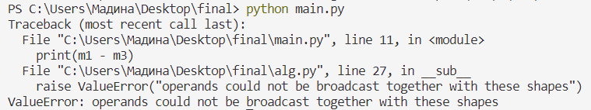
Subtraction of matrices 3x3 and 2x3

Slide 11
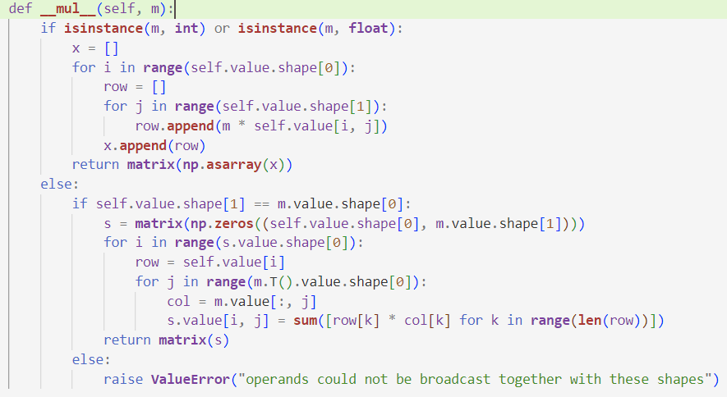
Multiplication

Slide 12
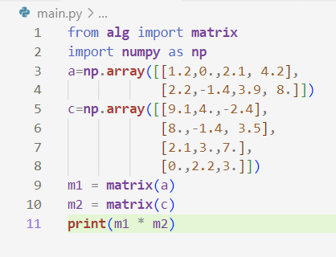
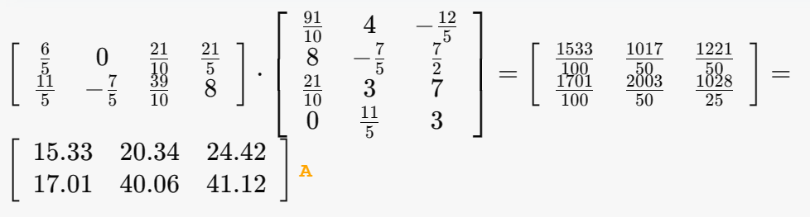

Multiplication of matrices 2x4 and 4x3
Online calculator

Slide 13
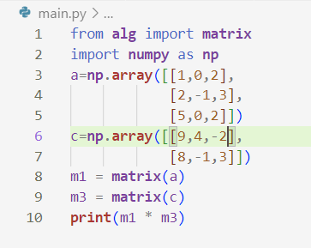
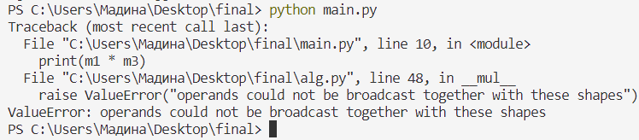
Multiplication of matrices 3x3 and 2x3

Slide 14
Subtraction, addition and multiplication
Online calculator

Slide 15
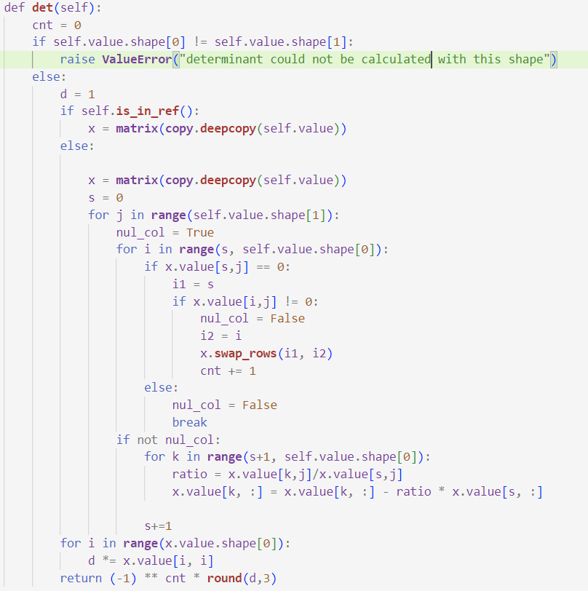
Determinant

Slide 16
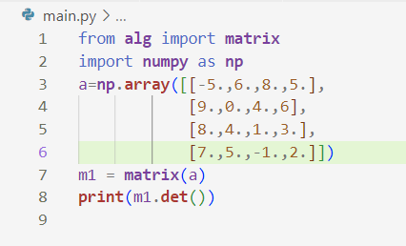
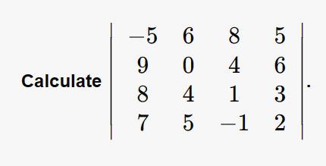


Determinant
Online calculator

Slide 17
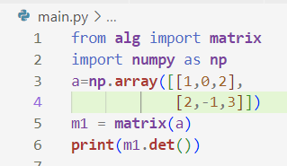
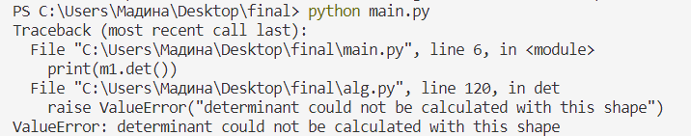
Determinant

Slide 18
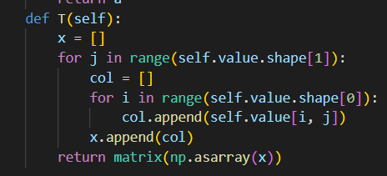
Transpose

Slide 19
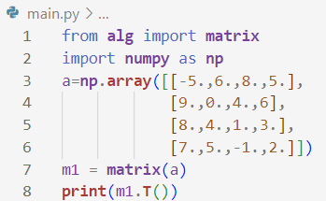
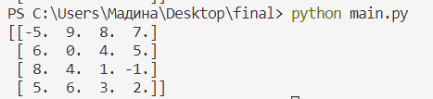
Transpose

Slide 20
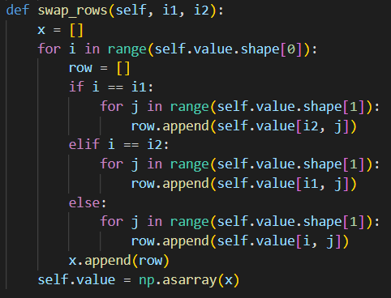
Swap rows

Slide 21
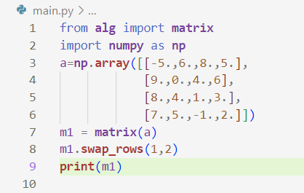
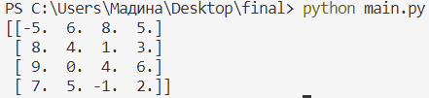
Swap rows

Slide 22
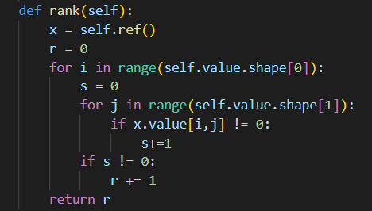
Rank

Slide 23
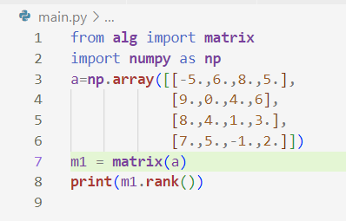
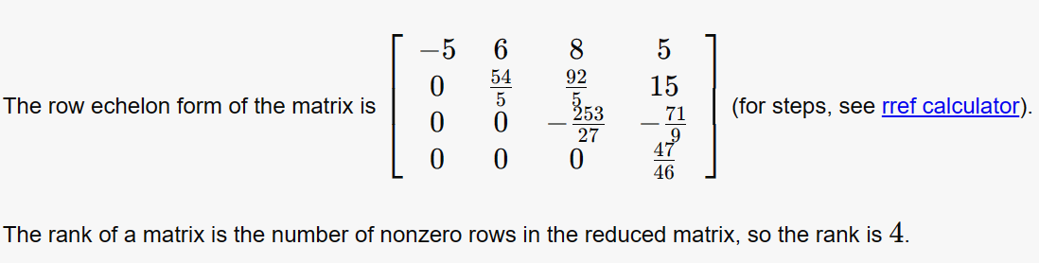
Rank
Online calculator

Slide 24
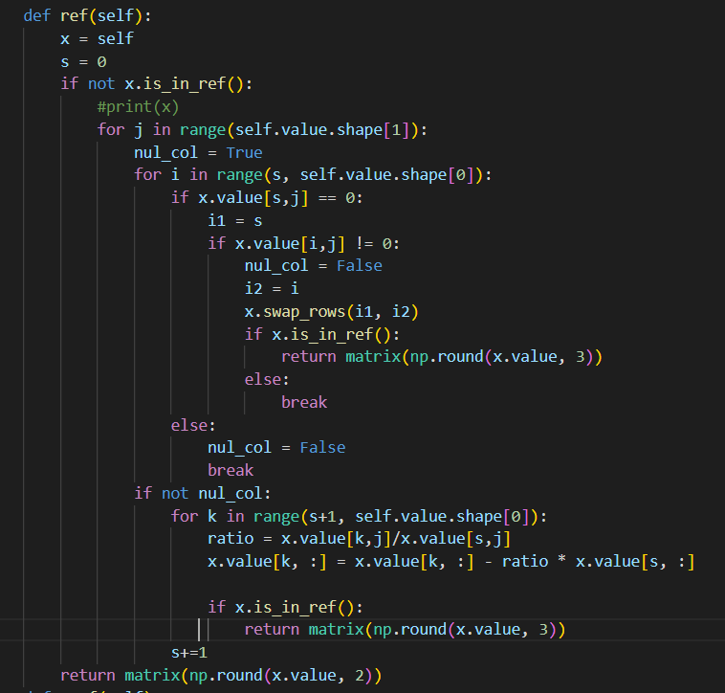
Ref

Slide 25
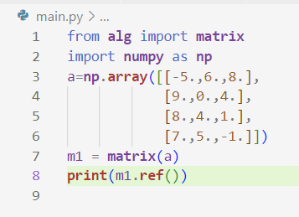
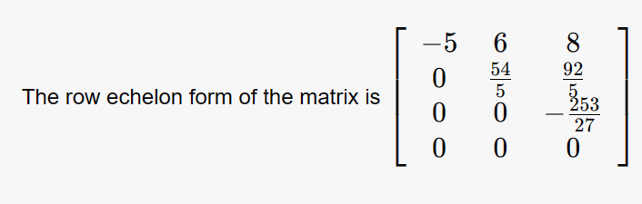
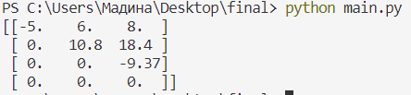
Ref
Online calculator

Slide 26
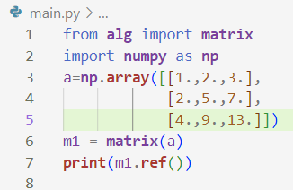
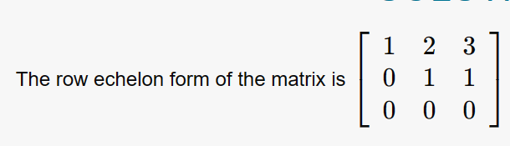

Ref
Online calculator

Slide 27
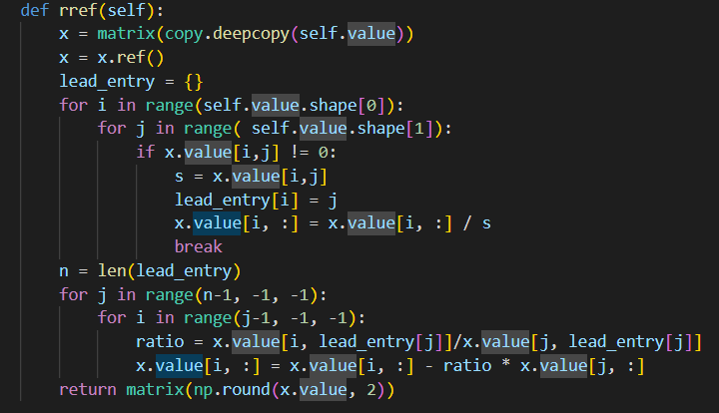
Rref

Slide 28
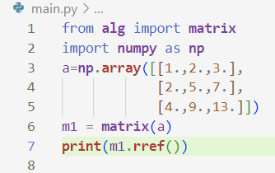
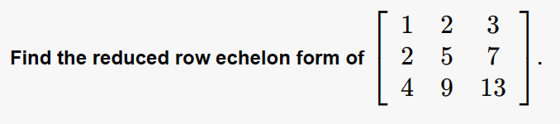
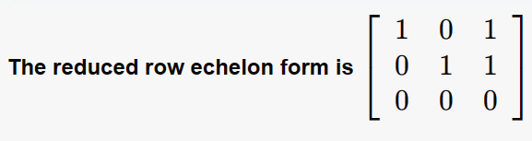

Rref
Online calculator

Slide 29
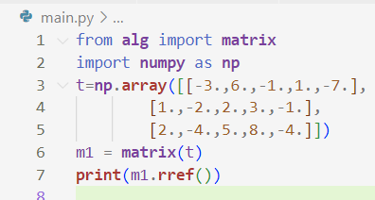
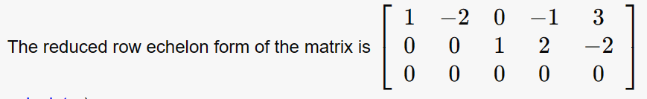

Rref
Online calculator

Slide 30
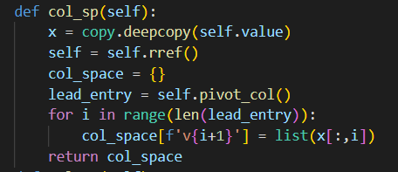
Col Space

Slide 31



Col Space
Online calculator

Slide 32


Col Space
Online calculator

Slide 33

Null Space

Slide 34



Null Space
Book

Slide 35



Null Space
Online calculator

Slide 36


SLE

Slide 37




SLE
Online calculator

Slide 38




SLE
Online calculator

Slide 39

Finding coefficients of characteristic polynomial

Slide 40


Coefficients: comparison with exact/online solution 3x3 matrix
import alg
import numpy as np
mat = np.array([[1,1,0], [1,1,0], [0,0,1]], dtype = float)
a = alg.decompositions(mat)
coef = a.coefficients()
print(mat)
print(coef)

Slide 41


Coefficients: comparison with exact/online solution 4x4 matrix
import alg
import numpy as np
mat=np.array([[1,1,0,2],
[1,1,0,2],
[0,0,1,3],
[0,1,2,0]], dtype = float)
a = alg.decompositions(mat)
coef = a.coefficients()
print(mat)
print(coef)

Slide 42


Decompositions

Slide 43

SINGULAR VALUE DECOMPOSITION

Slide 44


What is SVD

Slide 45

SVD Function
def SVD(self):
self.D_find()
self.C_find()
self.B_find()

Slide 46

1. D_find() function
.

Slide 47
1.1 Finding eigenvalues 1.1.1 Algorithm
Find QR decomposition
Find Schur decomposition(main diagonal stores eigenvalues)

Slide 48

1.1 Finding eigenvalues 1.1.2 QR decomposition

Slide 49

1.1 Finding eigenvalues 1.1.2 QR decomposition 1.1.2.1 Q matrix
Gram-Schmidt procedure

Slide 50
1.1 Finding eigenvalues 1.1.2 QR decomposition 1.1.2.1 Q matrix
def ortogonalize(self):
k = list()
for i in range(1, len(self.eigenvectors)):
for j in range(i):
if np.dot(self.eigenvectors[j], self.eigenvectors[j]) != 0:
temp = np.dot(self.eigenvectors[i], self.eigenvectors[j])/np.dot(self.eigenvectors[j], self.eigenvectors[j])
else:
temp = 1
k.append(temp)
for j in range(len(k)):
self.eigenvectors[i] -= k[j] * self.eigenvectors[j]
k.clear()

Slide 51
1.1 Finding eigenvalues 1.1.2 QR decomposition 1.1.2.1 Q matrix
def normalize(self):
for i in range(len(self.eigenvectors)):
length_v = 0
for j in range(len(self.eigenvectors[i])):
length_v += self.eigenvectors[i][j]**2
length_v = length_v ** 0.5
for k in range(len(self.eigenvectors[i])):
if length_v != 0:
self.eigenvectors[i][k] = self.eigenvectors[i][k]/length_v

Slide 52
1.1 Finding eigenvalues 1.1.2 QR decomposition
def QR(self):
if len(self.A) < len(self.A[0]):
raise ValueError("Number of columns cannot exceed the number of rows")
else:
self.Q_find()
self.R_find()
return self.Q, self.R

Slide 53
1.1 Finding eigenvalues 1.1.2 QR decomposition 1.1.2.1 Q matrix
def Q_find(self):
self.eigenvectors = self.A.copy()
self.eigenvectors = self.eigenvectors.T
self.ortogonalize()
self.normalize()
self.Q = self.eigenvectors.copy()
self.Q = self.Q.T

Slide 54

1.1 Finding eigenvalues 1.1.2 QR decomposition 1.1.2.2 R matrix
def R_find(self):
k = 0
self.R = np.zeros((len(self.eigenvectors), len(self.eigenvectors)))
for i in range(k, len(self.eigenvectors)):
for j in range(k, len(self.eigenvectors)):
self.R[i][j] = np.dot(self.eigenvectors[i].T, self.A.T[j])
k+=1

Slide 55


QR: comparison with exact/online solution 3x3 matrix
import alg
import numpy as np
mat = np.array([[-1, 2, 4], [5, 6, 6], [-3, 5, 9]], dtype = float)
a = alg.decompositions(mat)
Q, R = a.QR()
print(mat)
print(Q)
print(R)

Slide 56


QR: comparison with exact/online solution 4x4 matrix
import alg
import numpy as np
mat=np.array([[1.,0.,5.,2] ,
[0.,3.,2., 1.],
[5.,2.,0., 6.],
[2, 1, 0, 0.]])
a = alg.decompositions(mat)
Q, R = a.QR()
print(mat)
print(Q)
print(R)

Slide 57


QR: comparison with exact/online solution 4x3 matrix
import alg
import numpy as np
mat = np.array([[1, 0, 5], [0, 3, 2], [5, 2, 0], [2, 1, 0]], dtype = float)
a = alg.decompositions(mat)
Q, R = a.QR()
print(mat)
print(Q)
print(R)

Slide 58


1.1 Finding eigenvalues 1.1.3 Schur decomposition

Slide 59
1.1 Finding eigenvalues 1.1.3 Schur decomposition
def isuppertriangular(self, M):
for i in range(1, len(M)):
for j in range(0, i):
if abs(M[i][j]) > 0.001:
return False
return True
def round_matrix(self, M):
for i in range(len(M)):
for j in range(len(M)):
M[i][j] = round(M[i][j], 2)
return M

Slide 60
1.1 Finding eigenvalues 1.1.3 Schur decomposition
def schur(self):
while not self.isuppertriangular(self.A):
Q, R = self.QR()
self.A = np.matmul(R, Q)
else:
return self.round_matrix(self.A)

Slide 61


Schur: comparison with exact/online solution 3x3 matrix
import alg
import numpy as np
mat = np.array([[8, 0, 2], [0, 4, 0], [2, 0, 8]], dtype = float)
a = alg.decompositions(mat)
Shur = a.schur()
print(mat)
print(Shur)

Slide 62


Schur: comparison with exact/online solution 4x4 matrix
import alg
import numpy as np
mat = np.array([[1, 0, 5, 2],
[0, 3, 2, 1],
[5, 2, 0, 4],
[2, 1, 0, 0]], dtype = float)
a = alg.decompositions(mat)
Shur = a.schur()
print(mat)
print(Shur)

Slide 63


Schur: comparison with exact/online solution 5x5 matrix
import alg
import numpy as np
mat=np.array([[1,0,4,2,1],
[0,4,2,1,2],
[5,2,0,4,0],
[2,1,0,0,1],
[1,2,0,0,1]])
a = alg.decompositions(mat)
Shur = a.schur()
print(mat)
print(Shur)

Slide 64
2. C_find() function
def C_find(self):
self.eigenvectors = self.eigenvectors.T
self.ortogonalize()
self.normalize()
self.C = self.eigenvectors.T

Slide 65
2. C_find() function 2.2.2 Finding eigenvectors
Idea:
1 0 0
0 1 0
0 0 1 CEF REF 2 4 2 1 0 0
2 3 4 3 5 1 0 1 0
4 5 0 4 0 0 0 0 1
2 1 0

Slide 66


2. C_find() function 2.2.2 Finding eigenvectors

Slide 67
2. C_find() function 2.2.1 Ortogonalization Theory
Gram-Shmidt procedure

Slide 68
2. C_find() function 2.3 Normalization Function
def normalize(self, v):
length_v = 0
for i in range(len(v)):
length_v += v[i]**2
length_v = length_v ** 0.5
for i in range(len(v)):
v[i] = v[i]/length_v

Slide 69

3. B_find() function 3.1 Theory

Slide 70
3. B_find() function 3.2 Function
def B_find(self):
temp = list()
for i in range(min(len(self.sigmas), len(self.eigenvectors))):
a = 1/self.sigmas[i]
matrix = a * self.A
vector = np.matmul(matrix, self.eigenvectors[i])
temp.append(vector)
self.B = np.array(temp, dtype = float)

Slide 71


SVD: comparison with exact/online solution 3x3 matrix
import alg
import numpy as np
mat = np.array([[2, 0, 2], [0, -2, 0], [2, 0, -1]], dtype = float)
a = alg.decompositions(mat)
D, C, B = a.SVD()
print(mat)
print(C)
print(D)
print(B)

Slide 72


SVD: comparison with exact/online solution 2x3 matrix
import alg
import numpy as np
mat = np.array([[1, 1, 0], [0, 0, 1]], dtype = float)
a = alg.decompositions(mat)
D, C, B = a.SVD()
print(mat)
print(C)
print(D)
print(B)

Slide 73


SVD: comparison with exact/online solution 4x4 matrix
import alg
import numpy as np
mat = np.array([[1, 0, 5, 2], [0, 3, 2, 1], [5, 2, 0, 6], [2, 1, 0, 0]], dtype = float)
a = alg.decompositions(mat)
D, C, B = a.SVD()
print(mat)
print(C)
print(D)
print(B)

Slide 74
Diagonal form of matrix
def form_diagonal(self):
self.eig(self.A)
val,vec=self.qwer(self.A,1)
n=len(self.A)
D=np.zeros((n,n))
for i in range(len(self.eigenvalues)):
for j in range(len(self.eigenvalues)):
if i==j:
D[i][j]=self.eigenvalues[i]
B=self.eigenvectors
B_inv=self.inverse(B)
return B,D,B_inv
A=B*D*B^-1

Slide 75


Diagonal form of matrix
import alg3
import numpy as np
m = np.array([[1, 0, 2], [1, 4, 1], [2, 0, 1]], dtype = float)
a = alg3.decompositions(m)
b,d,c=a.form_diagonal()
print(b)
print(d)
print(c)

Slide 76

Polar decomposition
def Polar(self):
self.SVD()
self.U = np.matmul(self.B, self.C.T)
self.H = np.matmul(np.matmul(self.C, self.D), self.C.T)
return self.U, self.H

Slide 77


Polar decomposition: comparison with exact/online solution 3x3 matrix
import alg
import numpy as np
mat = np.array([[2, 0, 2], [0, -2, 0], [2, 0, -1]], dtype = float)
a = alg.decompositions(mat)
U, H = a.Polar()
print(mat)
print(U)
print(H)

Slide 78

Power of matrix
Theory

Slide 79
Power of matrix code realization
def power(self, n):
a = self.positivity_check()
b = True if n - int(n) == 0.0 else False
if b==False and a==False:
raise ValueError('No solution in real space')
else:
self.M = np.zeros((self.A.shape[0], self.A.shape[1]), dtype = float)
for i in range(self.A.shape[0]):
self.M[i, i] = self.eigenvalues[i] ** n
self.eigenvectors = self.eigenvectors.T
self.ortogonalize()
self.normalize()
self.P = self.eigenvectors
self.N = self.eigenvectors.T
return np.matmul(np.matmul(self.N, self.M), self.P)
def positivity_check(self):
f = decompositions(self.A)
self.eigenvalues, self.eigenvectors = f.eig(self.A)
a = self.A == self.A.T
b = all(elements >= 0 for elements in self.eigenvalues)
return a.all() and b

Slide 80


Power 1.5 of matrix: comparison with exact/online solution 3x3 matrix
import alg
import numpy as np
mat = np.array([[6, 0, 2], [0, 2, 0], [2, 0, 3]], dtype = float)
a = alg.decompositions(mat)
power = a.power(1.5)
print("Initial matrix: ")
print(mat)
print("Matrix in second power")
print(power)

Slide 81


Power 0.5 of matrix: comparison with exact/online solution 4x4 matrix
import alg
import numpy as np
mat = np.array([[30, 12, 17, 2], [12, 14, 12, 3], [17, 12, 65, 12], [2, 3, 12, 5]], dtype = float)
a = alg.decompositions(mat)
power = a.power(2)
print("Initial matrix: ")
print(mat)
print("Matrix in second power")
print(power)

Slide 82

Power 2.5 of matrix: real field condition checking
import alg
import numpy as np
mat = np.array([[1, 1, 0, 4, 2], [0, 0, 1, 1, 3], [1, 1, 4, 2, 1], [2, 3, 0, 3, 2], [1, 2, 1, 2, 0]], dtype = float)
a = alg.decompositions(mat)
power = a.power(2.5)
print("Initial matrix: ")
print(mat)
print("Matrix in second power")
print(power)

Slide 83

LU decomposition
Decompose a matrix to Lower and Upper-triangular matrixes

Slide 84


LU decomposition: comparison with exact/online solution 3x3 matrix
import alg
import numpy as np
mat = np.array([[1, 0, 3], [1, 3, 1], [4, 0, 1]], dtype = float)
a = alg.decompositions2(mat)
a.LU()

Slide 85


PLU decomposition: comparison with exact/online solution 3x3 matrix
import alg​
import numpy as np​
mat = np.array([[0, 0, 3], [1, 0, 1], [4, 0, 1]], dtype = float)​
a = alg.decompositions2(mat)​
a.LU()

Slide 86

LDU decomposition: comparison with exact/online solution 3x3 matrix
import alg
import numpy as np
mat = np.array([[1, 0, 3], [1, 3, 1], [4, 0, 1]], dtype = float)
a = alg.decompositions2(mat)
a.LDU()

Slide 87

Self-study
QR decomposition
QR algorithm for Schur decomposition
Faddeev-LeVerrier algorithm to find inverse and coefficient of characteristic polynomial
Modules and packages in python
Practical implementation of mathematical knowledge
Magic methods

Slide 88

Thank you for your attention

