Slide 1

PLAN OF PRESENTATION
ALGORITHMS
Matrix operations
Determinant
SVD
QR decomposition
Schur decomposition
Eig function
Gram-Schmidt
Polar
Power of matrix
Solving SLE
QR method
LDU & PLU
SELF-STUDY

Slide 2
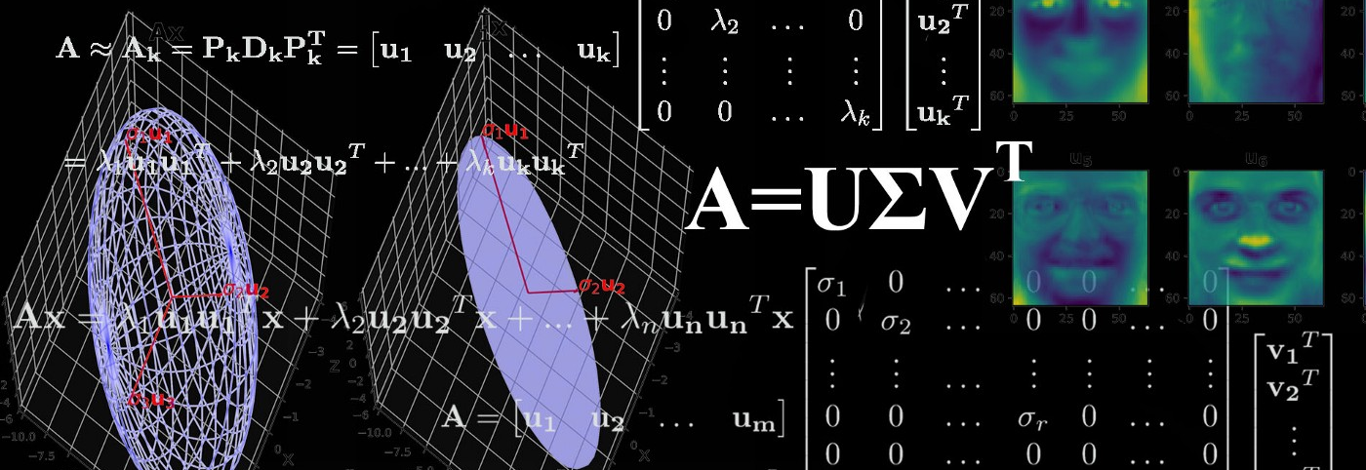
SINGULAR VALUE DECOMPOSITION

Slide 3
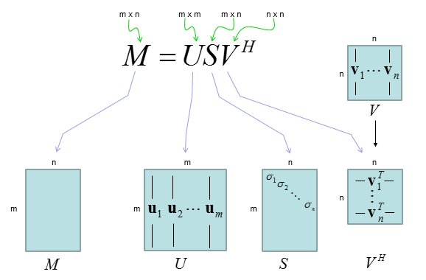
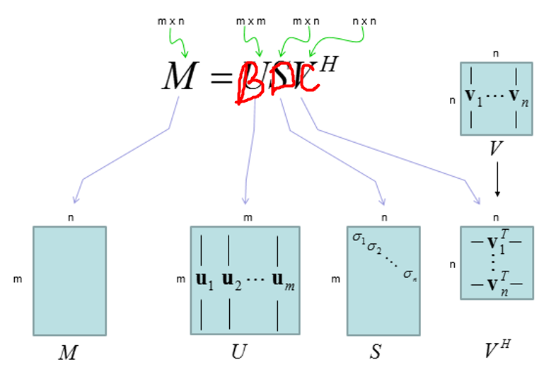
What is SVD

Slide 4
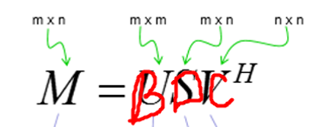
SVD Function
def SVD(self):
self.D_find()
self.C_find()
self.B_find()

Slide 5
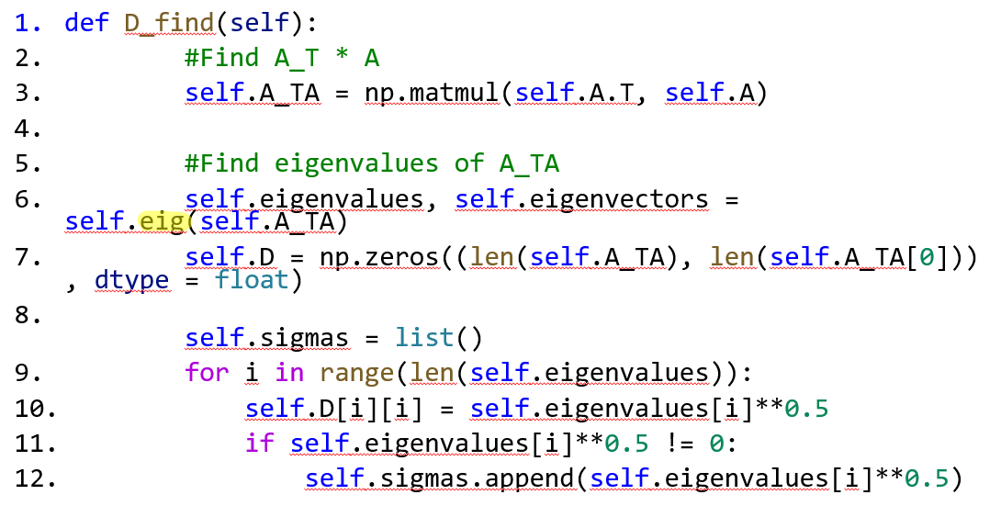
1. D_find() function
.

Slide 6
1.1 Finding eigenvalues 1.1.1 Algorithm
Find QR decomposition
Find Schur decomposition(main diagonal stores eigenvalues)

Slide 7
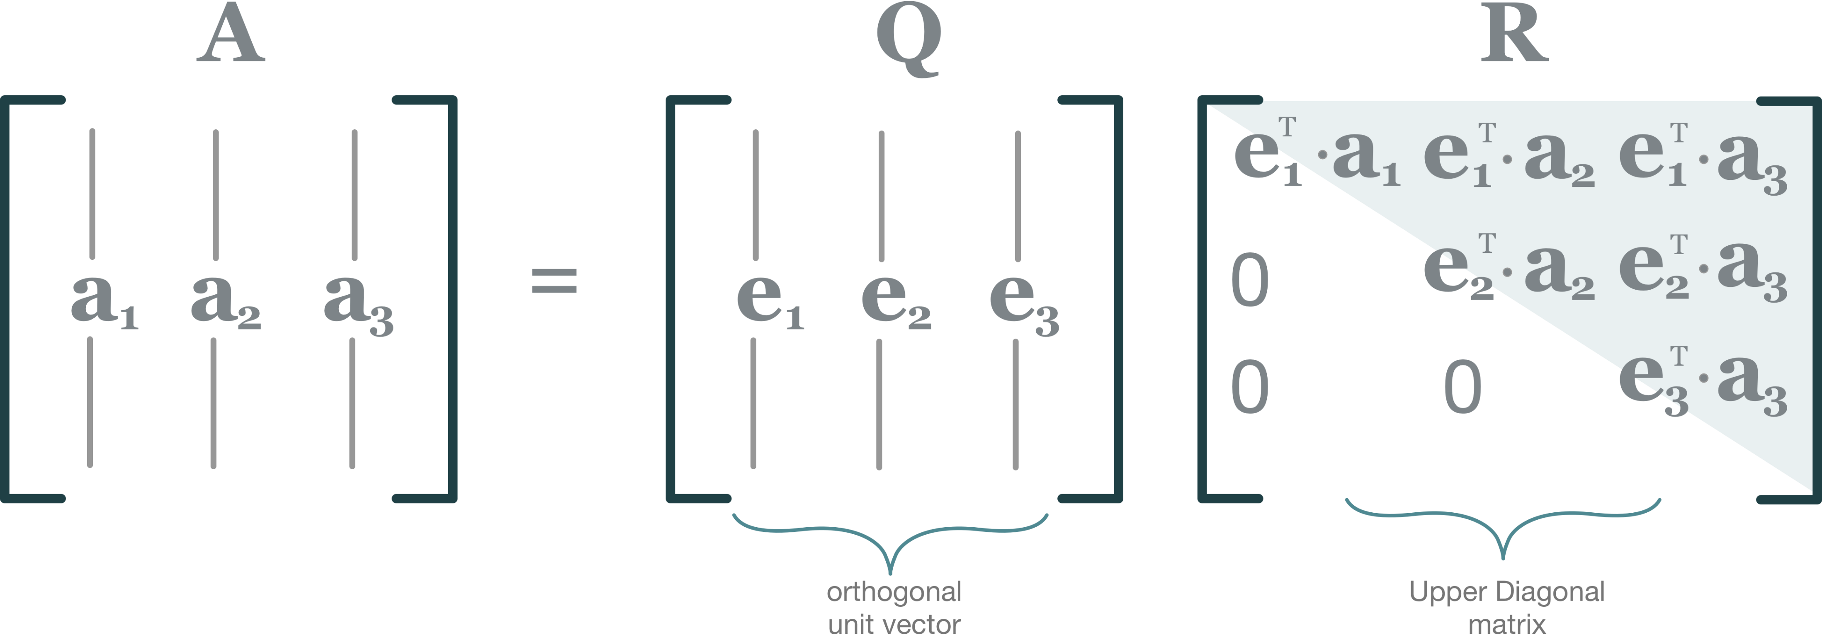
1.1 Finding eigenvalues 1.1.2 QR decomposition

Slide 8
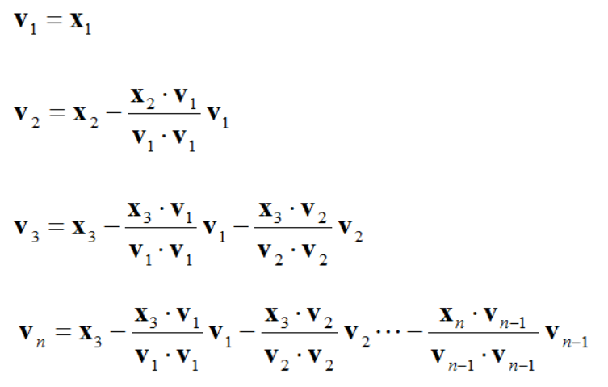
1.1 Finding eigenvalues 1.1.2 QR decomposition 1.1.2.1 Q matrix
Gram-Schmidt procedure

Slide 9
1.1 Finding eigenvalues 1.1.2 QR decomposition 1.1.2.1 Q matrix
def ortogonalize(self):
k = list()
for i in range(1, len(self.eigenvectors)):
for j in range(i):
if np.dot(self.eigenvectors[j], self.eigenvectors[j]) != 0:
temp = np.dot(self.eigenvectors[i], self.eigenvectors[j])/np.dot(self.eigenvectors[j], self.eigenvectors[j])
else:
temp = 1
k.append(temp)
for j in range(len(k)):
self.eigenvectors[i] -= k[j] * self.eigenvectors[j]
k.clear()

Slide 10
1.1 Finding eigenvalues 1.1.2 QR decomposition 1.1.2.1 Q matrix
def normalize(self):
for i in range(len(self.eigenvectors)):
length_v = 0
for j in range(len(self.eigenvectors[i])):
length_v += self.eigenvectors[i][j]**2
length_v = length_v ** 0.5
for k in range(len(self.eigenvectors[i])):
if length_v != 0:
self.eigenvectors[i][k] = self.eigenvectors[i][k]/length_v

Slide 11
1.1 Finding eigenvalues 1.1.2 QR decomposition 1.1.2.1 Q matrix
def Q_find(self):
self.eigenvectors = self.A.copy()
self.eigenvectors = self.eigenvectors.T
self.ortogonalize()
self.normalize()
self.Q = self.eigenvectors.copy()
self.Q = self.Q.T

Slide 12
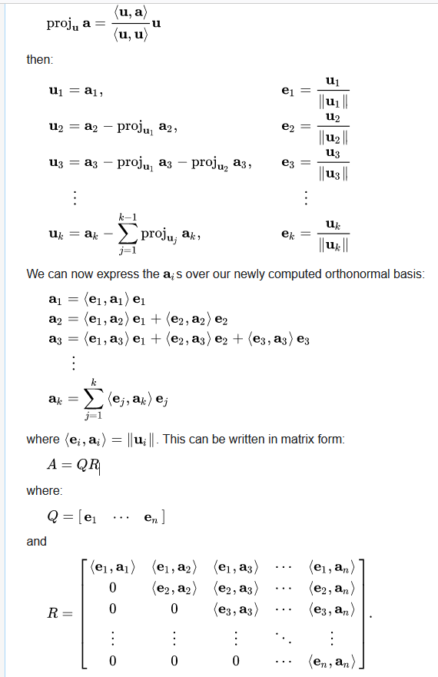
1.1 Finding eigenvalues 1.1.2 QR decomposition 1.1.2.2 R matrix
def R_find(self):
k = 0
self.R = np.zeros((len(self.eigenvectors), len(self.eigenvectors)))
for i in range(k, len(self.eigenvectors)):
for j in range(k, len(self.eigenvectors)):
self.R[i][j] = np.dot(self.eigenvectors[i].T, self.A.T[j])
k+=1

Slide 13
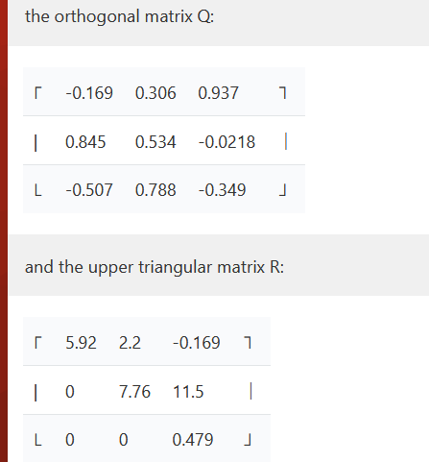
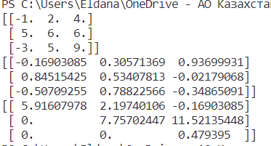
QR: comparison with exact/online solution 3x3 matrix
import alg
import numpy as np
mat = np.array([[-1, 2, 4], [5, 6, 6], [-3, 5, 9]], dtype = float)
a = alg.decompositions(mat)
Q, R = a.QR()
print(mat)
print(Q)
print(R)

Slide 14
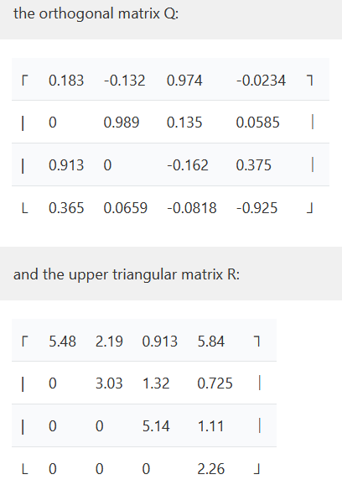
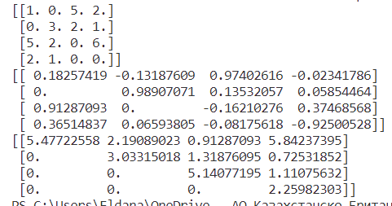
QR: comparison with exact/online solution 4x4 matrix
import alg
import numpy as np
mat=np.array([[1.,0.,5., 2.],
[0.,3.,2., 1.],
[5.,2.,0., 6.],
[2, 1, 0, 0.]])
a = alg.decompositions(mat)
Q, R = a.QR()
print(mat)
print(Q)
print(R)

Slide 15
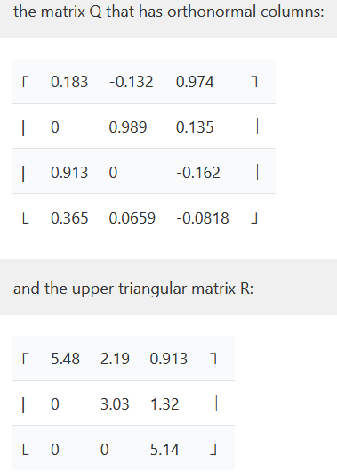
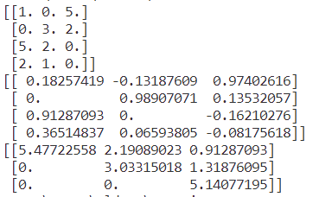
QR: comparison with exact/online solution 4x3 matrix
import alg
import numpy as np
mat = np.array([[-1, 2, 4], [5, 6, 6], [-3, 5, 9]], dtype = float)
a = alg.decompositions(mat)
Q, R = a.QR()
print(mat)
print(Q)
print(R)

Slide 16

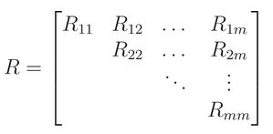
1.1 Finding eigenvalues 1.1.3 Schur decomposition

Slide 17
1.1 Finding eigenvalues 1.1.3 Schur decomposition
def isuppertriangular(self, M):
for i in range(1, len(M)):
for j in range(0, i):
if abs(M[i][j]) > 0.001:
return False
return True
def round_matrix(self, M):
for i in range(len(M)):
for j in range(len(M)):
M[i][j] = round(M[i][j], 2)
return M

Slide 18
1.1 Finding eigenvalues 1.1.3 Schur decomposition
def schur(self):
while not self.isuppertriangular(self.A):
Q, R = self.QR()
self.A = np.matmul(R, Q)
else:
return self.round_matrix(self.A)

Slide 19
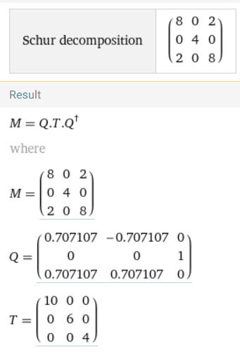
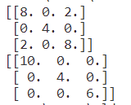
Schur: comparison with exact/online solution 3x3 matrix
import alg
import numpy as np
mat = np.array([[8, 0, 2], [0, 4, 0], [2, 0, 8]], dtype = float)
a = alg.decompositions(mat)
Shur = a.schur()
print(mat)
print(Shur)

Slide 20
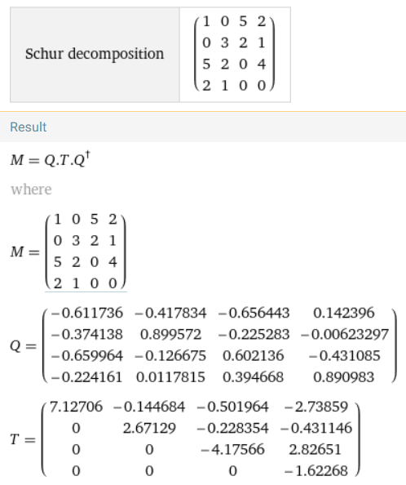
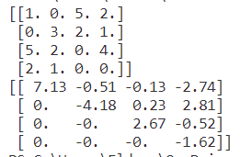
Schur: comparison with exact/online solution 4x4 matrix
import alg
import numpy as np
mat = np.array([[1, 0, 5, 2],
[0, 3, 2, 1],
[5, 2, 0, 4],
[2, 1, 0, ,]], dtype = float)
a = alg.decompositions(mat)
Shur = a.schur()
print(mat)
print(Shur)

Slide 21
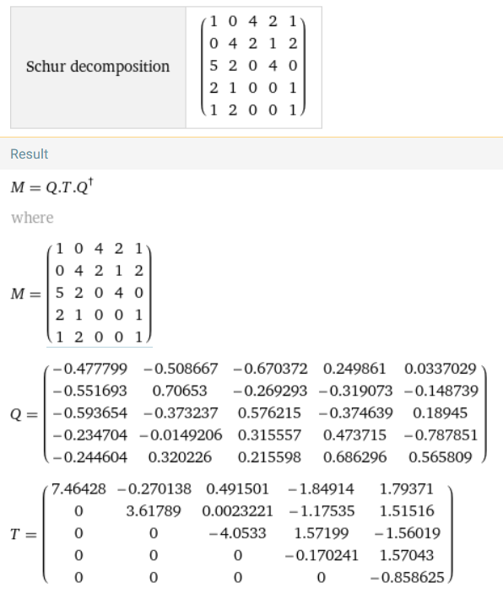
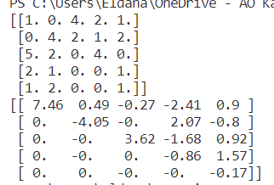
Schur: comparison with exact/online solution 5x5 matrix
import alg
import numpy as np
mat=np.array([[1,0,4,2,1],
[0,4,2,1,2],
[5,2,0,4,0],
[2,1,0,0,1]
[1,2,0,0,1])
a = alg.decompositions(mat)
Shur = a.schur()
print(mat)
print(Shur)

Slide 22
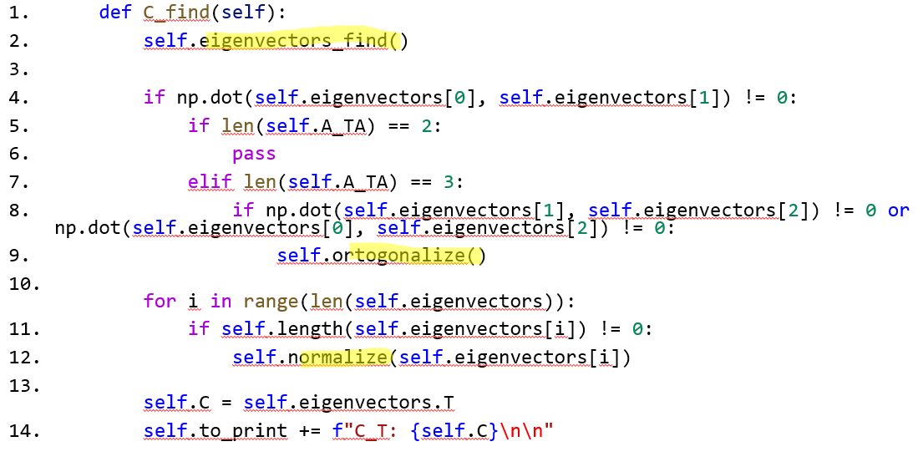
2. C_find() function

Slide 23
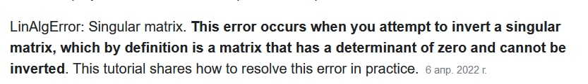
2.1 Finding eigenvectors 2.1.2 Theory&problems
Methods to solve SLE:
Method of inverse matrix
Cramer’s method
Gauss method
Problem :
Zero Determinant matrix → Free Variable

Slide 24
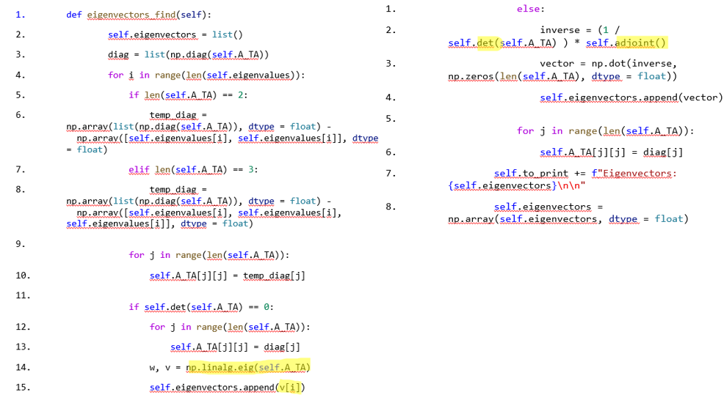
2.1 Finding eigenvectors 2.1.2 Function

Slide 25
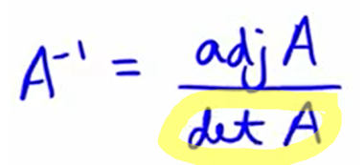
2.1 Finding eigenvectors 2.1.2.1 Determinant of matrix
def det(self, A):
det = 0
det += math.prod(np.diag(A))
det -= math.prod(np.diag(np.fliplr(A)))
if len(A) == 3:
det += (math.prod([A[2][0], A[0][1], A[1][2]]) + math.prod([A[1][0], A[2][1], A[0][2]]))
det -= (math.prod([A[0][1], A[1][0], A[2][2]]) + math.prod([A[0][0], A[2][1], A[1][2]]))
return det
return det

Slide 26
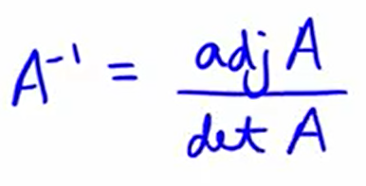
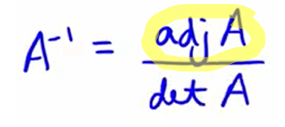
2.1 Finding eigenvectors 2.1.2.2 Adjoint Matrix
def adjoint(self):
temp = list()
if len(self.A_TA) == 2:
temp.append(self.A_TA[1][1])
temp.append(-1 * self.A_TA[1][0] )
temp.append(-1 * self.A_TA[0][1] )
temp.append(self.A_TA[0][0] )
return np.array(np.array(temp).reshape(2, 2), dtype = float)
elif len(self.A_TA) == 3:
temp.append(self.det(self.A_TA[1:3, 1:3]))
temp.append(-1 *self.det(self.A_TA[::2, ::2]))
temp.append(self.det(self.A_TA[1:3, :2]))
temp.append(-1*self.det(self.A_TA[:3:2, 1:3]))
temp.append(self.det(self.A_TA[:3:2, :3:2]))
temp.append(-1 * self.det(self.A_TA[:3:2, :2]))
temp.append(self.det(self.A_TA[:2, 1:3]))
temp.append(-1 * self.det(self.A_TA[:2, :3:2]))
temp.append(self.det(self.A_TA[:2, :2]))
return np.array(np.array(temp).reshape(3, 3), dtype = float)

Slide 27
2. C_find() function 2.2.1 Ortogonalization Theory
Gram-Shmidt procedure

Slide 28
2. C_find() function 2.2.2 Ortogonalization Function
def ortogonalize(self):
k = list()
for i in range(1, len(self.eigenvectors)):
for j in range(i):
if np.dot(self.eigenvectors[j], self.eigenvectors[j]) != 0:
temp = np.dot(self.eigenvectors[i], self.eigenvectors[j])/np.dot(self.eigenvectors[j], self.eigenvectors[j])
else:
temp = 1
k.append(temp)
for j in range(len(k)):
self.eigenvectors[i] -= k[j] * self.eigenvectors[j]
k.clear()

Slide 29
2. C_find() function 2.3 Normalization Function
def normalize(self, v):
length_v = 0
for i in range(len(v)):
length_v += v[i]**2
length_v = length_v ** 0.5
for i in range(len(v)):
v[i] = v[i]/length_v

Slide 30
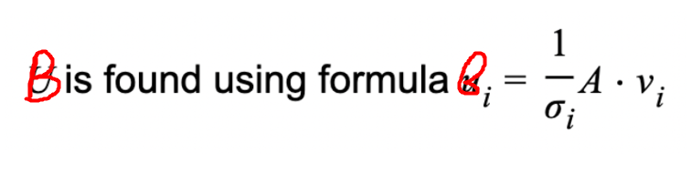
3. B_find() function 3.1 Theory

Slide 31
3. B_find() function 3.2 Function
def B_find(self):
temp = list()
for i in range(len(self.sigmas)):
a = 1/self.sigmas[i]
matrix = a * self.A
vector = np.matmul(matrix, self.eigenvectors[i])
temp.append(vector)
self.B = np.array(temp, dtype = float)

Slide 32
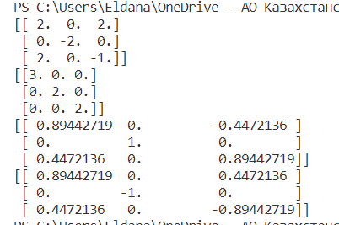
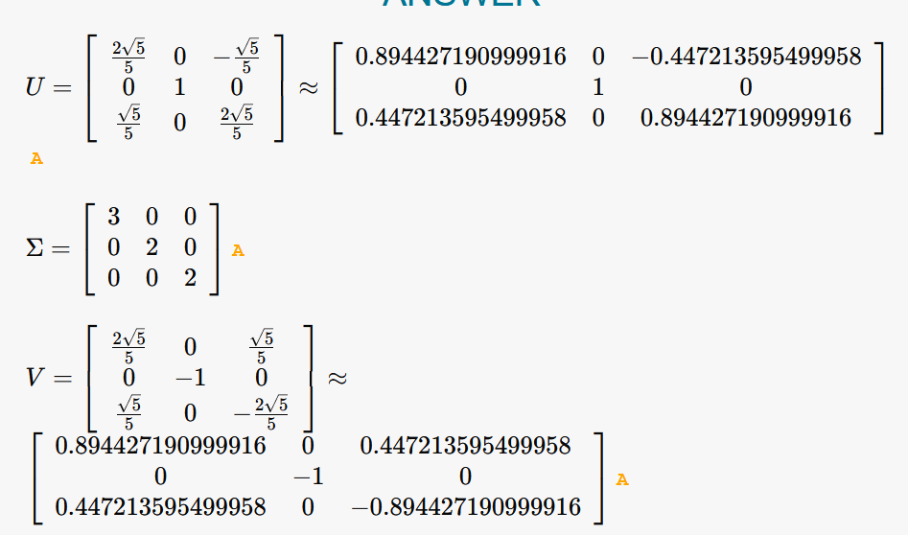
SVD: comparison with exact/online solution 3x3 matrix
import alg
import numpy as np
mat = np.array([[2, 0, 2], [0, -2, 0], [2, 0, -1]], dtype = float)
a = alg.decompositions(mat)
D, C, B = a.SVD()
print(mat)
print(C)
print(D)
print(B)

Slide 33
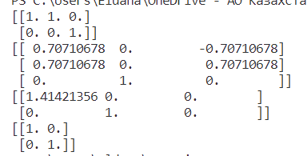
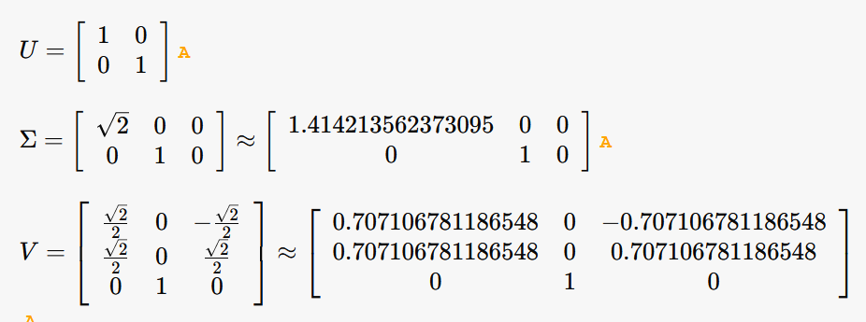
SVD: comparison with exact/online solution 2x3 matrix
import alg
import numpy as np
mat = np.array([[1, 1, 0], [0, 0, 1]], dtype = float)
a = alg.decompositions(mat)
D, C, B = a.SVD()
print(mat)
print(C)
print(D)
print(B)

Slide 34
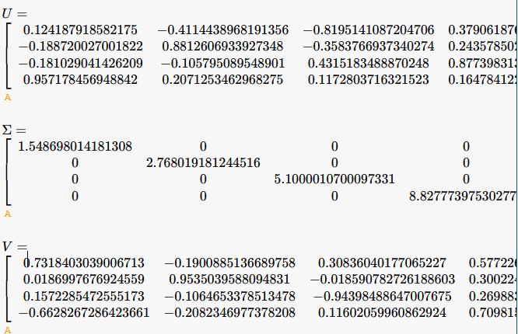
SVD: comparison with exact/online solution 4x4 matrix
import alg
import numpy as np
mat = np.array([[1, 0, 5, 2], [0, 3, 2, 1], [5, 2, 0, 6], [2, 1, 0, 0]], dtype = float)
a = alg.decompositions(mat)
D, C, B = a.SVD()
print(mat)
print(C)
print(D)
print(B)

Slide 35
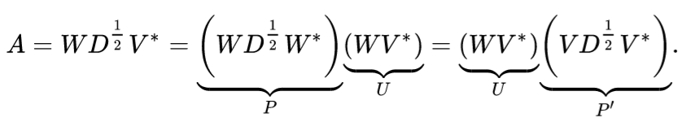
Polar decomposition
def Polar(self):
self.SVD()
self.U = np.matmul(self.B, self.C.T)
self.H = np.matmul(np.matmul(self.C, self.D), self.C.T)
return self.U, self.H

Slide 36
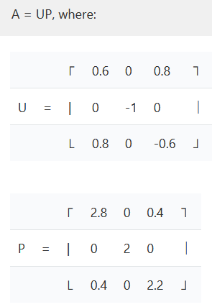
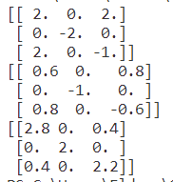
Polar decomposition: comparison with exact/online solution 2x3 matrix
import alg
import numpy as np
mat = np.array([[2, 0, 2], [0, -2, 0], [2, 0, -1]], dtype = float)
a = alg.decompositions(mat)
U, H = a.Polar()
print(mat)
print(U)
print(H)

Slide 37
Self-study
QR decomposition
QR algorithm for Schur decomposition
Practical implementation of mathematical knowledge

Slide 38

Thank you for your attention

