Slide 1

PLAN OF PRESENTATION
ALGORITHMS
SVD
QR decomposition
Hessenberg decomposition
Eig function
Gram-Shmidt
Polar
Power of matrix
Solving SLE
QR method
LDU & PLU
Matrix operations
Determinant
SELF-STUDY

Slide 2
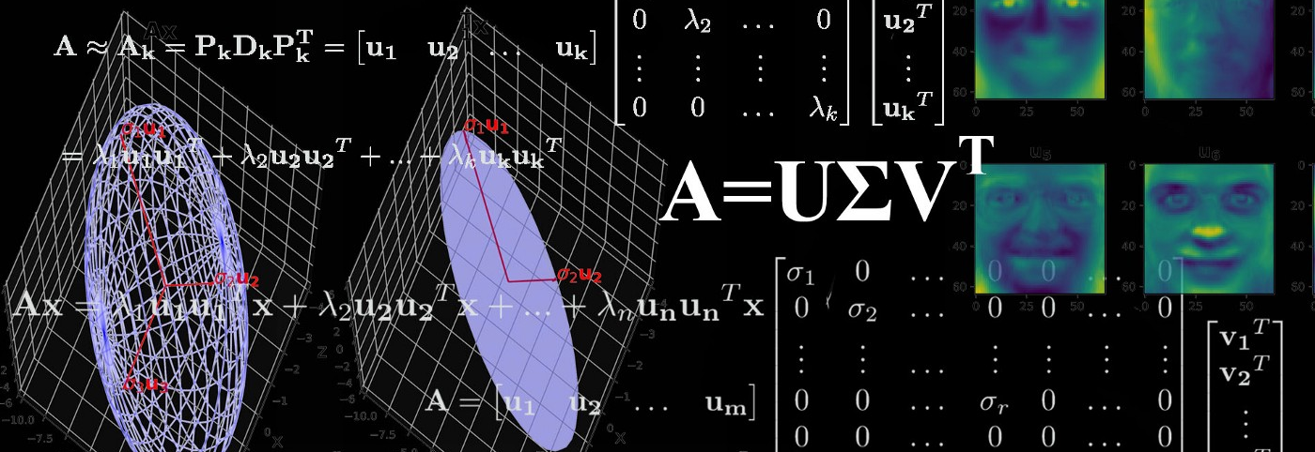
SINGULAR VALUE DECOMPOSITION

Slide 3
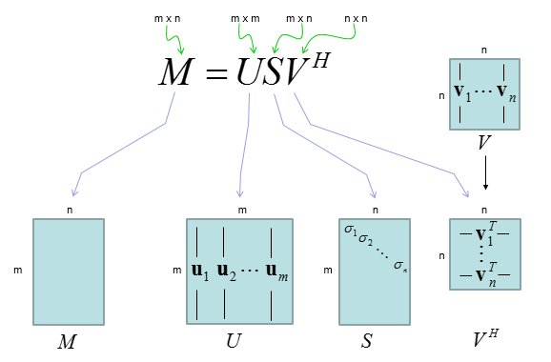
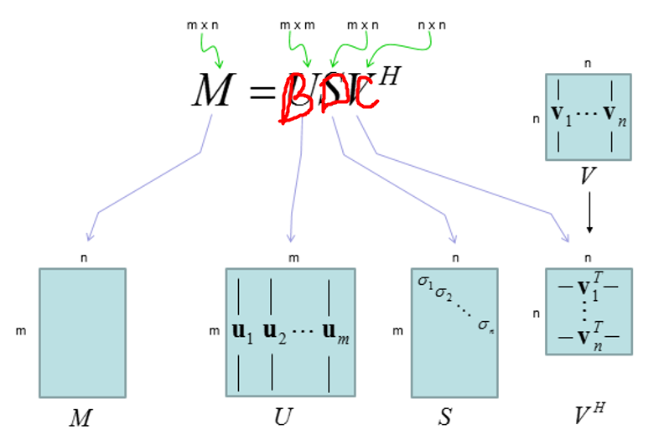
What is SVD

Slide 4
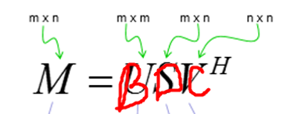
SVD Function
def SVD(self):
self.D_find()
self.C_find()
self.B_find()

Slide 5
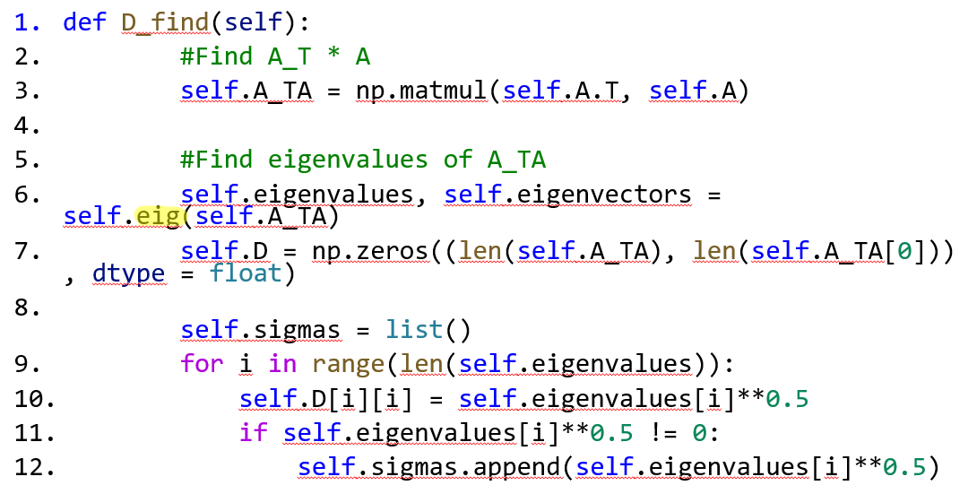
1. D_find() function
.

Slide 6


1.1 Eigenvalues_find() function 1.1.1 Finding characteristic polynomial
def eigenvalues_find(self):
if len(self.A_TA) == 2:
a = 0
b = -1
c = sum(np.diag(self.A_TA))
d = -1 * self.det(self.A_TA)
ch_pol = f"{b}x² + ({c})x + ({d})"
elif len(self.A_TA) == 3:
a = -1
b = sum(np.diag(self.A_TA))
c = -1 * sum([self.det(self.A_TA[:2, :2]), self.det(self.A_TA[1:3, 1:3]), self.det(self.A_TA[::2, ::2])])
d = self.det(self.A_TA)
ch_pol = f"{a}x³ + ({b})x² + ({c})x + ({d})"
self.to_print += f"Characteristic polynomial: {ch_pol}\n\n"

Slide 7

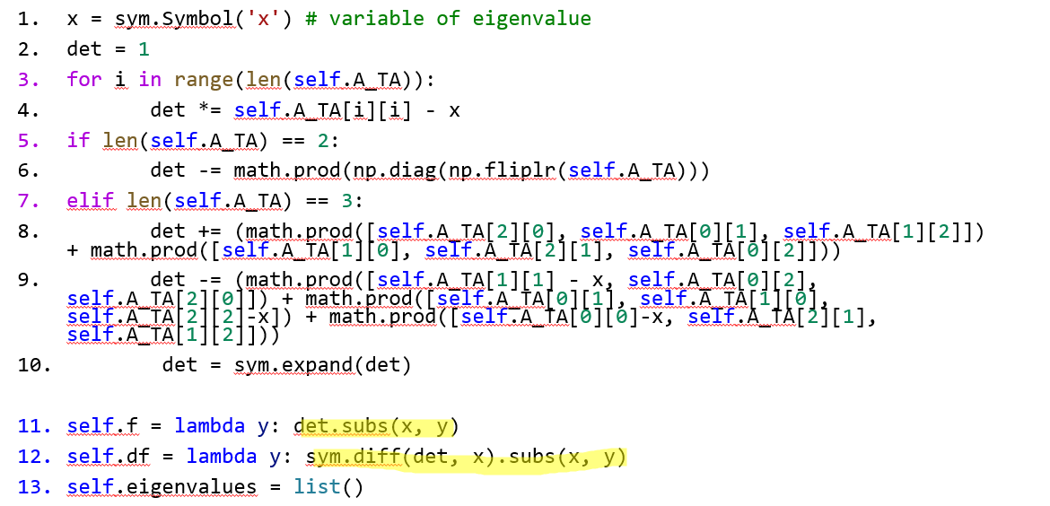


Slide 8
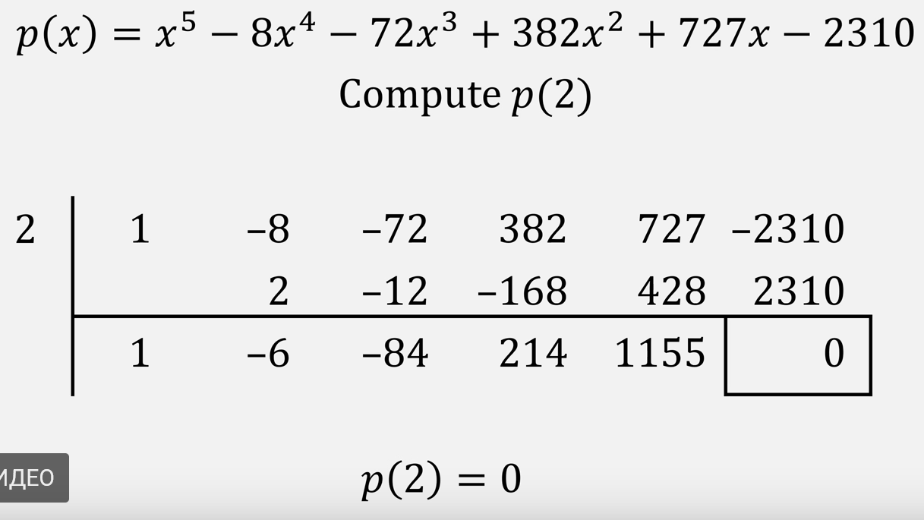
1.1 Eigenvalues_find() function 1.1.2 Solving characteristic polynomial 1.1.2.1 Algorithm
Main strategy → Use Horner’s method to decompose equation to square
https://www.youtube.com/watch?v=zEvfkSuPqWk&feature=youtu.be
Condition for Horner’s method:
Find at least one root of equation
Solution → Newton-Raphson Method
https://brilliant.org/wiki/newton-raphson-method/

Slide 9

1.1 Eigenvalues_find() function 1.1.2 Solving characteristic polynomial 1.1.2.2 Newton_Raphson() function
def newtonRaphson(self, x):
h = self.f(x) / self.df(x)
while abs(h) >= 0.0000001:
h = self.f(x)/self.df(x)
# x(i+1) = x(i) - f(x) / f'(x)
x = x - h
return round(x)
x0 = 0.75 #Initial guess
self.eigenvalues.append(float(self.newtonRaphson(x0)))

Slide 10
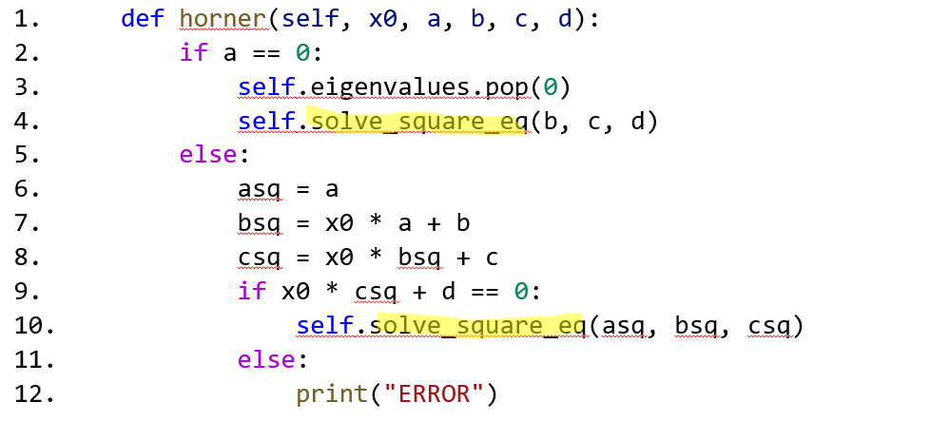
1.1 Eigenvalues_find() function 1.1.2 Solving characteristic polynomial 1.1.2.3 Horner’s method

Slide 11
1.1 Eigenvalues_find() function 1.1.2 Solving characteristic polynomial 1.1.2.4 Solving Square equation
def solve_square_eq(self, a, b, c):
D = b**2 - 4 * a * c
x1 = (-b + D**0.5)/2*a
self.eigenvalues.append(x1)
x2 = (-b - D**0.5)/2*a
self.eigenvalues.append(x2)

Slide 12
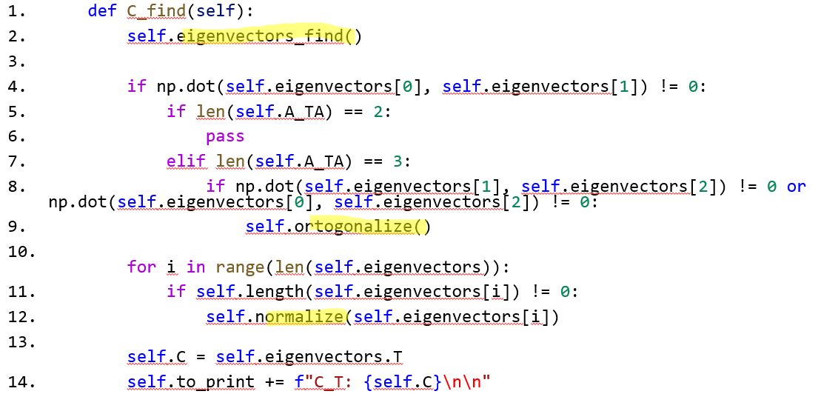
2. C_find() function

Slide 13
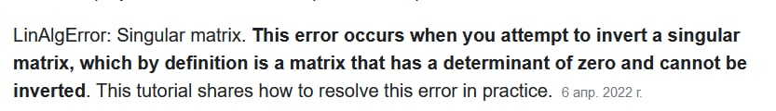
2.1 Finding eigenvectors 2.1.2 Theory&problems
Methods to solve SLE:
Method of inverse matrix
Cramer’s method
Gauss method
Problem :
Zero Determinant matrix → Free Variable

Slide 14
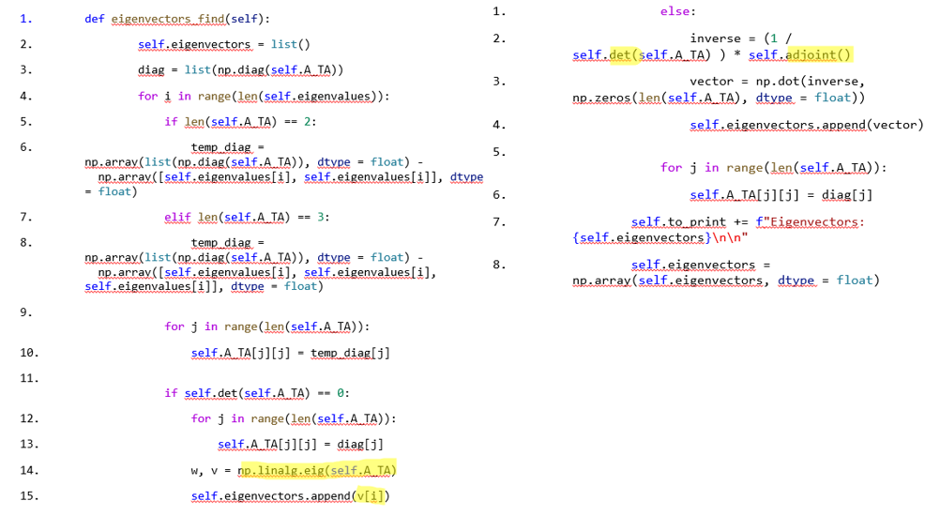
2.1 Finding eigenvectors 2.1.2 Function

Slide 15
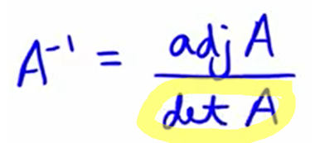
2.1 Finding eigenvectors 2.1.2.1 Determinant of matrix
def det(self, A):
det = 0
det += math.prod(np.diag(A))
det -= math.prod(np.diag(np.fliplr(A)))
if len(A) == 3:
det += (math.prod([A[2][0], A[0][1], A[1][2]]) + math.prod([A[1][0], A[2][1], A[0][2]]))
det -= (math.prod([A[0][1], A[1][0], A[2][2]]) + math.prod([A[0][0], A[2][1], A[1][2]]))
return det
return det

Slide 16
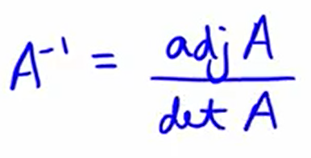
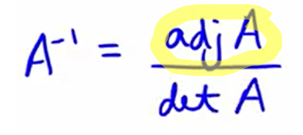
2.1 Finding eigenvectors 2.1.2.2 Adjoint Matrix
def adjoint(self):
temp = list()
if len(self.A_TA) == 2:
temp.append(self.A_TA[1][1])
temp.append(-1 * self.A_TA[1][0] )
temp.append(-1 * self.A_TA[0][1] )
temp.append(self.A_TA[0][0] )
return np.array(np.array(temp).reshape(2, 2), dtype = float)
elif len(self.A_TA) == 3:
temp.append(self.det(self.A_TA[1:3, 1:3]))
temp.append(-1 *self.det(self.A_TA[::2, ::2]))
temp.append(self.det(self.A_TA[1:3, :2]))
temp.append(-1*self.det(self.A_TA[:3:2, 1:3]))
temp.append(self.det(self.A_TA[:3:2, :3:2]))
temp.append(-1 * self.det(self.A_TA[:3:2, :2]))
temp.append(self.det(self.A_TA[:2, 1:3]))
temp.append(-1 * self.det(self.A_TA[:2, :3:2]))
temp.append(self.det(self.A_TA[:2, :2]))
return np.array(np.array(temp).reshape(3, 3), dtype = float)

Slide 17
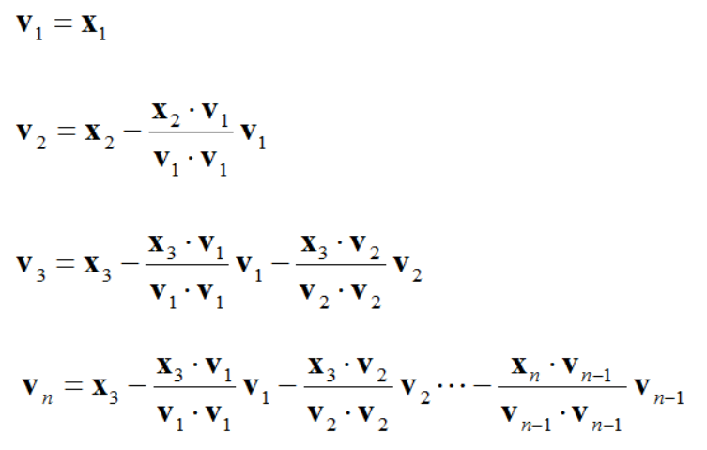
2. C_find() function 2.2.1 Ortogonalization Theory
Gram-Shmidt procedure

Slide 18
2. C_find() function 2.2.2 Ortogonalization Function
def ortogonalize(self):
k = list()
for i in range(1, len(self.eigenvectors)):
for j in range(i):
if np.dot(self.eigenvectors[j], self.eigenvectors[j]) != 0:
temp = np.dot(self.eigenvectors[i], self.eigenvectors[j])/np.dot(self.eigenvectors[j], self.eigenvectors[j])
else:
temp = 1
k.append(temp)
for j in range(len(k)):
self.eigenvectors[i] -= k[j] * self.eigenvectors[j]
k.clear()

Slide 19
2. C_find() function 2.3 Normalization Function
def normalize(self, v):
length_v = 0
for i in range(len(v)):
length_v += v[i]**2
length_v = length_v ** 0.5
for i in range(len(v)):
v[i] = v[i]/length_v

Slide 20
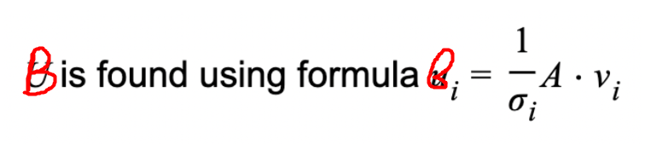
3. B_find() function 3.1 Theory

Slide 21
3. B_find() function 3.2 Function
def B_find(self):
temp = list()
for i in range(len(self.sigmas)):
a = 1/self.sigmas[i]
matrix = a * self.A
vector = np.matmul(matrix, self.eigenvectors[i])
temp.append(vector)
self.B = np.array(temp, dtype = float)
self.to_print += f"B: {self.B}\n\n"

Slide 22
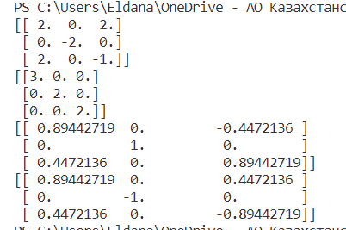
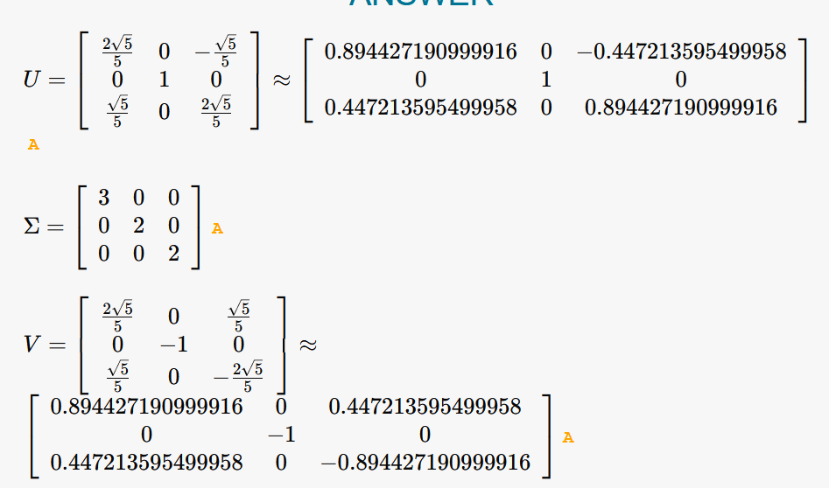
SVD: comparison with exact/online solution 3x3 matrix
import alg
import numpy as np
mat = np.array([[2, 0, 2], [0, -2, 0], [2, 0, -1]], dtype = float)
a = alg.decompositions(mat)
D, C, B = a.SVD()
print(mat)
print(C)
print(D)
print(B)

Slide 23
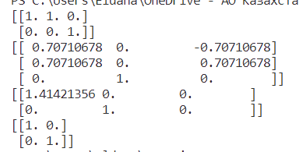
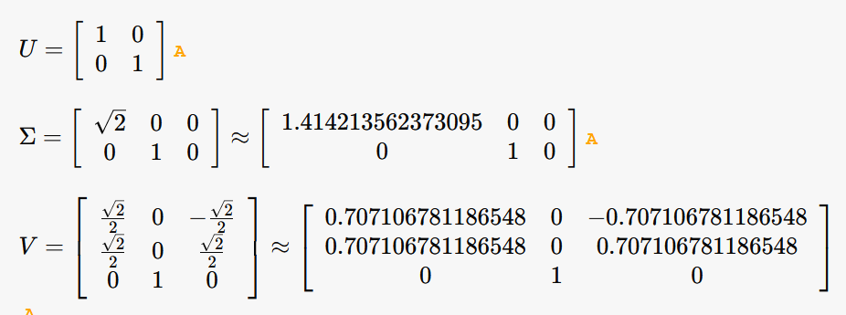
SVD: comparison with exact/online solution 3x2 matrix
import alg
import numpy as np
mat = np.array([[1, 1, 0], [0, 0, 1]], dtype = float)
a = alg.decompositions(mat)
D, C, B = a.SVD()
print(mat)
print(C)
print(D)
print(B)

Slide 24
SVD: comparison with exact/online solution 4x4 matrix
import alg
import numpy as np
mat = np.array([[2, 0, 2], [0, -2, 0], [2, 0, -1]], dtype = float)
a = alg.decompositions(mat)
D, C, B = a.SVD()
print(mat)
print(C)
print(D)
print(B)

Slide 25
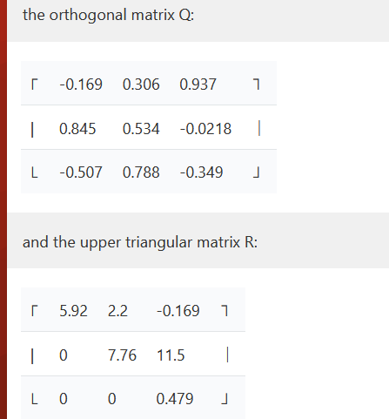
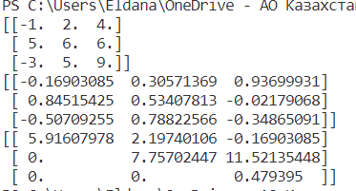
QR: comparison with exact/online solution 3x3 matrix
import alg
import numpy as np
mat = np.array([[-1, 2, 4], [5, 6, 6], [-3, 5, 9]], dtype = float)
a = alg.decompositions(mat)
Q, R = a.QR()
print(mat)
print(Q)
print(R)

Slide 26
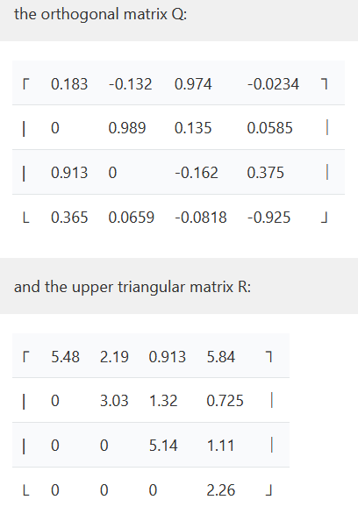
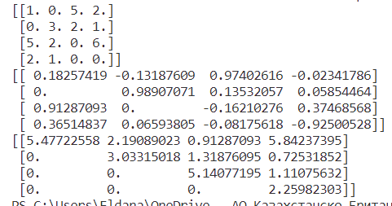
QR: comparison with exact/online solution 4x4 matrix
import alg
import numpy as np
mat=np.array([[1.,0.,5., 2.],
[0.,3.,2., 1.],
[5.,2.,0., 6.],
[2, 1, 0, 0.]])
a = alg.decompositions(mat)
Q, R = a.QR()
print(mat)
print(Q)
print(R)

Slide 27
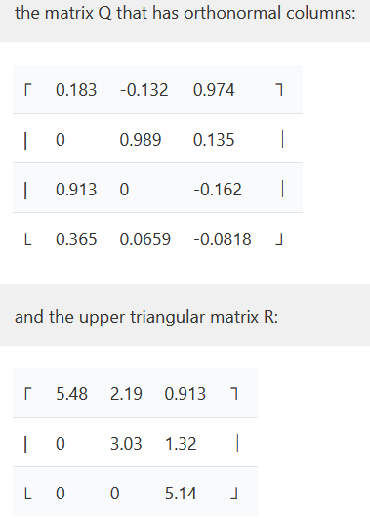
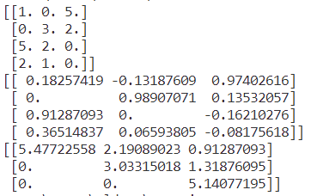
QR: comparison with exact/online solution 4x3 matrix
import alg
import numpy as np
mat = np.array([[-1, 2, 4], [5, 6, 6], [-3, 5, 9]], dtype = float)
a = alg.decompositions(mat)
Q, R = a.QR()
print(mat)
print(Q)
print(R)

Slide 28
Self-study
Numerical methods of finding eigenvalues
Practical implementation of mathematical knowledge

Slide 29

Thank you for your attention

