Slide 1
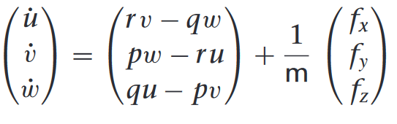
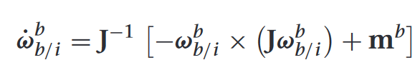
Body simulation
Update loop
Initialization
Velocity
Angle of attack (body)
Angle of attack (tail)
Body Dimensions
Control surfaces
Body Velocity
Wind velocity
Tail Angle
Aero forces and moments in body frame:
Calculate Cd, Cl
Calculate q_dynamic
Calculate gravity in body frame
External Wind Conditions (0)
Initial Conditions
Physical Parameters
Update velocity, and angle of attacks, and sideslip
Control Surfaces
(tail angle, flapping, throttle)
Time
Velocities and rotation rates
Integration using Runge-Kutta RK4
X_dot = v
V_dot =
Theta_dot =
Omega_dot =
Fx, Fy, Fz, Mx, My, Mz
Current state (pos, velocities)
Mass, J
Wind speeds

Slide 2
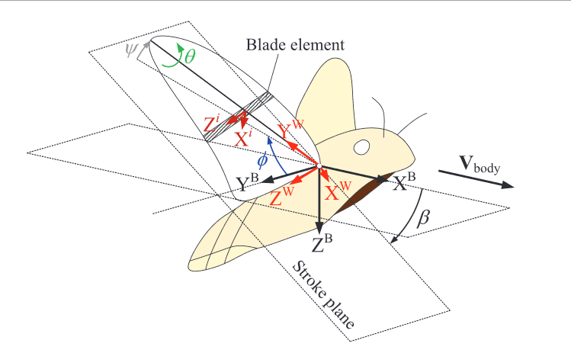
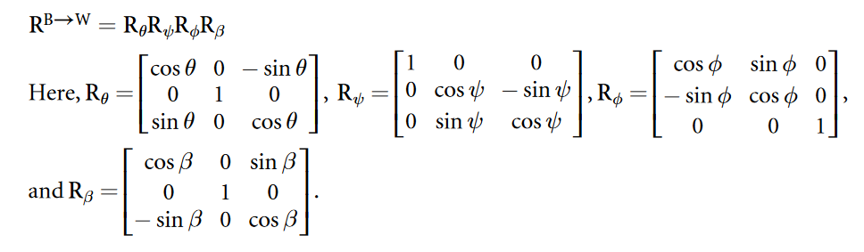
Body to wing frame

Slide 3
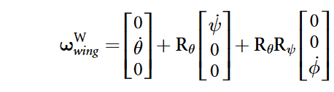
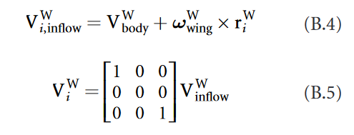

Getting velocity at each element
Distance from pivot to ith blade element

Slide 4
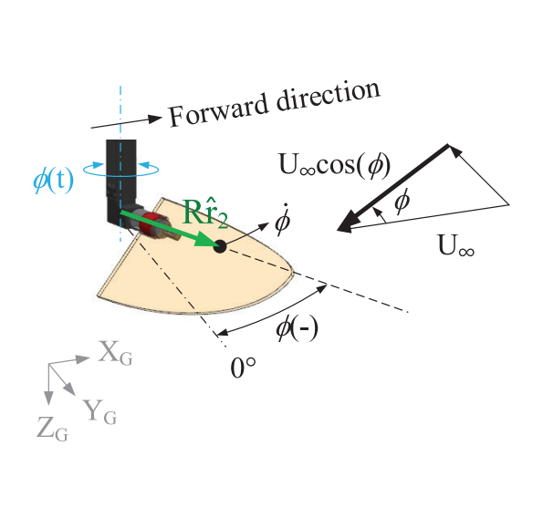
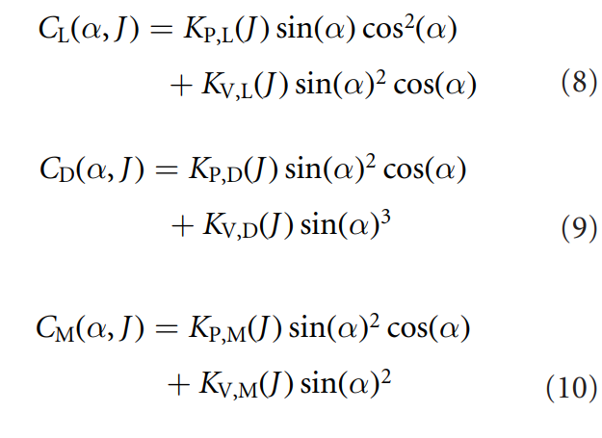
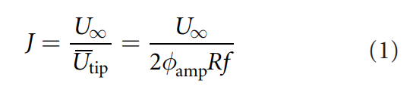
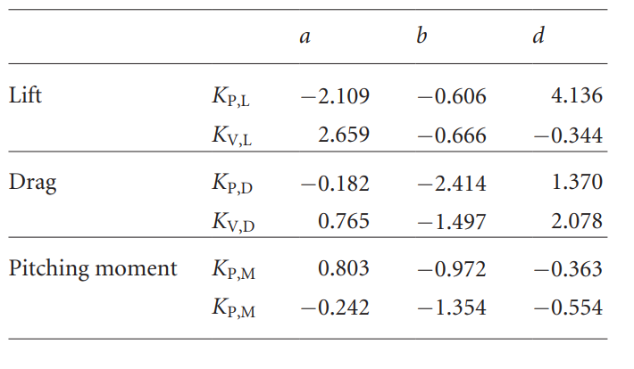
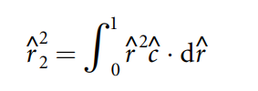
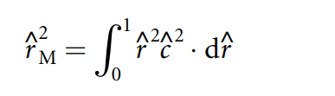
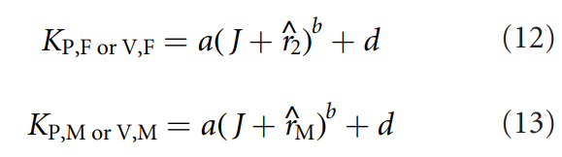
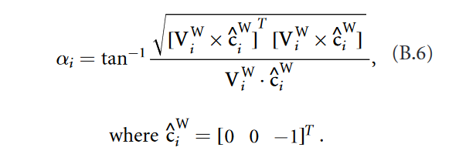
Unit vector of blade element towards leading edge

Slide 5
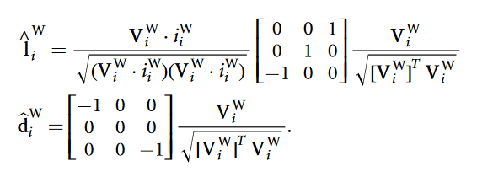

Lift unit vector
Drag unit vector
Vector from pivot to element center of mass

Slide 6
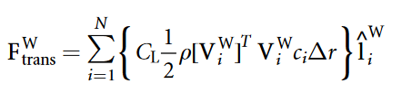

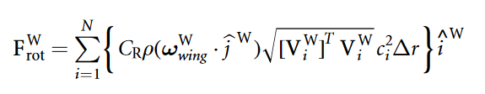









Slide 7
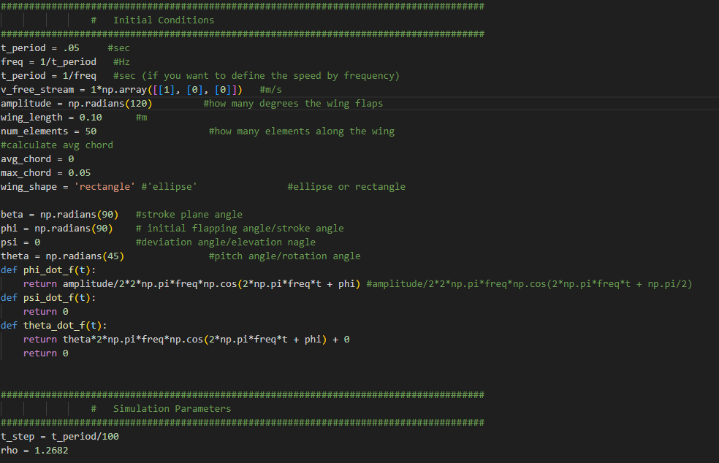
Code Implementation
Parameters

Slide 8
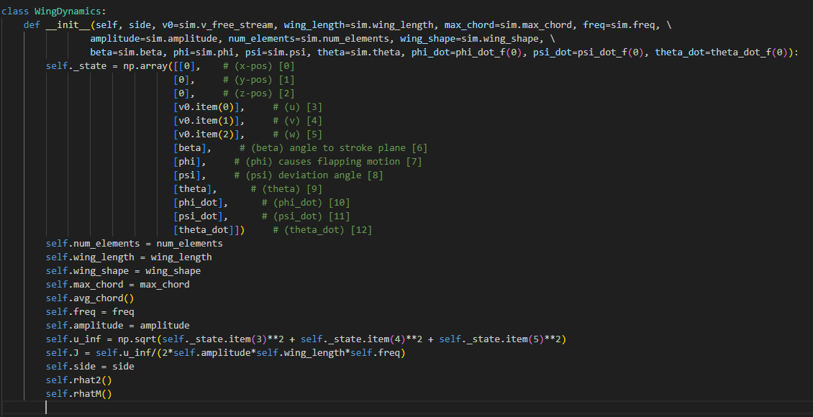
Code Implementation
Initialization

Slide 9
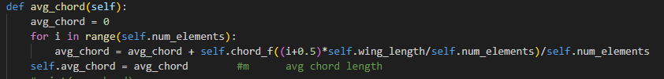
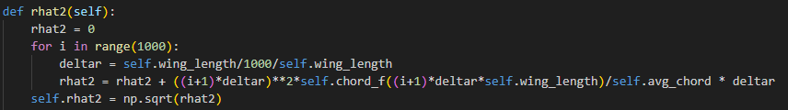
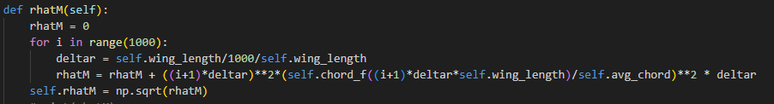
Code Implementation
Avg_chord()
Rhat2()
rhatM()

Slide 10
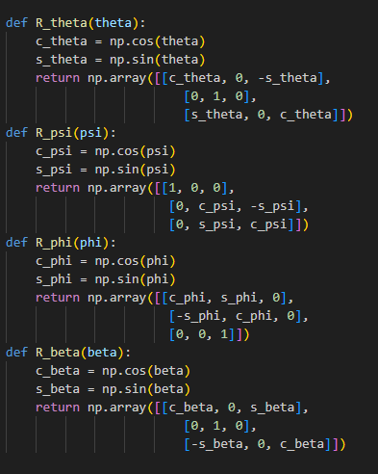
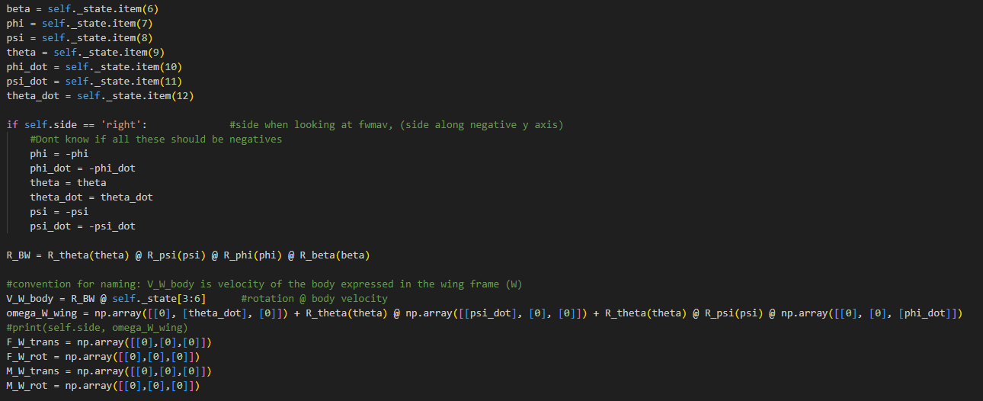
Code- calculate forces- before blade elements

Slide 11
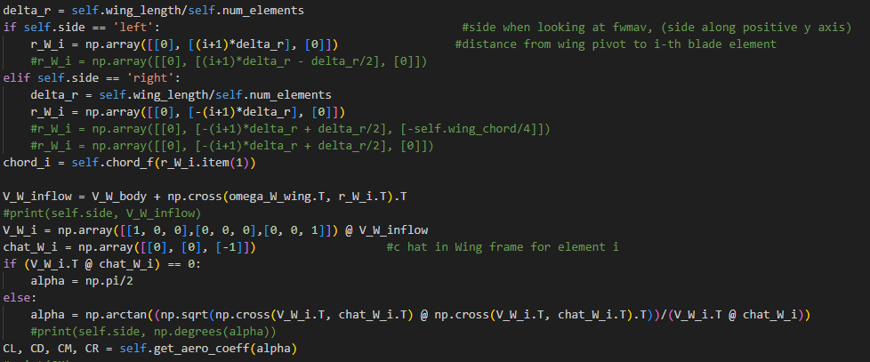
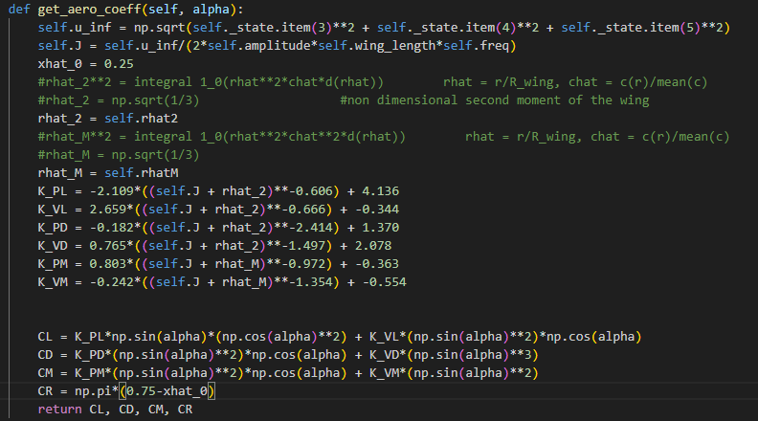
Code- calculate forces- blade elements

Slide 12
Code- calculate forces- blade elements

Slide 13
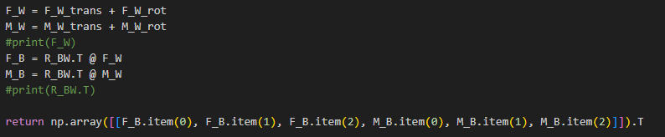
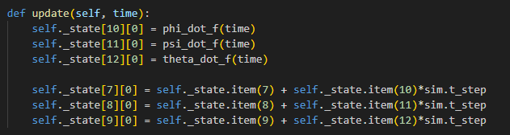
Code- calculate forces- post blade elements
Updating angles and angular velocities

Slide 14
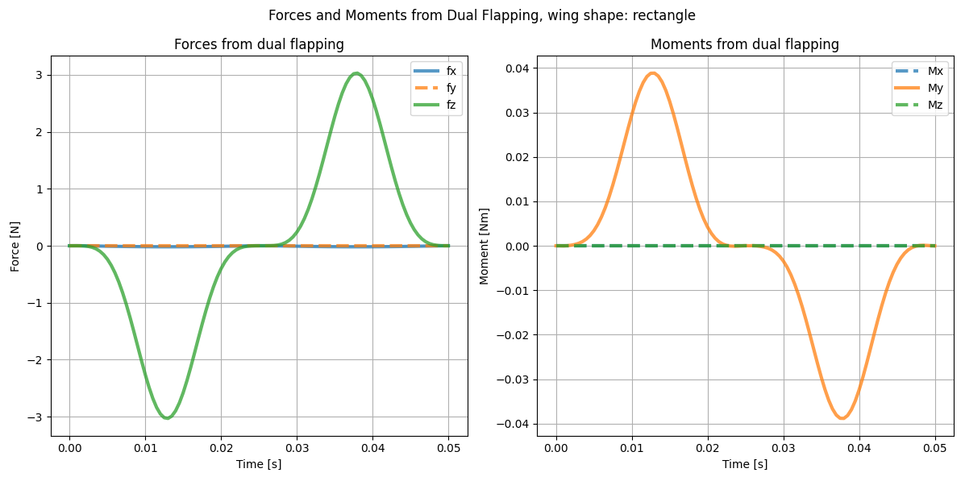
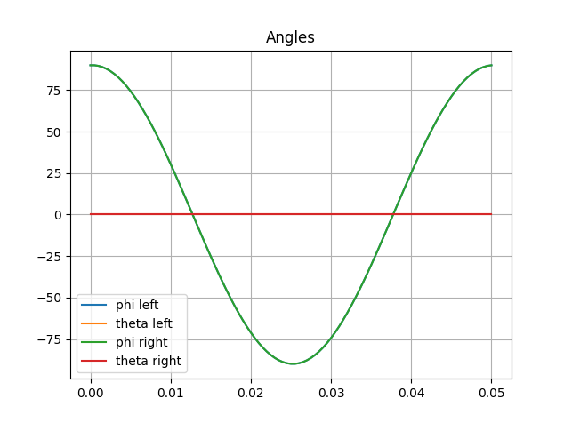
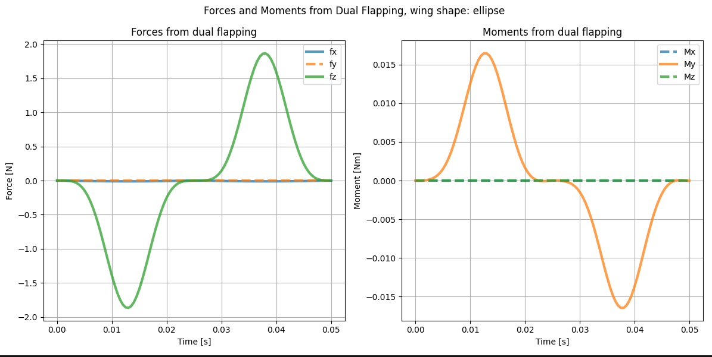
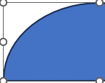
Test cases, flapping up and down, no pitch
0.05m
0.05 m
0.1 m
0.1 m

Slide 15
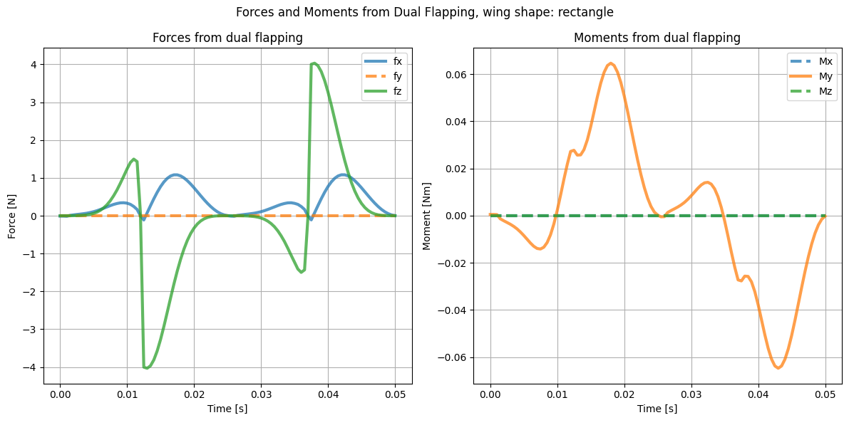
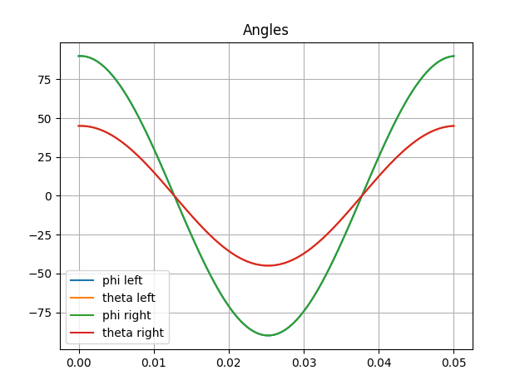
Flapping with pitch

