Slide 1
Data Pipeline & NaN Handling
MethylLlama Pretraining on the 49k CpG Union Corpus
How missing measurements (NaN) flow through the pipeline and are correctly excluded from the reconstruction loss
Netanel Azran | BMFM-RNA Methylation | Hebrew University
Run: llama-small-all49k-r0.5-w0.0-44450919

Slide 2
The Two Datasets
Pretrain: 169k samples × 49k CpGs | Fine-tune: 11.5k samples × 49k CpGs
PRETRAINING
FINE-TUNING
169,120 samples × 49,156 CpGs
11,500 samples × 49,156 CpGs
📁 File
methylgpt_pretrain_type3.h5ad
📁 File
finetuning_49k.h5ad
⚙ Script
pretrain_llama_small.sh → pretrain_llama.py
⚙ Script
finetune_llama_small.sh → finetune_llama.py
🔷 Module
WCEDLlamaModule (wced_llama.py)
🔷 Module
WCEDLlamaModule (wced_llama.py)
Same 49k vocab
📐 Architecture
256D × 4L × 4H ≈ 5M params
📐 Pooling
Mean over all tokens
🎯 Input ratio
0.5 — 50% of valid CpGs per view
🎯 Input ratio
1.0 — all valid CpGs as input
🏋 Age weight
0.0 — pure reconstruction pretraining
🏋 Recon weight
0.0 — age MSE loss only
🔖 Job ID
44450919 (7-day run)
❄ Encoder
Frozen (unfrozen after epoch 10)

Slide 3
Why NaN Exists — The Illumina Array Union Problem
Each sample was measured on ONE array type → other probes are structurally missing
27k Array
450k Array
EPIC Array
~27,000 probes
~450,000 probes
~850,000 probes
Legacy
2012–
2016–
▼
▼
▼
Union of all studies → 49,156 CpGs in shared vocabulary
→
NaN where not measured
PER-SAMPLE BREAKDOWN
Sample type
Valid CpGs
NaN positions
NaN rate
Typical in
450k-array sample
~19,600
~29,556
~60%
Fine-tune dataset (confirmed)
EPIC-array sample
~40,000
~9,156
~19%
Most of pretrain corpus
27k-array sample
~27,000
~22,156
~45%
Some of pretrain corpus
★ From pretrain valid_pct ≈ 42% → NaN rate ≈ 16% (pretrain corpus is mostly well-measured EPIC-array samples)

Slide 4
Full Pipeline — NaN Handling at Each Stage
From raw file to loss function: where NaN is detected, imputed, and excluded
Input
Step 1
Step 2a
Step 2b
Step 3
h5ad File
MethylationDataset
WCEDCollator 2a
WCEDCollator 2b
WCEDLlamaModule
methylgpt_pretrain _type3.h5ad 169k × 49k
→
Reads β values Computes valid_mask = isfinite(β)
→
NaN → 0 in targets valid_mask stored in batch dict
→
Input views built from valid CpGs only (NaN never tokenised)
→
recon_mask = ~input_mask & valid_mask
CpG POSITIONS — THREE CATEGORIES PER SAMPLE
In input view
Valid — held out
NaN position
~20.5k positions 50% of valid CpGs shown to encoder
~20.5k positions 50% of valid CpGs not in input
~8k positions never measured target = 0.0 (imputed)
EXCLUDED from recon loss (encoder already saw it)
INCLUDED in recon loss ✓ Real β target → true signal
EXCLUDED by valid_mask ✓ No gradient from fake zeros

Slide 5
Step 1 — MethylationDataset: Reading the Data
bmfm_methylation/shared/data_module.py · MethylationDataset.__getitem__
📄 adata.X[idx]
🔢 float32 array
🔍 isfinite(β)
WHY THIS DESIGN
Raw row from h5ad 49,156 float values Sparse or dense
→
Convert to numpy float32 array shape: (49156,)
→
np.isfinite(beta_values) True = real value False = NaN
● NaN is preserved — not replaced here
● valid_mask is computed while NaN is still visible
▼
● If we replaced NaN→0 first, the mask would be wrong
Two outputs
↙ ↘
● Separation of concerns: Dataset reads, Collator decides
beta_values
valid_mask
Shape: (49156,) float32 NaN values preserved Passed to collator as-is
Shape: (49156,) bool True = measured False = NaN position
● valid_mask travels through the batch dict to the loss fn
After Step 1: beta_values contains NaN · valid_mask = True/False array · both in MultiFieldInstance

Slide 6
Step 2a — WCEDCollator: NaN Detection & Replacement
bmfm_methylation/shared/data_module.py · WCEDCollator.__call__
VISUAL EXAMPLE — ONE SAMPLE ROW (6 CpGs shown)
Input (beta_values):
0.23
NaN
0.87
NaN
0.61
NaN
▼
np.where(valid, β, 0.0)
▼
all_betas (target):
0.23
0.00
0.87
0.00
0.61
0.00
← NaN replaced with 0.0
valid_mask:
True
False
True
False
True
False
← passed in batch dict → Step 3
all_betas — reconstruction target
valid_mask — the critical guard
Shape: [batch, 49156] dtype: float32 Real positions: actual β ∈ [0, 1] NaN positions: 0.0 (imputed — safe because valid_mask will exclude them from loss) This is what the model tries to predict
Shape: [batch, 49156] dtype: bool True = position was actually measured → include in loss False = position was NaN → exclude from loss Returned in batch dict → used in Step 3 to build recon_mask
After Step 2a: all_betas ready (NaN→0.0) · valid_mask ready (True/False) · both in batch dict

Slide 7
Step 2b — WCEDCollator: Input View Selection
NaN positions are never tokenised — input is sampled from valid CpGs only
49,156 CpG VOCABULARY — BREAKDOWN PER SAMPLE
NaN positions ~4.3k (8.7%)
Input view ~22.5k (45.7%)
Held-out (recon target) ~22.5k (45.7%)
INPUT RATIO FORMULA
Why this matters for high-NaN samples
valid_indices = positions where isfinite(β) → ~44.9k of 49k (NaN rate = 8.7%)
450k sample (60% NaN) → only 19.6k valid CpGs n_input = 0.5 × 19.6k = 9.8k (not 0.5 × 49k = 24.5k) Always exactly 50% of what was measured is shown. NaN positions NEVER appear as encoder input tokens.
n_input = int( len(valid_indices) × input_ratio ) = int( 44,900 × 0.5 ) = 22,450
input_ratio applied to valid CpGs — NOT to the full 49k vocabulary
WHAT GETS ASSIGNED TO EACH CATEGORY
In input view ~n_input positions
Valid — held out remaining valid positions
NaN positions never in valid_indices
randomly sampled from valid_indices input_ratio × |valid_indices|
|valid_indices| - n_input positions not sampled into input view
np.where(vocab_valid) returns only non-NaN indices — NaN excluded
→ encoder tokens → excluded from recon loss
→ recon_mask = True → included in loss ✓
→ valid_mask = False → excluded from loss ✓

Slide 8
Step 3 — WCEDLlamaModule: Correct Reconstruction Loss
bmfm_methylation/llama/wced_llama.py · _shared_step
HOW recon_mask IS BUILT
~input_mask
AND
valid_mask
=
recon_mask
Positions NOT shown to encoder
Positions that were actually measured
Positions included in loss computation
POSITION-BY-POSITION DECISION TABLE
Position type
~Count
Encoder sees?
in ~input_mask?
valid_mask?
In recon loss?
In input view
~20.5k
✓ Yes
True
True
✗ NO
Valid — held out
~20.5k
✗ No
False
True
✓ YES
NaN position
~8k
✗ No
False
False
✗ NO
Loss formula
Metrics (PCC, MAE) use same recon_mask
loss = Σ MSE(pred, target) × recon_mask ÷ recon_mask.sum() (true denominator) ≈ 42% of 49k positions contribute per step
pred_values = pred_betas[recon_mask] true_values = all_betas[recon_mask] PCC computed only on real, held-out CpGs → honest metric

Slide 9
Bug in Old Code vs. Correct Implementation in LLaMA
Your LLaMA runs are NOT affected — the fix is already in wced_llama.py ✓
✗ BUG — wced_module.py (SCBert)
✓ CORRECT — wced_llama.py (LLaMA)
NOT YOUR RUN
YOUR PRETRAIN RUN 44450919
recon_mask = ~input_mask ONLY
recon_mask = ~input_mask AND valid_mask
valid_mask is in the batch dict but never read
valid_mask explicitly applied — NaN positions excluded
Denominator includes NaN positions
Denominator = recon_mask.sum()
~29k NaN positions with target=0 are in the loss denominator
only counts positions that are real AND held-out
75% of gradient is from fake zeros
100% of gradient from real CpGs
model is trained on artificial 0.0 values it never actually saw
every position contributing to loss has a true β measurement
MSE looks artificially low
MSE is honest
easy-to-predict zeros pull the loss down — misleading metric
no artificial zeros — metric reflects true reconstruction quality
PCC computed on all non-input
PCC on real held-out only
correlation diluted by 29k positions with target=0
correlation computed on the same clean mask as the loss
Signal quality: OLD = 25% real · NEW = ~100% real Metric honesty: OLD = inflated · NEW = correct Your run: ✓ Already correct from day 1

Slide 10
Pretrain Results — Run 44450919 (Epoch 99 / 300)
llama-small-all49k-r0.5-w0.0 · 256D × 4L × 4H · ~5M params · Runtime: ~4.5 days
0.971
0.043
0.006
42.0%
val / pcc Reconstruction quality
val / mae β error on [0, 1]
val / loss Recon MSE
valid_pct Useful positions / step
CLS COLLAPSE DIAGNOSTICS (collapsed = bad)
0.376
0.429
0.310
0.570
cls_similarity (1.0 = fully collapsed)
cls_variance (0.0 = fully collapsed)
pred_std (0.0 = predicting mean)
pred_var_ratio (1.0 = perfect spread)
NaN RATE INFERENCE FROM valid_pct
TRAINING HEALTH
Investigation confirms: NaN rate = 8.69% in pretrain → ~44.9k of 49k probes measured per sample on average valid_pct ≈ 42% = (0.5 × 44.9k) / 49.15k ✓ consistent Pretrain corpus is dominated by EPIC-array samples
cpg_scale
3.68 ✓ (init=0.1 → growing healthily)
grad_norm
0.0018 (stable convergence)
train/pcc
0.970 (no overfitting)
LR @ ep 99
3.82e-4 (cosine decay on track)
✓ No CLS collapse ✓ Reconstruction excellent (PCC 0.971) ⚠ pred_var_ratio = 0.57 — slight underdispersion (normal for pure reconstruction pretraining)

Slide 11
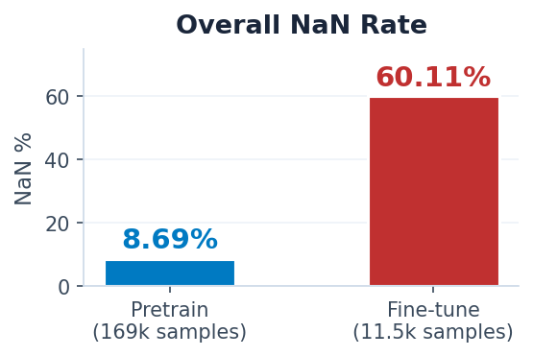
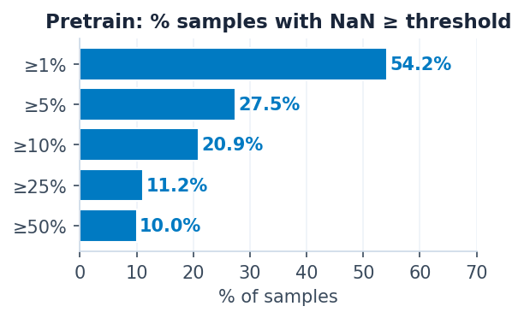
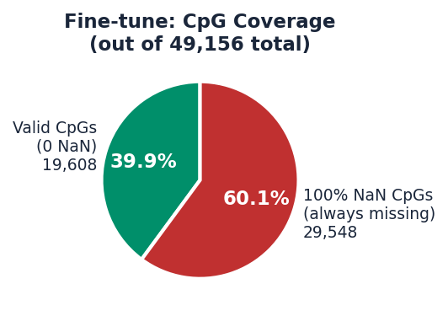
Data Investigation Results — NaN Statistics
Job 44584079 · Mon Apr 27 10:20–10:28 IDT 2026
8.69%
60.11%
29,548 / 49,156
5,461 / 1,366 / 4,626
Pretrain NaN %
Fine-tune NaN %
Fine-tune fully-missing CpGs (100% NaN)
Fine-tune splits train / val / test
Key insight: Fine-tune = pure 450k-array dataset — same 29,548 CpGs are 100% NaN across every single sample. Pretrain = mostly EPIC-array (NaN only 8.69%). The WCEDCollator valid_mask handles both correctly.

Slide 12
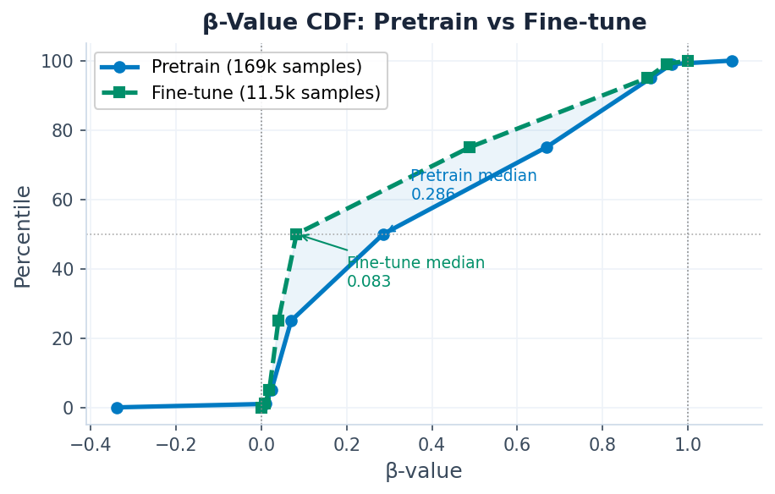
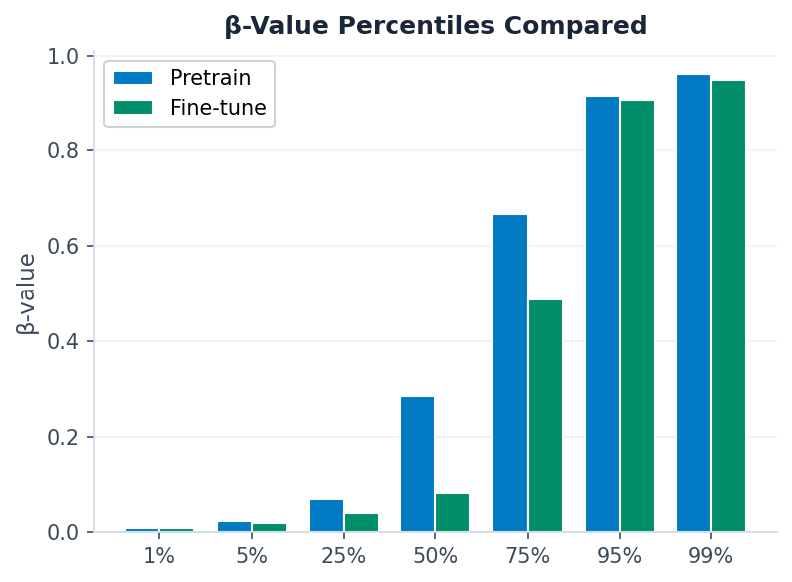
Data Investigation Results — β-Value Distribution
Valid values only · NaN excluded · Pretrain: 7.6B values · Fine-tune: 225M values
0.286
0.083
248,776 ⚠
0 ✓
Pretrain median β
Fine-tune median β
Pretrain out-of-range
Fine-tune out-of-range
Distribution shift: Pretrain is bimodal (unmethylated 0–0.2 + methylated 0.6–1.0) · Fine-tune is more heavily unmethylated (median 0.083) · Pretrain out-of-range due to raw Illumina signal (harmless — model learns from valid range)

Slide 13
Summary
The full NaN handling chain is correct in both pretrain and fine-tune LLaMA runs
PIPELINE — WHAT EACH FILE DOES
YOUR LLAMA RUNS — STATUS
Step 1 · MethylationDataset
✓ Pretrain 44450919: correct NaN handling
Reads β · computes valid_mask = isfinite(β) · NaN preserved
✓ Fine-tune 44574410: recon_weight=0.0 → NaN irrelevant
✓ wced_llama.py had the fix from the very start
Step 2a · WCEDCollator
✓ Bug exists only in old SCBert code (not your runs)
NaN → 0 in all_betas · valid_mask stored in batch dict
Step 2b · WCEDCollator
PRETRAIN QUALITY (EPOCH 99)
Input views: only sample from valid_indices · NaN never tokenised
PCC = 0.971
excellent reconstruction
MAE = 0.043
4.3% error on [0,1]
Step 3 · WCEDLlamaModule
cls_similarity = 0.376
no CLS collapse
recon_mask = ~input_mask & valid_mask · honest denominator
cls_variance = 0.429
healthy representation diversity
pred_var_ratio = 0.570
slight underdispersion — expected
valid_pct ≈ 42%
NaN rate ≈ 16% in pretrain corpus
Next: paste investigate_data.sh results into slides 11–12 · Monitor finetune val/r2 to assess if reconstruction pretraining transferred to age prediction

