Slide 1
תכנות מונחה עצמים תרגול 7
Netanel.levine@msmail.ariel.ac.il מייל:
נערך ע"י: נתנאל לוין

Slide 2
נושאים להיום
Thread life cycle
Create a Thread
Object functions : join , wait and notify
Producer consumer.

Slide 3
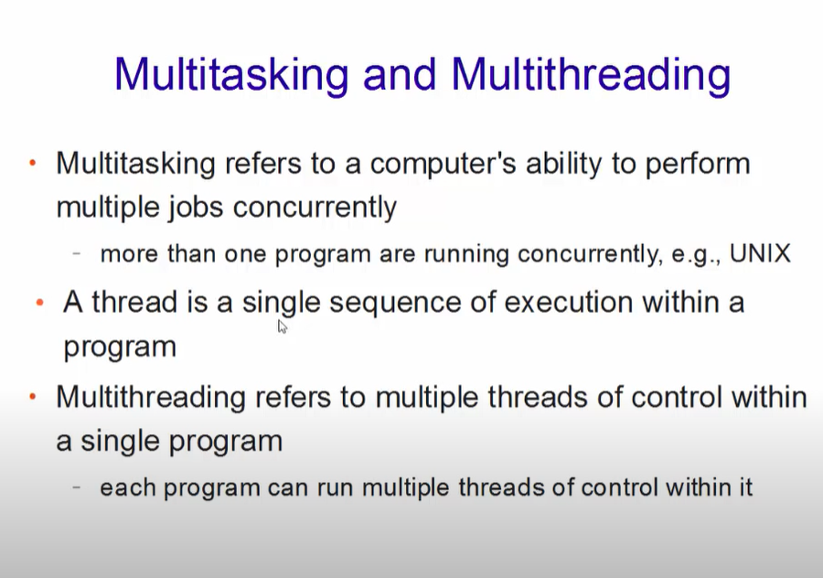

Slide 4
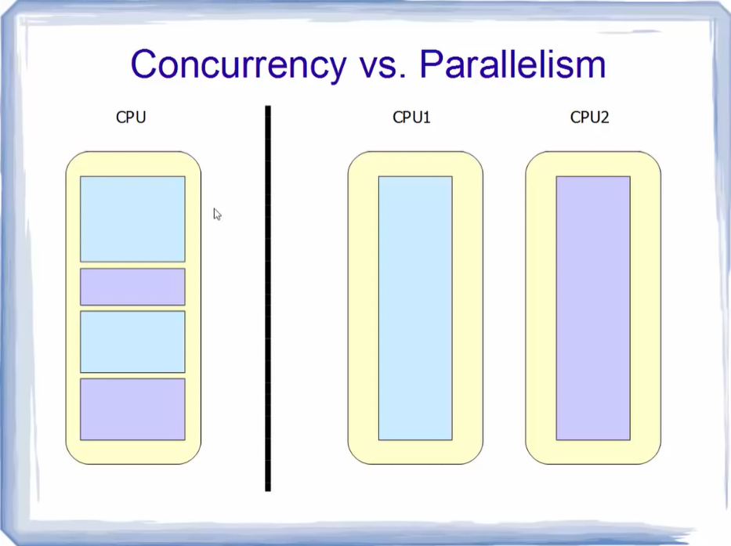

Slide 5
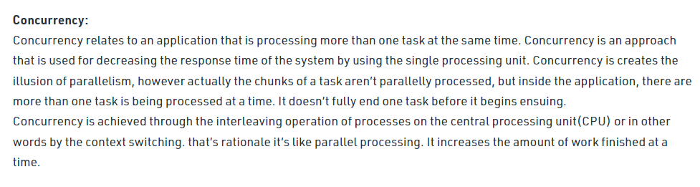
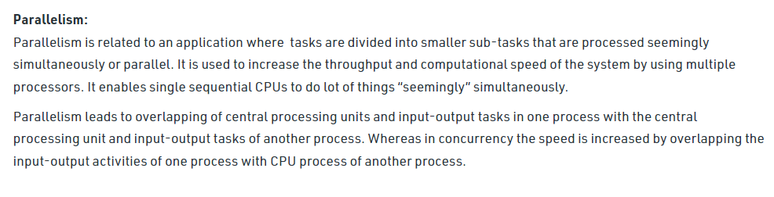

Slide 6
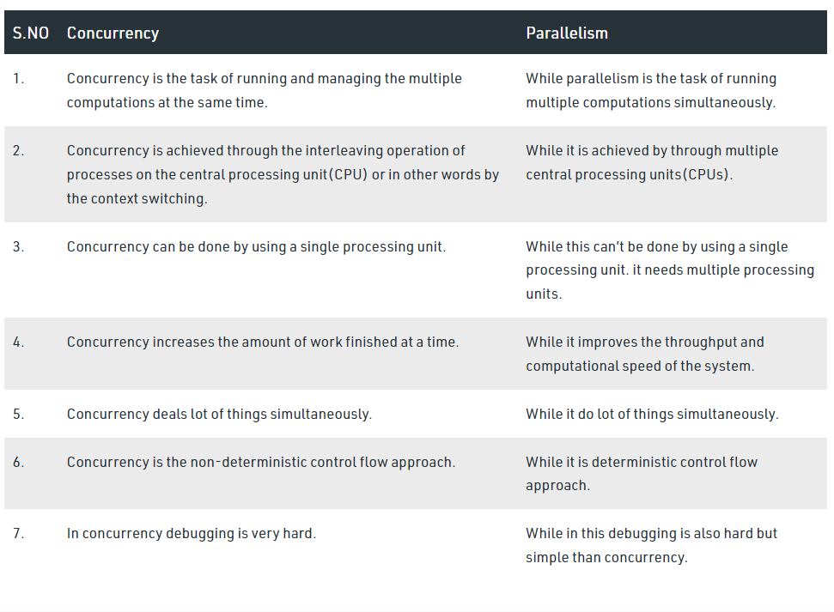
Differences between Concurrency and Parallelism:

Slide 7
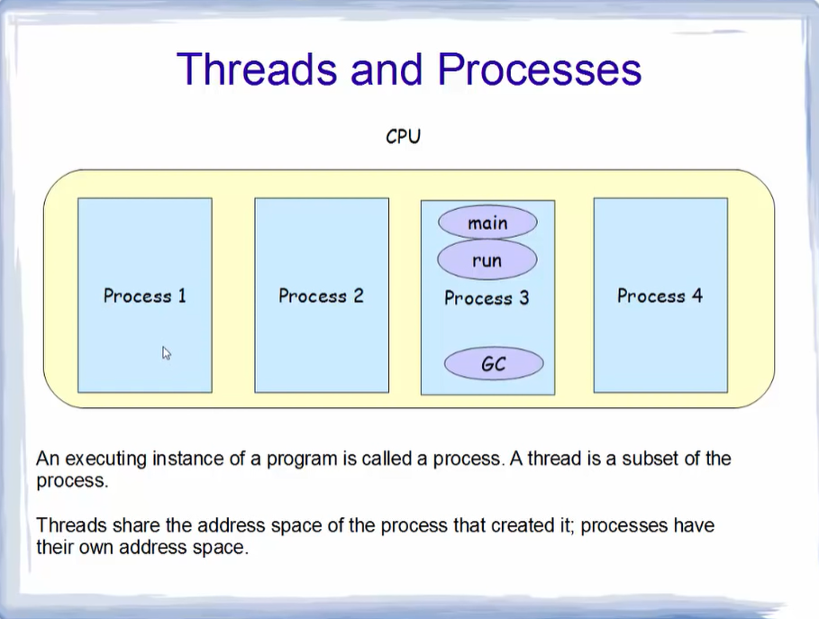

Slide 8
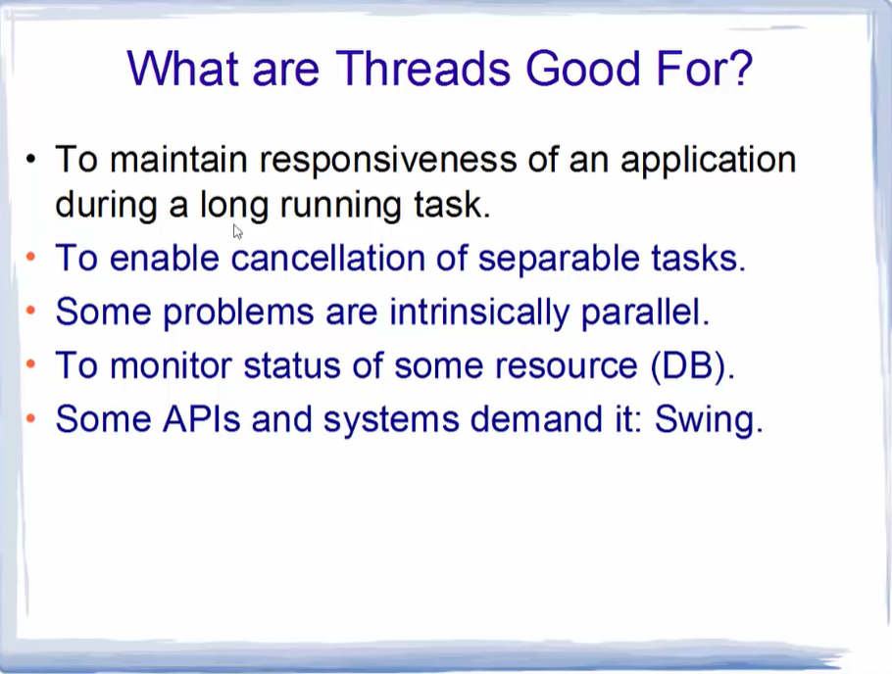

Slide 9
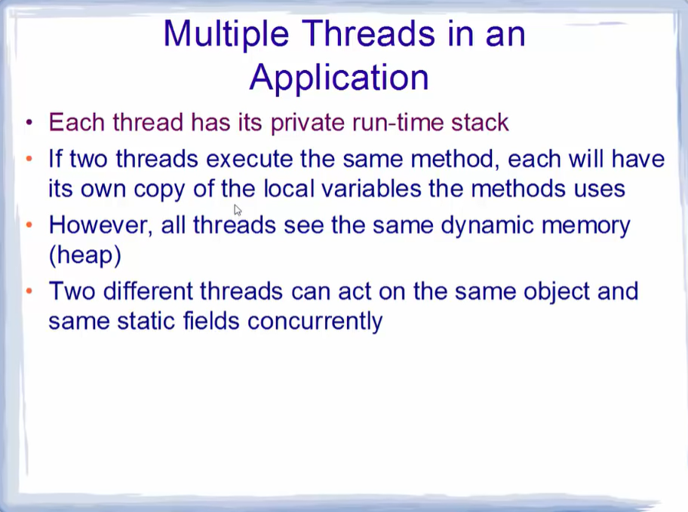

Slide 10

Java - Multithreading

Slide 11
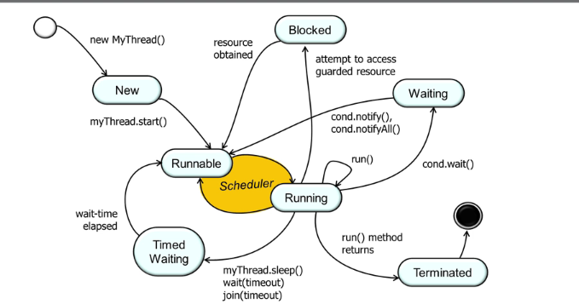
Java - Multithreading
Java is a multi-threaded programming language which means we can develop multi-threaded program using Java. A multi-threaded program contains two or more parts that can run concurrently and each part can handle a different task at the same time making optimal use of the available resources specially when your computer has multiple CPUs.
By definition, multitasking is when multiple processes share common processing resources such as a CPU. Multi-threading extends the idea of multitasking into applications where you can subdivide specific operations within a single application into individual threads. Each of the threads can run in parallel. The OS divides processing time not only among different applications, but also among each thread within an application.
Multi-threading enables you to write in a way where multiple activities can proceed concurrently in the same program.

Slide 12
Create a Thread by Implementing a Runnable Interface
If your class is intended to be executed as a thread then you can achieve this by implementing a Runnable interface. You will need to follow three basic steps −
Step 1
As a first step, you need to implement a run() method provided by a Runnable interface. This method provides an entry point for the thread and you will put your complete business logic inside this method. Following is a simple syntax of the run() method −
public void run( );
Step 2
As a second step, you will instantiate a Thread object using the following constructor −
Thread(Runnable threadObj, String threadName);
Where, threadObj is an instance of a class that implements the Runnable interface and threadName is the name given to the new thread.
Step 3
Once a Thread object is created, you can start it by calling start() method, which executes a call to run( ) method. Following is a simple syntax of start() method −
void start();

Slide 13
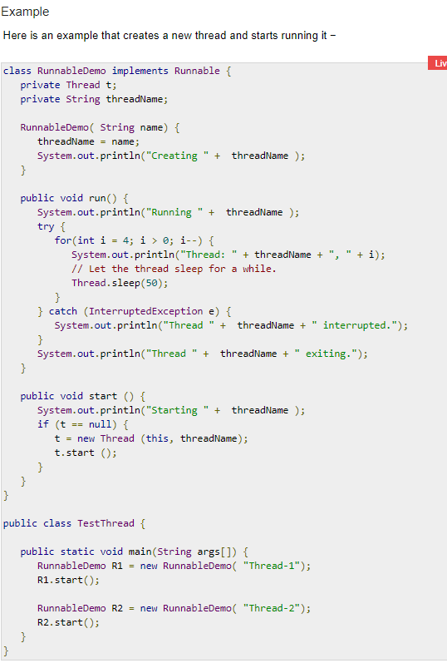
Create a Thread by Implementing a Runnable Interface example

Slide 14
Create a Thread by by Extending a Thread Class
Create a Thread by Extending a Thread Class
The second way to create a thread is to create a new class that extends Thread class using the following two simple steps. This approach provides more flexibility in handling multiple threads created using available methods in Thread class.
Step 1
You will need to override run( ) method available in Thread class. This method provides an entry point for the thread and you will put your complete business logic inside this method. Following is a simple syntax of run() method −
public void run( )
Step 2
Once Thread object is created, you can start it by calling start() method, which executes a call to run( ) method. Following is a simple syntax of start() method −
void start( );

Slide 15
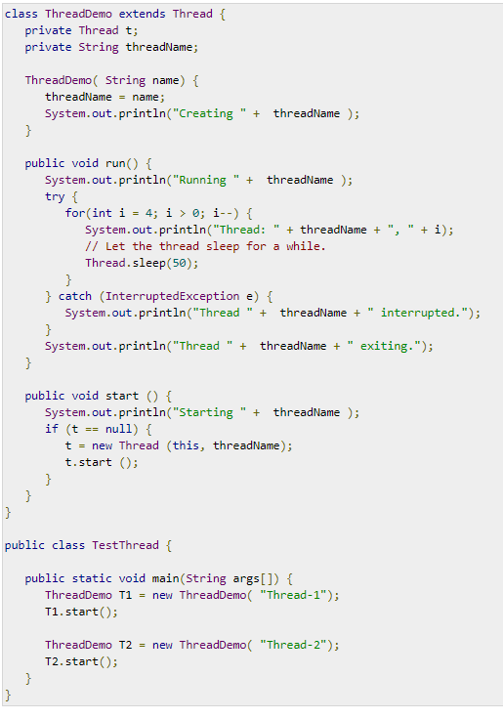
Create a Thread by by Extending a Thread Class example

Slide 16
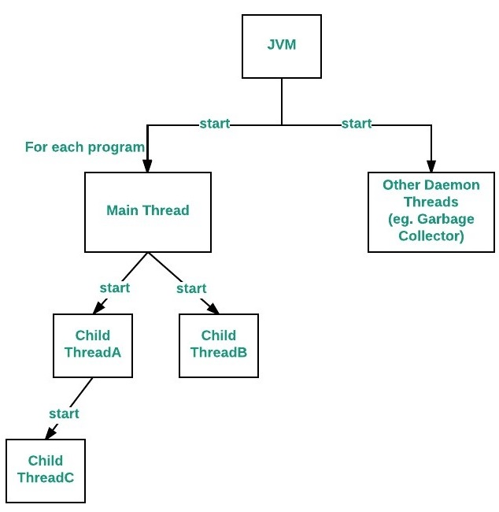
Main thread
Java provides built-in support for multithreaded programming. A multi-threaded program contains two or more parts that can run concurrently. Each part of such a program is called a thread, and each thread defines a separate path of execution.
Main Thread
When a Java program starts up, one thread begins running immediately. This is usually called the main thread of our program, because it is the one that is executed when our program begins.
Properties :
It is the thread from which other “child” threads will be spawned.
Often, it must be the last thread to finish execution because it performs various shutdown actions
Flow diagram :

Slide 17
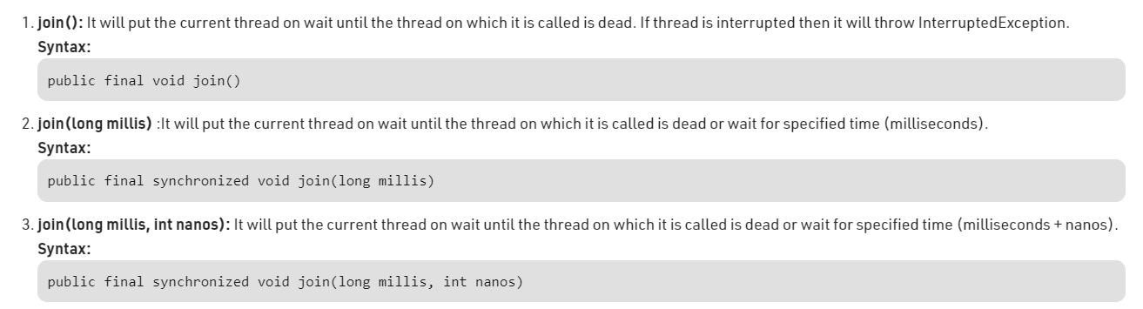
Joining Threads in Java
java.lang.Thread class provides the join() method which allows one thread to wait until another thread completes its execution. If t is a Thread object whose thread is currently executing, then t.join() will make sure that t is terminated before the next instruction is executed by the program.
If there are multiple threads calling the join() methods that means overloading on join allows the programmer to specify a waiting period. However, as with sleep, join is dependent on the OS for timing, so you should not assume that join will wait exactly as long as you specify.
There are three overloaded join functions :

Slide 18
Inter-thread Communication in Java
What is Polling and what are problems with it? The process of testing a condition repeatedly till it becomes true is known as polling.
Polling is usually implemented with the help of loops to check whether a particular condition is true or not. If it is true, certain action is taken. This waste many CPU cycles and makes the implementation inefficient. For example, in a classic queuing problem where one thread is producing data and other is consuming it.
How Java multi threading tackles this problem? To avoid polling, Java uses three methods, namely, wait(), notify() and notifyAll(). All these methods belong to object class as final so that all classes have them. They must be used within a synchronized block only.
wait()-It tells the calling thread to give up the lock and go to sleep until some other thread enters the same monitor and calls notify().
notify()-It wakes up one single thread that called wait() on the same object. It should be noted that calling notify() does not actually give up a lock on a resource.
notifyAll()-It wakes up all the threads that called wait() on the same object.

Slide 19
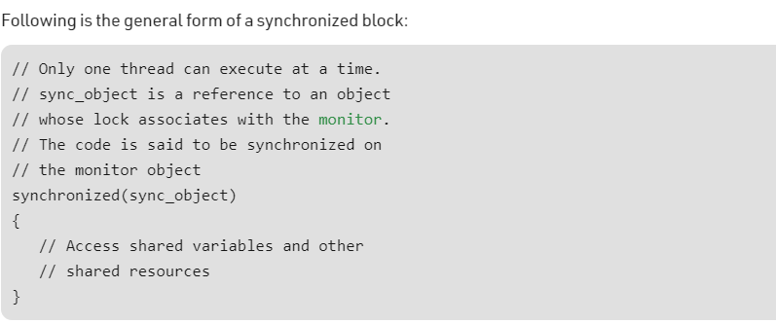
Synchronized
Multi-threaded programs may often come to a situation where multiple threads try to access the same resources and finally produce erroneous and unforeseen results.
So it needs to be made sure by some synchronization method that only one thread can access the resource at a given point of time.
Java provides a way of creating threads and synchronizing their task by using synchronized blocks. Synchronized blocks in Java are marked with the synchronized keyword. A synchronized block in Java is synchronized on some object. All synchronized blocks synchronized on the same object can only have one thread executing inside them at a time. All other threads attempting to enter the synchronized block are blocked until the thread inside the synchronized block exits the block.
Following is the general form of a synchronized block:

Slide 20
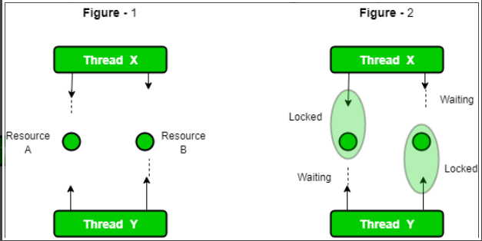
Deadlock in Java Multithreading
synchronized keyword is used to make the class or method thread-safe which means only one thread can have lock of synchronized method and use it, other threads have to wait till the lock releases and anyone of them acquire that lock.
It is important to use if our program is running in multi-threaded environment where two or more threads execute simultaneously. But sometimes it also causes a problem which is called Deadlock. Below is a simple example of Deadlock condition.

Slide 21
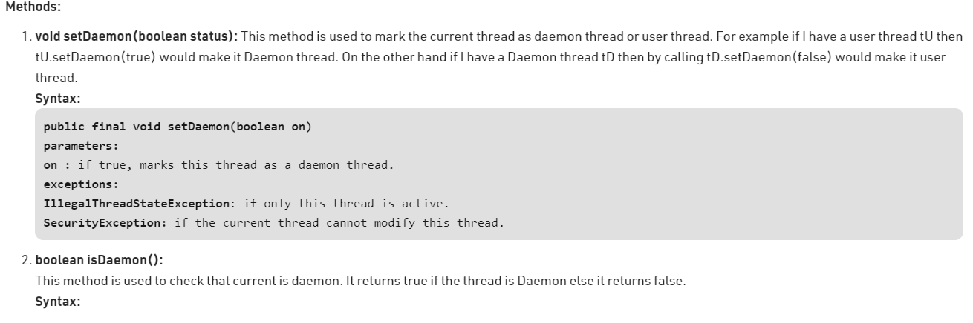
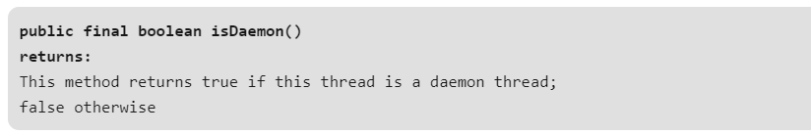
Daemon thread in Java
Daemon thread is a low priority thread that runs in background to perform tasks such as garbage collection.
Properties:
They can not prevent the JVM from exiting when all the user threads finish their execution.
JVM terminates itself when all user threads finish their execution
If JVM finds running daemon thread, it terminates the thread and after that shutdown itself. JVM does not care whether Daemon thread is running or not.
It is an utmost low priority thread.

Slide 22
Java Thread Priority in Multithreading
In a Multi threading environment, thread scheduler assigns processor to a thread based on priority of thread. Whenever we create a thread in Java, it always has some priority assigned to it. Priority can either be given by JVM while creating the thread or it can be given by programmer explicitly.
Accepted value of priority for a thread is in range of 1 to 10. There are 3 static variables defined in Thread class for priority.
public static int MIN_PRIORITY: This is minimum priority that a thread can have. Value for this is 1.
public static int NORM_PRIORITY: This is default priority of a thread if do not explicitly define it. Value for this is 5.
public static int MAX_PRIORITY: This is maximum priority of a thread. Value for this is 10.
Get and Set Thread Priority:
public final int getPriority(): java.lang.Thread.getPriority() method returns priority of given thread.
public final void setPriority(int newPriority): java.lang.Thread.setPriority() method changes the priority of thread to the value newPriority. This method throws IllegalArgumentException if value of parameter newPriority goes beyond minimum(1) and maximum(10) limit.

Slide 23
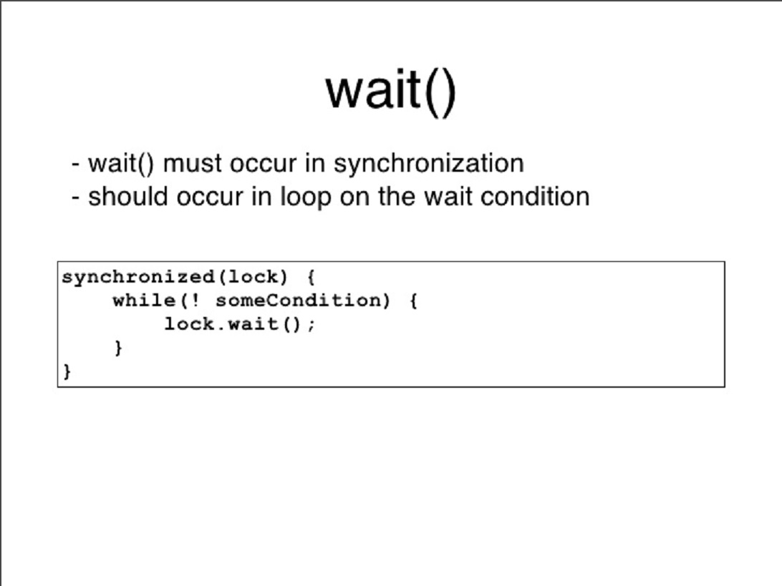
wait
wait()
The wait() method causes the current thread to wait indefinitely until another thread either invokes notify() for this object or notifyAll().
wait(long timeout)
Using this method, we can specify a timeout after which thread will be woken up automatically. A thread can be woken up before reaching the timeout using notify() or notifyAll().
Note that calling wait(0) is the same as calling wait().

Slide 24
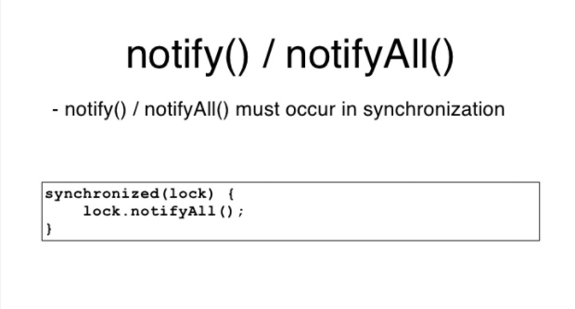
notify
notify() and notifyAll()
The notify() method is used for waking up threads that are waiting for an access to this object's monitor.
There are two ways of notifying waiting threads:
notify()
For all threads waiting on this object's monitor (by using any one of the wait() method), the method notify() notifies any one of them to wake up arbitrarily. The choice of exactly which thread to wake is non-deterministic and depends upon the implementation.
Since notify() wakes up a single random thread it can be used to implement mutually exclusive locking where threads are doing similar tasks, but in most cases, it would be more viable to implement notifyAll().
notifyAll()
This method simply wakes all threads that are waiting on this object's monitor.
The awakened threads will complete in the usual manner – like any other thread.
But before we allow their execution to continue, always define a quick check for the condition required to proceed with the thread – because there may be some situations where the thread got woken up without receiving a notification (this scenario is discussed later in an example).

Slide 25
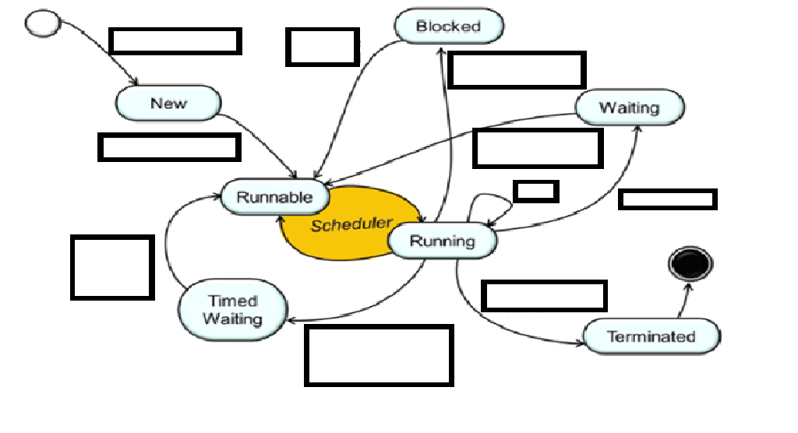








Fill this to see if you understood

Slide 26
Fill this to see if you understood

Slide 27
Fill this to see if you understood

Slide 28
Fill this to see if you understood

Slide 29
Fill this to see if you understood

Slide 30
Fill this to see if you understood

Slide 31
Fill this to see if you understood

Slide 32
Fill this to see if you understood

Slide 33
Fill this to see if you understood

Slide 34
Fill this to see if you understood

Slide 35
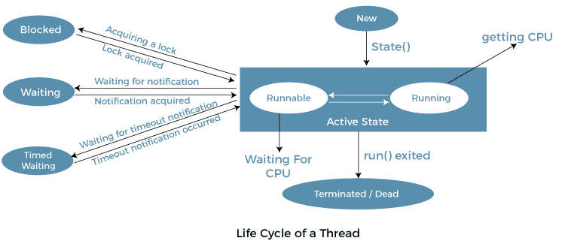

Slide 36
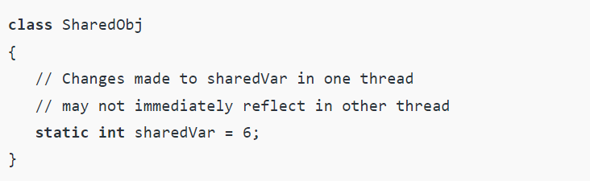
Volatile keyword
Using volatile is yet another way (like synchronized, atomic wrapper) of making class thread-safe. Thread-safe means that a method or class instance can be used by multiple threads at the same time without any problem. Consider the below example.
Suppose that two threads are working on SharedObj. If two threads run on different processors each thread may have its own local copy of sharedVariable. If one thread modifies its value the change might not reflect in the original one in the main memory instantly. This depends on the write policy of cache. Now the other thread is not aware of the modified value which leads to data inconsistency.

Slide 37
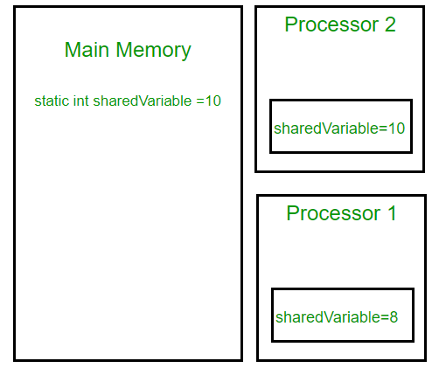
Volatile keyword

Slide 38
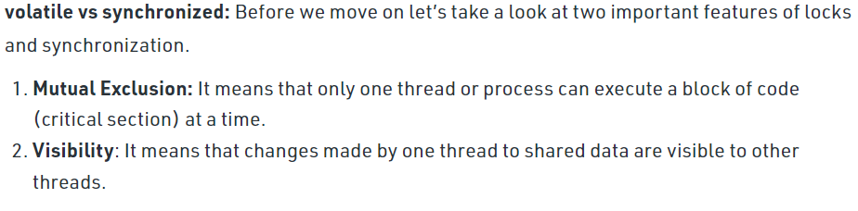
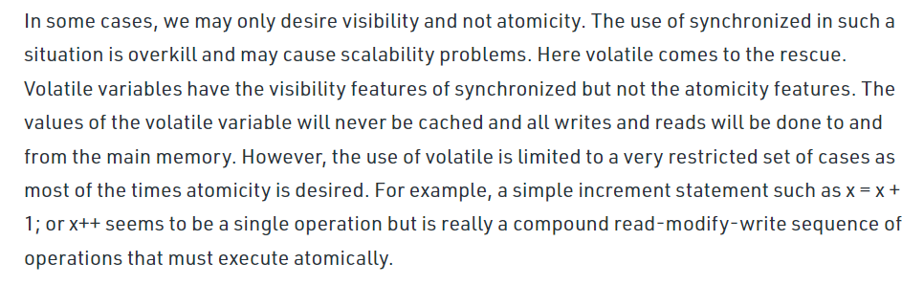
Volatile keyword

Slide 39
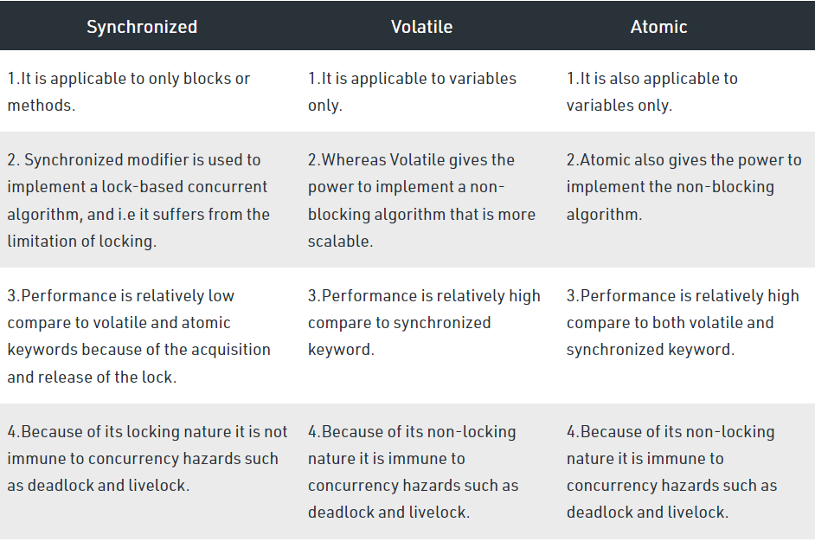
Volatile, Atomic, Synchronized

Slide 40
Java Concurrency Utilities - java.util.concurrent
Java 5 added a new Java package to the Java platform, the java.util.concurrent package. This package contains a set of classes that makes it easier to develop concurrent (multithreaded) applications in Java. Before this package was added, you would have to program your utility classes yourself.
Java BlockingQueue
Java ArrayBlockingQueue
Java DelayQueue
Java LinkedBlockingQueue
Java PriorityBlockingQueue
Java SynchronousQueue
Java BlockingDeque
Java LinkedBlockingDeque
Java ConcurrentMap
Java ConcurrentNavigableMap
Java CountDownLatch
Java CyclicBarrier
Java Exchanger
Java Semaphore
Java ExecutorService
Java Callable
Java Future
Java ThreadPoolExecutor
Java ScheduledExecutorService
Java ForkJoinPool
Java Lock
Java ReadWriteLock
Java AtomicInteger
Java AtomicLong
Java AtomicReference
Java AtomicStampedReference
Java AtomicIntegerArray
Java AtomicLongArray
Java AtomicReferenceArray

Slide 41
Sources
https://www.geeksforgeeks.org/daemon-thread-java/?ref=lbp
http://tutorials.jenkov.com/java-util-concurrent/index.html
https://www.slideshare.net/alexmiller/java-concurrency-idioms

