Slide 1
תכנות מונחה עצמים תרגול 9
מייל Netanel.levine@msmail.ariel.ac.il
תוקף ע"י : נתנאל לוין

Slide 2
נושאים להיום
Design Patterns

Slide 3

Design Patterns

Slide 4
Design Patterns: Definition and Utility
In software engineering, a design pattern is a general repeatable solution to a commonly occuring problem in software design.
It isn’t a finished design that can be transformed directly into code, but a description or template for how to solve a
problem that can be used in many different situations.
Design patterns:
Provide general solutions, documented in a format that doesn’t require specifics tied to a particular problem
Can speed up the development process by providing tested, proven development paradigms
Help you benefit from the experience of fellow developers
Prevent subtle issues that can cause major problems
Improve code readability for coders and architects familiar with them

Slide 5
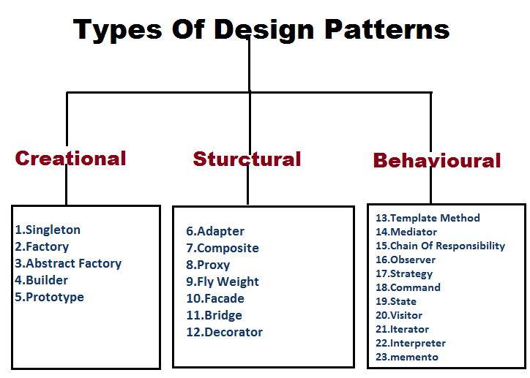
GoF Design
Design Patterns: Definition and Utility
The Gang of Four are the four authors of the book « Design Patterns: Elements of Reusable Object-Oriented Software »
Defined 23 design patterns for recurrent design issues, called GoF design patterns
Classified by purpose:
Structural : Concerns the composition of classes and objects
Behavioral : Characterizes the interaction and responsibility of objects and classes
Creational : Concerns the creation process of objects and classes

Slide 6
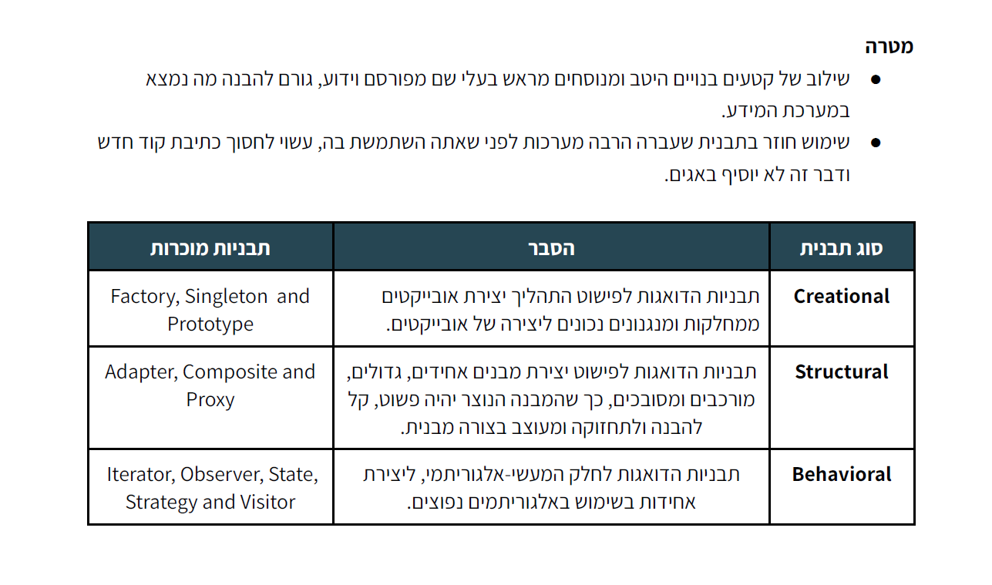

Slide 7
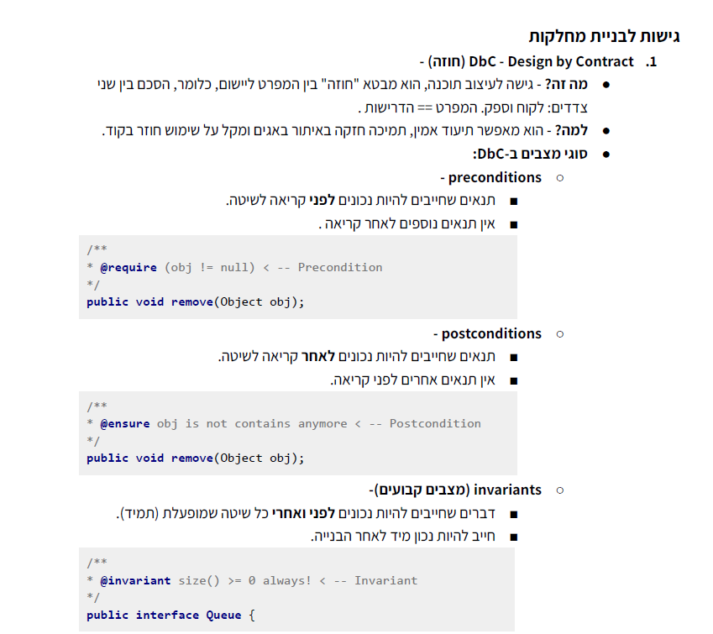

Slide 8
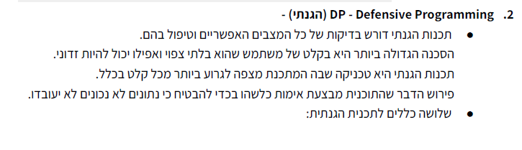
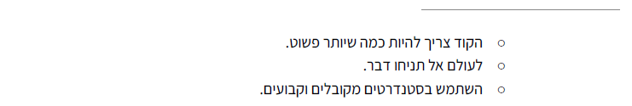

Slide 9
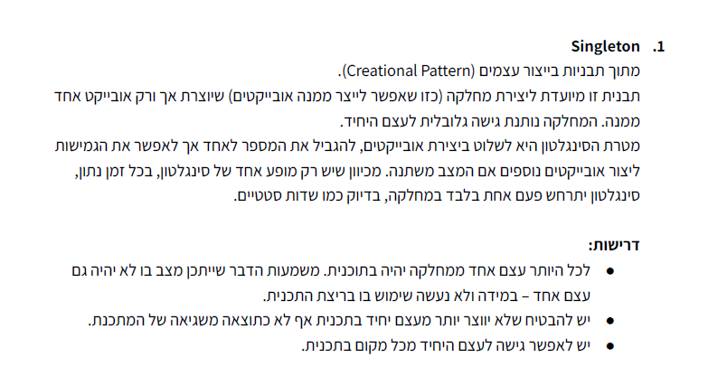

Slide 10
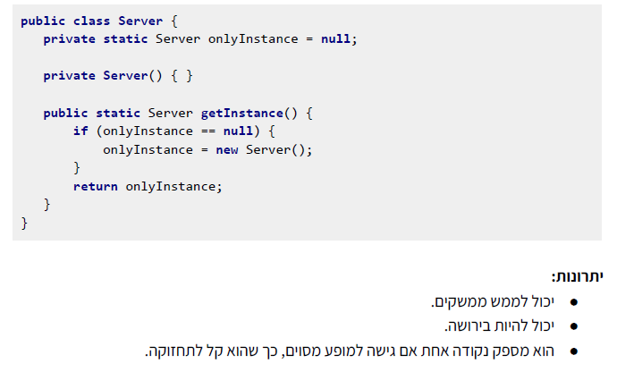

Slide 11
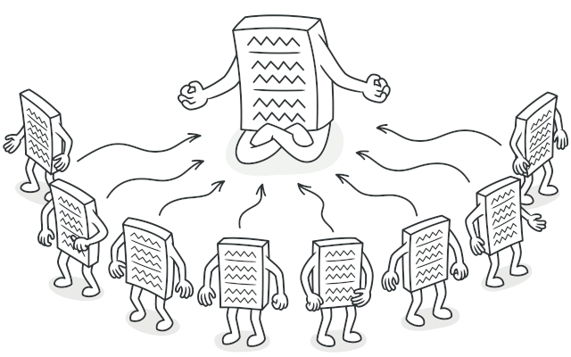
Singleton
Singleton is a creational design pattern that lets you ensure that a class has only one instance, while providing a global access point to this instance.

Slide 12
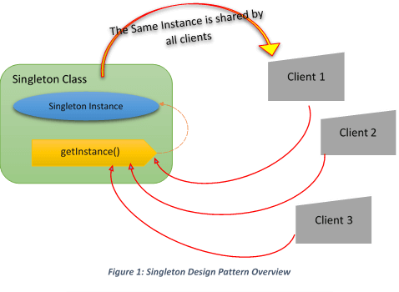
Singleton

Slide 13
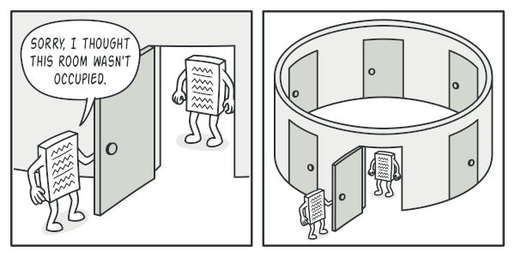
Singleton

Slide 14
Singleton When to Use
When to Use
When we must ensure that only one instance of a class is created
When the instance must be available through all the code
In multi-threading environments when multiple threads must access the same resources through the same singleton object.
Common Usage
Logger Classes
Configuration Classes
Accessing resources in shared mode
Other design patterns implemented as Singletons:
Factories and Abstract Factories, Builder, Prototype

Slide 15
Singleton
Singleton pattern restricts the instantiation of a class and ensures that only one instance of the class exists in the java virtual machine.
The singleton class must provide a global access point to get the instance of the class.
Singleton pattern is used for logging, drivers objects, caching and thread pool.
Singleton design pattern is also used in other design patterns like Abstract Factory, Builder, Prototype, Facade etc.
Singleton design pattern is used in core java classes also, for example java.lang.Runtime, java.awt.Desktop.
Java Singleton Pattern Implementation
To implement a Singleton pattern, we have different approaches but all of them have the following common concepts.
Private constructor to restrict instantiation of the class from other classes.
Private static variable of the same class that is the only instance of the class.
Public static method that returns the instance of the class, this is the global access point for outer world to get the instance of the singleton class.

Slide 16
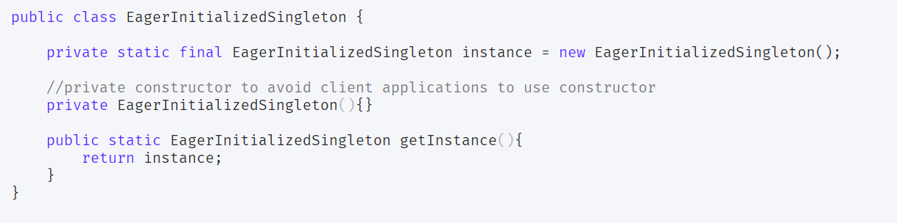
Singleton Eager initialization
In eager initialization, the instance of Singleton Class is created at the time of class loading, this is the easiest method to create a singleton class but it has a drawback that instance is created even though client application might not be using it.
Here is the implementation of the static initialization singleton class.

Slide 17
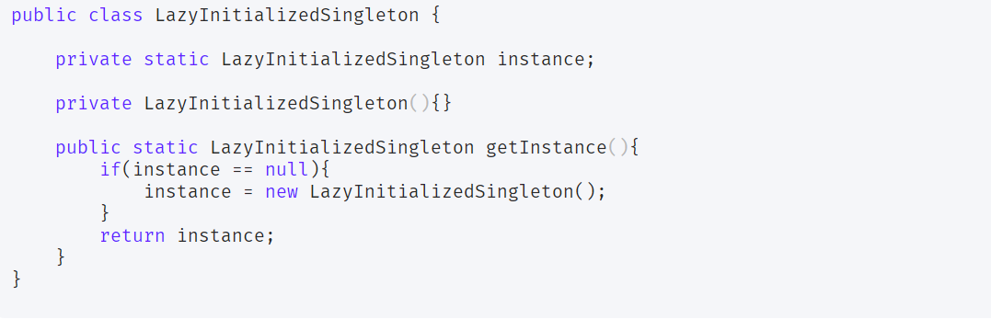
Lazy Initialization
Lazy initialization method to implement Singleton pattern creates the instance in the global access method. Here is the sample code for creating Singleton class with this approach.
The above implementation works fine in case of the single-threaded environment but when it comes to multithreaded systems, it can cause issues if multiple threads are inside the if condition at the same time. It will destroy the singleton pattern and both threads will get the different instances of the singleton class. In next section, we will see different ways to create a thread-safe singleton class.

Slide 18
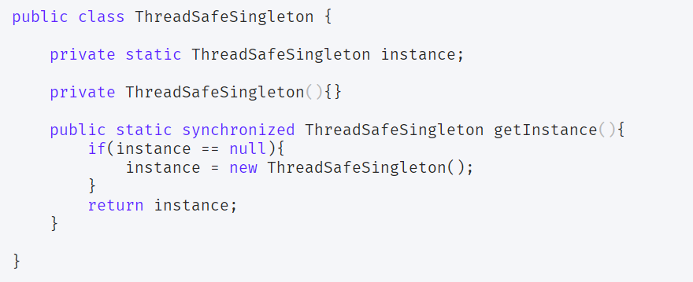
Thread Safe Singleton – low performance
The easier way to create a thread-safe singleton class is to make the global access method synchronized, so that only one thread can execute this method at a time. General implementation of this approach is like the below class
Above implementation works fine and provides thread-safety but it reduces the performance because of the cost associated with the synchronized method, although we need it only for the first few threads who might create the separate instances.

Slide 19
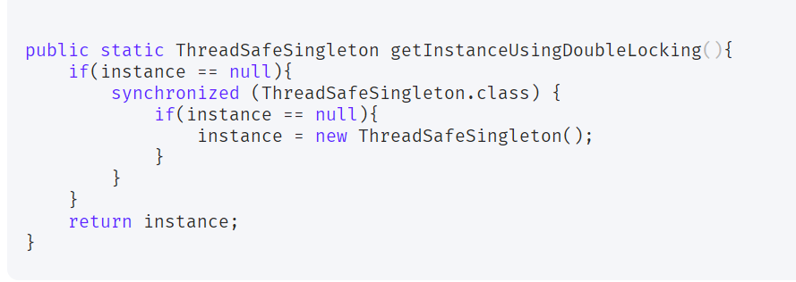
Thread Safe Singleton – performance solution
double checked locking principle is used. In this approach, the synchronized block is used inside the if condition with an additional check to ensure that only one instance of a singleton class is created.
The following code snippet provides the double-checked locking implementation.

Slide 20
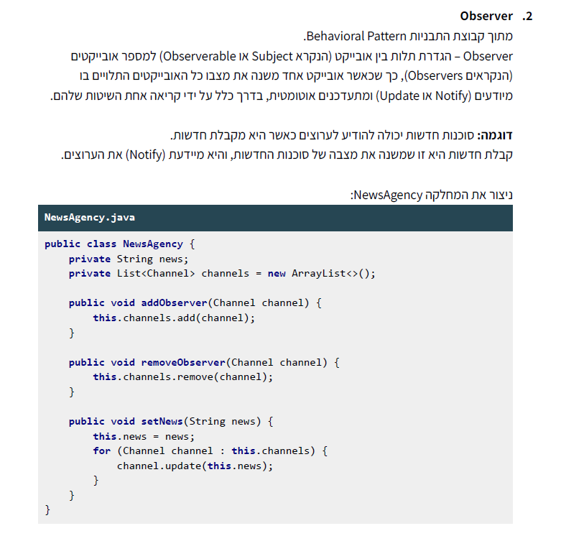

Slide 21
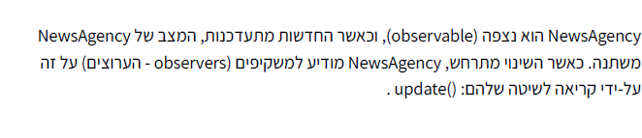
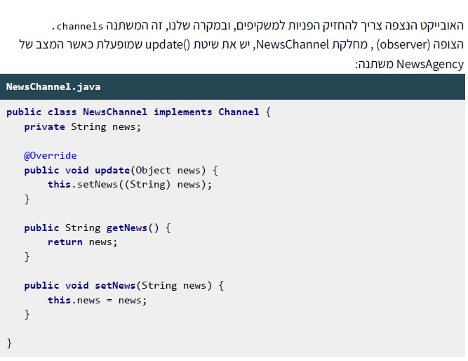

Slide 22
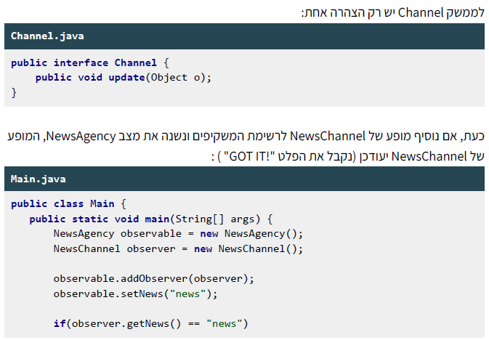


Slide 23
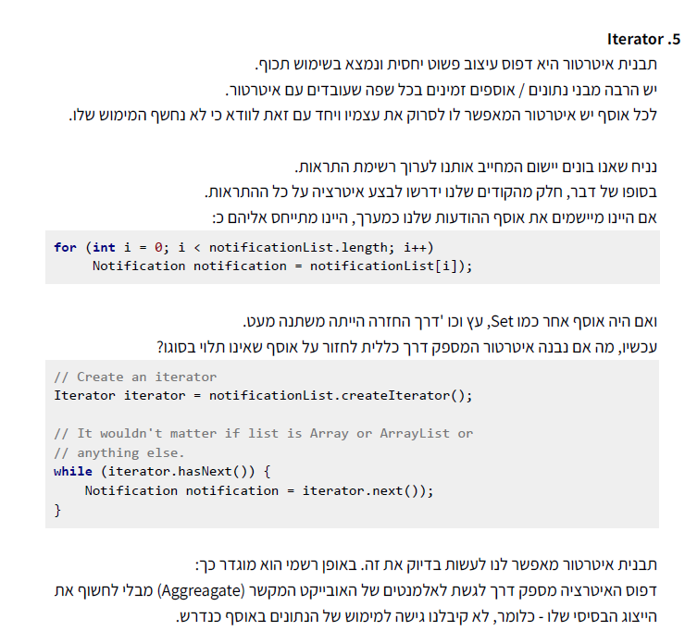

Slide 26
Creational Patterns
Creational Patterns
Creational patterns abstract the instantiation process.
They help to make a system independent of how its objects are created, composed, and represented
Creational patterns for classes use inheritance to vary the class that is instantiated.
Creational patterns for objects delegate instantiation to another object.
Examples:
Factory
Singleton
Builder
Prototype
MedTech

Slide 27
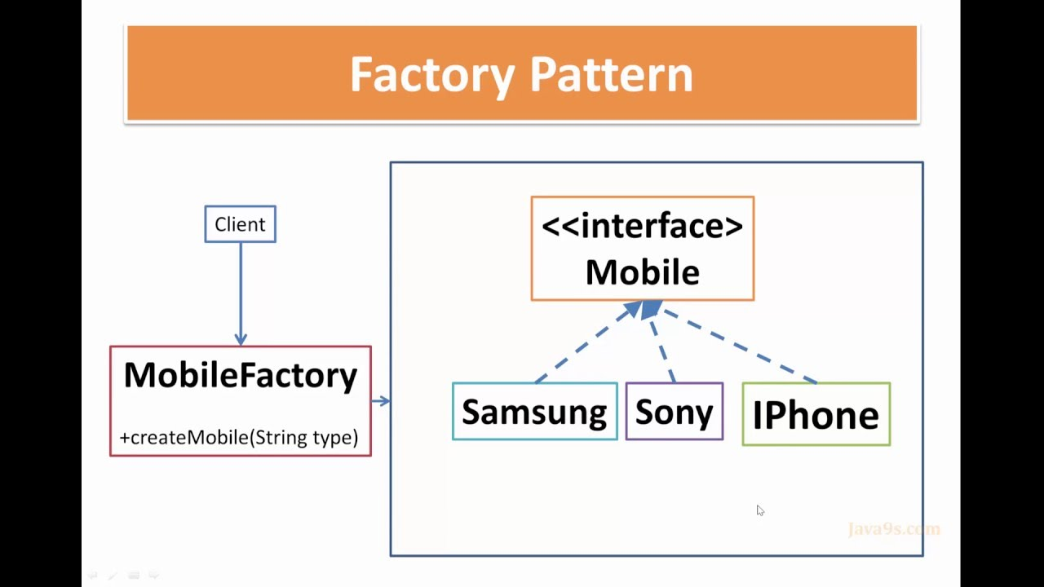
Factory
Creates objects without exposing the instantiation logic to the client
Refers to the newly created object through a common interface.

Slide 28
Factory
When to use
When a framework delegates the creation of objects derived from a common superclass to the factory
When we need flexibility in adding new types of objects that must be created by the class
Common Usage
factories providing an xml parser:
javax.xml.parsers.DocumentBuilderFactory
javax.xml.parsers.SAXParserFactory
java.net.URLConnection

Slide 29
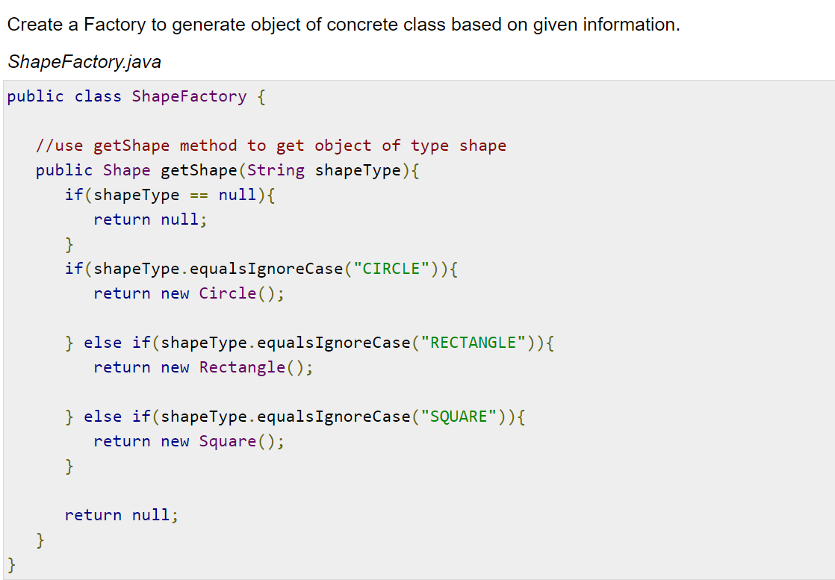
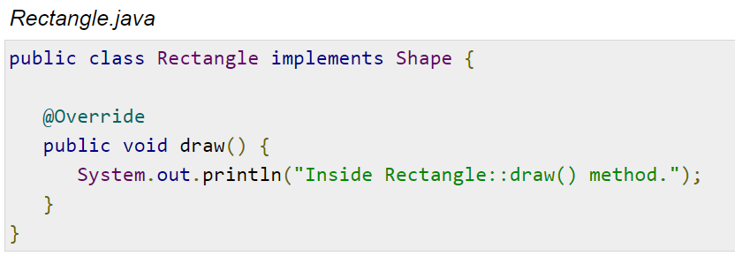
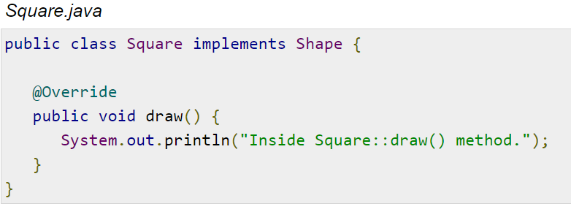
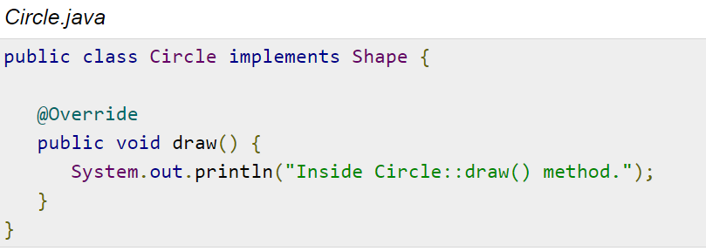
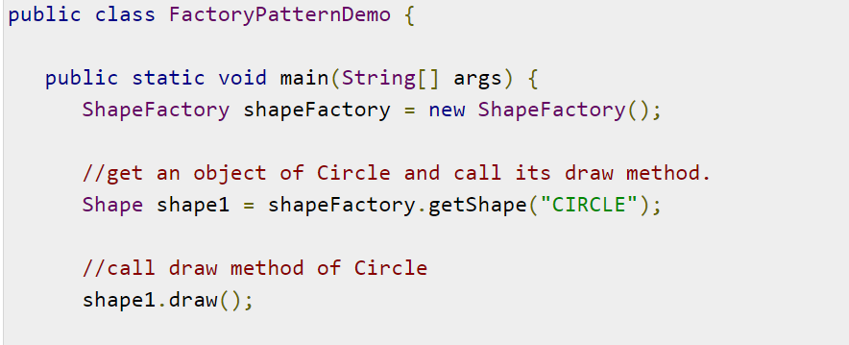
Factory

Slide 30

Prototype
The Prototype pattern is generally used when we have an instance of the class (prototype) and we'd like to create new objects by just copying the prototype.
Let's use an analogy to better understand this pattern.
In some games, we want trees or buildings in the background. We may realize that we don't have to create new trees or buildings and render them on the screen every time the character moves.
So, we create an instance of the tree first. Then we can create as many trees as we want from this instance (prototype) and update their positions. We may also choose to change the color of the trees for a new level in the game.
The Prototype pattern is quite similar. Instead of creating new objects, we just have to clone the prototypical instance.

Slide 31
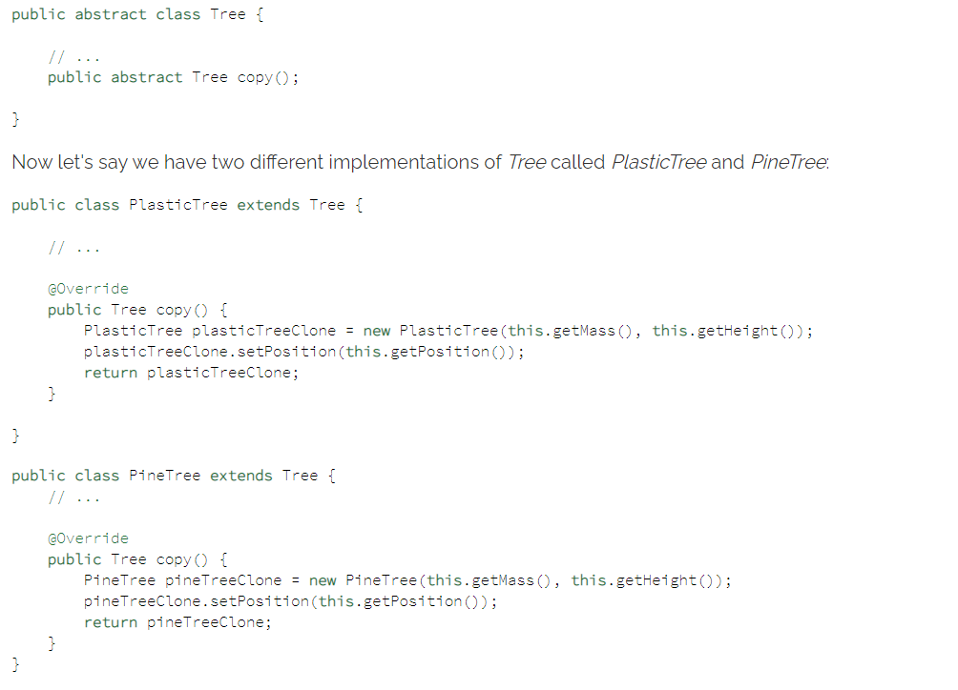
Prototype

Slide 32
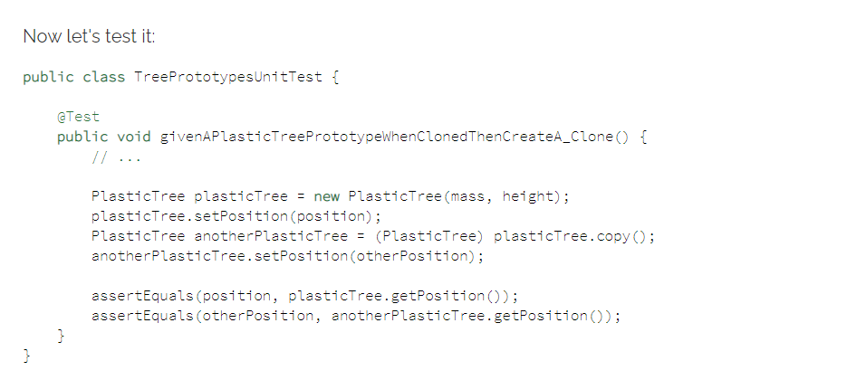
Prototype

Slide 33
Structural Patterns
Structural patterns are concerned with how classes and objects are composed to form larger structures.
Structural class patterns use inheritance to compose interfaces or implementations.
Structural object patterns describe ways to compose objects to realize new
functionality. The added flexibility of object composition comes from the ability to change the composition at runtime, which is impossible with static class
composition.
Examples:
Adapter
Proxy
Bridge
Composite
MedTech

Slide 34
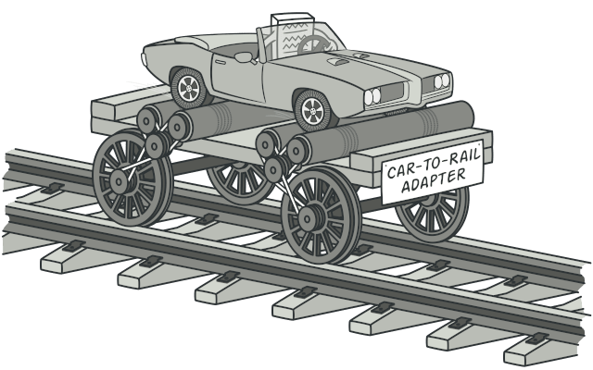
Adapter
Adapter is a structural design pattern that allows objects with incompatible interfaces to collaborate.

Slide 35
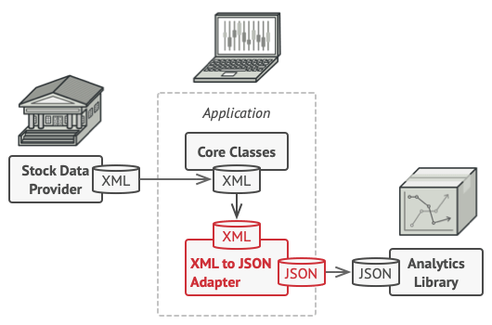
Adapter
Problem
Imagine that you’re creating a stock market monitoring app. The app downloads the stock data from multiple sources in XML format and then displays nice-looking charts and diagrams for the user.
At some point, you decide to improve the app by integrating a smart 3rd-party analytics library. But there’s a catch: the analytics library only works with data in JSON format.
The structure of the app before integration with the analytics library
You can’t use the analytics library “as is” because it expects the data in a format that’s incompatible with your app.
You could change the library to work with XML. However, this might break some existing code that relies on the library. And worse, you might not have access to the library’s source code in the first place, making this approach impossible.

Slide 36
Adapter
You can create an adapter. This is a special object that converts the interface of one object so that another object can understand it.
An adapter wraps one of the objects to hide the complexity of conversion happening behind the scenes. The wrapped object isn’t even aware of the adapter. For example, you can wrap an object that operates in meters and kilometers with an adapter that converts all of the data to imperial units such as feet and miles.
Adapters can not only convert data into various formats but can also help objects with different interfaces collaborate. Here’s how it works:
The adapter gets an interface, compatible with one of the existing objects.
Using this interface, the existing object can safely call the adapter’s methods.
Upon receiving a call, the adapter passes the request to the second object, but in a format and order that the second object expects.
Sometimes it’s even possible to create a two-way adapter that can convert the calls in both directions.

Slide 37
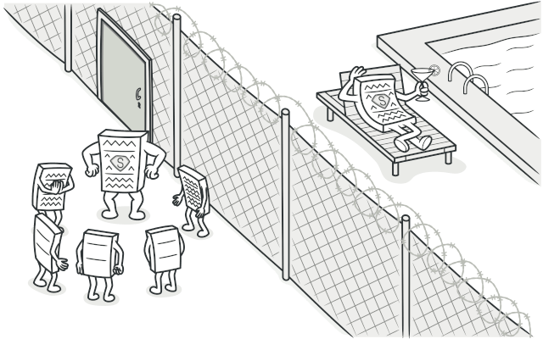
Proxy
Proxy is a structural design pattern that lets you provide a substitute or placeholder for another object. A proxy controls access to the original object, allowing you to perform something either before or after the request gets through to the original object.

Slide 38
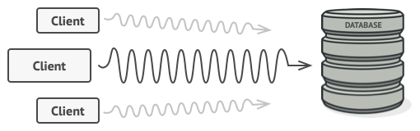
Proxy
Problem
Why would you want to control access to an object? Here is an example: you have a massive object that consumes a vast amount of system resources. You need it from time to time, but not always.

Slide 39
Proxy
When to Use Proxy
Understanding how to use a pattern is important.
Understanding when to use it is critical.
Let's talk about when to use the Proxy pattern:
When we want a simplified version of a complex or heavy object. In this case, we may represent it with a skeleton object which loads the original object on demand, also called as lazy initialization. This is known as the Virtual Proxy
When the original object is present in different address space, and we want to represent it locally. We can create a proxy which does all the necessary boilerplate stuff like creating and maintaining the connection, encoding, decoding, etc., while the client accesses it as it was present in their local address space. This is called the Remote Proxy
When we want to add a layer of security to the original underlying object to provide controlled access based on access rights of the client. This is called Protection Proxy

Slide 40
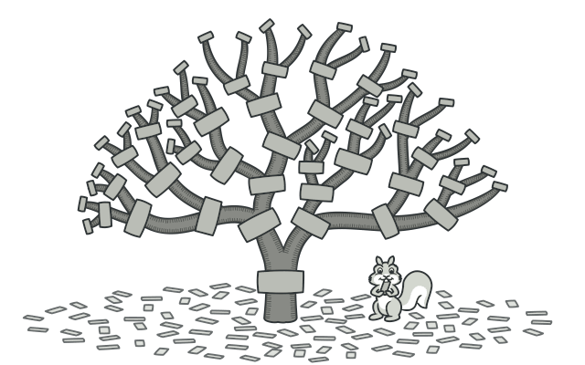
Composite
Composite is a structural design pattern that lets you compose objects into tree structures and then work with these structures as if they were individual objects.

Slide 41
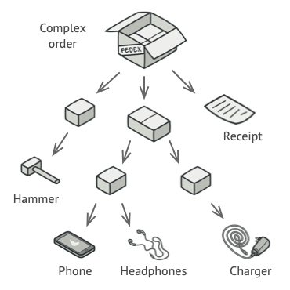
Composite
Problem
Using the Composite pattern makes sense only when the core model of your app can be represented as a tree.
For example, imagine that you have two types of objects: Products and Boxes. A Box can contain several Products as well as a number of smaller Boxes. These little Boxes can also hold some Products or even smaller Boxes, and so on.
Say you decide to create an ordering system that uses these classes. Orders could contain simple products without any wrapping, as well as boxes stuffed with products...and other boxes. How would you determine the total price of such an order?

Slide 42
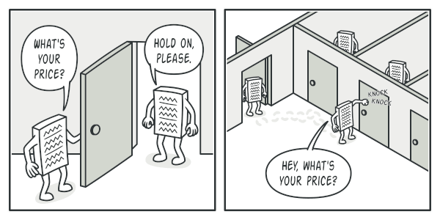
Composite
Solution
The Composite pattern suggests that you work with Products and Boxes through a common interface which declares a method for calculating the total price.
How would this method work? For a product, it’d simply return the product’s price. For a box, it’d go over each item the box contains, ask its price and then return a total for this box. If one of these items were a smaller box, that box would also start going over its contents and so on, until the prices of all inner components were calculated. A box could even add some extra cost to the final price, such as packaging cost.

Slide 43
BEHAVIORAL PATTERNS
Behavioral patterns are concerned with algorithms and the assignment of responsibilities between objects
Behavioral class patterns use inheritance to distribute behavior between classes.
Behavioral object patterns use composition rather than inheritance. Some describe how a group of peer objects cooperate to perform a task that no single object can carry out by itself.
Examples:
Command
Iterator
Observer
Strategy
MedTech

Slide 44
BEHAVIORAL PATTERNS
Behavioral patterns are concerned with algorithms and the assignment of responsibilities between objects
Behavioral class patterns use inheritance to distribute behavior between classes.
Behavioral object patterns use composition rather than inheritance. Some describe how a group of peer objects cooperate to perform a task that no single object can carry out by itself.
Examples:
Command
Iterator
Observer
Strategy
MedTech

Slide 45
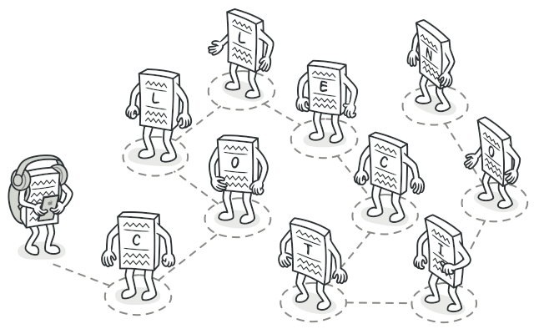
Iterator
Iterator is a behavioral design pattern that lets you traverse elements of a collection without exposing its underlying representation (list, stack, tree, etc.).

Slide 46
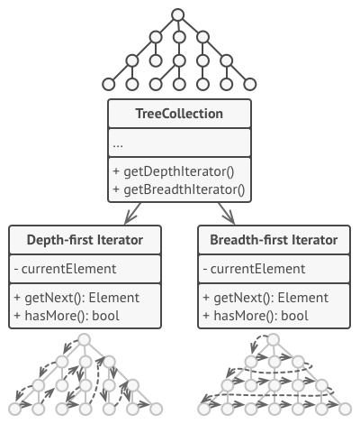
Iterator
The main idea of the Iterator pattern is to extract the traversal behavior of a collection into a separate object called an iterator.

Slide 47
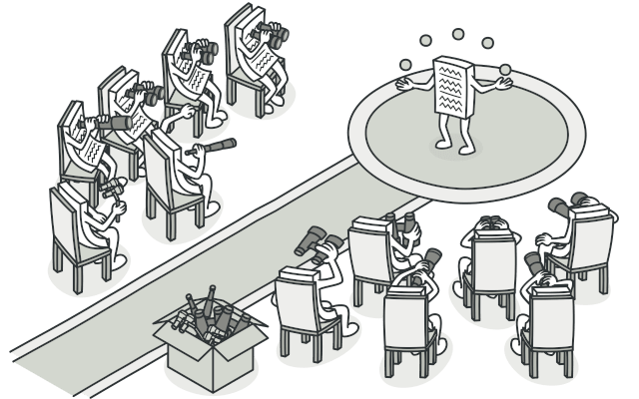
Observer
Observer is a behavioral design pattern that lets you define a subscription mechanism to notify multiple objects about any events that happen to the object they’re observing.

Slide 48
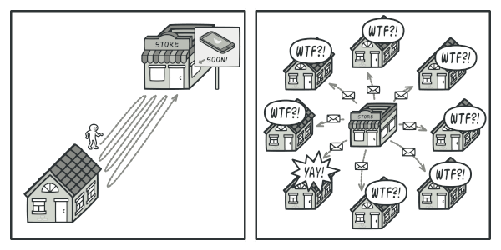
Observer
Problem
Imagine that you have two types of objects: a Customer and a Store. The customer is very interested in a particular brand of product (say, it’s a new model of the iPhone) which should become available in the store very soon.
The customer could visit the store every day and check product availability. But while the product is still en route, most of these trips would be pointlessOn the other hand, the store could send tons of emails (which might be considered spam) to all customers each time a new product becomes available. This would save some customers from endless trips to the store. At the same time, it’d upset other customers who aren’t interested in new products.
It looks like we’ve got a conflict. Either the customer wastes time checking product availability or the store wastes resources notifying the wrong customers..

Slide 49
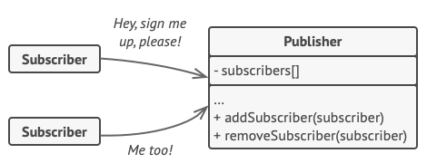
Observer
Solution
The object that has some interesting state is often called subject, but since it’s also going to notify other objects about the changes to its state, we’ll call it publisher. All other objects that want to track changes to the publisher’s state are called subscribers.
The Observer pattern suggests that you add a subscription mechanism to the publisher class so individual objects can subscribe to or unsubscribe from a stream of events coming from that publisher. Fear not! Everything isn’t as complicated as it sounds. In reality, this mechanism consists of 1) an array field for storing a list of references to subscriber objects and 2) several public methods which allow adding subscribers to and removing them from that list.
Subscription mechanism
A subscription mechanism lets individual objects subscribe to event notifications.
Now, whenever an important event happens to the publisher, it goes over its subscribers and calls the specific notification method on their objects.
Real apps might have dozens of different subscriber classes that are interested in tracking events of the same publisher class. You wouldn’t want to couple the publisher to all of those classes. Besides, you might not even know about some of them beforehand if your publisher class is supposed to be used by other people.

Slide 50
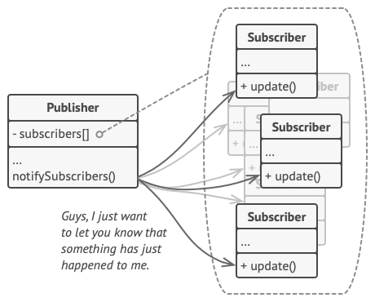
Observer
Solution
That’s why it’s crucial that all subscribers implement the same interface and that the publisher communicates with them only via that interface. This interface should declare the notification method along with a set of parameters that the publisher can use to pass some contextual data along with the notification.
Notification methods
Publisher notifies subscribers by calling the specific notification method on their objects.
If your app has several different types of publishers and you want to make your subscribers compatible with all of them, you can go even further and make all publishers follow the same interface. This interface would only need to describe a few subscription methods. The interface would allow subscribers to observe publishers’ states without coupling to their concrete classes.

Slide 51
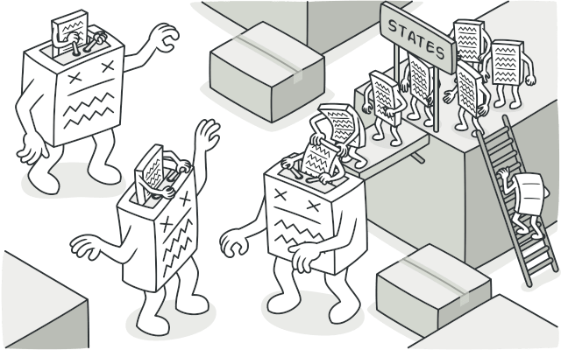
State
State is a behavioral design pattern that lets an object alter its behavior when its internal state changes. It appears as if the object changed its class.

Slide 52
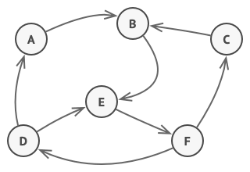
State
The State pattern is closely related to the concept of a Finite-State Machine.
Finite-State Machine’
The main idea is that, at any given moment, there’s a finite number of states which a program can be in. Within any unique state, the program behaves differently, and the program can be switched from one state to another instantaneously. However, depending on a current state, the program may or may not switch to certain other states. These switching rules, called transitions, are also finite and predetermined.
You can also apply this approach to objects. Imagine that we have a Document class. A document can be in one of three states: Draft, Moderation and Published. The publish method of the document works a little bit differently in each state:
In Draft, it moves the document to moderation.
In Moderation, it makes the document public, but only if the current user is an administrator.In Published, it doesn’t do anything at all.

Slide 53
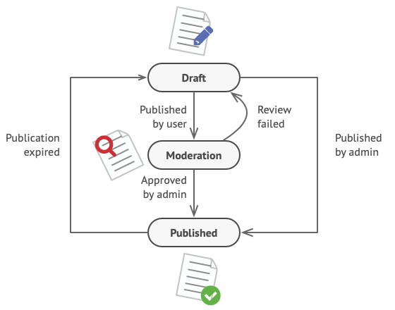
State
The biggest weakness of a state machine based on conditionals reveals itself once we start adding more and more states and state-dependent behaviors to the Document class. Most methods will contain monstrous conditionals that pick the proper behavior of a method according to the current state. Code like this is very difficult to maintain because any change to the transition logic may require changing state conditionals in every method.
The problem tends to get bigger as a project evolves. It’s quite difficult to predict all possible states and transitions at the design stage. Hence, a lean state machine built with a limited set of conditionals can grow into a bloated mess over time.

Slide 54
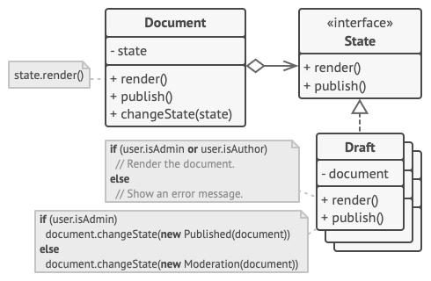
State
The State pattern suggests that you create new classes for all possible states of an object and extract all state-specific behaviors into these classes.
Instead of implementing all behaviors on its own, the original object, called context, stores a reference to one of the state objects that represents its current state, and delegates all the state-related work to that object.
To transition the context into another state, replace the active state object with another object that represents that new state. This is possible only if all state classes follow the same interface and the context itself works with these objects through that interface.
This structure may look similar to the Strategy pattern, but there’s one key difference. In the State pattern, the particular states may be aware of each other and initiate transitions from one state to another, whereas strategies almost never know about each other.

Slide 55
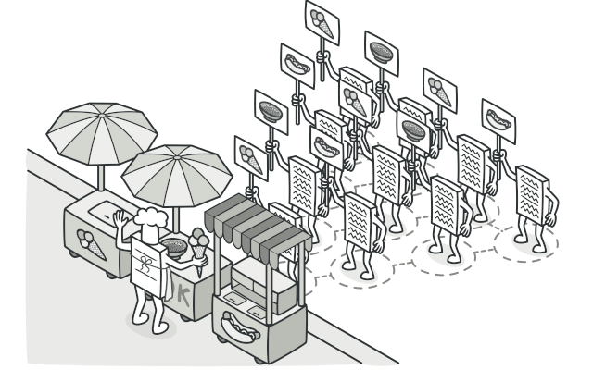
Visitor
Visitor design pattern is one of the behavioral design patterns. It is used when we have to perform an operation on a group of similar kind of Objects. With the help of visitor pattern, we can move the operational logic from the objects to another class.
a method called Visit() which is implemented by the visitor and is called for every element in the data structure
visitable classes providing Accept() methods that accept a visitor

Slide 56
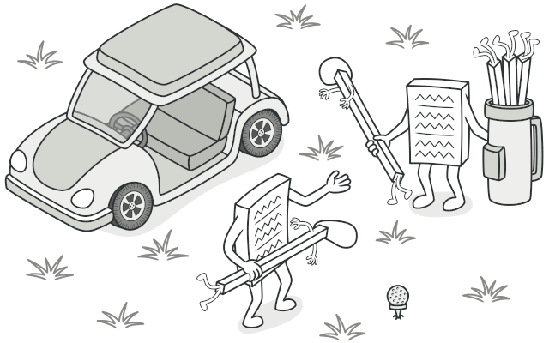
Strategy
Strategy is a behavioral design pattern that lets you define a family of algorithms, put each of them into a separate class, and make their objects interchangeable.

Slide 57
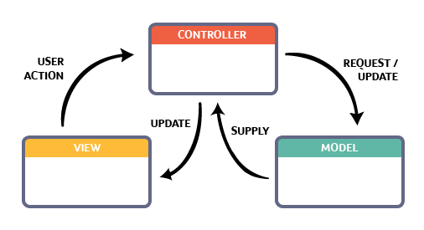
MVC
The Model View Controller (MVC) design pattern specifies that an application consist of a data model, presentation information, and control information. The pattern requires that each of these be separated into different objects.
Multiple developers can work simultaneously on the model, controller and views.
MVC enables logical grouping of related actions on a controller together. The views for a specific model are also grouped together.
Models can have multiple views.

Slide 58
Sources
https://www2.slideshare.net/LiliaSfaxi/software-engineering-chp4-design-patterns
https://www.journaldev.com/1377/java-singleton-design-pattern-best-practices-examples

