Slide 2
Burst 4x

Slide 3
trace

Slide 4
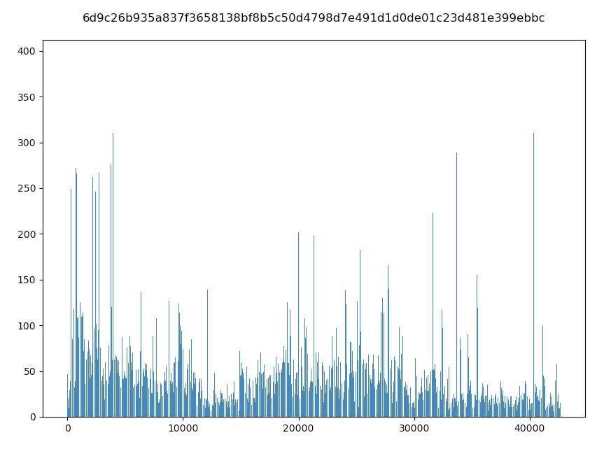
high

Slide 5
high
==============================
blind_routing_with_original_autoscaler_c0
- Avg: 224.36
- 50p: 245.82
- 90p: 289.74
- 95p: 334.3
- 99p: 363.35
- 99.9p: 391.43
==============================
==============================
blind_routing_with_original_autoscaler_c1
- Avg: 211.89
- 50p: 187.63
- 90p: 321.37
- 95p: 340.94
- 99p: 363.68
- 99.9p: 389.25
==============================
==============================
autoscaler_only_c0
- Avg: 136.9
- 50p: 100.29
- 90p: 112.11
- 95p: 116.08
- 99p: 1285.2
- 99.9p: 5943.74
==============================
==============================
autoscaler_only_c1
- Avg: 103.96
- 50p: 101.76
- 90p: 119.87
- 95p: 131.86
- 99p: 152.89
- 99.9p: 184.03
==============================
==============================
slate_with_original_autoscaler_c0
- Avg: 101.74
- 50p: 100.82
- 90p: 113.54
- 95p: 118.43
- 99p: 140.62
- 99.9p: 201.32
==============================
==============================
slate_with_original_autoscaler_c1
- Avg: 104.03
- 50p: 101.84
- 90p: 120.06
- 95p: 131.89
- 99p: 153.09
- 99.9p: 186.31
==============================

Slide 6
High

Slide 7
medium

Slide 8
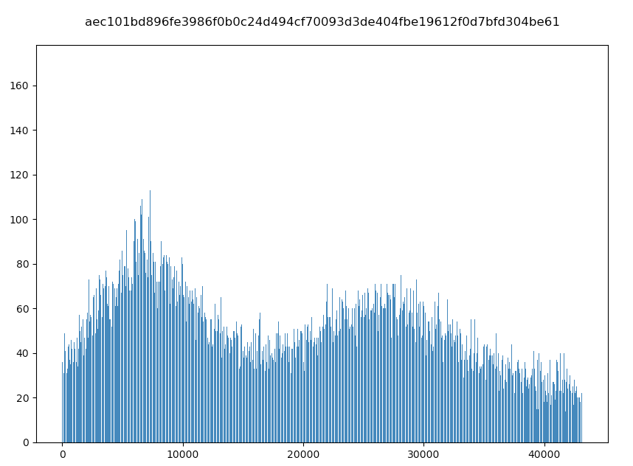
low

Slide 9
#Burst=40(high)

Slide 10
#Burst=5(low)
#Burst=20(intermediate)
#Burst=40(high)

Slide 11
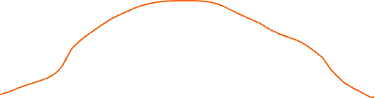
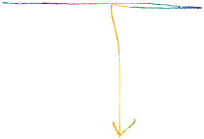
high
Avg: 136/100 = 1.4x
P99: 1285/127 = 10.1x
P99.9: 5943/201 = 29.5x
==============================
autoscaler_only_c0_RR
- Avg: 136.9
- 50p: 100.29
- 90p: 112.11
- 95p: 116.08
- 99p: 1285.2
- 99.9p: 5943.74
==============================
==============================
autoscaler_only_c1_RR
- Avg: 103.96
- 50p: 101.76
- 90p: 119.87
- 95p: 131.86
- 99p: 152.89
- 99.9p: 184.03
==============================
==============================
blind_routing_with_original_autoscaler_c0_RR
- Avg: 211.36
- 50p: 223.21
- 90p: 265.01
- 95p: 282.79
- 99p: 342.94
- 99.9p: 369.76
==============================
==============================
blind_routing_with_original_autoscaler_c1_RR
- Avg: 210.95
- 50p: 223.27
- 90p: 263.82
- 95p: 287.01
- 99p: 341.64
- 99.9p: 370.59
==============================
==============================
slate_with_original_autoscaler_c0_RR
- Avg: 100.74
- 50p: 100.18
- 90p: 111.84
- 95p: 115.48
- 99p: 127.96
- 99.9p: 201.15
==============================
==============================
slate_with_original_autoscaler_c1_RR
- Avg: 104.01
- 50p: 101.82
- 90p: 120.02
- 95p: 131.86
- 99p: 152.84
- 99.9p: 184.82
==============================
Avg: 211/100 = 2.1x
P99: 343/127 = 2.7x
P99.9: 370/201 = 1.8x

Slide 12
med
==============================
autoscaler_only_c0_RR
- Avg: 110.38
- 50p: 103.17
- 90p: 129.59
- 95p: 147.07
- 99p: 232.44
- 99.9p: 872.18
==============================
==============================
autoscaler_only_c1_RR
- Avg: 111.47
- 50p: 105.16
- 90p: 141.12
- 95p: 156.16
- 99p: 192.28
- 99.9p: 245.59
==============================
==============================
blind_routing_with_original_autoscaler_c0_RR
- Avg: 246.08
- 50p: 251.15
- 90p: 336.67
- 95p: 351.46
- 99p: 376.84
- 99.9p: 414.1
==============================
==============================
blind_routing_with_original_autoscaler_c1_RR
- Avg: 246.31
- 50p: 251.61
- 90p: 335.24
- 95p: 350.27
- 99p: 374.33
- 99.9p: 406.52
==============================
==============================
slate_with_original_autoscaler_c0_RR
- Avg: 108.26
- 50p: 103.29
- 90p: 128.72
- 95p: 145.43
- 99p: 204.71
- 99.9p: 270.79
==============================
==============================
slate_with_original_autoscaler_c1_RR
- Avg: 112.08
- 50p: 105.44
- 90p: 142.24
- 95p: 158.33
- 99p: 198.02
- 99.9p: 256.35
==============================

