Slide 2
Burst 4x

Slide 3
trace

Slide 4
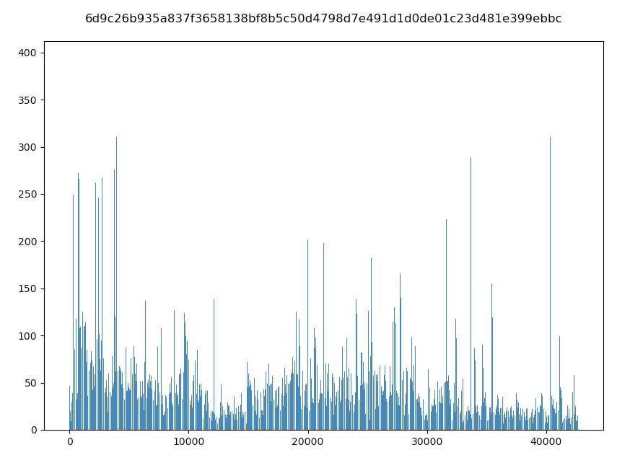
high

Slide 5
high
==============================
blind_routing_with_original_autoscaler_c0
- Avg: 224.36
- 50p: 245.82
- 90p: 289.74
- 95p: 334.3
- 99p: 363.35
- 99.9p: 391.43
==============================
==============================
blind_routing_with_original_autoscaler_c1
- Avg: 211.89
- 50p: 187.63
- 90p: 321.37
- 95p: 340.94
- 99p: 363.68
- 99.9p: 389.25
==============================
==============================
autoscaler_only_c0
- Avg: 136.9
- 50p: 100.29
- 90p: 112.11
- 95p: 116.08
- 99p: 1285.2
- 99.9p: 5943.74
==============================
==============================
autoscaler_only_c1
- Avg: 103.96
- 50p: 101.76
- 90p: 119.87
- 95p: 131.86
- 99p: 152.89
- 99.9p: 184.03
==============================
==============================
slate_with_original_autoscaler_c0
- Avg: 101.74
- 50p: 100.82
- 90p: 113.54
- 95p: 118.43
- 99p: 140.62
- 99.9p: 201.32
==============================
==============================
slate_with_original_autoscaler_c1
- Avg: 104.03
- 50p: 101.84
- 90p: 120.06
- 95p: 131.89
- 99p: 153.09
- 99.9p: 186.31
==============================

Slide 6
High

Slide 7
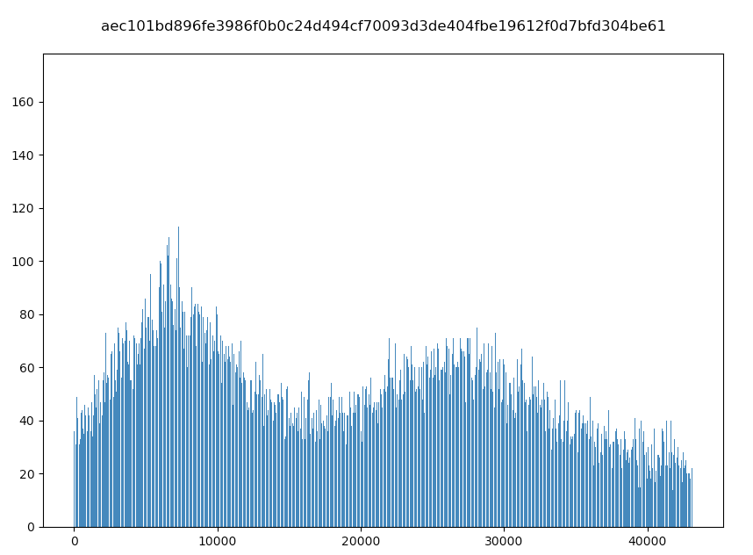
low

