Slide 1
MODEL BASED TESTING

Slide 2
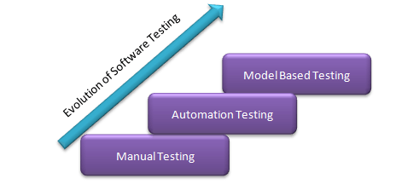
What is Model Based Testing?
Model-based testing is a software testing technique in which the test cases are derived from a model that describes the functional aspects of the system under test.
Notes:
Model tabanlı test, test senaryolarının test edilen sistemin fonksiyonel yönlerini tanımlayan bir modelden türetildiği bir yazılım test tekniğidir.
- Uluslararası yazılım test vasıflandırma merkezi tarafından uluslararası sertifika verilmekte

Slide 3
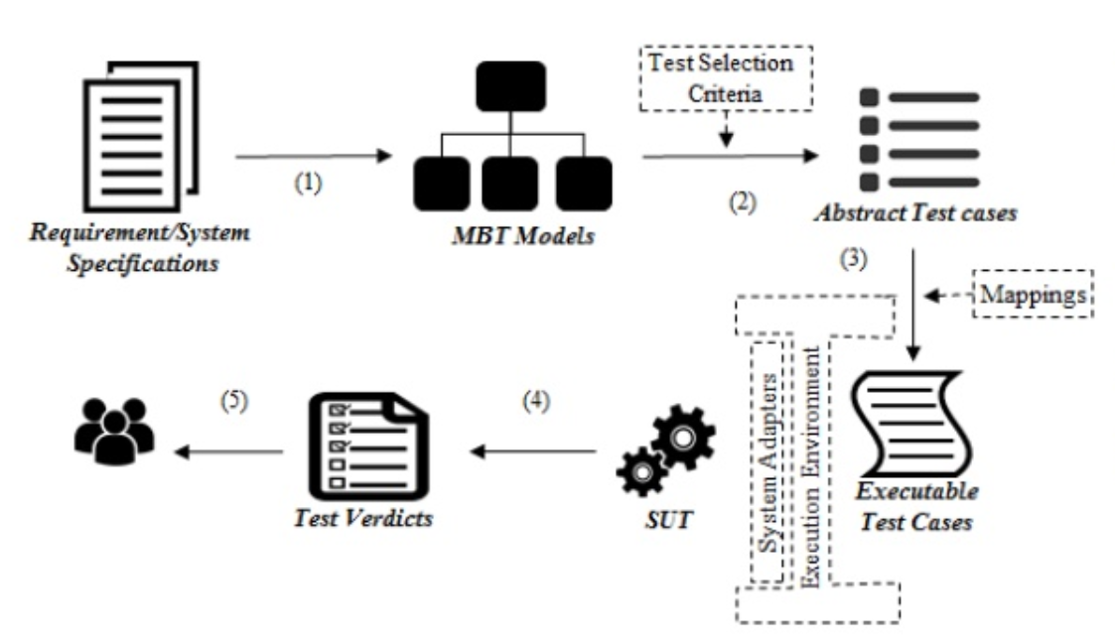
Model Based Testing Workflow
System under test (SUT) refers to a system that is being validated by the testers. The terminology is also known as application under test.
Notes:
1 – Gereksinimlerden model üretme
2- üretilen modelden otomatik olarak soyut test case’lerin üretilmesi
3- soyut olarak üretilen test case:lerin somutlaştırılması
4- test case’lerin çalıştırılması
5- sonuç yorumlanması

Slide 4
Types of Model Based Testing
Offline / a priori: Generation of Test Suites before executing it. A test suite is nothing but a collection of test cases.
Offline generation of executable tests means that a model-based testing tool generates test cases as computer-readable assets that can be later run automatically; for example, a collection of Python classes that embodies the generated testing logic.
Offline generation of manually deployable tests means that a model-based testing tool generates test cases as human-readable assets that can later assist in manual testing; for instance, a PDF document in a human language describing the generated test steps.
Online / on-the-fly: Generation of Test Suites during test execution. Online testing means that a model-based testing tool connects directly to an SUT and tests it dynamically.
Notes:
- Test için iki yol bulunmakta bunlardan ilki online SUT ortamında test yapılırken test süites ‘in oluşması
- İkinci yol offline önce tets suites oluşur sonra test koşulur. İki farklı test case üretilir biri bilgisayar tarafından işletilebilir diğeri insan tarafından okunabilirdir.

Slide 5
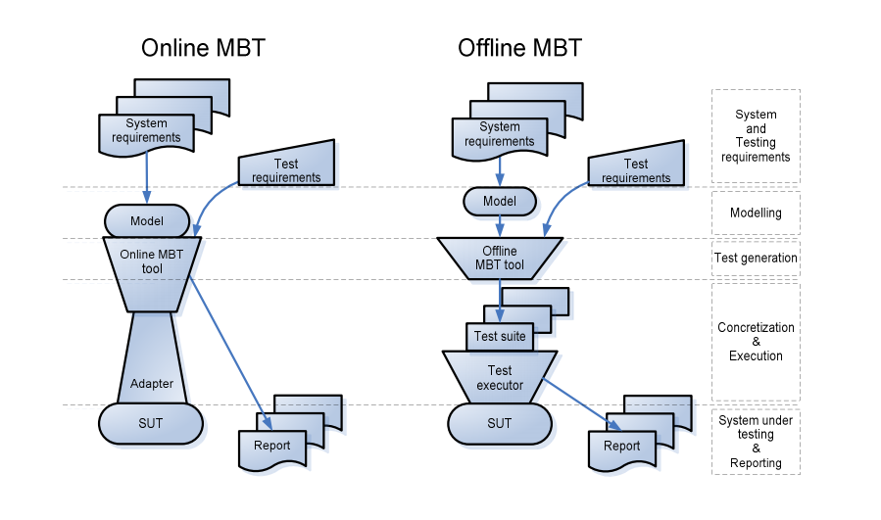
Types of Model Based Testing
Notes:
Sistem ve test gereksinimleri belirleme
Model oluşturma offline sonrasında modele uygun test oluşturur ancak online da test sut içerisinde oluşur

Slide 6
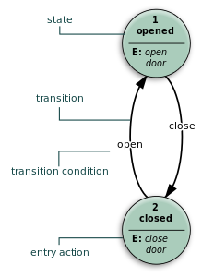
Different Models in Testing
Finite State Machines
This model helps testers to assess the result depending on the input selected. There can be various combinations of the inputs which result in a corresponding state of the system.
The system will have a specific state and current state which is governed by a set of inputs given from the testers.
Notes:
- sınırlı sayıda durumdan, durumlar arası geçişlerden ve eylemlerin birleşmesiyle oluşan davranışların bir modelidir.

Slide 7
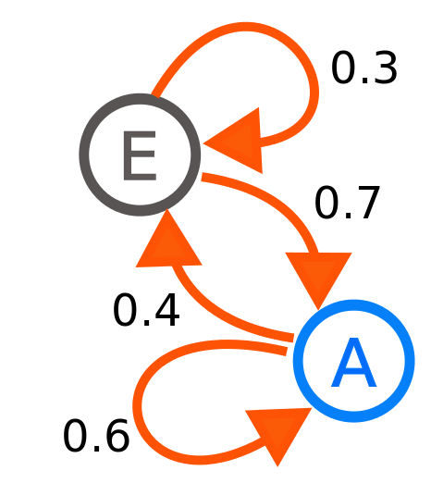
Different Models in Testing
Test case generation by using a Markov chain test model
Markov chains are an efficient way to handle Model-based Testing. Test models realized with Markov chains can be understood as a usage model: it is referred to as Usage/Statistical Model Based Testing. Usage models, so Markov chains, are mainly constructed of 2 artifacts : the Finite State Machine (FSM) which represents all possible usage scenario of the tested system and the Operational Profiles (OP) which qualify the FSM to represent how the system is or will be used statistically. The first (FSM) helps to know what can be or has been tested and the second (OP) helps to derive operational test cases. Usage/Statistical Model-based Testing starts from the facts that is not possible to exhaustively test a system and that failure can appear with a very low rate.This approach offers a pragmatic way to statically derive test cases which are focused on improving the reliability of the system under test. Usage/Statistical Model Based Testing was recently extended to be applicable to embedded software systems.
Notes:
Markov özelliğine sahip olmak, mevcut durum verildiğinde, gelecek durumların geçmiş durumlardan bağımsız olması anlamına gelir.
Markov zinciri state machine kullanarak tüm senaryoların test edilmesini operational profiles kullanarak ise test durumlarını elde etmeyi sağlar
Örnek Markov modelleri aynı zamanda kullanıcıların internet gezinti davranışlarını analiz etmek için de kullanılmıştır. Bir kullanıcının bir internet sayfasından web bağlantısı ile geçişi, birincil ya da ikincil Markov modelleri ile modellenebilir ve gelecekteki hareketleri öngörmede ve dolayısıyla internet sayfasını kullanıcı için kişiselleştirme de kullanılabilir.

Slide 8
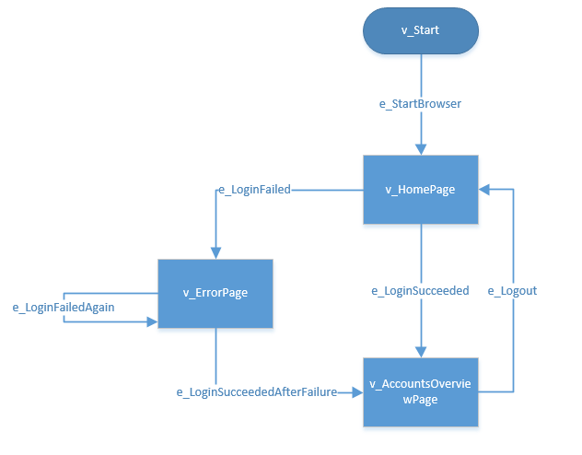
Model Example
Vertex
A vertex represents an expected state that we want to examine.
Edge
Represents the transition from one vertex to another. It is whatever action is needed to be made in order to reach the next state. It could be selecting some menu choice, clicking a button, or making a REST API call.

Slide 9
MBT Advantages/Disadvantages
Higher level of Automation is achieved.
Exhaustive testing is possible.
Changes to the model can be easily tested.
Easy test case/suite maintenance
Reduction in Cost
Improved Test Coverage
Can run different tests on n number of machines
Early defect detection
Increase in defect count
Time savings
Improved tester job satisfaction
Requires a formal specification or model to carry out testing.
Changes to the model might result in a different set of tests altogether.
Test Cases are tightly coupled to the model.
Notes:
Otomasyonun top noktası
Kapsamlı test oluşturulması
Sadece modelde değişiklik yaparak tüm test yapısında değişiklik yapılabilmesi

Slide 10
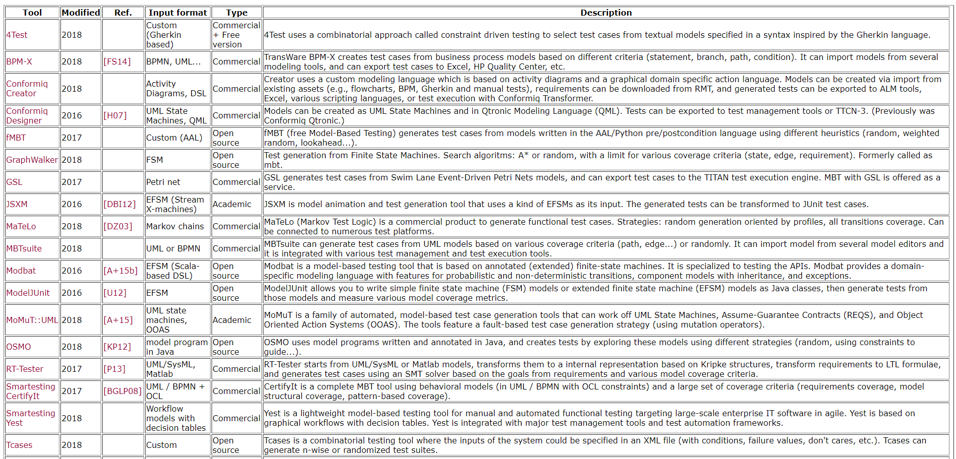
Model Based Testing Tools

