Slide 1


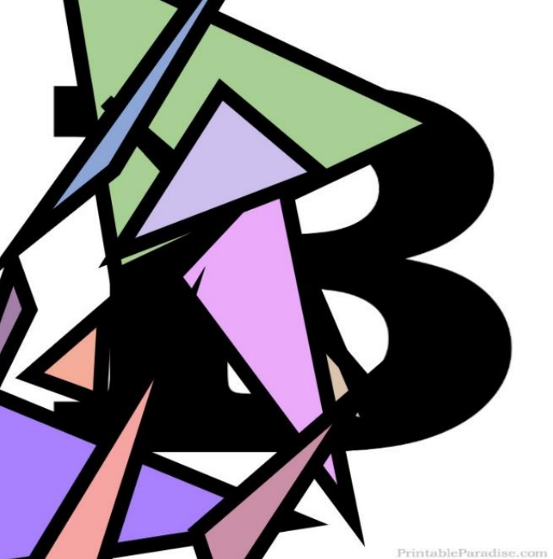
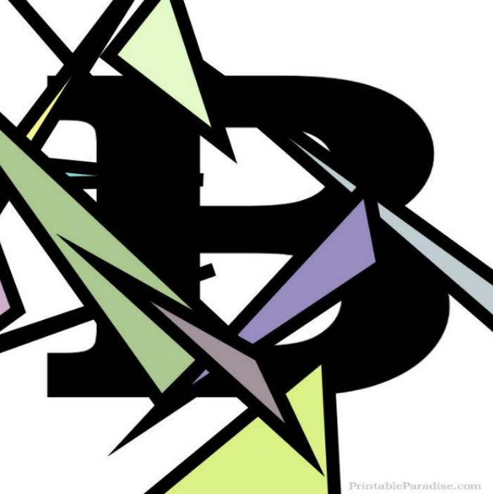



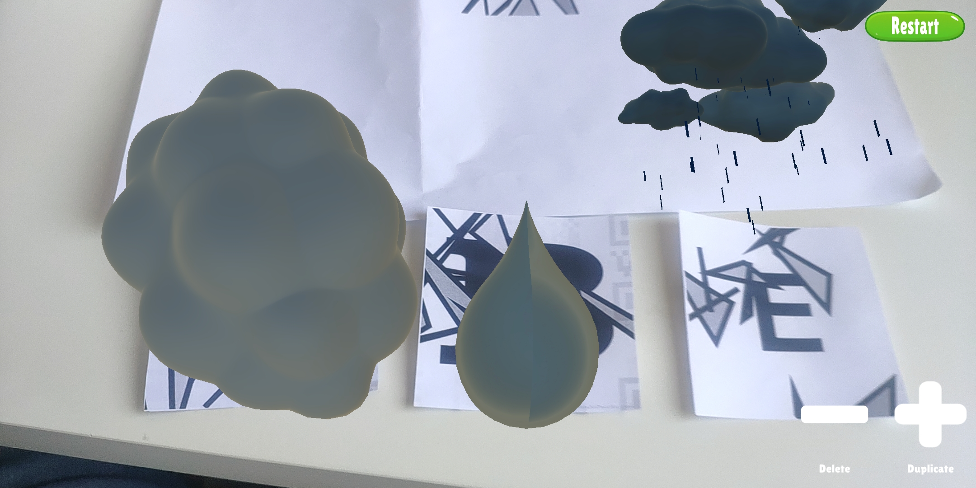
ARlchemy
⚗️
Discovery elements combination in AR world
Three levels with different goals
🌇(Level 1) ,🚓 (Level 2) ,🚢(Level 3)
Combination start from 5 BasicMarker (B) only possible
if two elements combinable
An EmptyMarker (E) is detected
EmptyMarker (E)
BasicMarker (B)
💧
☁️
+
=
🌧️

