Slide 1

Game Physics Exercise 4 Presentation
Topic: Force Based Coupling
Team 18:
Chang Luo 03759570
Guanyu Chen 03756192
Taro Yoshioka 03734918
31. January 2021

Slide 2
Contents
- Coupled Simulation
- Demo Demonstration
- Game Logic

Slide 3

Mass Spring System
class Point {
Vec3 position;
Vec3 velocity;
. . .
void Integrate(float timestep); // Leap frog method
void applyImpulse(float J, Vec3 colNormal); };
class Spring {
size_t p1, p2;
. . .
void applyElasticForceToPoints(std::vector<Point*>);
};
Leap-Forg Integration
initVelocity(h/2);
…
Using current positions!
ComputeElasticF;
intEuler_Velocity; intEuler_Positions;

Slide 4

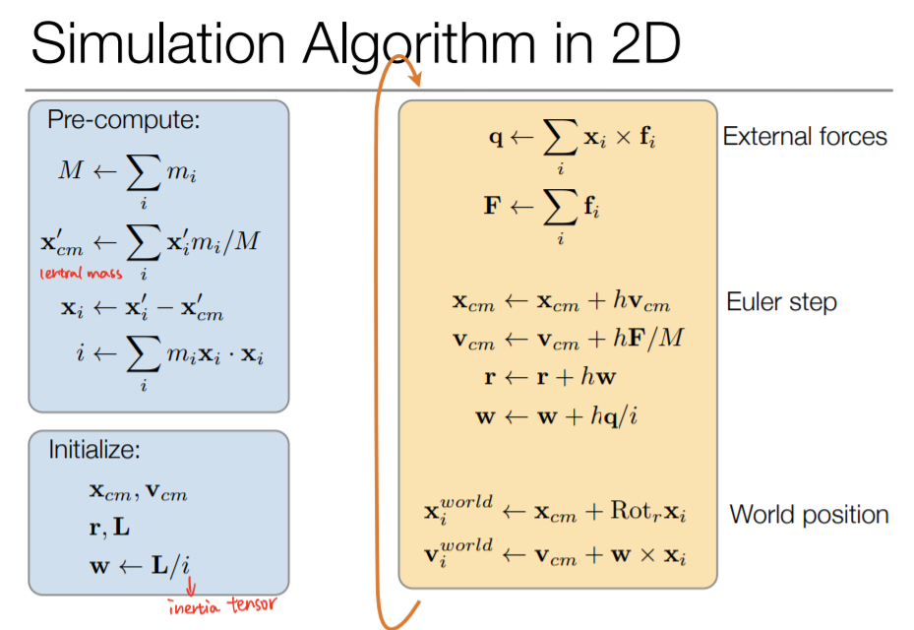
Rigid Body Sphere
class RigidBodySphere {
Vec3 position;
Vec3 velocity;
Vec3 force;
float mass;
float radius;
float bounciness;
. . . void Integrate(); // Euler step
void applyImpulse(float, Vec3);
}

Slide 5
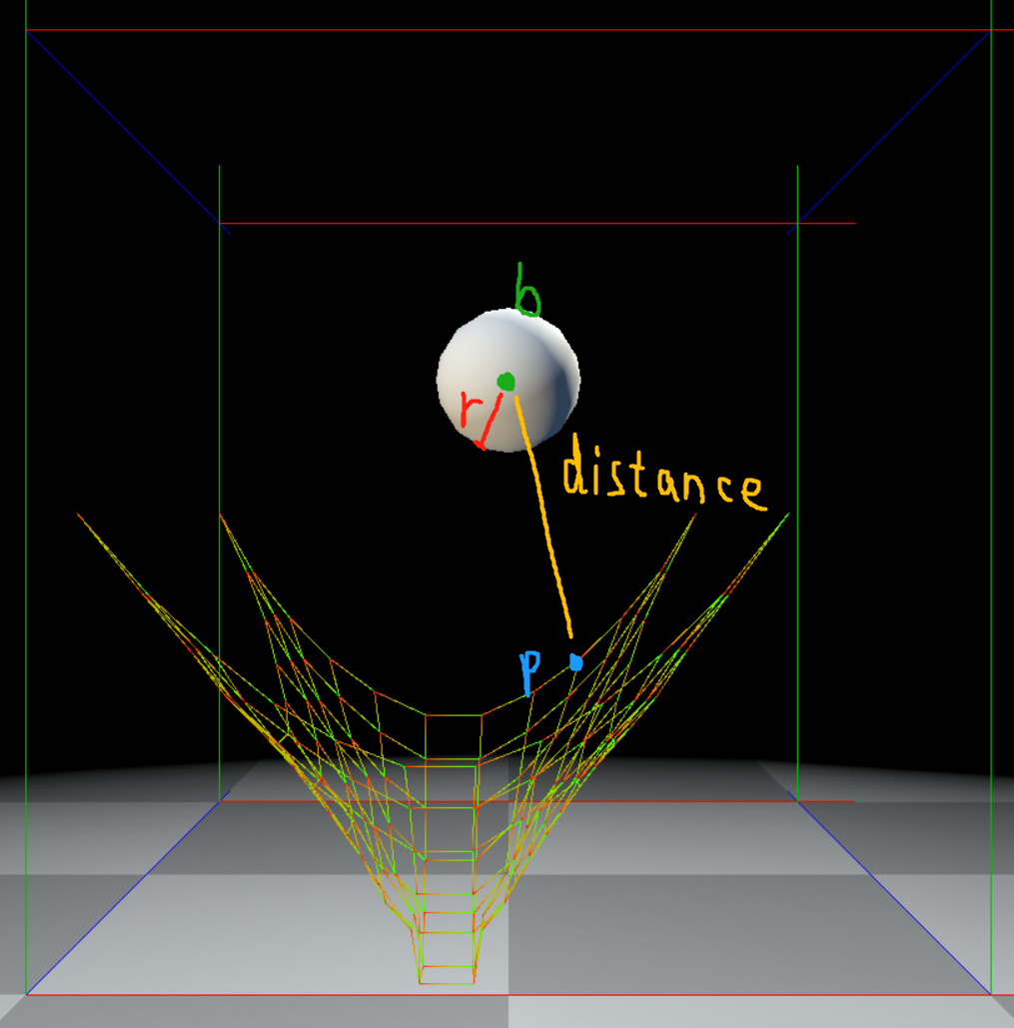
Collisions between bodies and springs
for (RigidBodySphere b : bodies) {
for (MassPoint p: points) {
Vec3 direction = b.pos() - p.pos();
Vec3 distance = norm(direction);
Vec3 normal = direction / distance;
Vec3 relVelocity = b.vel() - p.vel();
. . .
// collision condition
if (distance < b.radius) {
// apply impulse;
// update position;
}
}

Slide 6
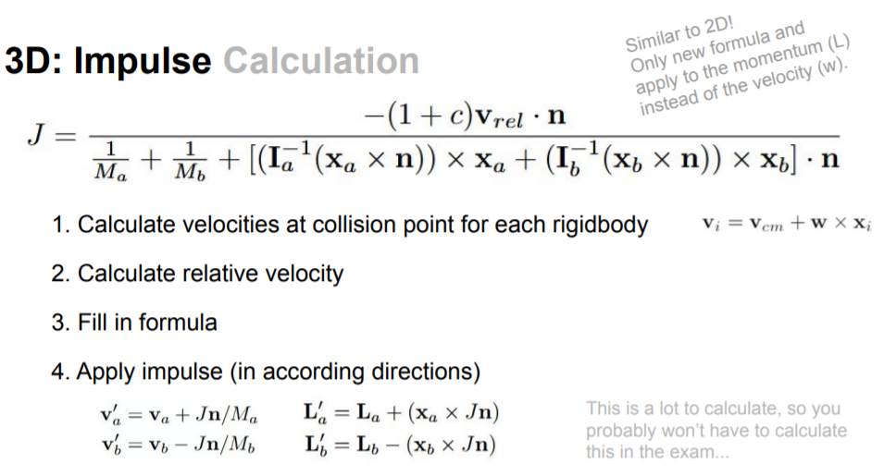
Collisions between bodies and springs
for (RigidBodySphere b : bodies) {
for (MassPoint p: points) {
Vec3 direction = b.pos() - p.pos();
Vec3 distance = norm(direction);
Vec3 normal = direction / distance;
Vec3 relVelocity = b.vel() - p.vel();
// collision condition
if (distance < b.radius) {
// apply impulse;
// update position;
}
}
p->setPos(p->pos() + timeStep * J * normal / p->getMass());
s->setPos(s->pos() - timeStep * J * normal / s->getMass());

Slide 7
External Force
// Move points[0] along cameras view plane
get mouse diff;
if moved:
get mouse diff in world view;
apply a proper scale;
set position of points[0];
// put a picture on the right
// to show how the point is dragged
I think we don’t need to talk about this by using slide, if someone ask just show code and explain briefly because it’s very simple

Slide 8
Demo Demenstration
Two scenes: Vertical, Horizontal, Game
A „sheet“ of points connected with springs with fixed corners: 12x12
Bodies with velocity fall to the “net”: 4 (?)
Boundary: Floor
Three results: (?)
Body goes through the net;
Body be bounced off the net;
Body lie on the net.

Slide 9
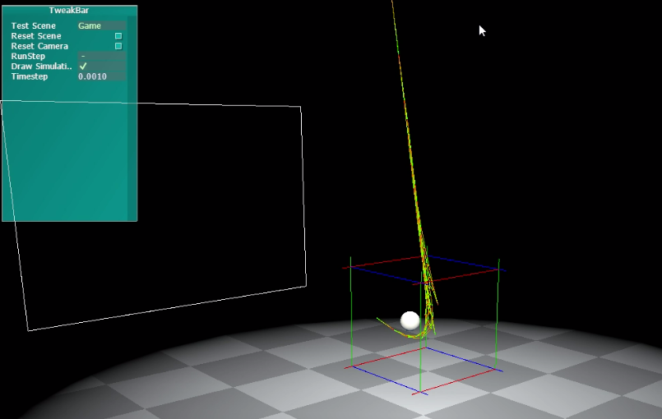
Game Logic
See if you can make a shot! Drag corner point to stick the body to the screen!

