Slide 1
测试驱动开发

Slide 2
什么是TDD
TDD = 测试先行 + 重构

Slide 3
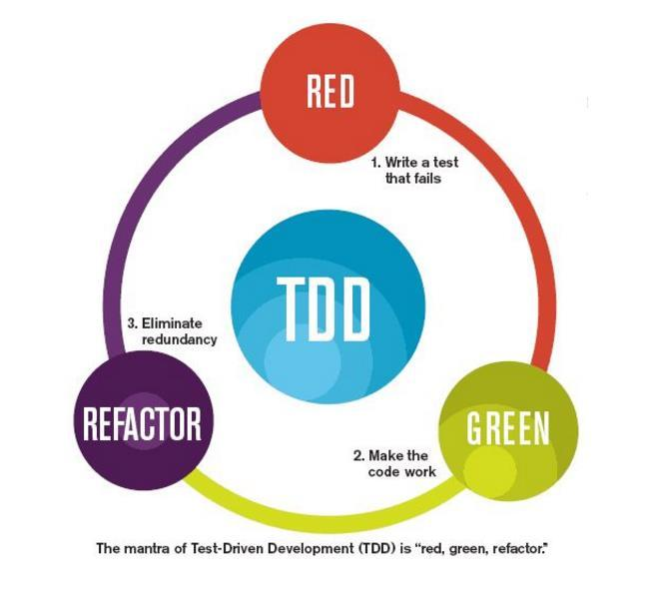
TDD 基本流程
编写一个测试（红）
让测试通过（绿）
重构

Slide 4
TDD 三条准则
1. You are not allowed to write any production code unless it is to make a failing unit test pass.
2. You are not allowed to write any more of a unit test than is sufficient to fail; and compilation failures are failures.
3. You are not allowed to write any more production code than is sufficient to pass the one failing unit test.

Slide 5
TDD 三条准则
1.只在让失败的测试通过时才编写产品代码
2.当测试刚好失败时，停止继续编写（测试代码），编译失败也是失败。
3.只编写刚好让一个失败测试通过的产品代码。

