Slide 1
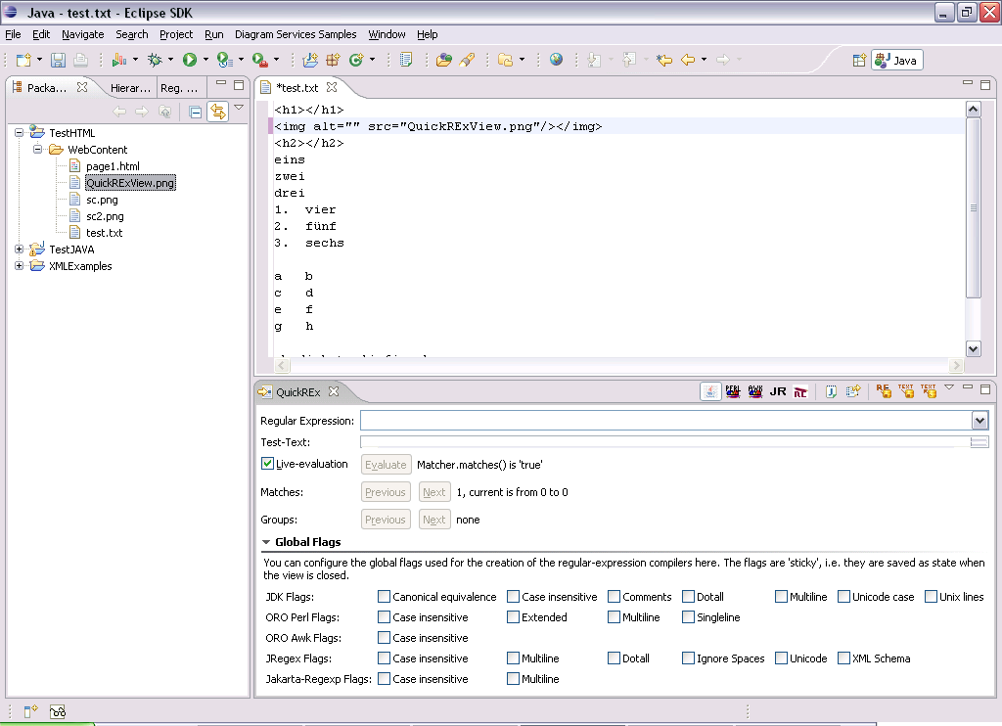
Grep
Keep Regular Expression
Copy to Java
Save Test-Text
Load Test-Text
Select RE-implementation
(JDK, ORO Perl, ORO Awk,
JRegex, Jakarta Regexp)

