Slide 1
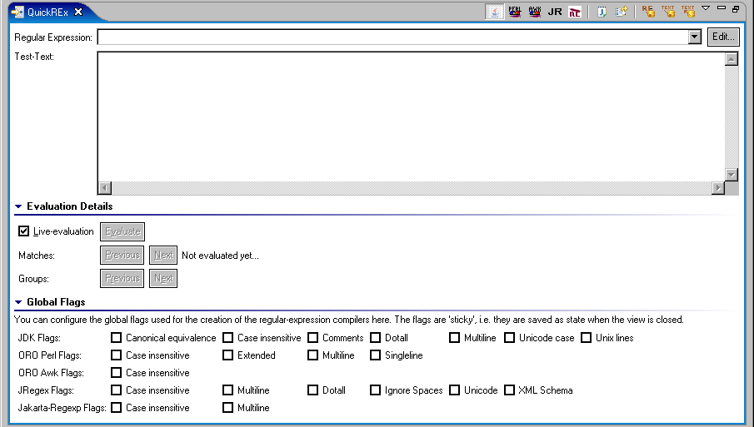
Navigate back- and forward through the matches using these buttons
The area for entering the regular expression
The area for entering the test-text
Start the RE-Edit-dialog here
Control live-evaluation or manually request
evaluation here
Information about the global matching, the number of matches/groups, the extent of the current match and the content of the current group (if applicable) is displayed here
Navigate back- and forward through the groups
in the current match using these buttons
Set (global) compiler-flags for the different
Reg-Exp-Implementations here

