Slide 1
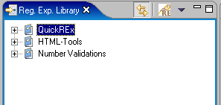
Link with Editor
Search library

