Slide 1
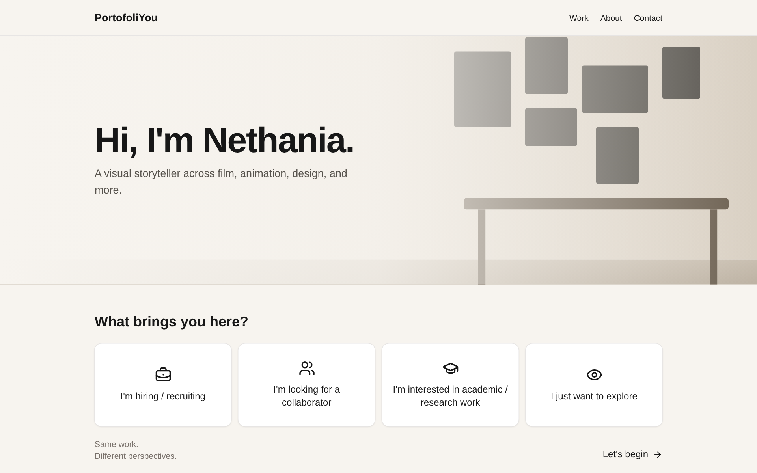
PortofoliYou
Midterm Progress Report
A purpose-driven portfolio for a multidisciplinary creator
Nethania · October 20, 2026
Live: portofoli-you.vercel.app
Notes:
Hi everyone. My project is PortofoliYou, a portfolio website for a multidisciplinary creator like me. Today I'll cover the overview and objectives, how I used generative AI, where the project stands now, and what comes next. The site is already live at portofoli-you.vercel.app.

Slide 2
Project overview
THE PROBLEM
≤ 3 clicks
My work spans film, animation, design, content and research. A recruiter or collaborator usually cares about only one part, and a single long portfolio buries it.
from landing page to relevant work
THE IDEA
5 disciplines
Ask visitors why they are here, then show only the relevant work, framed for their perspective.
Film · Animation · Design · Content · Research
WHO IT'S FOR
4 visitor purposes
Recruiters, creative collaborators, academic readers, and anyone just exploring.
Hiring · Collaborating · Academic · Exploring
Notes:
The problem: my work covers five very different fields, but each visitor usually cares about one. A recruiter for a film role does not want to scroll through research papers. So the idea is simple: ask the visitor why they are here, then show only the work that matters to them. The success goal is that a visitor reaches relevant work in three clicks or fewer.

Slide 3




Objectives
Relevant work, fast
Different perspectives
Every visitor reaches work that matters to them in three clicks or fewer.
One project is framed differently for recruiters, collaborators and researchers.
Content I can manage myself
Private and simple by design
Add, edit and feature projects in an admin dashboard: no code, no redeploy.
No visitor tracking or accounts; the database stores only the fields it needs.
Notes:
I have four objectives. First, speed: relevant work in three clicks or fewer. Second, perspective: the same project shows different details depending on who is looking. Third, I can manage everything myself through an admin dashboard. Fourth, privacy: there is no tracking and no visitor accounts.

Slide 4






Main features and contents
Purpose selection
Category filter
Purpose-based detail
Home asks “What brings you here?”: hiring, collaborating, academic, or exploring.
Pick Film, Animation, Design, Content Creation, Research, or Other; one tap opens the list.
Video, stills, and a panel “For Recruiters” or “For Collaborators”.
About
Contact
Admin dashboard
Profile, skills, experience, education, and a CV download link.
Validated form with inline errors; messages are saved to the database.
Private login to add, edit, delete and feature projects, and read messages.
Notes:
These are the six main features. Purpose selection and the category filter decide what the visitor sees. The detail page changes based on purpose. About and Contact are standard pages, but contact messages are stored in my database. The admin dashboard lets me manage everything.

Slide 5
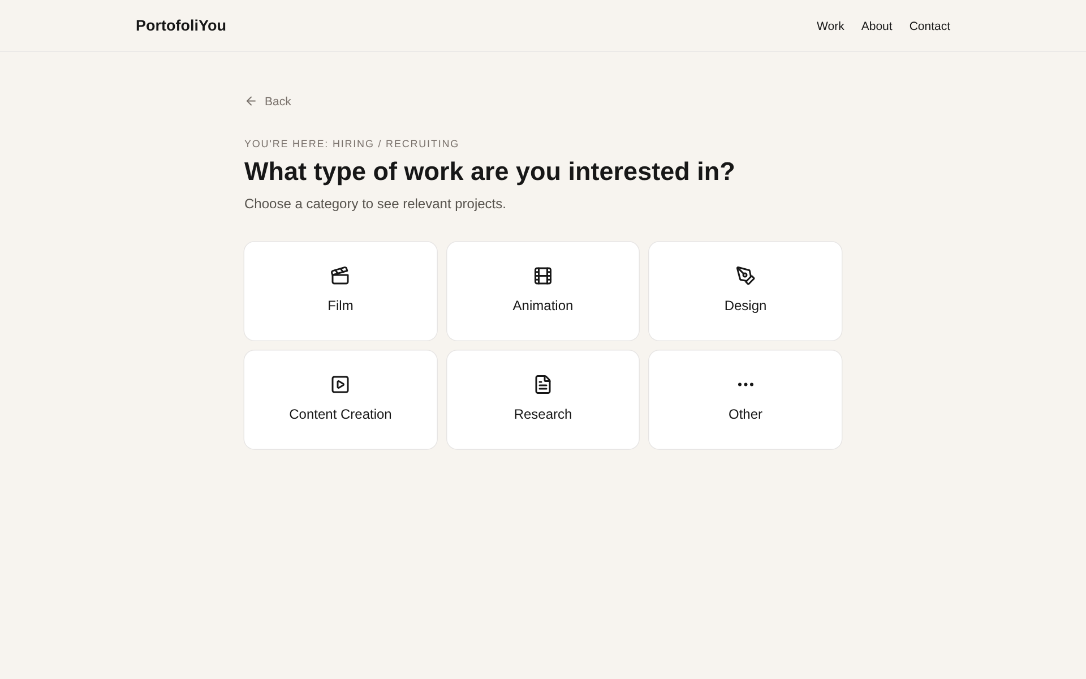
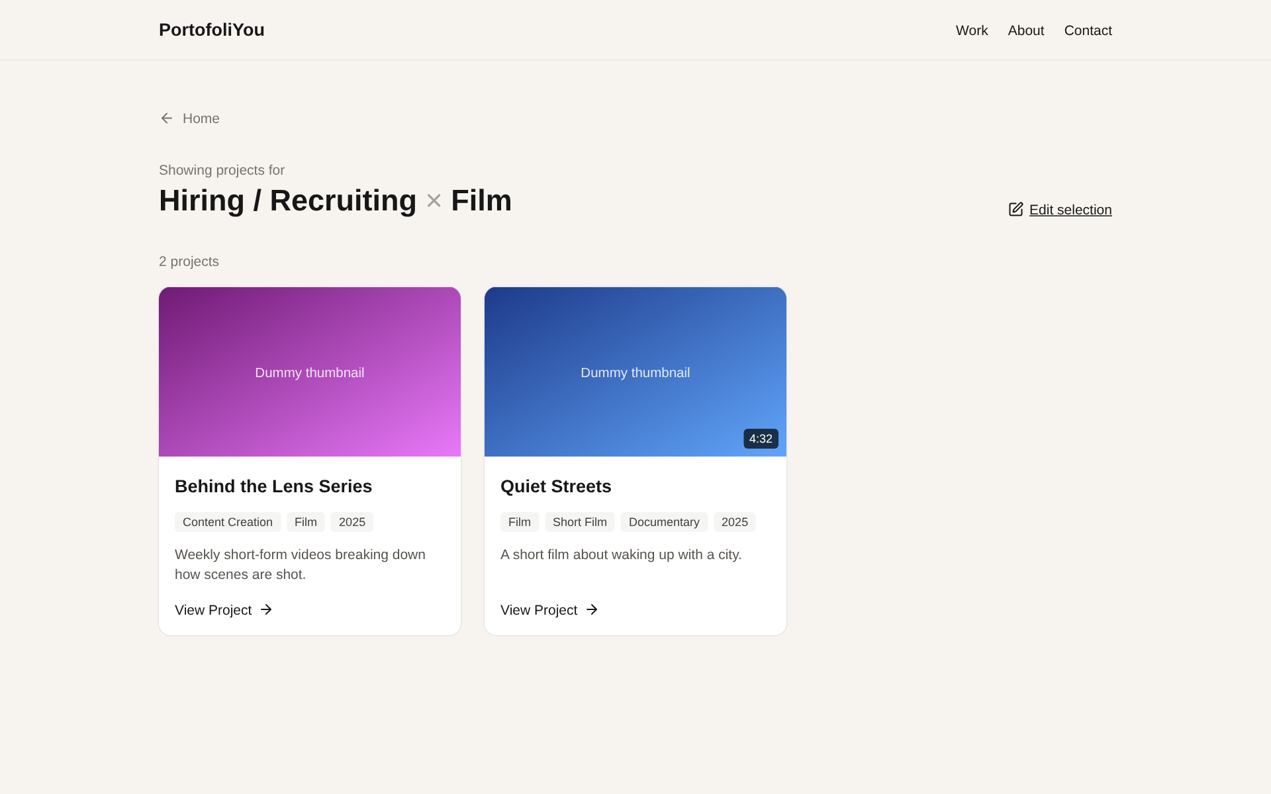
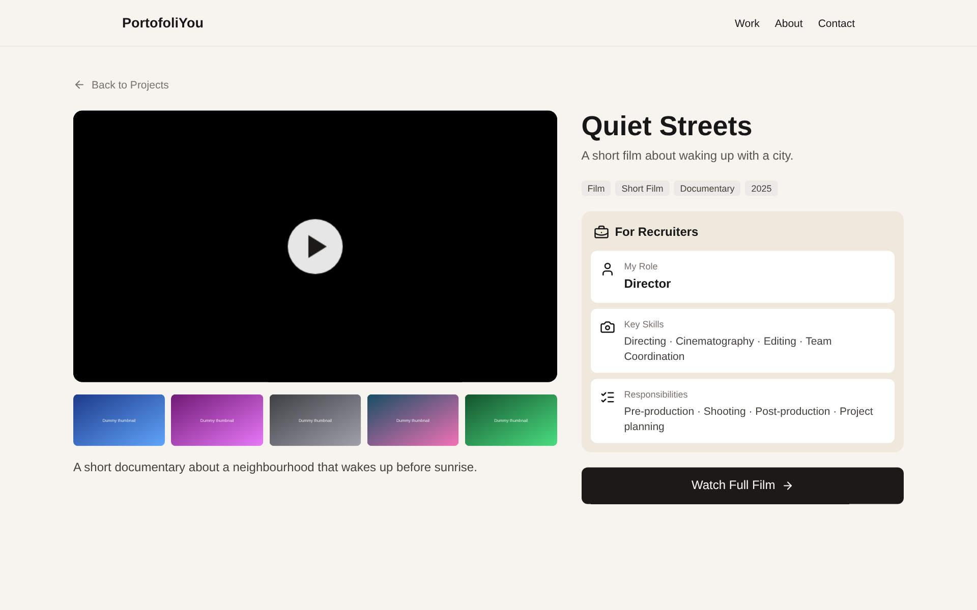

How a visitor moves through the site
1
2
3
4
Choose a purpose
Choose a type of work
See matching projects
Open a project
“I'm hiring / recruiting”
One tap, e.g. Film
Newest first, with tags
Panel for recruiters
3 clicks for hiring and collaborators (purpose → type → project). 2 clicks for academic and exploring visitors, who skip the type step.
Notes:
Here is the actual flow on the live site. A recruiter clicks I'm hiring, taps Film, sees only film projects, and opens one. That's three clicks. Academic visitors go straight to my research projects, and explorers see everything, so they need only two clicks. Originally there was a Show Projects button after choosing a type; I removed it so one tap goes straight to the list.

Slide 6
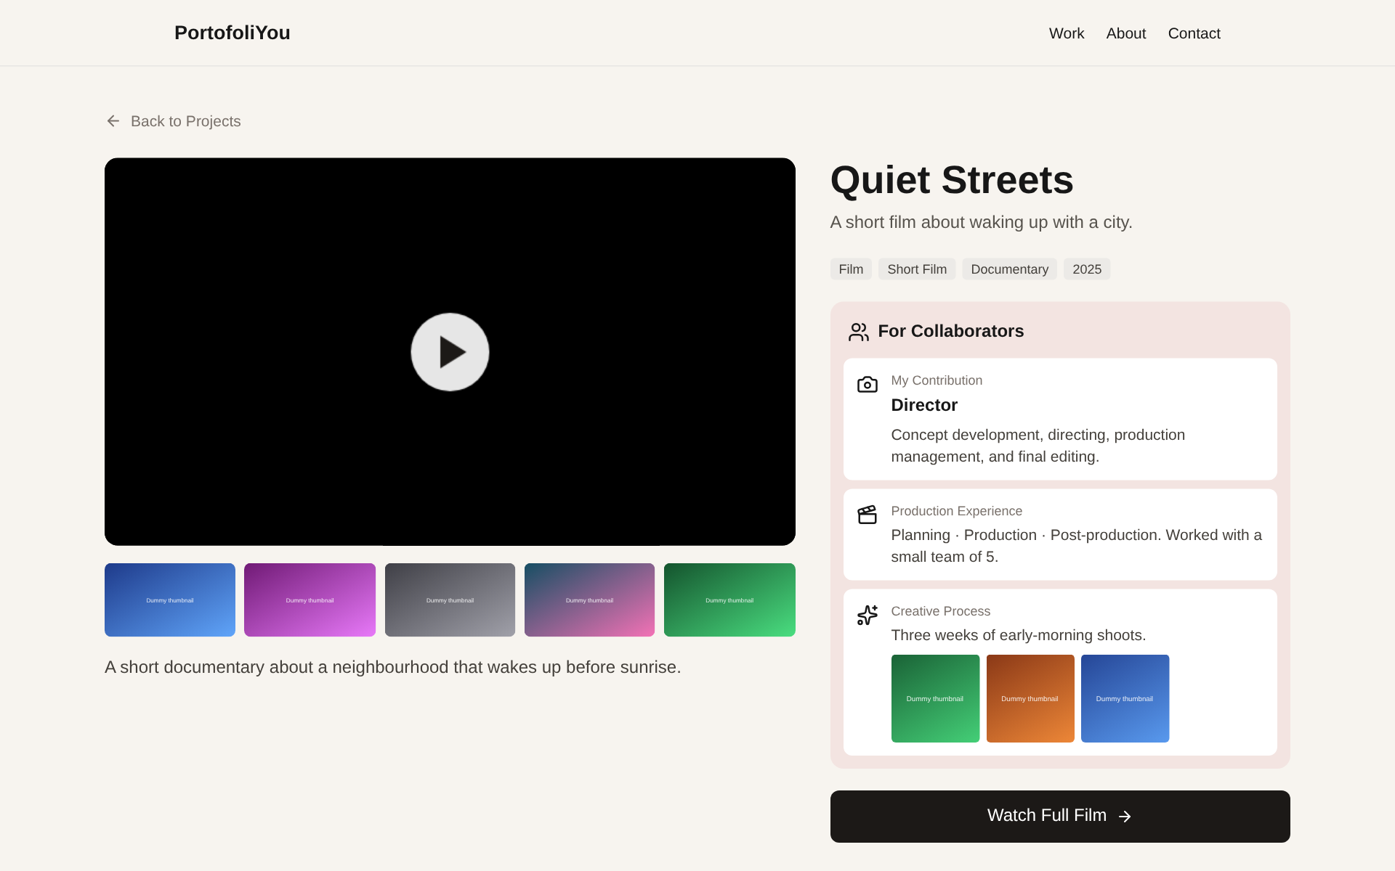
Same work, different perspectives
For Recruiters
For Collaborators
My role · Key skills · Responsibilities
My contribution · Production experience · Creative process
Notes:
This is the core idea of the project. Both screenshots show the same film, but the right-hand panel changes. A recruiter sees my role, key skills and responsibilities. A collaborator sees my contribution, production experience and creative process, with process images. Academic visitors and explorers see a general panel.

Slide 7




Technology and architecture
Browser
Next.js on Vercel
Supabase
Visitors and me (admin)
Phone and laptop, light and dark mode
Pages, forms, admin actions
TypeScript · Tailwind CSS
Postgres database + Auth
Projects · contact messages
Always fresh: pages read the database on every visit, so admin edits appear without redeploying.
GitHub
Push → auto-deploy
Security: database rules (RLS) let visitors read projects and send messages; only the single admin account can change data.
Notes:
The stack is Next.js with TypeScript and Tailwind, hosted on Vercel, with Supabase for the database and login. When I push to GitHub, Vercel deploys automatically. Security is handled in the database itself with row-level security: visitors can only read projects and send messages, and only my admin account can change anything.

Slide 8
Development schedule
When | Milestone | Status
Sep 29 | Phase 1: Next.js + Tailwind setup, Supabase database design | Done
Oct 6 | Phase 2: all screens built with sample data | Done
Oct 6 | Phase 3: Supabase connected, admin login and dashboard | Done
Oct 6 | Redesign: purpose flow and purpose-based detail pages | Done
Oct 20 | Midterm presentation; admin account and database update live | This week
Oct 27 – Nov 9 | Real content: projects, videos, photos, bio, CV | Planned
Nov 10 – Nov 23 | Polish: link previews, loading states, accessibility | Planned
Nov 24 – Dec 7 | User testing with 5 people, then fixes | Planned
Dec 8 – Dec 21 | Final checks, final report and live demo | Planned
Notes:
Phase 1 was setup in late September. On October 6 I built all the screens, connected the database, built the admin dashboard, and redesigned the visitor flow based on my mockups. This week is the midterm. Next come real content, polish, user testing with five people, and final checks before the final exam around December 21. The professor asked for weekly updates, so I'm working step by step.

Slide 9

How I use generative AI
Me: product owner
CLAUDE.md: persistent project spec
## Working rules
- Owner is new to web dev. Explain
steps in plain language.
- Build one screen/feature at a time;
after each, give steps to verify.
- Check in before big structural
decisions.
- Do not build anything outside scope.
- Excluded: AI recommendations, visitor
accounts, payment, chat, analytics,
file uploads, multi-language.
- Privacy: store only schema fields;
no visitor tracking.
Define scope, rules and design mockups
Make every product decision
Test each step on the live site
AI: Claude Code (coding agent)
Write, run and test the code
Explain each step in plain language
Ask before big decisions; commit to GitHub
Read by the AI at the start of every session, so it works like a system prompt for the whole project.
Notes:
For AI-assisted development I use Claude Code, an AI coding agent that works directly in my GitHub repository. I act as the product owner: I set the rules, design the mockups, decide, and test. The AI writes and tests the code and explains every step. The key prompt specification is a file called CLAUDE.md. The AI reads it at the start of every session, so it works like a permanent system prompt: plain-language explanations, one feature at a time, check in before big decisions, and a strict scope and privacy list.

Slide 10
Prompt specifications by stage
Stage | My prompt (summarised, translated from Indonesian) | Result
Recovery | Bring the Phase 1 history from my old GitHub account into this repo and check that it builds. | History restored; build passes
Phase 2 | Continue Phase 2: Home screen with dummy data. (Repeated for each screen.) | 5 screens with sample data
Phase 3 | Connect to Supabase. (I provided the Project URL and publishable key.) | Live data; contact saved
Admin | Build Admin Login + Dashboard: add/edit/delete, featured toggle, read messages. | Admin built and tested
Redesign | I want it like this, with “What brings you here?”. (5 mockup figures attached.) | Purpose flow + detail panels
Refine | No “Show Projects” click: tapping a type should open the projects directly. | One-tap category page
Style | Restyle About and Contact to match the new warm design. | Consistent card design
Notes:
This table shows the actual prompts I gave, in order. They are short, because the rules file supplies the context. For the redesign, I attached my five mockup figures as images, and the AI built the purpose flow from them. When something did not feel right, like the extra Show Projects click, I wrote a short correction prompt and the AI changed it.

Slide 11

Prompt structure and human decisions
The AI asked before building; I decided
Every request includes
Context
What exists now (project rules file, current site, screenshot)
What does “Other” mean?
→ Show all categories
Goal
One screen or feature, e.g. “purpose-based detail page”
What do Academic and Explore show?
→ Research projects only / everything
Constraints
Scope list, privacy, my design mockup as reference
How should projects be ordered?
→ Newest first
Check
How I verify it, e.g. “Animation shows only Animation projects”
Real photos already?
→ Use placeholders for now
Notes:
My prompts follow a simple structure: context, goal, constraints, and how I will check the result. An important part of the specification is that the AI must check in before big decisions. During the redesign it asked me four questions before writing any code, and these are my answers. So the product decisions stay mine.

Slide 12


Current development status
9
Completion checks from my project plan
Home → Animation shows only Animation projects (incl. multi-tagged)
Working on the live site
screens built
13
Contact form shows a confirmation and the message is saved
Working on the live site
commits on GitHub
Contact messages visible in the Admin Dashboard
Built; waiting for my admin account
Live
Admin edits a title → appears on the site without redeploying
Built and tested; live check this week
on Vercel since Oct 6
Notes:
Nine screens are built: Home, type selection, project list, project detail, About, Contact, admin login, dashboard, and the project form. The site has been live since October 6. Of my four completion checks, two already work on the live site. The admin ones are built and tested, but I still need to create my admin account in Supabase and run one database update. That is this week's task.

Slide 13



Next steps in development
01
02
03
04
Go live with admin
Real content
Real profile
Clean up and test
Create my admin account, turn off public sign-up, run the database update.
Replace sample projects with my own videos, stills and descriptions.
Bio, skills, experience, education, hero photo and CV link.
Remove sample files; re-run all completion checks on the live site.
Goal by November 9: the live site shows only my real work.
Notes:
The next steps are concrete. First, make the admin work live. Then replace all sample projects and the profile with my real work. Finally, remove the sample files and run the completion checks again. My goal is that by November 9 the site shows only my real work.

Slide 14





Planned improvements and additional features
Link previews and SEO
Faster loading
Accessibility check
Title, description and image when the link is shared.
Loading placeholders and optimised images.
Keyboard use, contrast and image descriptions.
3 languages: ID · EN · KO
Multi-select categories
Better admin tools
Language switcher for Indonesian, English and Korean visitors.
Reconsider after user testing.
Image previews and project ordering.
Out of scope by design: AI recommendations, visitor accounts, payment, chat, visitor tracking/analytics, file uploads.
Notes:
After the content is in, I plan these improvements: proper link previews for when I share the site, faster loading, an accessibility check, and better admin tools. A new addition is three languages: I'm Indonesian and live in Korea, so my visitors may be Indonesian, Korean or international. I plan a language switcher for Indonesian, English and Korean. Multi-language was originally out of scope, so this is a deliberate scope change, planned after the real content is in. Multi-select categories is an open question that I'll decide after user testing. I'm also keeping a clear out-of-scope list so the project stays finishable in eleven weeks.

Slide 15



Future service and deployment plans
Hosting Vercel, with automatic deploys from GitHub main
Data Supabase free tier (Singapore region) for projects and messages
After the course
Domain Optional custom domain for the final version
PortofoliYou becomes my real portfolio for internship and job applications: one link on my CV, LinkedIn and Instagram that shows each visitor the work they came for.
Security Single admin, sign-up disabled, database rules (RLS)
Maintenance Content updated in the admin dashboard; no code needed
Notes:
For deployment, the site already runs on Vercel with automatic deploys, and the data lives in Supabase in the Singapore region. Both free tiers are enough for a personal portfolio. I might add a custom domain for the final version. After the course, this becomes my real portfolio, the one link I share for internships and jobs.

Slide 16
Thank you
Questions and feedback are welcome
Live demo: portofoli-you.vercel.app
Notes:
Thank you. If there's time, I can show the live site: choosing a purpose, picking Film, and opening a project. I'd love any feedback, especially on the purpose-based detail panels.

