Slide 1
React, Typescript,
ASP.NET Core
Pavel Janecka

Slide 2
About me
SW Developer
When needed: architect, scrum master, coach
Currently working at Snapshot
  .NET Core
  React.js
  Redux
  Typescript
Interests: Elm, F#, Clojure, Squash
pavel@janecka.me

Slide 3
Agenda
React.js - what it is?
Libraries commonly used with React
React with typescript
React with ASP.NET Core

Slide 4
What’s React.js?
Package - library (not a framework), build by Facebook
JSX - “HTML in Javascript”, “HTML is an expression”
  let name = 'Test';
  let nameInDiv = <div>{name}</div>;
Components
Uni-directional data flow
  Action -> Dispatcher -> Store -> View -> Action -> (etc.)
  Flux architecture

Slide 5
React.js - Components
<div class="contact-list">
<div class="contact">
<img src="Petr.jpg">
<span class="name">Petr</span>
<span class="label">Favorite food</span>
<span>Meat</span>
</div>
<div class="contact">
<img src="Jirka.jpg">
<span class="name">Jirka</span>
<span class="label">Favorite food</span>
<span>Pasta</span>
</div>
</div>
<ContactList>
<Contact data={petr}>
<Contact data={jirka}>
</ContactList>

Slide 6
React.js - Component definition 1/2
class Contact extends React.Component {
render() {
const personData = this.props.data;
return (
<div class="contact">
<img src={personData.pictureUrl}>
<span class="name">{personData.name}</span>
<span class="label">Favorite food</span><span>{personData.food}</span>
</div>);
}
}

Slide 7
React.js - Component definition 2/2
function(props) {
return (
<div class="contact">
<img src={props.personData.pictureUrl}>
<span class="name">{props.personData.name}</span>
<span class="label">Favorite food</span>
<span>{props.personData.food}</span>
</div>
);
}

Slide 8
Component usage
const petr = {
pictureUrl: "https://cdn28750278364.xyz/Petr.jpg",
name: "Petr",
food: "Meat"
};
reactDOM.render(<Contact data={petr}>, document.getElementById('root'))
// or
// const component = <Contact data={petr}>;
// reactDOM.render(component, document.getElementById('root'))

Slide 9
Before we start - minimal JS tooling knowledge
node.js - runtime, SDK, commandline utilities (node, npm)
npm - package manager for javascript
JS tooling in JS
npm init -y
package.json (like csproj)
npm install package-name
  --save
  --saveDev
  --global
  (without an option)
Create-react-app (package)

Slide 10
Before we start 2 - webpack
Browser runs only Javascript
Bundling, minification, preprocessing, compilation
Entrypoint
Loaders

Slide 11
React DEMO

Slide 12
React Component State
immutable
manipulate via setState(obj) or setState((prevState) => functionToGetNewState(prevState))
Merge
setState
  only class-based components
  always prefix with this.

Slide 13
React - Component Props
way to pass:
  data to component (read-only)
  behavior to component (Inversion of Control)
class Contact extends React.Component {
render() {
return <div>{this.props.name}</div>;
}
}
<Contact name={“John”}>

Slide 14
React with State and Props DEMO

Slide 15
Dealing with a more complex apps
React - only UI
Passing state - tedious, error-prone
Revisiting Flux
  Reactive system, i.e.
  various implementations (alt, relay, mobx, redux)

Slide 16
Redux - the most popular
Single state tree (store)
Composable
Immutable
Uni-directional data flow

Slide 17
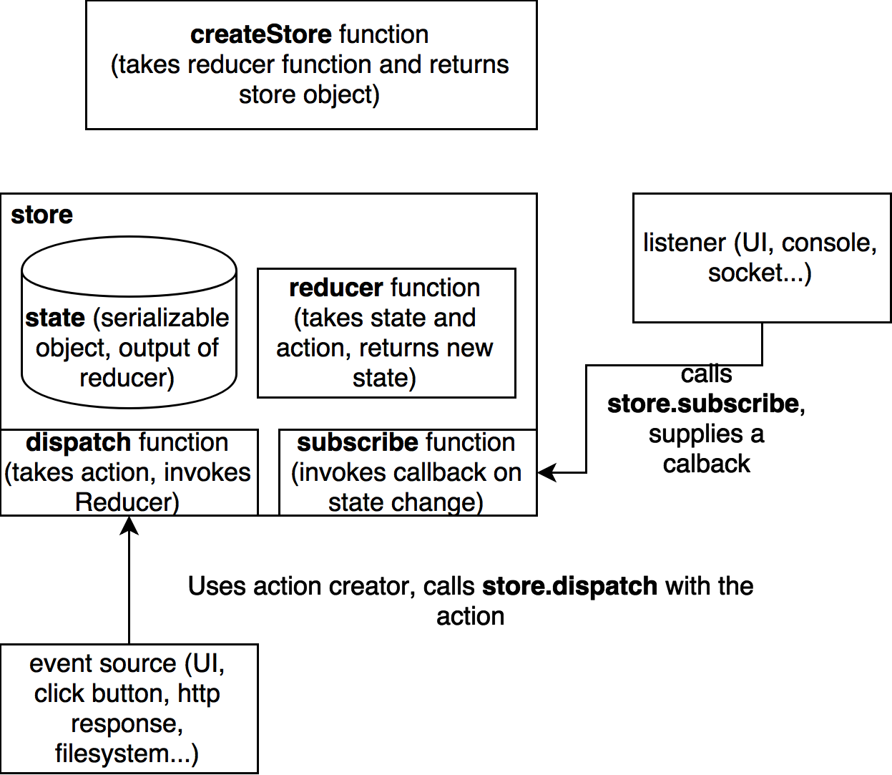
Redux - terms
Store
Reducer
Dispatch
Subscribe
Action
Action creator

Slide 18
Redux - state shape example
{
userId: 1,
contacts: [ “ivan”, “jane”, “pluto” ]
}

Slide 19
Redux - sample action creators and actions
function addContact(name) {
return {
type: “ADD_CONTACT”,
name: name
};
}
function clearContacts() {
return { type: “CLEAR_CONTACTS” };
}

Slide 20
Redux - sample reducer
function contacts(state = {userId: undefined, contacts: [], action) {
switch (action.type) {
case “ADD_CONTACT”:
return { userId: state.userId, contacts: [...contacts, action.name”];
case “CLEAR_CONTACTS”:
return { userId: state.userId, contacts: [];
default: return state;
}
}

Slide 21
Redux - creating store
const store = createStore(contacts);
store.subscribe(function() {
console.log(store.getState());
});
store.dispatch(addContact(“Test”));

Slide 22
React with Redux
Package react-redux
  Component Provider
  Function connect

Slide 23
React, Redux, Provider, connect
const Person = ({ name, favoriteFood }) => (
<div>{name} likes to eat {favoriteFood}</div>);
const PersonList = ({ people }) => (<div>{people.map(p => (<Person ...p>))}</div>);
const ConnectedPersonList = connect(mapStateToProps)(PersonList);
const app = (
<Provider store={personStore}>
<ConnectedPersonList />
</Provider>
);
reactDOM.render(app, document.getElementById('root'));

Slide 24
React with Redux

Slide 25
Typescript
* Language that transpiles to Javascript (tsc)
* Webpack - awesome typescript loader
* REPL - ts-node
* download type definitions for libs (@types/react, @types/redux...)
* TS Lint

Slide 26
Typescript - type annotations
const a: string = “hello”;
const b: number = 1;
const c: ‘ME’ | ‘YOU’ | number = ‘ME’;
const d: any = { a: “anything” };
const e: ‘ITEM’ = ‘ITEM’;
function f(p) { return p + 1; }
function f(p: number): number { return p + 1; }
const f2 = (p) => p + 1;
const f2: (p: number) => number = (p) => p + 1;

Slide 27
Typescript - classes and interfaces
class Item {
private stuff = 'asd';
constructor (public name: string = 'defaultname') { }
interact() { console.log(`interacted with ${this.stuff}`); }
}
interface Payload {
name: string;
score: number;
}

Slide 28
Typescript - types, type system
interface ActionA {
type: ‘A’;
name: string;
}
Interface ActionB {
type: ‘B’;
score: number;
}
type Action = ActionA | ActionB;
function handleAction(action: Action) {
switch (action.type) {
case ‘A’: return workWithName(action.name);
case ‘B’: return workWithScore(action.score);
}
}

Slide 29
Demo - React, Redux, Typescript

Slide 30
Demo - React, Redux, TS, .NET Core

Slide 31
Recommended tutorials and docs
FB docs on React: https://facebook.github.io/react/
Juho Vepsäläinen’s tutorial on React: https://survivejs.com/react/introduction/
Pluralsight courses by https://www.pluralsight.com/authors/cory-house
Free video courses by Dan Abramov (author of Redux)
  https://egghead.io/courses/getting-started-with-redux
  https://egghead.io/courses/building-react-applications-with-idiomatic-redux
These two practical blog series about Redux:
  http://blog.isquaredsoftware.com/series/practical-redux/
  http://blog.isquaredsoftware.com/series/idiomatic-redux/

Slide 32
pavel@janecka.me

