Slide 1
FRONTEND Development
Netcompany TCCS
Oslo, 25.08.2020​
So close
Øystein Kvamme Repp & Isa Salem Hame
oysteinr@netcompany.com & isasah@netcompany.com

Slide 2
Agenda
Welcome
Frontend stack
Concepts
Javascript
Vue
SPAs and routing
Testing
Talking to server
Work with assignments
12.00 - 13.00 Lunch break
Work with assignments
14.00 - 14.15 Snack break
16.30 - 17.00 Wrapping it up

Slide 3
Pandemitilpasninger
Vi kjører hele presentasjonen i én økt på starten av dagen, heller enn i bolker. Resten av dagen arbeider dere med oppgavene.
Vi deler dere inn i grupper i Teams, slik at det er enklere å samarbeide.
Det er sterkt oppfordret at dere er inne på samtalen og har på video hele dagen
Vi har mulighet til å delta i samtale hos alle gruppene. Det er bare å spørre om hjelp, så hopper vi inn
Husk at dere har mulighet til å dele skjerm, både for å få hjelp fra oss og fra hverandre
Felles lunsjpause kl. 11:00 – 11:30

Slide 4



Our Frontend Stack
Vue + Vuex
The frontend code where 99% of the coding is done
Vuetify
The Material Design component framework for Vue.js that provides all the tools to easily create beautiful applications.
Babel
The transpiler that makes your cutting-edge code run even on old browsers
Webpack
The bundler which combines everything into a package you can deploy & run

Slide 5
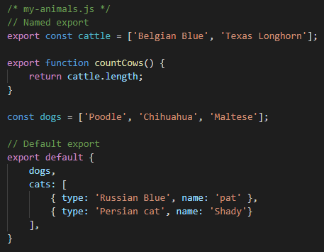
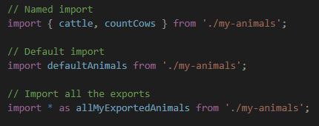
Concept: Modules
In short: Some collection of Javascript code you can import and reuse
One module per file, one file per module
Named export/import
Default export/import
https://developer.mozilla.org/en-US/docs/Web/JavaScript/Reference/Statements/import

Slide 6
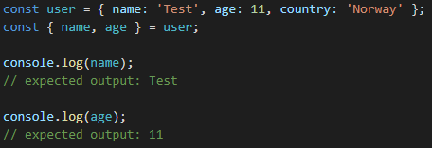
Concept: EcmaScript6 -> Destructuring
Assign properties of an array or object to variables

Slide 7
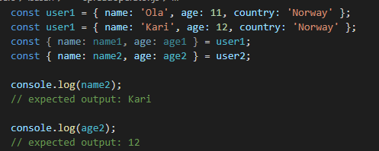
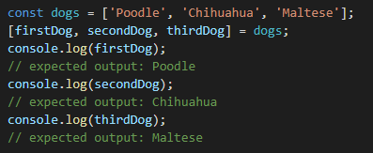

Concept: EcmaScript6 -> Destructuring
Assign properties of an array or object to variables

Slide 8
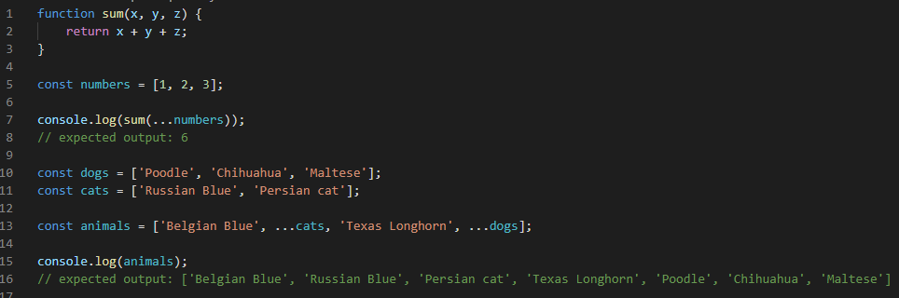

Concept: EcmaScript6 -> Spread operator

Slide 9
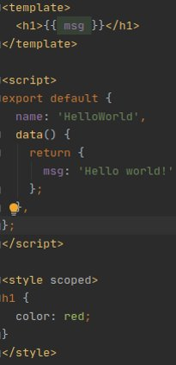
Concept: Vue Single File Components (SFC)
Wrap everything you need in one file (.vue)
3 parts:
<template>
Your "HTML", I.e. your view.
<script>
Your code, I.e. your logic.
<style>
Your styling
Supports different dialects/languages in addition to vanilla CSS. E.g. SASS, SCSS, Stylus, Less
Notes:
Fra her

Slide 10
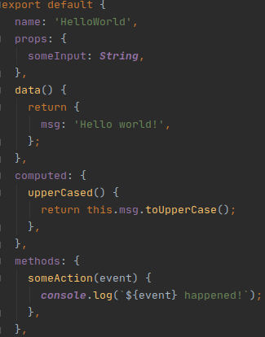
Concept: Properties etc.
Props
The "interface" of the component.
Used for passing properties or data to your component
Data
The internal state (i.e. data) of the component
Should only be changed by the component itself, never from the outside
Computed
Methods that returns computed data.
Refreshed automatically when referenced data or properties change
Accessed from the view in the same way as data
Methods
For handling actions or events from your view. E.g. button clicks.
Takes event as 1st argument by default, but this can be omitted when defining the function if you don't need the event

Slide 11
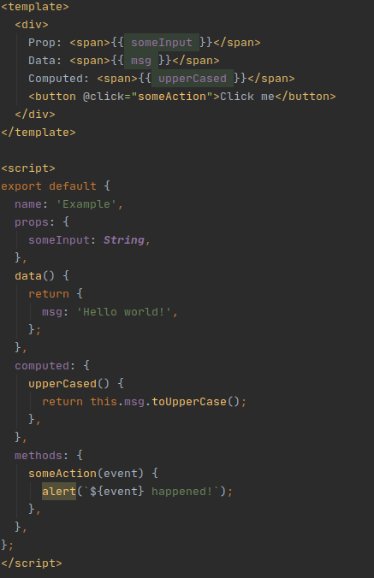
Example
Notice that this is required when referenced in script, but not in template

Slide 12
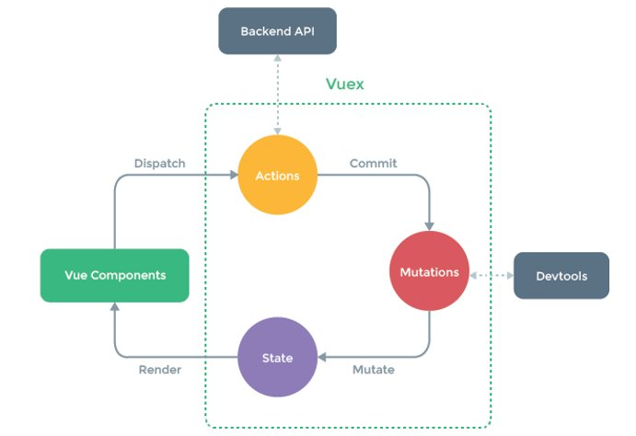
Concept: Vuex / Store
State
Changed (only!) by mutations
Mutations
Committed by actions
Synchronous
Actions
Typically dispatched when an event occurs in the application. E.g. when a button is clicked.
Asynchronous
https://vuex.vuejs.org/

Slide 13
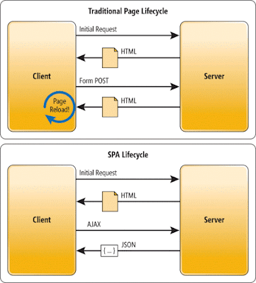
Concept: Single-Page Applications (SPA)
Dynamically rewriting the current web page using JavaScript. In other words, the page is never reloaded in the browser
Faster loading which makes the site feel more like a native app
Requires routing on the client side - I.e. the application itself is handling route changes instead of a web server
Easily implemented in Vue using Vue router
http://thephantomprogrammer.blogspot.com/2016/08/web-fundamentals.html

Slide 14
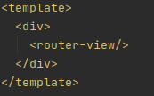
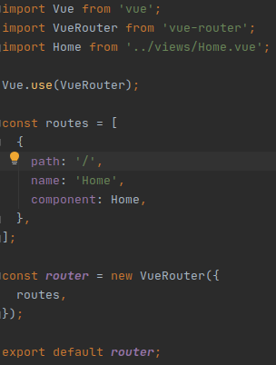
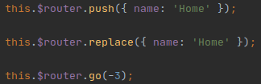
Concept: Vue Router
<router-view/>
What is rendered inside this tag is decided by your router config
this.$router
Accessible from inside Vue components
push
Navigate to a new route
Appends a new path to the browser history
replace
Replaces the current path in the browser history
go
Move N steps back or forth in the browser history
<router-link></router-link>
to
replace

Slide 15
Concept: Vue Router
this.$route
Can be used to access the current route from within your component
name
The name of the route. This should be used when referencing the route, instead of using the raw path.
path
The path of the route. What is displayed in your browser's address bar.
params
Path parameters from the URL
/my/path/id/:id
query
Query parameters from the URL
/my/path?someParam=lol&anotherParam=wut
meta
Can be used to access some meta data belonging to the route. Defined in your router config.

Slide 16
Concept: Testing
Unit testing
Validate the functionality of the code in an isolated environment.
Test small sections of the code
Tests output based on given input
GUI testing
Tests the graphical user interface to ensure that the UI works as intended
Tests controls like menus, buttons, toolbars, etc.
Test Driven Development
An approach where executable tests are written before the program code is written
Helps you clarify your ideas of what the code is supposed to do
Makes it easier to understand and write the required code

Slide 17
Concept: Talk to server
Fetch (e.g. data containing user details)
REST
REpresentational State Transfer
POST, GET, PUT, DELETE
CRUD (create, read, update, delete)
JSON = JavaScript Object Notation
Firebase
https://developer.mozilla.org/en-US/docs/Learn/JavaScript/Client-side_web_APIs/Introduction

Slide 18
Course materials
Assignments https://github.com/netcompanyno/tccs-frontend-assignments
Solutions https://github.com/netcompanyno/tccs-frontend-v2

Slide 19
Structuring the day
08.00 - 08.30: Welcome and presentation
08.30 - 11.00: Assignment 1, 2 & 3
11.00 - 12.00: Assignment 4
12.00 - 13.00: Lunch break
13.00 - 14.00: Assignment 5
14.00 - 14.15: Snack break
14.15 - 15.30: Assignment 6
15.30 - 16.00: Assignment 7
Rest of the day: Assignment 8 & 9. If you run out of time, prioritize assignment 9.
16.30-ish: Wrapping up

