Slide 1
Frontend Development
Netcompany TCCS
VersIon
1.0
Status:
Nearly there
Author
Mikkel Steine
mikkels@netcompany.com
Fredrick Biering
fredrick@netcompany.com
Oslo, 04.06.2019
© Copyright 2018 Netcompany.
Neither this document nor any part thereof may be passed on to others, copied or reproduced in any form or by any means, or translated into another language without the express prior permission in writing from Netcompany.

Slide 2
Agenda
Welcome
Frontend stack
Concepts & Assignments
2-4 Getting started
5 Getting dirty
6-7 A little breather
8 Being sensible
9 Going crazy (as in fun)
Lunch 11:30 and snacks later
Notes:
For at rette KUNDENAVN – PROJEKTNAVN:
1. Click View
2. Click Slide master
3. Scroll til den første slide i venstre menuen
4. Ret KUNDENAVN – PROJEKTNAVN i slide mastere til højre
5. Click Close Master View

Slide 3
Our Frontend Stack
Vue + VueX
The frontend code where 99% of the coding is done
Babel
The transpiler that makes your cutting edge code run even on old browsers
Webpack 4
The bundler which combines everything into a package you can deploy & run
Notes:
For at rette KUNDENAVN – PROJEKTNAVN:
1. Click View
2. Click Slide master
3. Scroll til den første slide i venstre menuen
4. Ret KUNDENAVN – PROJEKTNAVN i slide mastere til højre
5. Click Close Master View

Slide 4
Concept: Component
export something
export default C
import C from './module'
import { something } from './module' === C.something
.vue files:
<template></template>
<script></script>
<style></style>

Slide 5
Concept: Properties etc.
props => external
data => internal
computed => generated (functions)
methods => methods for events
Notes:
props: interfacet til komponenter
Data: lokal state for komponenter. Kun komponenten selv kan/skal endre denne
Computed: Kan aksesseres fra visningslaget på samme måte som data, men outputen er generert fra annen data
Methods: Brukes stort sett for å håndtere events som f.eks. tastetrykk. Her dispatches typisk actions

Slide 6
Assignments 2 - 4

Slide 7
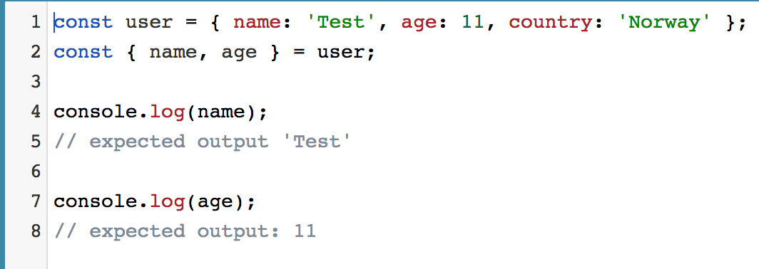
Concept: EcmaScript6 -> Destructuring

Slide 8
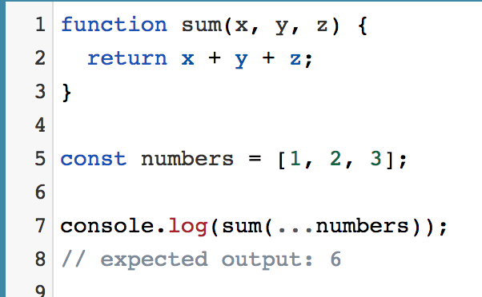
Concept: EcmaScript6 -> Spread operator

Slide 9
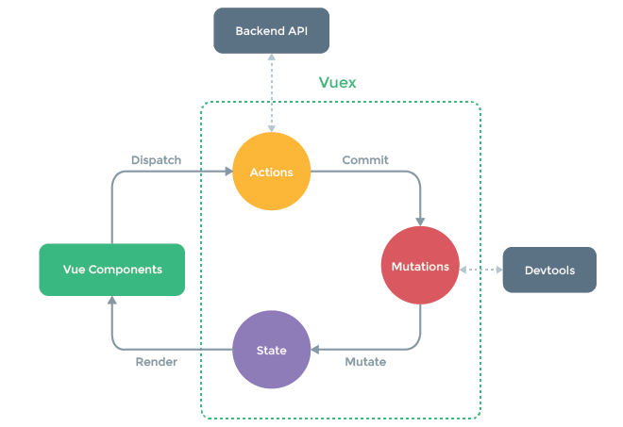
Concept: Vuex / Store
State
Mutations
Actions
Notes:
- Video: https://vuex.vuejs.org/

Slide 10
Assignment 5

Slide 11
Concept: Vue Router
<router-view/>
this.$router
push
replace
go
<router-link></router-link>
to
replace
Notes:
Tilsvarer Browser History API
Go = antall steg fremover eller bakover i historien

Slide 12
Concept: Vue Route
this.$route
params
query
...

Slide 13
Assignments 6 - 7

Slide 14
Concept: TDD
Test Driven Development
Why?
What to test in GUI

Slide 15
Assignment 8

Slide 16
Concept: Talk to server
Fetch
REST
POST, GET, PUT, DELETE
CRUD
JSON = JavaScript Object Notation
Firebase

Slide 17
Assignment 9

Slide 18
Concept: Talk to server
REST
POST, GET, PUT, DELETE
CRUD
JSON = JavaScript Object Notation
Firebase

