Slide 1
Subscription Drafts
IETF #100 - NETCONF WG
Eric Voit & Alexander Clemm
16-Nov-2017
DRAFT
With Thanks to...
Authors on at least 1 WG draft
Andy Bierman
Alexander Clemm
Tim Jenkins
Balazs Lengyel
Einar Nilsen-Nygaard
Alberto Gonzalez Prieto
Ambika Prasad Tripathy
Eric Voit
+ Design Team 1
Sharon Chisholm
Yan Gang
Peipei Guo
Susan Hares
Michael Scharf
Hector Trevino
Kent Watsen
Guangying Zheng (Walker)
+ new with Design Team 2
Henk Birkholz
Igor Bryskin
Xufeng Liu
Tianran Zhou
Notes:
The subteam met ½ dozen times since IETF 97
And assembled and reviewed proposals on quite a few issues. Minutes and mechanisms were sent to NETCONF WG mailer. We will talk about several of these during todays presentation.
We are now at a point where we are very close to going to WG last call on several drafts.

Slide 2
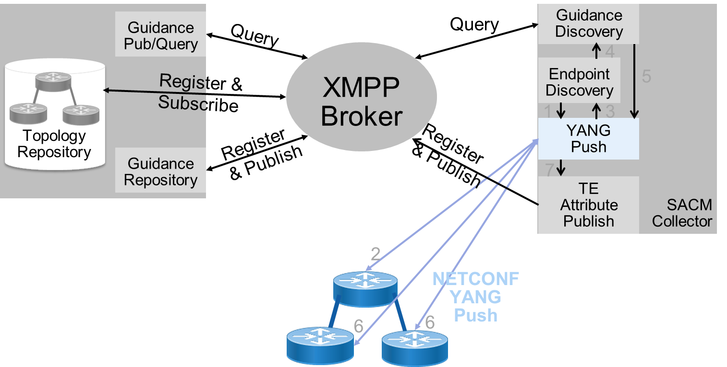
Hackathon 100 Results
SACM + Telemetry via YANG Push
SACM
NETCONF
CoRE
Winner: Best Cross WG collaboration
Device discovery
Topology maintenance
Security events
On Change subscription
L2 link neighbors
Hardware/software inventory

Slide 3
NETCONF WG Subscription Drafts
13. UDP based Publication Channel for Streaming Telemetry
draft-ietf-netconf-udp-pub-channel
14. Subscription to Multiple Stream Originators
draft-zhou-netconf-multi-stream-originators
15. YANG PUSH Based Generalized Network Control Automation Problem Stmt.
draft-bryskin-netconf-automation-framework
16. Coap Transfer
draft-birkholz-yang-push-coap-problemstatement
17. Smart filters for Push Updates - Problem Statement
draft-clemm-netconf-push-smart-filters-ps
8. Custom Subscription to Event Streams
draft-ietf-netconf-subscribed-notifications
9. YANG Datastore Subscription
draft-ietf-netconf-yang-push
10. NETCONF Support for Event Notifications
draft-ietf-netconf-netconf-event-notifications
11. RESTCONF & HTTP Transport for Event Notifications
draft-ietf-netconf-restconf-notif
12. Notification Message Headers and Bundles
draft-ietf-netconf-notification-messages
Overview (covered in this presentation)
draft-voit-netconf-subscription-and-notif-overview

Slide 4
Adopted Drafts in Layered Framework
Application
Subscriber
Receiver
Publisher
Subscription
Management
Transport
TCP
UDP
TLS
SSH
HTTP2
HTTP1.1
gRPC
RESTCONF
NETCONF
Dynamic
Configured
Notification
Message
Encoding
State Change
XML
JSON
CBOR
GPB
Admission Control
YANG
YANG Notification
Common Headers
Bundling
OAM
Negotiation
Stream Discovery
Event
Record
Generation
Filtering
Access Control
On-Change
Periodic
Subscribable
Information
Operational
Running
Config
Startup
Config
Candidate
Config
Intended
Config
NETCONF
Stream
Custom
Stream
Legend
draft-ietf-netconf-yang-push
draft-ietf-netconf-subscribed-notifications
draft-ietf-netconf-notification-messages
draft-ietf-netconf-udp-pub-channel
draft-ietf-netconf-netconf-event-notifications
draft-ietf-netconf-restconf-notif

Slide 5
Updates since IETF #99
draft-ietf-netconf-yang-push
-v11, based on review comments
  Integrated draft-ietf-netmod-revised-datastores (as this work as caught up)
  Returned to explicit filter subtyping of v00-v05
  Scrubbed the examples
  Resynch on-change RPC
  Deferred the multi-line card issue to draft-zhou-netconf-multi-stream-originators
Request: go to WGLC
  Must first close on issues from subscribed notifications
  Issue YP#11: Shift to NMDA compliant structure? Context shift mid-effort would add delay. Recommendation: simplest thing is to do this once all other issues are closed.

Slide 6
Updates since IETF #99
draft-ietf-netconf-subscribed-notifications
v07, based on review comments
  Model returns to string for stream
  Model returns to explicit filter subtyping
  RFC5277 exclusively used for one-way notifications (i.e., defer new encoding to draft-ietf-netconf-notification-messages)
  SYSLOG identity removed
  JSON & XML become optional features
  Xpath and Subtree filtering become optional features
  Added explicit state-machine for configured subscriptions
  Cleaned up examples and terminology

Slide 7
WG Comments to close
draft-ietf-netconf-subscribed-notifications
Request: get opinion now, with closure during WGLC
  SN#6 - String or Integer for Subscription ID
  SN#4 - Configured Subscriptions - Protocol, Encoding
  SN #5 - Source VRF or leafref to ietf-network-instance

Slide 8
SN#6 - String or Integer for Subscription ID
draft-ietf-netconf-subscribed-notifications
Recommend
Integer for all contexts | Use string for configuration, integer for updates
Need to partition integer space to avoid collisions/reuse. | Receiver must match context from subscription-started state change notification as id is different from what was configured. Receiver app must be able to force transport reconnect if subscription state is lost. Configured subscription correlation across multiple receivers is more complex (automatically assigned integer won't be the same across publishers.) String must be human readable, and also act as a key. Larger model
Note: were early thoughts on using string for configured subscription ID in update messages. With IoT inefficiencies & model complexities, no recent support.

Slide 9
SN#4 - Configured Subscriptions - Protocol, Encoding
draft-ietf-netconf-subscribed-notifications
Can either the Transport Protocol or Encoding vary by Configured Receiver?
Neither vary | Transport protocol | Both transport and encoding
Simplest model Applications may need to create and track multiple subscription-ids for the same content. Missed steps in converting transports can duplicate content streams | Can convert transport without requiring an application to learn a duplicate subscription id | Code allowing for different encodings seen as difficult to implement. Unclear if this will be seen in practice.
Slight preference

Slide 10
SN #5 - Source VRF or leafref to ietf-network-instance
draft-ietf-netconf-subscribed-notifications
Slight preference
+-- subscriptions +-- subscription* +-- (notification-message-origin)? +--:(address-originated) +-- source-vrf? String | +-- subscriptions +-- subscription* +-- (notification-message-origin)? +--:(address-originated) +-- source-vrf? leafref:ietf-network-instance /network-instances/network-instance/name
Doesn’t link YANG model for VRFs, so it is possible to add a string for a VRF which doesn’t exist. | Creates dependency on schema mount for event subscriptions. Establishes dependency on when draft-ietf-rtgwg-ni-model goes through WGLC. Note: also need to verify when adding leafref that the ni-type is l3vpn.

Slide 11
Updates since IETF #99 based on Comments
draft-ietf-netconf-netconf-event-notifications
-06 revision
  Normative text placed up front (pages 2-4)
  Removed all JSON text
  Clarifications in call home text for retries
  Examples move to Appendix
  Scrubbed examples (many fixes / changes)

Slide 12
NETCONF WG Subscription Drafts
13. UDP based Publication Channel for Streaming Telemetry
draft-ietf-netconf-udp-pub-channel
14. Subscription to Multiple Stream Originators
draft-zhou-netconf-multi-stream-originators
15. YANG PUSH Based Generalized Network Control Automation Problem Stmt.
draft-bryskin-netconf-automation-framework
16. Coap Transfer
draft-birkholz-yang-push-coap-problemstatement
17. Smart filters for Push Updates - Problem Statement
draft-clemm-netconf-push-smart-filters-ps
8. Custom Subscription to Event Streams
draft-ietf-netconf-subscribed-notifications
9. YANG Datastore Subscription
draft-ietf-netconf-yang-push
10. NETCONF Support for Event Notifications
draft-ietf-netconf-netconf-event-notifications
11. RESTCONF & HTTP Transport for Event Notifications
draft-ietf-netconf-restconf-notif
12. Notification Message Headers and Bundles
draft-ietf-netconf-notification-messages
Recommendation: Ready for WGLC now
Overview (covered in this presentation)
draft-voit-netconf-subscription-and-notif-overview

Slide 13
Updates Needed (none posted since IETF #99)
draft-ietf-netconf-restconf-notif
A new -04 revision must address the following:
  Still need guidance on transparency of GRPC mapping to RESTCONF (e.g., RESTCONF uses GET, not POST.)
  An ‘ok’ must be sent after subscription-started for a Configured subscription over HTTP2. But which one-way notification encoding to use for a receiver? If ‘ok’ indicates support for draft-ietf-netconf-notification-messages, everything is clean. Otherwise alternate HTTP response codes needed to signal different encodings.
  Extract examples to Appendices, leaving normative text up front
  Examples need to be scrubbed (JSON only?)
Unlike draft-ietf-netconf-netconf-event-notifications, no implementations yet.
Recommend deferring WGLC until there is concurrent support of draft-ietf-netconf-notification-messages.

Slide 14
Updates since IETF #99
draft-ietf-netconf-notification-messages
-v00 to -v02
  Alternative to 5277 one-way notification added
  Storage of default headers by notification type
  Backwards compatibility
  Discovering Receiver Support
    Issue NM#1: Alternatives to use of client based capabilities discovery for NETCONF?
  Headers for module and notification-type
  yang-data encapsulation containers fixed
Upcoming: dialogs on specific headers
    Signatures, attestation, others

Slide 15
Thank you!

